Slide 1
Information Extraction
William Wang
School of Computer Science
Carnegie Mellon University
yww@cs.cmu.edu
CIPS Summer School
07/25/2015

Slide 2
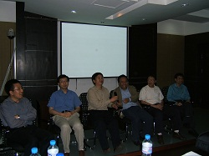
History of Summer School
1st MSRA Summer Workshop of Information Extraction:
June, 2005

Slide 3
IE Course Logistics
Don’t be afraid of asking questions!
Homepage:
http://www.cs.cmu.edu/~yww/ss2015.html
Prerequisite:
No previous experience on IE is required.
Some basic knowledge in Machine Learning.

Slide 4


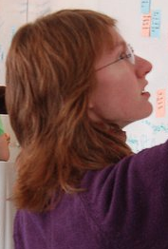
Acknowledgement
William
Cohen
Tom
Mitchell
Katie
Mazaitis
Some of the slides are also adapted from Andrew McCallum, Sunita Sarawagi, Luke Zettlemoyer, Rion Snow, Pedro Domingos, Ralf Grishman, Raphael Hoffmann, and many other people.

Slide 5
Instructor
William Wang (CMU)
Teaching experience:
CMU Machine Learning (100+ students)
CMU Machine Learning for Large Dataset (60+ students)
Affiliations:
Yahoo! Labs NYC (2015)
Microsoft Research Redmond (2012-2013)
Columbia University (2009-2011)
University of Southern California (2010)

Slide 6
Research Interests
• machine learning
[Machine Learning 2015] [IJCAI 2015] [ACL 2015a] [CIKM 2014] [StarAI 2014] [CIKM 2013]
• natural language processing
[NAACL 2015a] [EMNLP 2014] [ACL 2014] [EMNLP 2013a] [EMNLP 2013b] [ACL 2012] [SIGDIAL 2012] [IJCNLP 2011] [COLING 2010]
• spoken language processing
[ACL 2015b] [NAACL 2015b] [INTERSPEECH 2015] [SLT 2014] [ASRU 2013] [ICASSP 2013] [CSL 2013]
[SLT 2012] [ASRU 2011] [INTERSPEECH 2011] [SIGDIAL 2011] [Book Chapter 2011]

Slide 7
What is Information Extraction (IE)?
And why do we care?

Slide 8
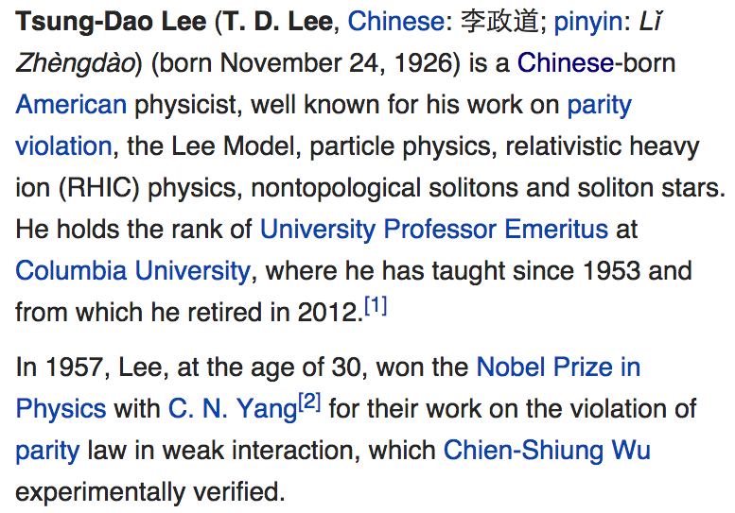
Named
Entity
Recognition
Relation
Extraction
Event
Extraction
Temporal IE
Multilingual
Information
Extraction

Slide 9
Information Extraction
Definition:
extracting structured knowledge from unstructured or semi-structured data (e.g. free text and tables).
In this short course: we will focus on IE from text data.

Slide 10
A Relation Extraction View
Input: documents.
October 14, 2002, 4:00 a.m. PT
For years, Microsoft Corporation CEO Bill Gates railed against the economic philosophy of open-source software with Orwellian fervor, denouncing its communal licensing as a "cancer" that stifled technological innovation.
Today, Microsoft claims to "love" the open-source concept, by which software code is made public to encourage improvement and development by outside programmers. Gates himself says Microsoft will gladly disclose its crown jewels--the coveted code behind the Windows operating system--to select customers.
"We can be open source. We love the concept of shared source," said Bill Veghte, a Microsoft VP. "That's a super-important shift for us in terms of code access.“
Richard Stallman, founder of the Free Software Foundation, countered saying…
Output: relation triples.
IE
NAME Relation ORGANIZATION
Bill Gates CEO Microsoft
Bill Veghte VP Microsoft
Richard Stallman founder Free Soft..

Slide 11
A Broader View of IE
As a family
of techniques:
Information Extraction =
segmentation + classification + association + clustering
October 14, 2002, 4:00 a.m. PT
For years, Microsoft Corporation CEO Bill Gates railed against the economic philosophy of open-source software with Orwellian fervor, denouncing its communal licensing as a "cancer" that stifled technological innovation.
Today, Microsoft claims to "love" the open-source concept, by which software code is made public to encourage improvement and development by outside programmers. Gates himself says Microsoft will gladly disclose its crown jewels--the coveted code behind the Windows operating system--to select customers.
"We can be open source. We love the concept of shared source," said Bill Veghte, a Microsoft VP. "That's a super-important shift for us in terms of code access.“
Richard Stallman, founder of the Free Software Foundation, countered saying…
Microsoft Corporation
CEO
Bill Gates
Microsoft
Gates
Microsoft
Bill Veghte
Microsoft
VP
Richard Stallman
founder
Free Software Foundation

Slide 12
A Broader View of IE
As a family
of techniques:
Information Extraction =
segmentation + classification + association + clustering
October 14, 2002, 4:00 a.m. PT
For years, Microsoft Corporation CEO Bill Gates railed against the economic philosophy of open-source software with Orwellian fervor, denouncing its communal licensing as a "cancer" that stifled technological innovation.
Today, Microsoft claims to "love" the open-source concept, by which software code is made public to encourage improvement and development by outside programmers. Gates himself says Microsoft will gladly disclose its crown jewels--the coveted code behind the Windows operating system--to select customers.
"We can be open source. We love the concept of shared source," said Bill Veghte, a Microsoft VP. "That's a super-important shift for us in terms of code access.“
Richard Stallman, founder of the Free Software Foundation, countered saying…
Microsoft Corporation
CEO
Bill Gates
Microsoft
Gates
Microsoft
Bill Veghte
Microsoft
VP
Richard Stallman
founder
Free Software Foundation

Slide 13
A Broader View of IE
As a family
of techniques:
Information Extraction =
segmentation + classification + association + clustering
October 14, 2002, 4:00 a.m. PT
For years, Microsoft Corporation CEO Bill Gates railed against the economic philosophy of open-source software with Orwellian fervor, denouncing its communal licensing as a "cancer" that stifled technological innovation.
Today, Microsoft claims to "love" the open-source concept, by which software code is made public to encourage improvement and development by outside programmers. Gates himself says Microsoft will gladly disclose its crown jewels--the coveted code behind the Windows operating system--to select customers.
"We can be open source. We love the concept of shared source," said Bill Veghte, a Microsoft VP. "That's a super-important shift for us in terms of code access.“
Richard Stallman, founder of the Free Software Foundation, countered saying…
Microsoft Corporation
CEO
Bill Gates
Microsoft
Gates
Microsoft
Bill Veghte
Microsoft
VP
Richard Stallman
founder
Free Software Foundation

Slide 14
A Broader View of IE
As a family
of techniques:
Information Extraction =
segmentation + classification + association + clustering
October 14, 2002, 4:00 a.m. PT
For years, Microsoft Corporation CEO Bill Gates railed against the economic philosophy of open-source software with Orwellian fervor, denouncing its communal licensing as a "cancer" that stifled technological innovation.
Today, Microsoft claims to "love" the open-source concept, by which software code is made public to encourage improvement and development by outside programmers. Gates himself says Microsoft will gladly disclose its crown jewels--the coveted code behind the Windows operating system--to select customers.
"We can be open source. We love the concept of shared source," said Bill Veghte, a Microsoft VP. "That's a super-important shift for us in terms of code access.“
Richard Stallman, founder of the Free Software Foundation, countered saying…
Microsoft Corporation
CEO
Bill Gates
Microsoft
Gates
Microsoft
Bill Veghte
Microsoft
VP
Richard Stallman
founder
Free Software Foundation

Slide 15
Complexity in IE
Closed set
Regular set
U.S. states (50 states)
U.S. phone numbers
He was born in Alabama…
Phone: (413) 545-1323
The big Wyoming sky…
The CALD main office can be
reached at 412-268-1299
Complex patterns
Ambiguous patterns
U.S. postal addresses
University of Arkansas
P.O. Box 140
Hope, AR 71802
Person names
…was among the six houses sold by Hope Feldman that year.
Headquarters:
1128 Main Street, 4th Floor
Cincinnati, Ohio 45210
Pawel Opalinski, Software
Engineer at WhizBang Labs.

Slide 16
Granularity of IE Tasks
Jack Welch will retire as CEO of General Electric tomorrow. The top role
at the Connecticut company will be filled by Jeffrey Immelt.
Single entity
Binary relationship
N-ary record
Person: Jack Welch
Relation: Person-Title
Person: Jack Welch
Title: CEO
Relation: Succession
Company: General Electric
Title: CEO
Out: Jack Welsh
In: Jeffrey Immelt
Person: Jeffrey Immelt
Location: Connecticut
Relation: Company-Location
Company: General Electric
Location: Connecticut

Slide 17
IE Applications

Slide 18
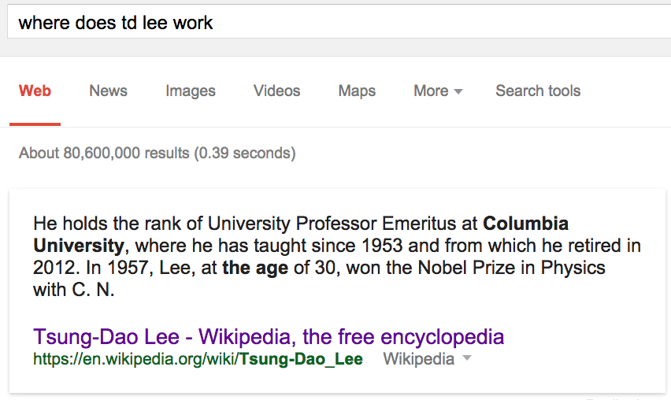
Question Answering

Slide 19
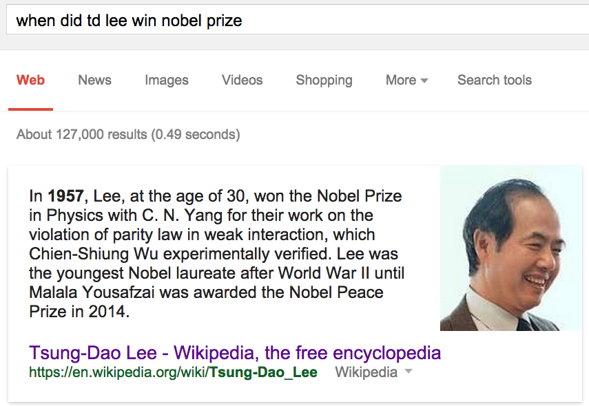
Question Answering

Slide 20
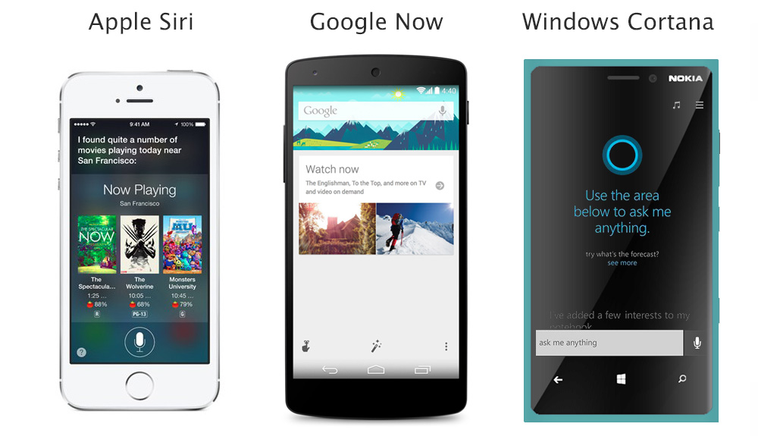
Virtual Assistant

Slide 21
Course Outline
Basic theories and practices on named entity recognition: supervised, semi-supervised, unsupervised.
Recent advances in relation extraction:
  distant supervision
  latent variable models
Scalable IE and reasoning with first-order logics.

Slide 22
Basic Theories and Practices of NER

Slide 23
Named Entity Recognition
Given a sentence:
Yesterday William Wang flew to Beijing.
extract the following information:
Person name: William Wang
Location name: Beijing
What is the easiest method?
use a lexicon of person names and location names, scan
the sentence and look for matches.
Why this will not work? The scalability issue.

Slide 24
Overview of NER Models
Classify Pre-segmented
Candidates
Lexicons
Sliding Window
Abraham Lincoln was born in Kentucky.
Abraham Lincoln was born in Kentucky.
Abraham Lincoln was born in Kentucky.
member?
Classifier
Alabama
Alaska
…
Wisconsin
Wyoming
Classifier
which class?
which class?
Try alternate
window sizes:
Boundary Models
Token Tagging
Abraham Lincoln was born in Kentucky.
Abraham Lincoln was born in Kentucky.
This is often treated as a structured prediction problem…classifying tokens sequentially
BEGIN
Most likely state sequence?
Classifier
which class?
BEGIN
END
BEGIN
END
HMMs, CRFs, ….

Slide 25
Sliding Window

Slide 26
IE by Sliding Window
GRAND CHALLENGES FOR MACHINE LEARNING
Jaime Carbonell
School of Computer Science
Carnegie Mellon University
3:30 pm
7500 Wean Hall
Machine learning has evolved from obscurity in the 1970s into a vibrant and popular discipline in artificial intelligence during the 1980s and 1990s. As a result of its success and growth, machine learning is evolving into a collection of related disciplines: inductive concept acquisition, analytic learning in problem solving (e.g. analogy, explanation-based learning), learning theory (e.g. PAC learning), genetic algorithms, connectionist learning, hybrid systems, and so on.
CMU UseNet Seminar Announcement

Slide 27
IE by Sliding Window
GRAND CHALLENGES FOR MACHINE LEARNING
Jaime Carbonell
School of Computer Science
Carnegie Mellon University
3:30 pm
7500 Wean Hall
Machine learning has evolved from obscurity in the 1970s into a vibrant and popular discipline in artificial intelligence during the 1980s and 1990s. As a result of its success and growth, machine learning is evolving into a collection of related disciplines: inductive concept acquisition, analytic learning in problem solving (e.g. analogy, explanation-based learning), learning theory (e.g. PAC learning), genetic algorithms, connectionist learning, hybrid systems, and so on.
CMU UseNet Seminar Announcement

Slide 28
IE by Sliding Window
GRAND CHALLENGES FOR MACHINE LEARNING
Jaime Carbonell
School of Computer Science
Carnegie Mellon University
3:30 pm
7500 Wean Hall
Machine learning has evolved from obscurity in the 1970s into a vibrant and popular discipline in artificial intelligence during the 1980s and 1990s. As a result of its success and growth, machine learning is evolving into a collection of related disciplines: inductive concept acquisition, analytic learning in problem solving (e.g. analogy, explanation-based learning), learning theory (e.g. PAC learning), genetic algorithms, connectionist learning, hybrid systems, and so on.
CMU UseNet Seminar Announcement

Slide 29
IE by Sliding Window
GRAND CHALLENGES FOR MACHINE LEARNING
Jaime Carbonell
School of Computer Science
Carnegie Mellon University
3:30 pm
7500 Wean Hall
Machine learning has evolved from obscurity in the 1970s into a vibrant and popular discipline in artificial intelligence during the 1980s and 1990s. As a result of its success and growth, machine learning is evolving into a collection of related disciplines: inductive concept acquisition, analytic learning in problem solving (e.g. analogy, explanation-based learning), learning theory (e.g. PAC learning), genetic algorithms, connectionist learning, hybrid systems, and so on.
CMU UseNet Seminar Announcement

Slide 30
A Naïve Bayes Sliding Window Model
[Freitag 1997]
…
00 : pm Place : Wean Hall Rm 5409 Speaker : Sebastian Thrun
…
w _{t-m}
w _{t-1}
w _{t}
w _{t+n}
w _{t+n+1}
w _{t+n+m}
prefix
contents
suffix
Estimate Pr(LOCATION|window) using Bayes rule
Try all “reasonable” windows (vary length, position)
Assume independence for length, prefix words, suffix words, content words
Estimate from data quantities like: Pr(“Place” in prefix|LOCATION)
If P(“Wean Hall Rm 5409” = LOCATION) is above some threshold, extract it.

Slide 31
A Naïve Bayes Sliding Window Model
[Freitag 1997]
…
00 : pm Place : Wean Hall Rm 5409 Speaker : Sebastian Thrun
…
w _{t-m}
w _{t-1}
w _{t}
w _{t+n}
w _{t+n+1}
w _{t+n+m}
prefix
contents
suffix
Create dataset of examples like these:
  +(prefix00,…,prefixColon, contentWean,contentHall,….,suffixSpeaker,…)
  - (prefixColon,…,prefixWean,contentHall,….,ContentSpeaker,suffixColon,….)
  …
Train a NaiveBayes classifier (or YFCL), treating the examples like BOWs for text classification
If Pr(class=+|prefix,contents,suffix) > threshold, predict the content window is a location.
  To think about: what if the extracted entities aren’t consistent, eg if the location overlaps with the speaker?

Slide 32
Sliding Window Performance
[Freitag 1997]
Domain: CMU UseNet Seminar Announcements
GRAND CHALLENGES FOR MACHINE LEARNING
Jaime Carbonell
School of Computer Science
Carnegie Mellon University
3:30 pm
7500 Wean Hall
Machine learning has evolved from obscurity in the 1970s into a vibrant and popular discipline in artificial intelligence during the 1980s and 1990s. As a result of its success and growth, machine learning is evolving into a collection of related disciplines: inductive concept acquisition, analytic learning in problem solving (e.g. analogy, explanation-based learning), learning theory (e.g. PAC learning), genetic algorithms, connectionist learning, hybrid systems, and so on.
Field F1
Person Name: 30%
Location: 61%
Start Time: 98%

Slide 33
Token Tagging

Slide 34
NER by Token Tagging
Given a sentence:
Yesterday William Wang flew to Beijing.
1) Break the sentence into tokens, and classify each token with a label indicating what sort of entity it’s part of:
person name
location name
background
Yesterday William Wang flew to Beijing
2) Identify names based on the entity labels
3) To learn an NER system, use YFCL.
Person name: William Wang
Location name: Beijing

Slide 35
NER by Token Tagging
Similar labels tend to cluster together in text
person name
location name
Yesterday William Wang flew to Beijing
background
Another common labeling scheme is BIO (begin, inside, outside; e.g. beginPerson, insidePerson, beginLocation, insideLocation, outside)
BIO also leads to strong dependencies between nearby labels (eg inside follows begin)

Slide 36
Hidden Markov Models for NER
Given a sequence of observations:
Today William Wang is teaching at Peking University.
and a trained HMM:
person name
location name
background
Find the most likely state sequence: (Viterbi)
Today William Wang is teaching at Peking University.
Any words said to be generated by the designated “person name”
state extract as a person name:
Person name: William Wang

Slide 37
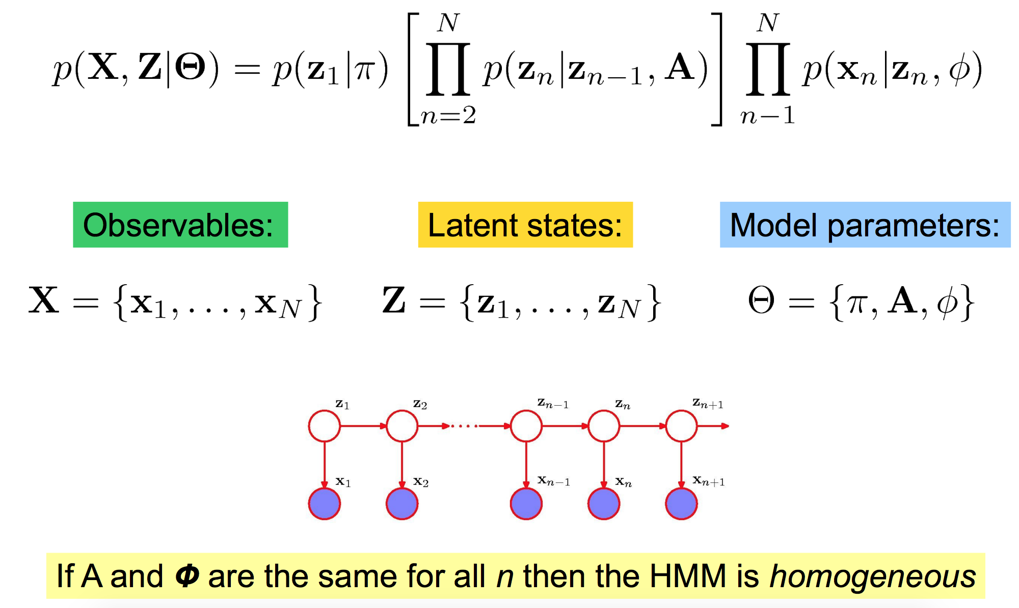
Review of Hidden Markov Models

Slide 38
Hidden Markov Models for NER
…
00 : pm Place : Wean Hall Rm 5409 Speaker : Sebastian Thrun
…
The HMM consists of two probability tables
  Pr(currentState=s|previousState=t) for s=background, location, speaker,
  Pr(currentWord=w|currentState=s) for s=background, location, …
Estimate these tables with a (smoothed) CPT
  Prob(location|location) = #(loc->loc)/#(loc->*) transitions
Given a new sentence, find the most likely sequence of hidden states using Viterbi method:
  MaxProb(curr=s|position k)=
    Max_{state t} MaxProb(curr=t|position=k-1) * Prob(word=w_{k-1}|t)*Prob(curr=s|prev=t)

Slide 39
Performance: Sliding Window vs HMMs
Domain: CMU UseNet Seminar Announcements
GRAND CHALLENGES FOR MACHINE LEARNING
Jaime Carbonell
School of Computer Science
Carnegie Mellon University
3:30 pm
7500 Wean Hall
Machine learning has evolved from obscurity in the 1970s into a vibrant and popular discipline in artificial intelligence during the 1980s and 1990s. As a result of its success and growth, machine learning is evolving into a collection of related disciplines: inductive concept acquisition, analytic learning in problem solving (e.g. analogy, explanation-based learning), learning theory (e.g. PAC learning), genetic algorithms, connectionist learning, hybrid systems, and so on.
Field F1
Speaker: 30%
Location: 61%
Start Time: 98%
Field F1
Speaker: 77%
Location: 79%
Start Time: 98%

Slide 40
Improving the HMMs
• we need richer representation for the observations
e.g., overlapping features.
• we would like to consider modeling the discriminative/conditional probability model of P(Z|X), rather than the joint/generative probability model of P(Z,X).

Slide 41
Maximum Entropy
Markov Model (MEMM)

Slide 42
Naïve Bayes vs HMM
S
t
-
1
S
t
S
t+1
William
William
yesterday
Wang
yesterday
Wang
O
-
O
t
O
t
+1
t
1
HMM = sequential Naïve Bayes

Slide 43
From HMM to MEMM
S
t
-
1
S
t
S
t+1
S
S
S
t
-
1
t
t+1
William
william
yesterday
Wang
yesterday
Wang
O
-
O
t
O
t
+1
O
O
O
t
1
t
-
1
t
t
+1
Replace generative model in HMM with a MaxEnt/Logistic Regression model

Slide 44
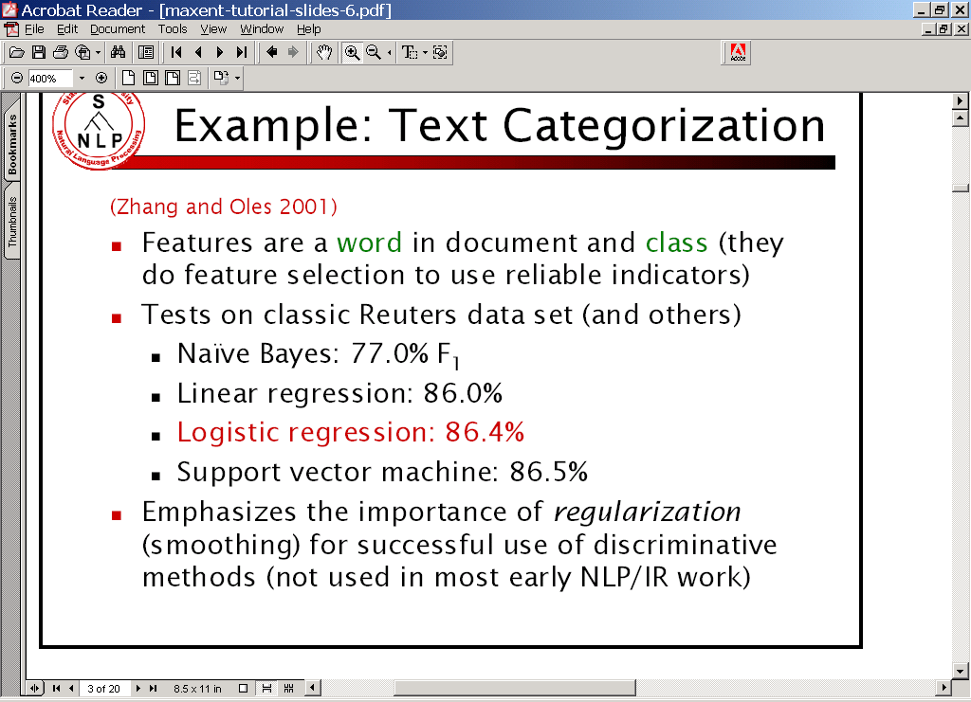
Why MaxEnt Model?
  Performance:
    Good MaxEnt methods are competitive with linear SVMs and other state of are classifiers in accuracy.
  Embedding in a
  larger system:
    MaxEnt optimizes Pr(y|x),
    not error rate.

Slide 45
From Naïve Bayes to MaxEnt

Slide 46
MEMMs
Basic difference from ME tagging:
  ME tagging: previous state is feature of MaxEnt classifier
  MEMM: build a separate MaxEnt classifier for each state.
    Can build any HMM architecture you want; eg parallel nested HMM’s, etc.
    MEMM does allow possibility of “hidden” states and Baum-Welsh like training
  Viterbi is the most natural inference scheme

Slide 47
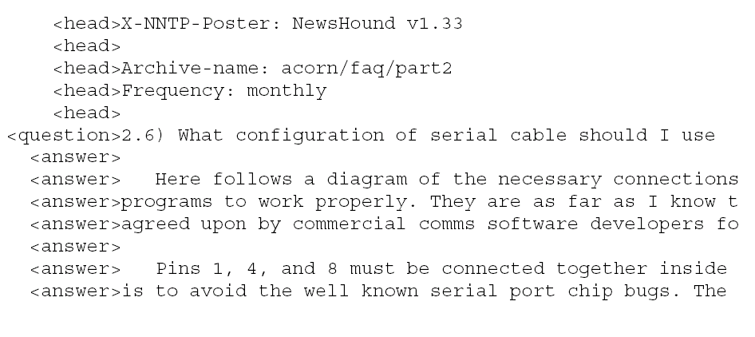
MEMM task: FAQ parsing

Slide 48
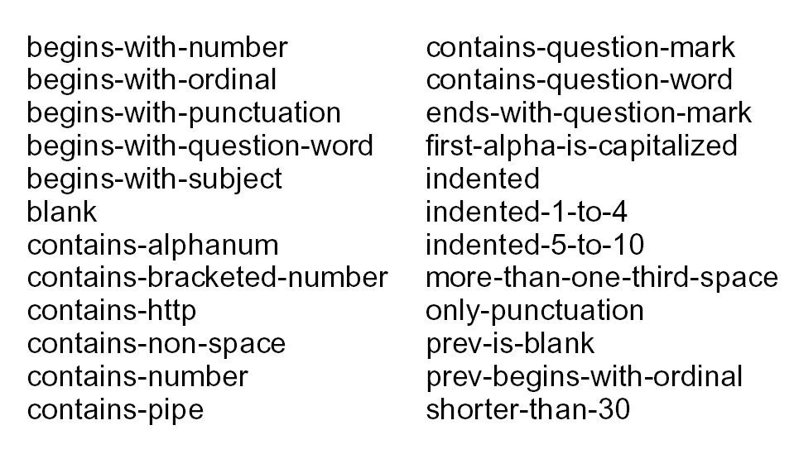
MEMM features

Slide 49
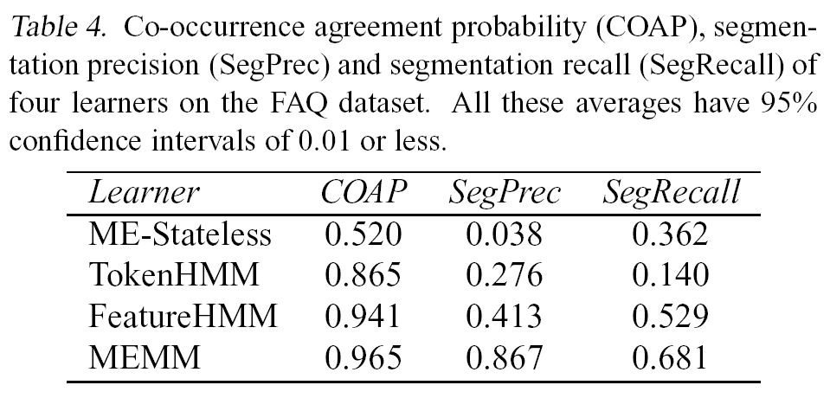
MEMM Performance

Slide 50
Conditional Random Fields

Slide 51
Label Bias Problem of MEMM
Consider a simple MEMM for person and location names
    all names are two tokens states:
      other
      b-person and e-person for person names
      b-locn and e-locn for location names

Slide 52
Label Bias Problem of MEMM
corpus:
Harvey Ford
(person 9 times, location 1 time)
Harvey Park
(location 9 times, person 1 time)
Myrtle Ford
(person 9 times, location 1 time)
Myrtle Park
(location 9 times, person 1 time)
b-person
e-person
other
b-locn
e-locn
second token a good indicator of person vs. location

Slide 53
Label Bias Problem of MEMM
Conditional probabilities:
p(b-person | other, w = Harvey) = 0.5
p(b-locn | other, w = Harvey) = 0.5
p(b-person | other, w = Myrtle) = 0.5
p(b-locn | other, w = Myrtle) = 0.5
p(e-person | b-person, w = Ford) = 1
p(e-person | b-person, w = Park) = 1
p(e-locn | b-locn, w = Ford) = 1
p(e-locn | b-locn, w = Park) = 1
b-person
e-person
other
b-locn
e-locn

Slide 54
Label Bias Problem of MEMM
Role of second token in
distinguishing
person vs. location
completely lost
b-person
e-person
other
b-locn
e-locn

Slide 55
Label Bias Problem of MEMM
Problem:
Probabilities of outgoing arcs normalized separately for each state.

Slide 56
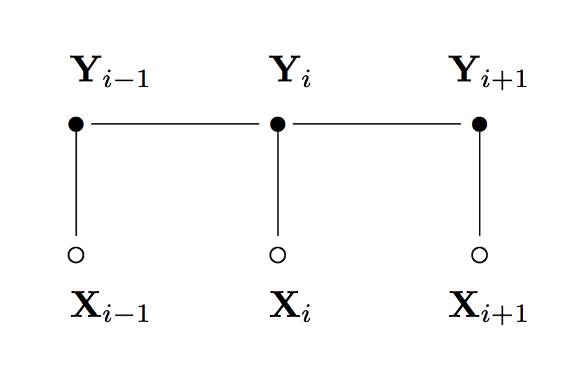
Conditional Random Fields
CRFs’ advantages
over HMM: the independence assumption is relaxed, allowing overlapping features.
over MEMM: undirected graphical model, a single exponential model for the joint probability of the entire label sequence.

Slide 57
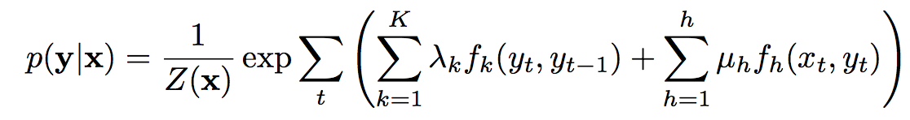
Linear Chain CRFs

Slide 58
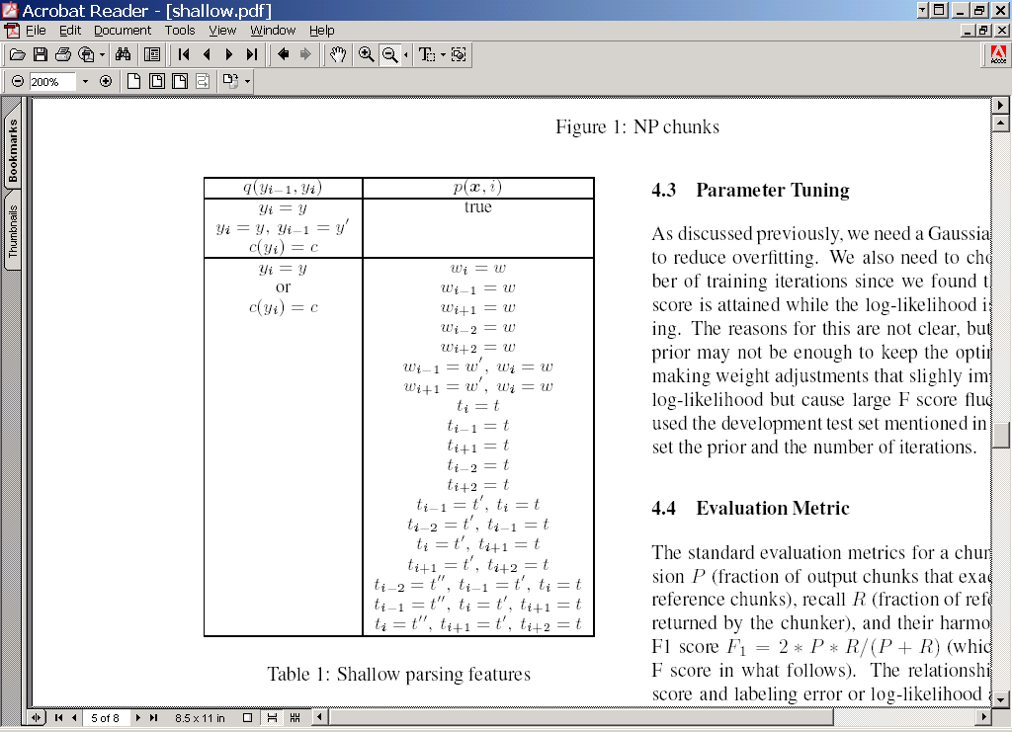
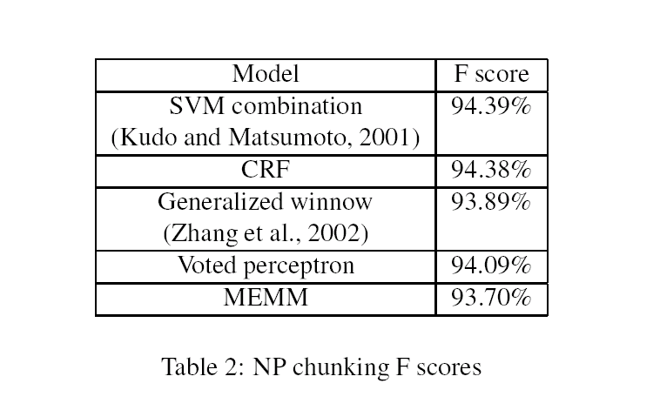
Sha & Pereira results
CRF beats MEMM (McNemar’s test); MEMM probably beats voted perceptron

Slide 59
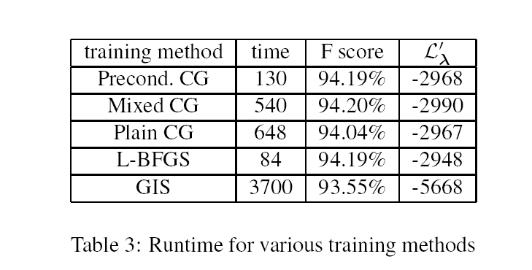
Sha & Pereira results
in minutes, 375k examples

Slide 60
Sequential Models for IE: Practical Advice

Slide 61
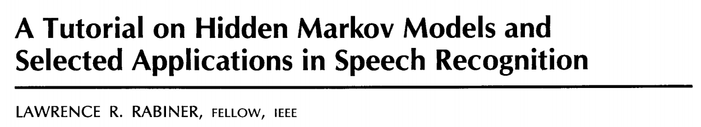
Implementing an HMM
• Follow Larry Rabiner’s classic HMM tutorial:
Debugging an HMM:
  Training (forward-backward): check your transition probability matrix.
  Decoding (Viterbi): check the output state sequence.

Slide 62
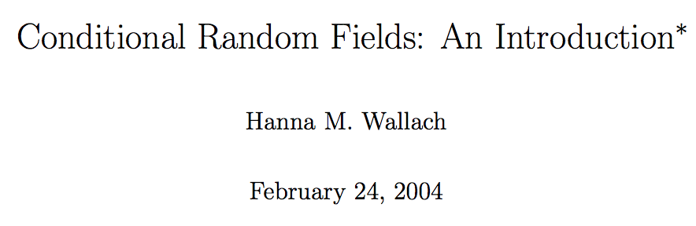
Understanding CRFs
• actually Lafferty’s paper is pretty hard to understand.
Instead, try to read Hanna Wallach’s CRF introduction.

Slide 63
CRF Tools
• CRF++：probably most widely used. Fast, multithreaded L-BFGS training. Support CoNLL format only.
• CRFsuite：flexible data input format. No parallelization.
• Wapiti (recommended)：Support CoNLL and customized data format. Fast, multithreaded L-BFGS training.
• Stochastic Gradient CRFs：using SGD training instead of L-BFGS.
• Mallet：CRFs in Java.

Slide 64
CRF Demo: Wapiti https://wapiti.limsi.fr
Training sentence:
Yesterday William Wang flew to Beijing.
Testing sentence:
Yesterday William Cohen flew to Buenos Aires.

Slide 65
Semi-supervised IE

Slide 66
Semi-supervised IE
Basic idea:
  Find where a known fact occurs in text, by matching/alignment/…
  Use this as training data for a conventional IE learning system.
Once you’ve learned an extractor from that data
  Run the extractor on some (maybe additional) text
  Take the (possibly noisy) new facts and start over
This is called: “Self-training” or “bootstrapping”

Slide 67
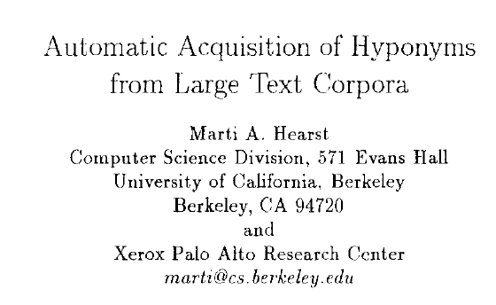
Macro-reading c. 1992
Idea: write some specific patterns that indicate A is a kind of B:
… such NP as NP (“at such schools as CMU, students rarely need extensions”)
NP, NP, or other NP (“William, Carlos or other machine learning professors”)
NP including NP (“struggling teams including the Pirates”)
NP, especially NP (prestigious conferences, especially NIPS)
[Coling 1992]
Results: 8.6M words of Grolier’s encyclopedia → 7067 pattern instances → 152 relations
Many were not in WordNet.
Marti’s system was iterative

Slide 68
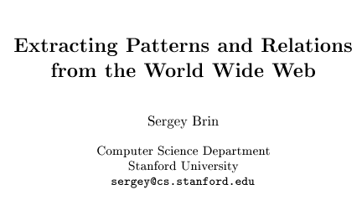
Another iterative, high-precision system
Idea: exploit “pattern/relation duality”:
Start with some seed instances of (author,title) pairs (“Isaac Asimov”, “The Robots of Dawn”)
Look for occurrences of these pairs on the web.
Generate patterns that match the seeds.
  - URLprefix, prefix, middle, suffix
Extract new (author, title) pairs that match the patterns.
Go to 2.
[some workshop, 1998]
Unlike Hearst, Brin learned the patterns; and learned very high-precision, easy-to-match patterns using regular expressions.
Result: 24M web pages + 5 books → 199 occurrences → 3 patterns → 4047 occurrences + 5M pages → 3947 occurrences → 105 patterns → … 15,257 books *with some manual tweaks

Slide 69
Key Ideas: So Far
High-precision low-coverage extractors and large redundant corpora (macro-reading)
Self-training/bootstrapping
    Advantage: train on a small corpus, test on a larger one
      You can use more-or-less off-the-shelf learning methods
      You can work with very large corpora
    But, data gets noisier and noisier as you iterate
    Need either
      really high-precision extractors, or
      some way to cope with the noise

Slide 70
A variant of bootstrapping: co-training
Redundantly Sufficient Features:
features x can be separated into two types x₁,x₂
either x₁ or x₂ is sufficient for classification – i.e.
there exists functions f₁ and f₂ such that
f(x) = f₁(x₁)=f₂(x₂) has low error
person
spelling feature
context feature
e.g. Capitalization=X+.X+
Prefix=Mr.
e.g., based on words nearby in dependency parse

Slide 71
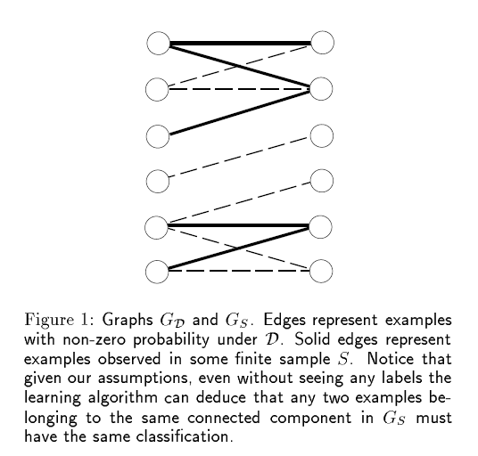
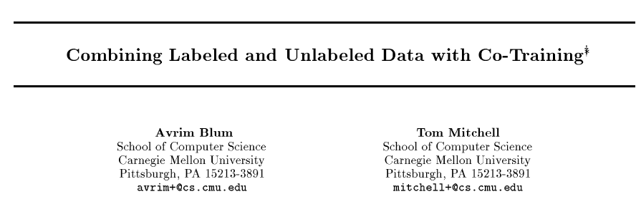
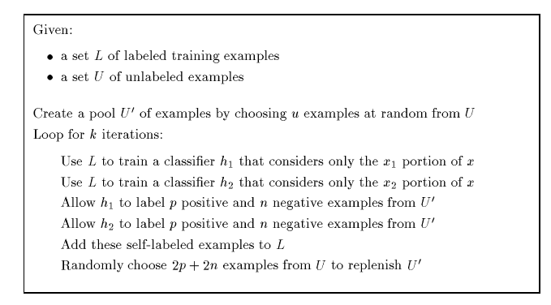
Another kind of self-training
[COLT 98]

Slide 72
A co-training algorithm

Slide 73
Unsupervised Models for Named Entity Classification
Michael Collins and Yoram Singer [EMNLP 99]
Redundantly Sufficient Features:
features x can be separated into two types x₁,x₂
either x₁ or x₂ is sufficient for classification – i.e.
there exists functions f₁ and f₂ such that
f(x) = f₁(x₁)=f₂(x₂) has low error
Candidate entities x segmented using a POS pattern
person
spelling feature
context feature
e.g., Capitalization=X+.X+
Prefix=Mr.
Based on dependency parse

Slide 74
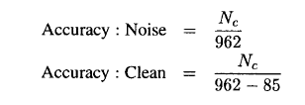
Evaluation for Collins and Singer
88,962 examples (spelling,context) pairs
7 seed rules are used
1000 examples are chosen as test data (85 noise)
We label the examples as (location, person, organization, noise)

Slide 75
Key Ideas: So Far
High-precision low-coverage extractors and large redundant corpora (macro-reading)
Self-training/bootstrapping
Co-training
Clustering phrases by context
  Don’t propagate labels;
  Instead do without them entirely
VP
Mr. Cooper
CEO
Pres.
Bob
MSR
intern
job
patent
IBM

Slide 76
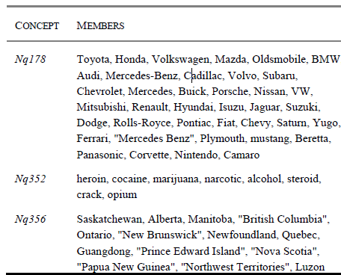
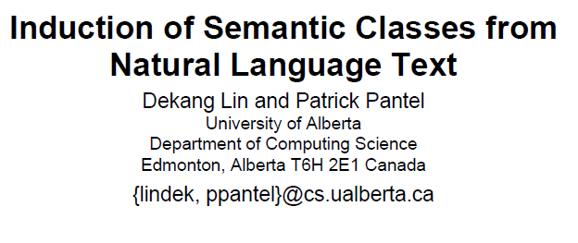
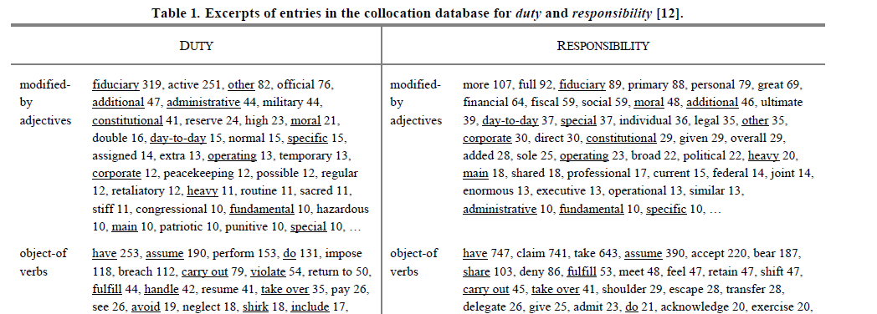
[KDD 2002]
Basic idea: parse a big corpus, then cluster NPs by their contexts

Slide 77
Key Ideas: So Far
High-precision low-coverage extractors and large redundant corpora (macro-reading)
Self-training/bootstrapping or co-training
Other semi-supervised methods:
  Expectation-maximization: like self-training but you “soft-label” the unlabeled examples with the expectation over the labels in each iteration.
  Works for almost any generative model (e.g., HMMs)
  Learns directly from all the data
      Maybe better; Maybe slower
      Extreme cases:
        supervised learning …. clustering + cluster-labeling

Slide 78
Key Ideas: So Far
High-precision low-coverage extractors and large redundant corpora (macro-reading)
Self-training/bootstrapping or co-training
Other semi-supervised methods:
  Expectation-maximization
  Transductive margin-based methods (e.g., transductive SVM)
  Graph-based methods

Slide 79
History: Open-domain IE by pattern-matching (Hearst, 92)
Start with seeds: “NIPS”, “ICML”
Look thru a corpus for certain patterns:
  … “at NIPS, AISTATS, KDD and other learning conferences…”
Expand from seeds to new instances
Repeat….until ___
  “on PC of KDD, SIGIR, … and…”

Slide 80
Bootstrapping as graph proximity
NIPS
SNOWBIRD
“…at NIPS, AISTATS, KDD and other learning conferences…”
“For skiiers, NIPS, SNOWBIRD,… and…”
AISTATS
SIGIR
KDD
… “on PC of KDD, SIGIR, … and…”
“… AISTATS,KDD,…”
shorter paths ~ earlier iterations
many paths ~ additional evidence

Slide 81
Similarity of Nodes in Graphs: Personal PageRank/RandomWalk with Restart
Similarity defined by PageRank
Similarity between nodes x and y:
  “Random surfer model”: from a node z,
    with probability α, stop and “output” z
    pick an edge label (rel) r using Pr(r | z) ... e.g. uniform
    pick a y given x, r: e.g. uniform from { y’ : z → y with label r }
    repeat from node y ....
  Similarity x~y = Pr( “output” y | start at x)
  Bootstrapping: propagate from labeled data to “similar” unlabeled data.
Intuitively, x~y is summation of weight of all paths from x to y, where weight of path decreases exponentially with length.

Slide 82
PPR/RWR on a Graph
“Christos Faloutsos, CMU”
“William W. Cohen, CMU”
cohen
william
w
cmu
dr
“Dr. W. W. Cohen”
“George H. W. Bush”
“George W. Bush”

Slide 83
A little math exercise…
Let x be less than 1 and larger than 0. Then
Example: x=0.1, and 1+0.1+0.01+0.001+…. = 1.11111 = 10/9.

Slide 84
Graph = Matrix
 | A | B | C | D | E | F | G | H | I | J
A |  | 1 |  | 1 |  | 1 |  |  | 1
B | 1 |  | 1
C |  | 1
D | 1 |  |  |  |  | 1
E |  |  |  |  |  | 1
F | 1 |  |  | 1 | 1
G |  |  |  |  |  |  |  |  | 1
H |  |  |  |  |  |  | 1 |  | 1 | 1
I | 1 |  |  |  |  |  | 1 | 1 |  | 1
J |  |  |  |  |  |  |  | 1 | 1
C
A
B
G
I
H
J
F
D
E

Slide 85
Graph = Matrix
Transitively Closed Components = “Blocks”
 | A | B | C | D | E | F | G | H | I | J
A | _ | 1 | 1 |  |  | 1 |  |  | 1
B | 1 | _ | 1
C | 1 | 1 | _
D |  |  |  | _ | 1 | 1
E |  |  |  | 1 | _ | 1
F | 1 |  |  | 1 | 1 | _
G |  |  |  |  |  |  | _ |  | 1 | 1
H |  |  |  |  |  |  |  | _ | 1 | 1
I | 1 |  |  |  |  |  | 1 | 1 | _ | 1
J |  |  |  |  |  |  | 1 | 1 | 1 | _
C
A
B
G
I
H
J
F
D
E
Of course we can’t see the “blocks” unless the nodes
are sorted by cluster…

Slide 86
Graph = Matrix
Vector = Node → Weight
M
v
 | A | B | C | D | E | F | G | H | I | J
A | _ | 1 | 1 |  |  | 1 |  |  | 1
B | 1 | _ | 1
C | 1 | 1 | _
D |  |  |  | _ | 1 | 1
E |  |  |  | 1 | _ | 1
F | 1 |  |  | 1 | 1 | _
G |  |  |  |  |  |  | _ |  | 1 | 1
H |  |  |  |  |  |  |  | _ | 1 | 1
I | 1 |  |  |  |  |  | 1 | 1 | _ | 1
J |  |  |  |  |  |  | 1 | 1 | 1 | _
 | A
A | 4
B | 2
C | 3
D
E
F
G
H
I
J
C
A
B
G
I
H
J
F
D
E
M

Slide 87
Graph = Matrix
M*v₁ = v₂ “propagates weights from neighbors”
M
*
v₁
=
v₂
 | A | B | C | D | E | F | G | H | I | J
A | _ | 1 | 1 |  |  | 1
B | 1 | _ | 1
C | 1 | 1 | _
D |  |  |  | _ | 1 | 1
E |  |  |  | 1 | _ | 1
F |  |  |  | 1 | 1 | _
G |  |  |  |  |  |  | _ |  | 1 | 1
H |  |  |  |  |  |  |  | _ | 1 | 1
I |  |  |  |  |  |  | 1 | 1 | _ | 1
J |  |  |  |  |  |  | 1 | 1 | 1 | _
A | 4
B | 2
C | 3
D
E
F
G
H
I
J
A | 2*1+3*1+0*1
B | 4*1+3*1
C | 4*1+2*1
D
E
F
G
H
I
J
C
A
B
G
I
H
J
F
D
E
M

Slide 88
A little math…
Let W[i,j] be Pr(walk to j from i)and let α be less than 1. Then:
The matrix (I- αW) is the Laplacian of αW.
Generally the Laplacian is (D - A) where D[i,i] is the degree of i in the adjacency matrix A.

Slide 89
A little math…
Let W[i,j] be Pr(walk to j from i)and let α be less than 1. Then:
component i
The matrix (I- αW) is the Laplacian of αW.
Generally the Laplacian is (D- A) where D[i,i] is the degree of i in the adjacency matrix A.

Slide 90
Bootstrapping via PPR/RWR on graph of patterns and nodes
NIPS
SNOWBIRD
“…at NIPS, AISTATS, KDD and other learning conferences…”
“For skiiers, NIPS, SNOWBIRD,… and…”
AISTATS
SIGIR
KDD
… “on PC of KDD, SIGIR, … and…”
“… AISTATS,KDD,…”
Examples: Cohen & Minkov EMNLP 2008; Komachi et al EMLNLP 2008; Talukdar et al, EMNLP 2008, ACL 2010

Slide 91
Key Ideas: So Far
High-precision low-coverage extractors and large redundant corpora (macro-reading)
Self-training/bootstrapping or co-training
Other semi-supervised methods:
  Expectation-maximization
  Transductive margin-based methods (e.g., transductive SVM)
  Graph-based methods
    Label propogation via random walk with reset

Slide 92
Bootstrapping
Clustering by distributional similarity…
Lin & Pantel ‘02
Hearst ‘92
Deeper linguistic features, free text…
BlumMitchell ’98
Learning, semi-supervised learning, dual feature spaces…
Brin’98
Scalability, surface patterns, use of web crawlers…

Slide 93
Bootstrapping
Clustering by distributional similarity…
Lin & Pantel ‘02
Hearst ‘92
Deeper linguistic features, free text…
Boosting-based co-train method using content & context features; context based on Collins’ parser; learn to classify three types of NE
Collins & Singer ‘99
BM’98
Learning, semi-supervised learning, dual feature spaces…
Brin’98
Scalability, surface patterns, use of web crawlers…

Slide 94
Bootstrapping
Clustering by distributional similarity…
Lin & Pantel ‘02
Hearst ‘92
Deeper linguistic features, free text…
Riloff & Jones ‘99
Hearst-like patterns, Brin-like bootstrapping (+ “meta-level” bootstrapping) on MUC data
Collins & Singer ‘99
BM’98
Learning, semi-supervised learning, dual feature spaces…
Brin’98
Scalability, surface patterns, use of web crawlers…

Slide 95
Bootstrapping
Clustering by distributional similarity…
Lin & Pantel ‘02
Hearst ‘92
Deeper linguistic features, free text…
Riloff & Jones ‘99
Collins & Singer ‘99
BM’98
Learning, semi-supervised learning, dual feature spaces…
EM like co-train method with context & content both defined by character-level tries
Cucerzan & Yarowsky ‘99
Brin’98
Scalability, surface patterns, use of web crawlers…

Slide 96
Bootstrapping
Clustering by distributional similarity…
Lin & Pantel ‘02
Hearst ‘92
Deeper linguistic features, free text…
Riloff & Jones ‘99
…
Collins & Singer ‘99
BM’98
Learning, semi-supervised learning, dual feature spaces…
Etzioni et al 2005
…
Cucerzan & Yarowsky ’99 (morphology)
Brin’98
Scalability, surface patterns, use of web crawlers…

Slide 97
Bootstrapping
Clustering by distributional similarity…
Lin & Pantel ‘02
Hearst ‘92
Deeper linguistic features, free text…
Riloff & Jones ‘99
…
Collins & Singer ‘99
BM’98
Learning, semi-supervised learning, dual feature spaces…
Etzioni et al 2005
…
TextRunner
Cucerzan & Yarowsky ‘99
Brin’98
Scalability, surface patterns, use of web crawlers…

Slide 98
Bootstrapping
Clustering by distributional similarity…
Lin & Pantel ‘02
Hearst ‘92
Deeper linguistic features, free text…
Riloff & Jones ‘99
…
Collins & Singer ‘99
NELL
BM’98
Learning, semi-supervised learning, dual feature spaces…
Etzioni et al 2005
…
TextRunner
Cucerzan & Yarowsky ‘99
Brin’98
Scalability, surface patterns, use of web crawlers…

Slide 99
OpenIE Demo http://knowitall.github.io/openie/

Slide 100
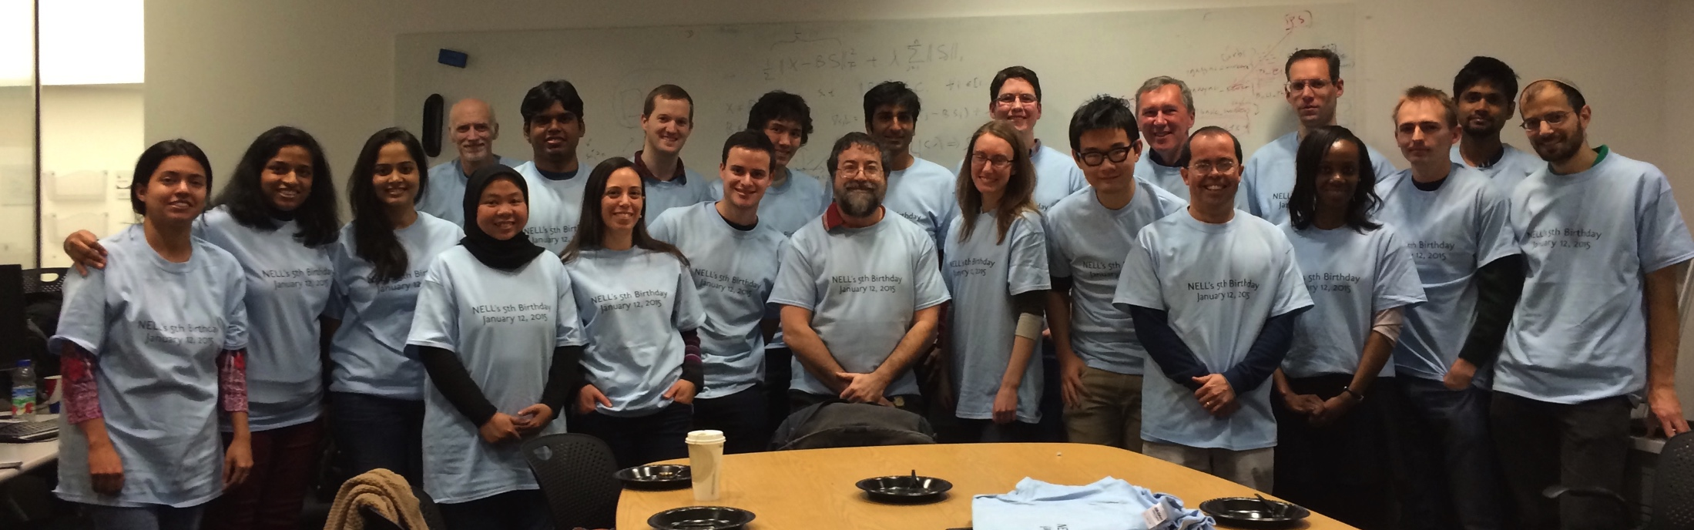
Never Ending Language Learning
PI: Tom M. Mitchell
Machine Learning Department
Carnegie Mellon University

Slide 101
NELL Theses
we’ll never understand learning until we build
never-ending machine learners
background knowledge is key to deep semantic analysis
  NELL KB, plus
  large scale corpus statistics

Slide 102
NELL today
Running 24x7, since January, 12, 2010
Today:
  knowledge base with ~100 million confidence-weighted
  beliefs
  learning to read
  gradually improving reading accuracy
  learning to reason
  gradually improving KB size,
    > 100,000 learned rules, scalable probabilistic inference
  extending ontology
    new relations: clustering typed pairs
    new categories: (developing) clustering + reading subsets
  beginning to include image analysis (via NEIL)

Slide 103
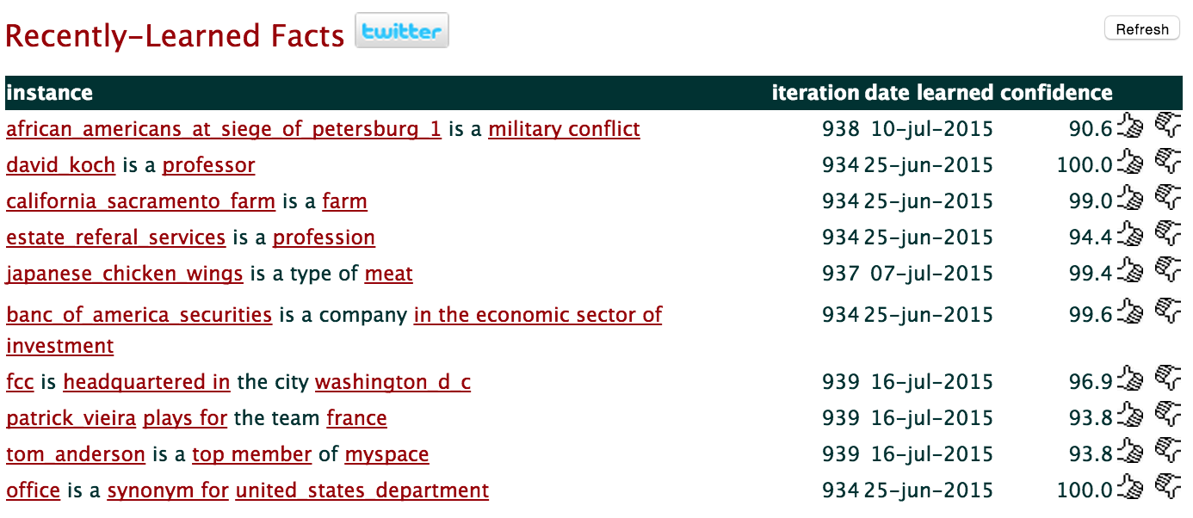
NELL Web Interface

Slide 104
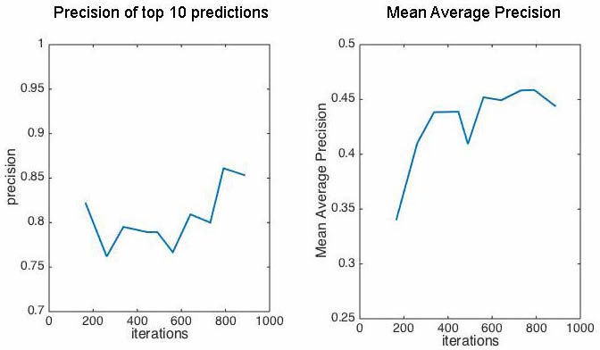
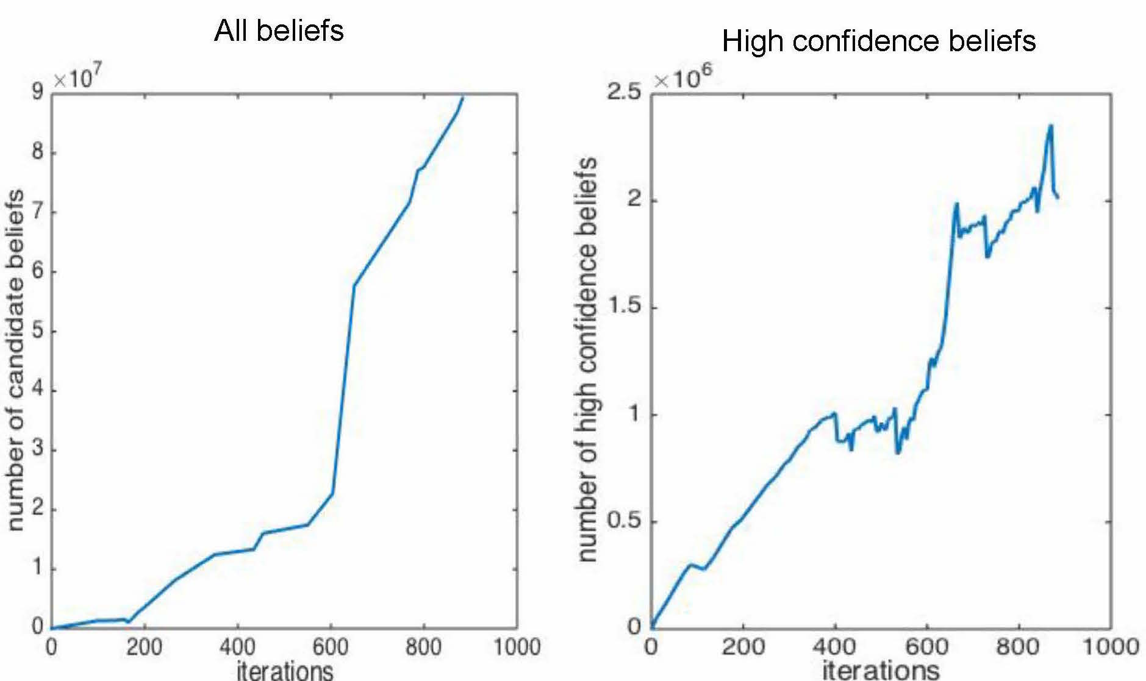
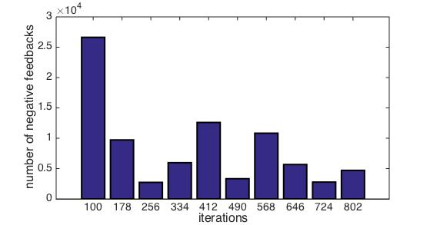
NELL Is Improving Over Time (Jan 2010 to Nov 2014)
mean avg. precision top 1000
all beliefs
high conf. beliefs
precision@10
10’s of millions
millions
number of NELL beliefs vs. time
reading accuracy vs. time
(average over 31 predicates)
[Mitchell et al., 2015]
human feedback vs. time
(average 2.4 feedbacks per predicate per month)

Slide 105
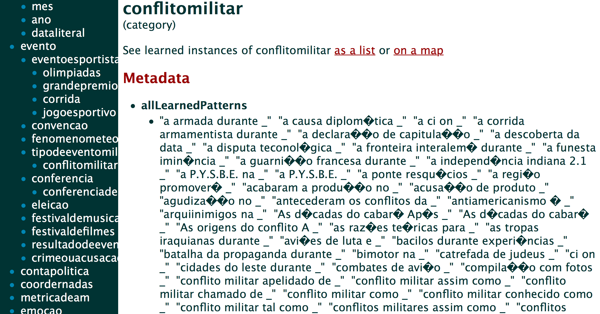
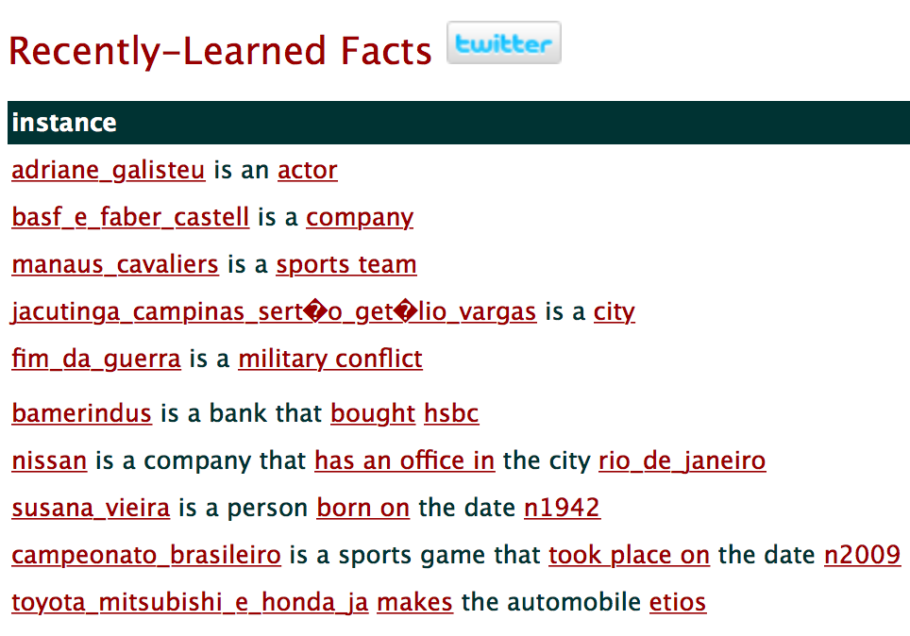
Portuguese NELL
[Estevam Hruschka]

Slide 106
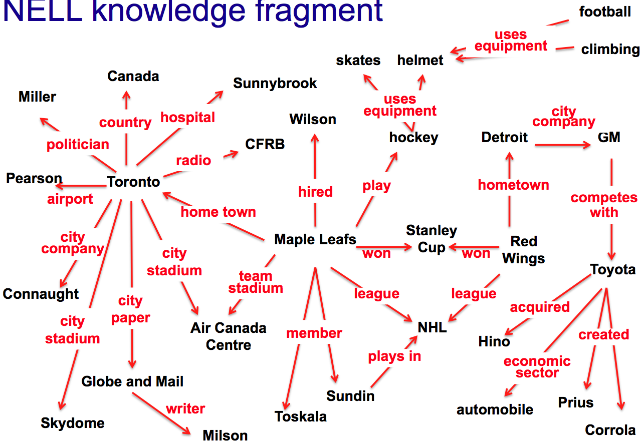
Infer New Beliefs
[Lao, Mitchell, Cohen, EMNLP 2011]
economic sector
If:
x1
competes
with (x1,x2)
x2
economic sector (x2, x3)
x3
Then:
economic sector (x1, x3)

Slide 107
Inference by Random Walks
PRA: [Lao, Mitchell, Cohen, EMNLP 2011]
PRA: [Ni Lao]
1. restrict precondition to a chain.
2. inference by random walks
3. combine multiple rule matches with log-linear model
economic sector
If:
x1
competes
with (x1,x2)
x2
economic sector (x2, x3)
x3
Then:
economic sector (x1, x3)

Slide 108
Course Outline
Basic theories and practices on named entity recognition.
Recent advances in relation extraction:
  distant supervision
  latent variable models
Scalable IE and reasoning with first-order logics.

Slide 109
Recent Advances in IE:
Distant Supervision

Slide 110
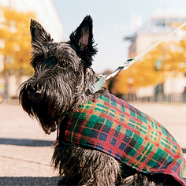
Relation Extraction
Predict relations between entities based on mentions (Cullota and Sorenson, 2004)
Example: learn the mascot(object, org) relation.
Training data:
“A Scottish Terrier has clearly
won the hearts of the campus
community and will become
Carnegie Mellon's new official mascot”

Slide 111
Challenge
It is very expensive to obtain labeled training data.

Slide 112
Distant Supervision
Idea: if we know the relation between two entities, then any sentence that includes these two entities is likely to express the same relation.

Slide 113

Distant Supervision
Mintz, Bills, Snow, Jurafsky. 2009. Distant supervision for relation extraction without labeled data. ACL-2009.
Use a knowledge base of
known relations to collect
a lot of noisy training data.

Slide 114
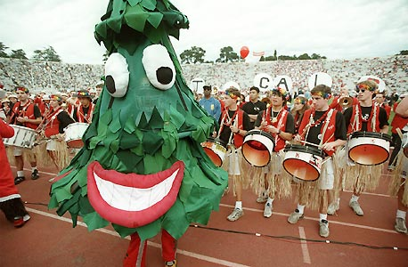
Distant Supervision
Example: mascot(Stanford_tree,Stanford_Band).
High quality examples:
“The Stanford Tree is the Stanford Band's mascot.”
“Called — appropriately — the Stanford Tree, it is the official mascot of the band.”
Noisy examples:
“The Stanford band invites
you to be Tree for a day.”

Slide 115
Distant Supervision: Pros
Has the advantages of supervised learning
                leverage rich, reliable hand-created knowledge
                can use rich features (e.g. syntactic features)
Has the advantages of unsupervised learning
                leverage unlimited amounts of text data
                allows for very large number of weak features
                not sensitive to training corpus: genre independent

Slide 116
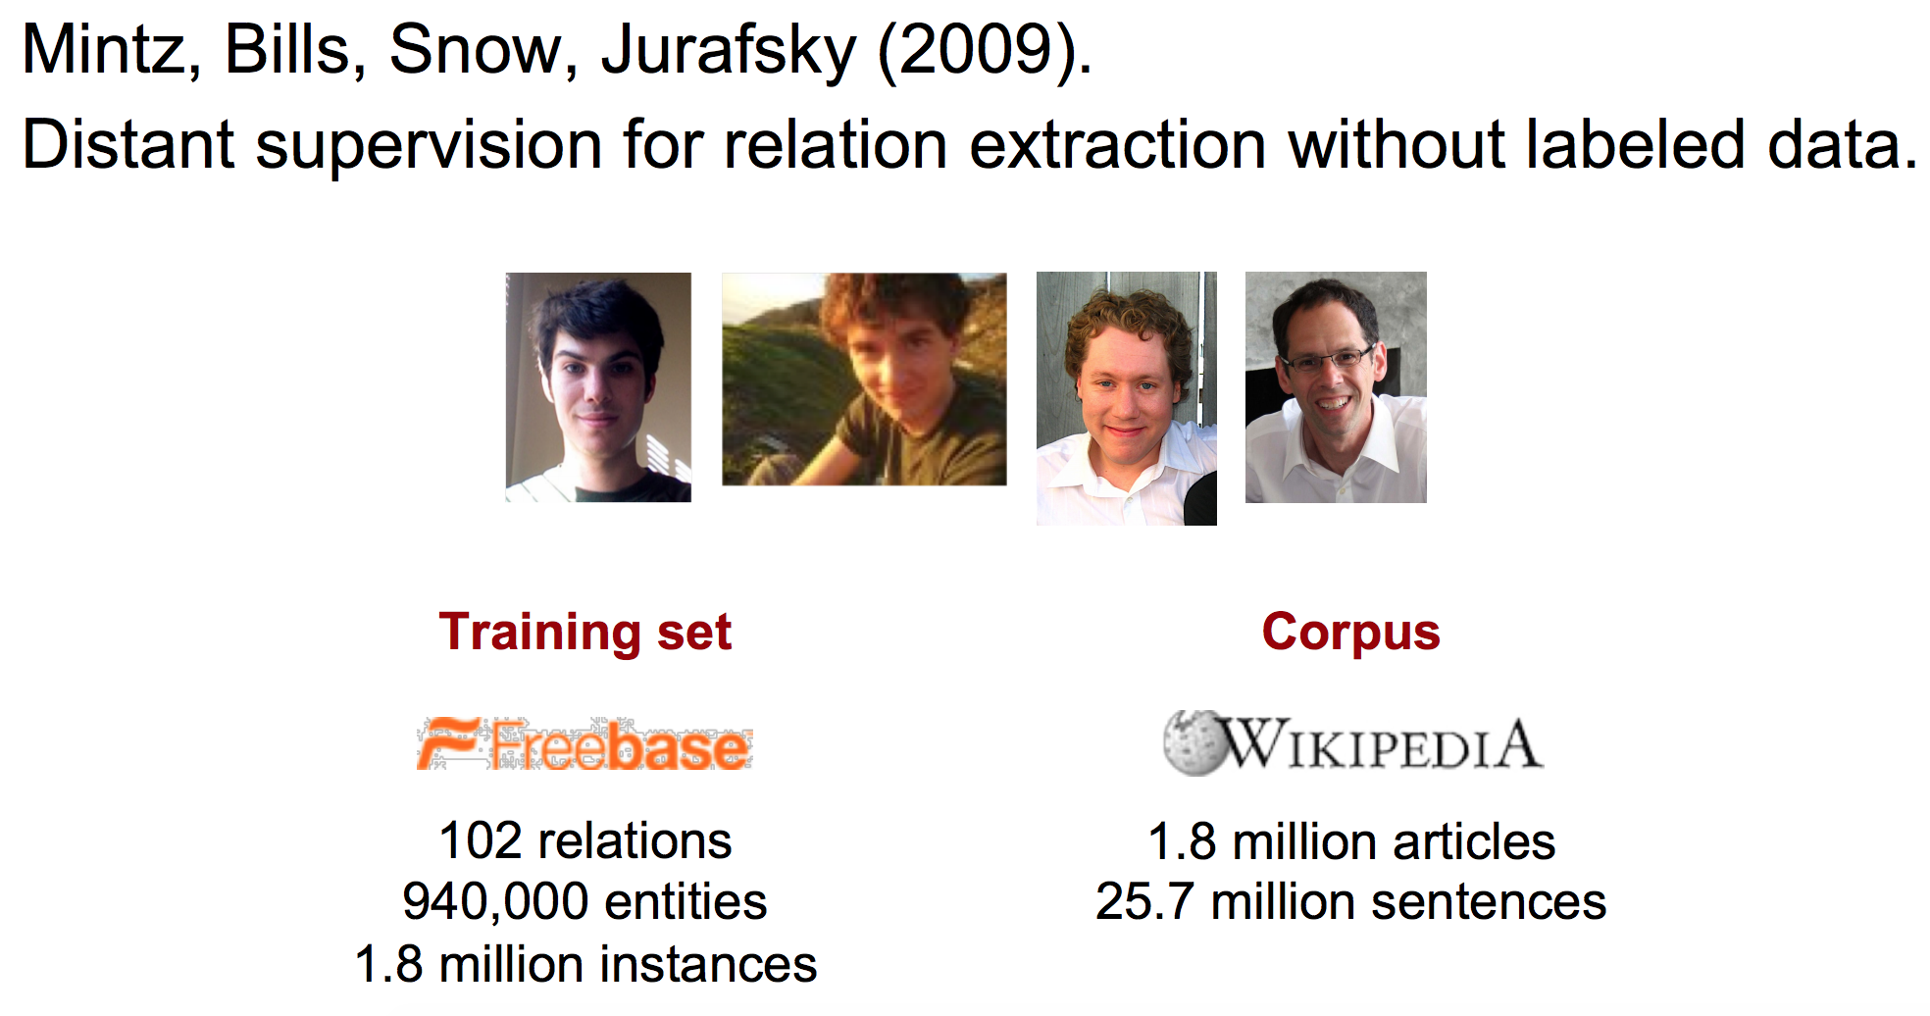
Mintz et al., (2009) ACL

Slide 117
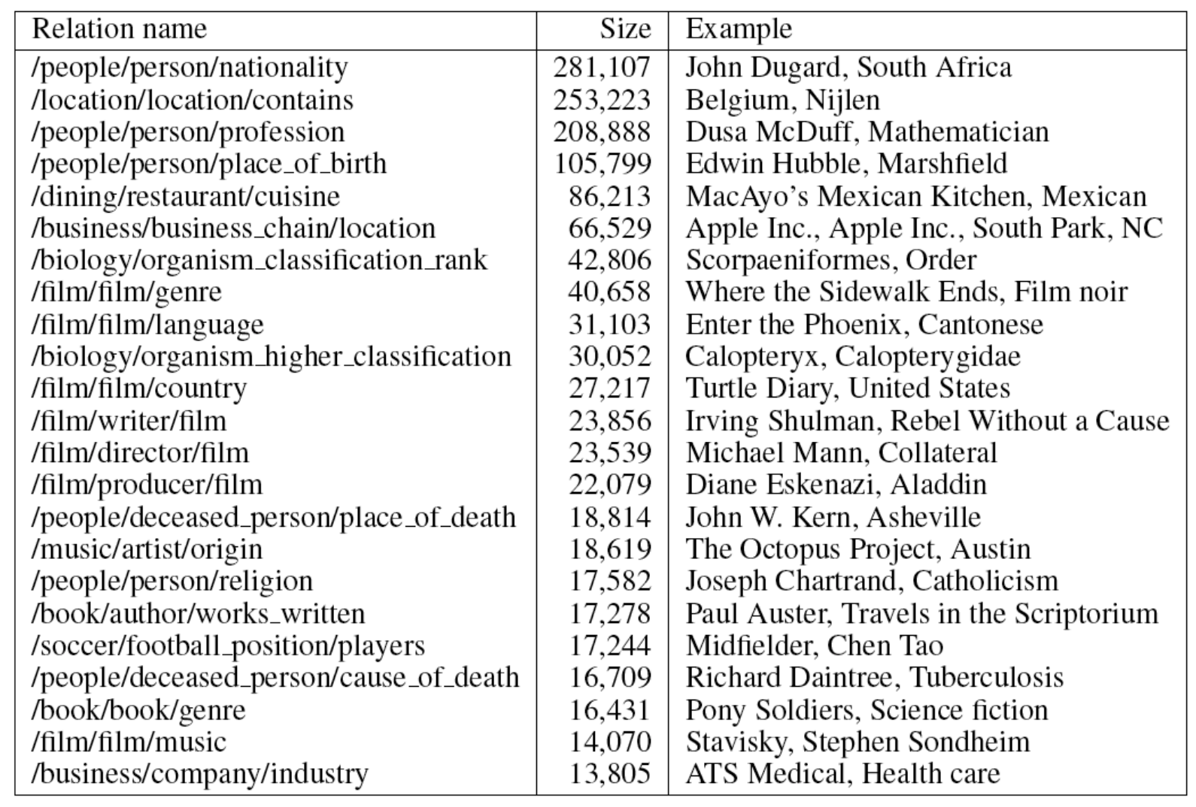
Frequent Freebase Relations

Slide 118
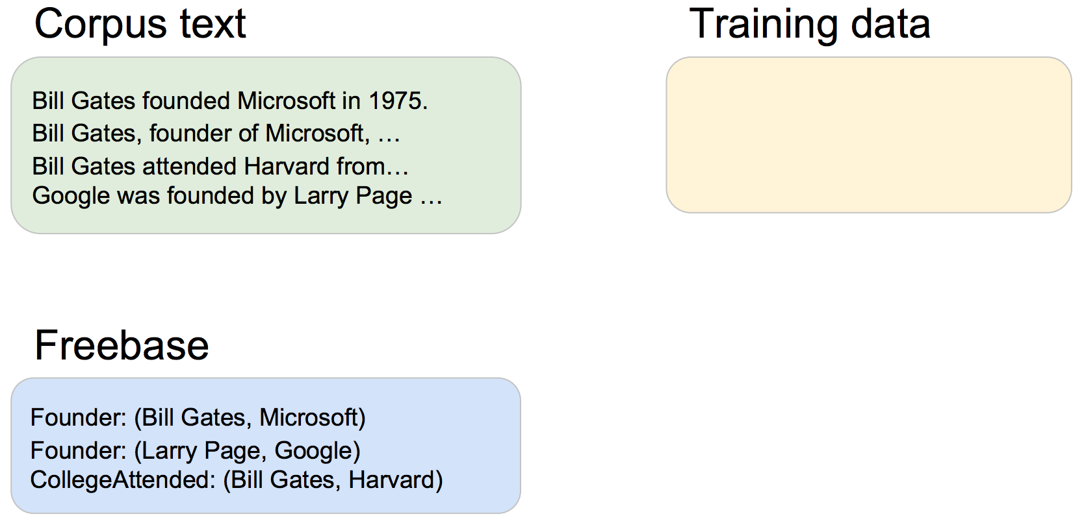
Collecting Training Data

Slide 119
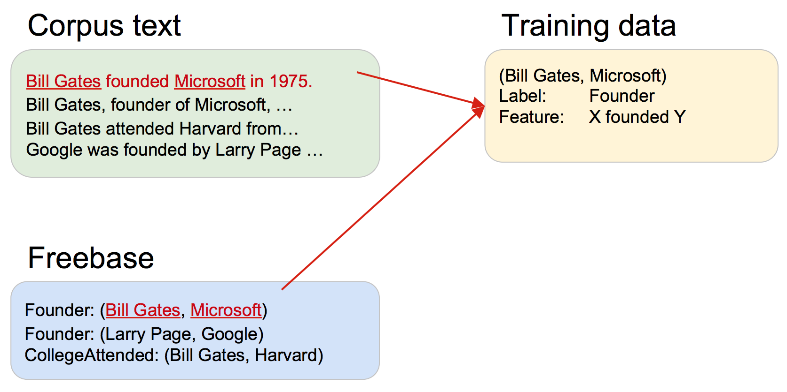
Collecting Training Data

Slide 120
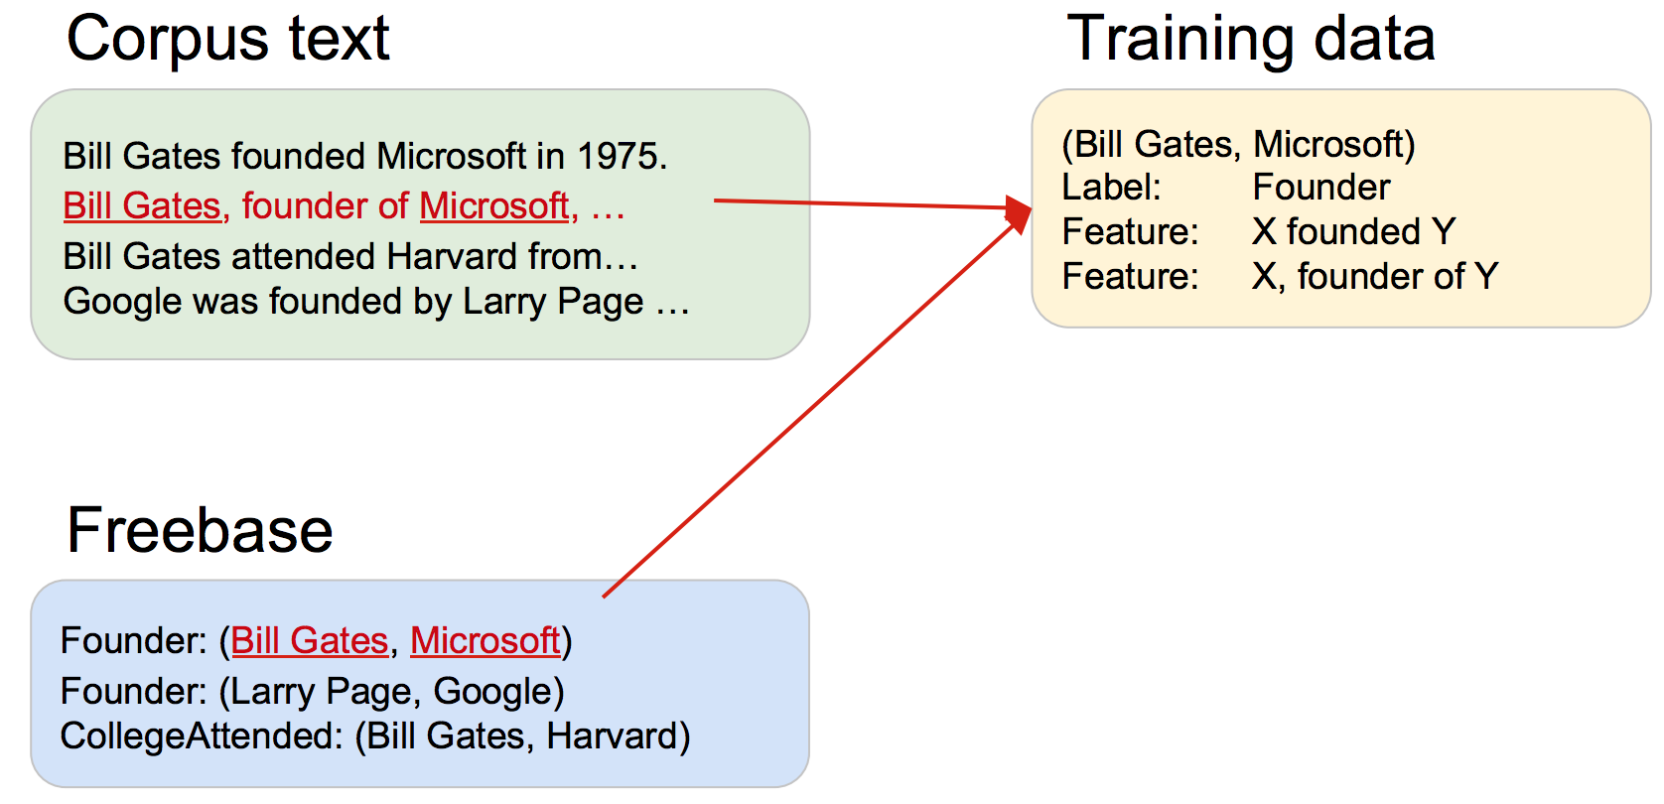
Collecting Training Data

Slide 121
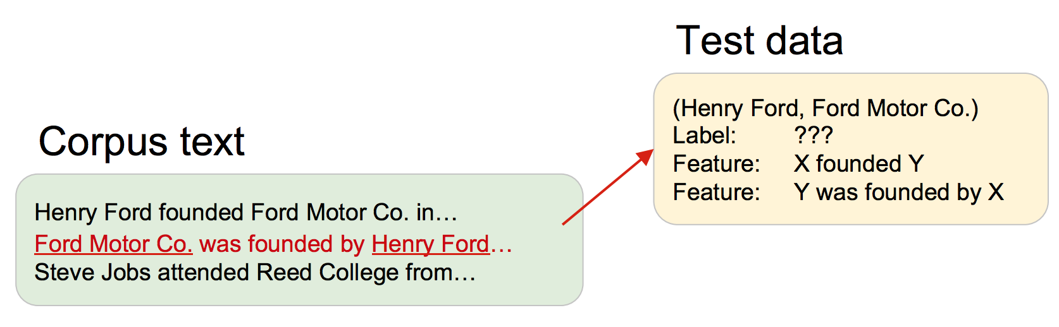
Processing Testing Data

Slide 122
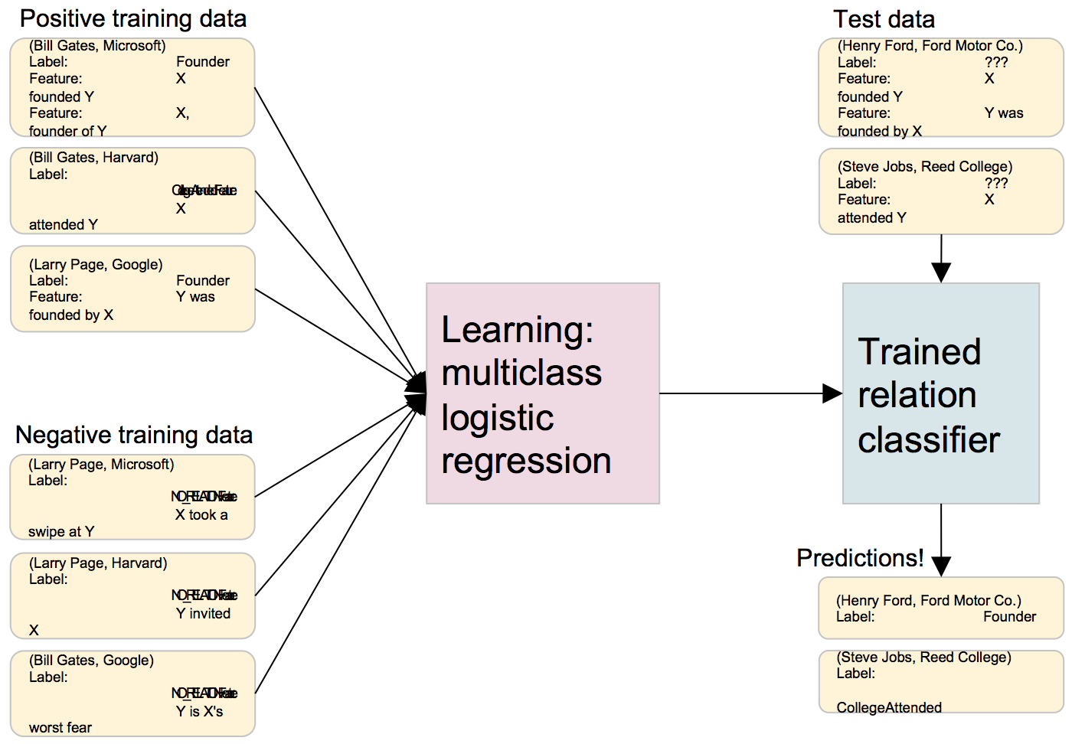
The Experiment

Slide 123
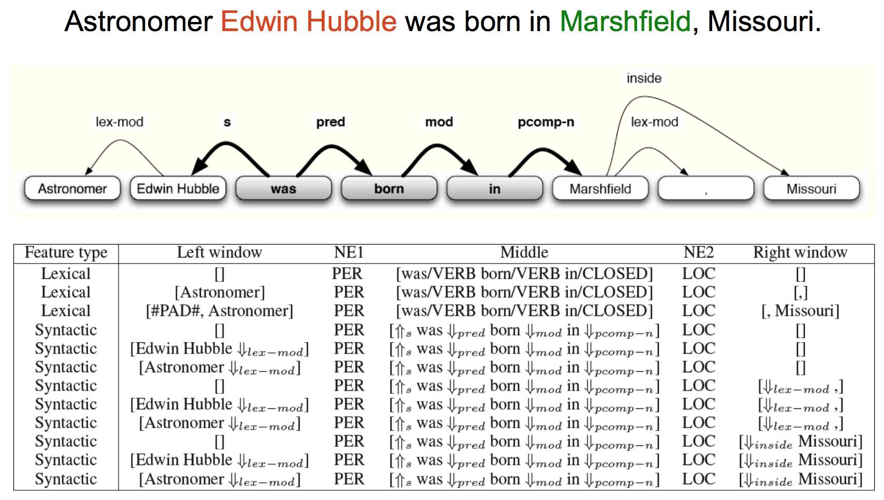
Lexical and Dependency Path Features

Slide 124
Experimental Settings
1.8 million relation instances used for training
800,000 Wikipedia articles used for training, 400,000 different articles used for testing
Only extract relation instances not already in Freebase

Slide 125
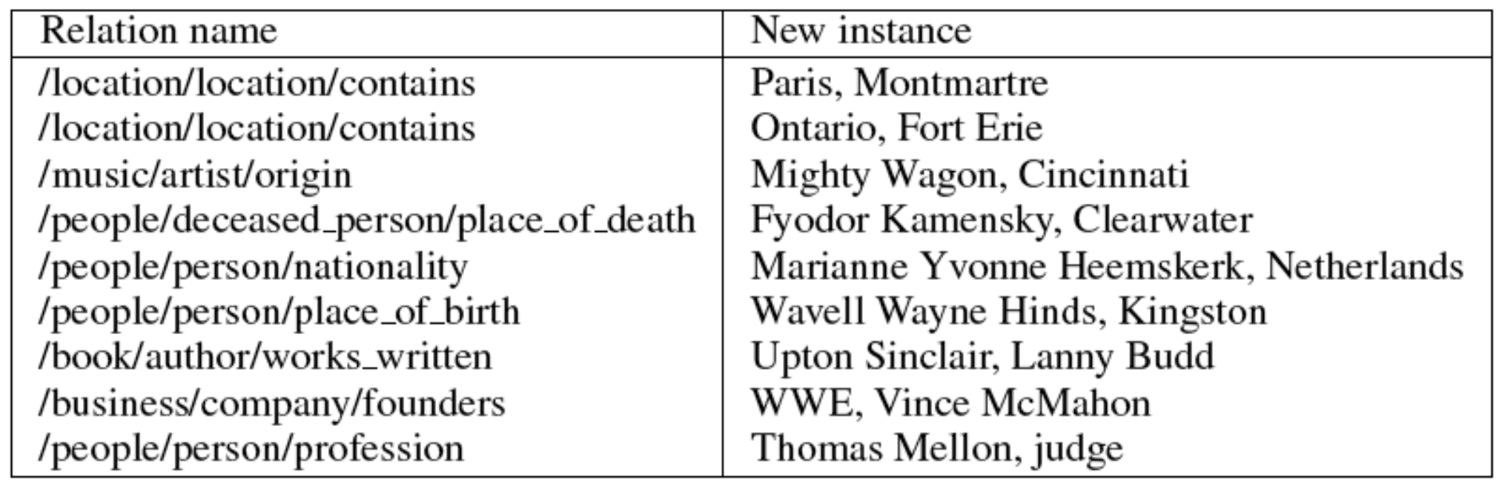
Learned Relational Facts

Slide 126
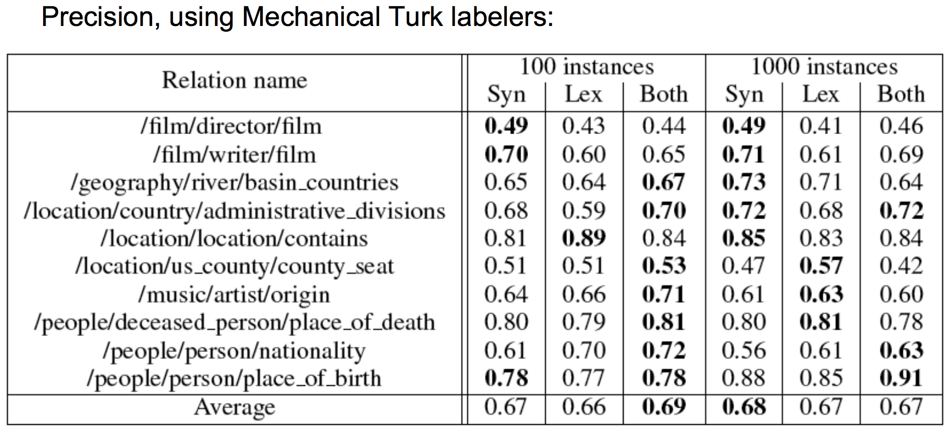
Human Evaluation

Slide 127
Mintz et al. : Aggregate Extraction
1
2
Steve Jobs presents Apple’s HQ.
Apple CEO Steve Jobs …
Steve Jobs holds Apple stock.
Steve Jobs, CEO of Apple, …
Google’s takeover of Youtube …
Youtube, now part of Google, …
Apple and IBM are public.
… Microsoft’s purchase of Skype.
CEO-of(1,2)
N/A(1,2)
Acquired(1,2)
?(1,2)
Acquired(1,2)
2
1
E
1
2
2
1
E
1
2
2
1
E
2
1
E
1
2
E
CEO-of(Rob Iger, Disney)
CEO-of(Steve Jobs, Apple)
Acquired(Google, Youtube)
Acquired(Msft, Skype)
Acquired(Citigroup, EMI)

Slide 128
Mintz et al. (2009)
Issues?
No multi-instance learning
No multi-relation learning

Slide 129
Multi-Instance Learning
1
2
Steve Jobs presents Apple’s HQ.
Apple CEO Steve Jobs …
Steve Jobs holds Apple stock.
Steve Jobs, CEO of Apple, …
Google’s takeover of Youtube …
Youtube, now part of Google, …
Apple and IBM are public.
… Microsoft’s purchase of Skype.
?(1,2)
?(1,2)
?(1,2)
?(1,2)
?(1,2)
?(1,2)
?(1,2)
?(1,2)
E
=N/A(1,2)
=CEO-of(1,2)
=N/A(1,2)
2
1
E
1
2
E
2
1
E
2
∨
1
E
2
1
E
2
1
E
1
2
E
CEO-of(Rob Iger, Disney)
CEO-of(Steve Jobs, Apple)
Acquired(Google, Youtube)
Acquired(Msft, Skype)
Acquired(Citigroup, EMI)
Cf. [Bunescu, Mooney 07],
[Riedel, Yao, McCallum 10])

Slide 130
Overlapping Relations
1
2
Steve Jobs presents Apple’s HQ.
Apple CEO Steve Jobs …
Steve Jobs holds Apple stock.
Steve Jobs, CEO of Apple, …
Google’s takeover of Youtube …
Youtube, now part of Google, …
Apple and IBM are public.
… Microsoft’s purchase of Skype.
?(1,2)
?(1,2)
?(1,2)
?(1,2)
?(1,2)
?(1,2)
?(1,2)
?(1,2)
E
=N/A(1,2)
=CEO-of(1,2)
=SH-of(1,2)
2
1
E
1
2
E
2
1
E
∨
1
2
E
2
1
E
2
1
E
1
2
E
SH-of(Steve Jobs, Apple)
CEO-of(Rob Iger, Disney)
CEO-of(Steve Jobs, Apple)
Acquired(Google, Youtube)
Acquired(Msft, Skype)
Acquired(Citigroup, EMI)

Slide 131
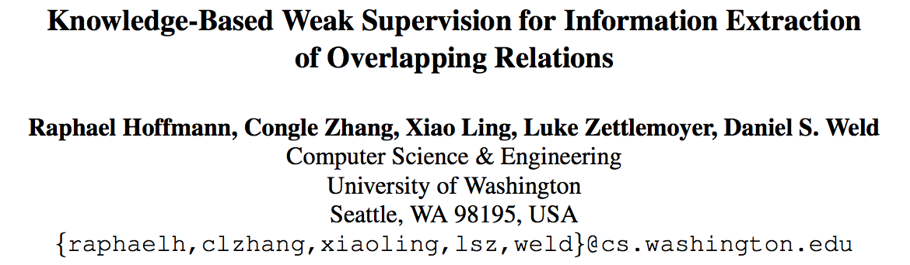
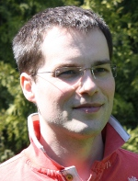
Hoffman et al. (2011)

Slide 132
Sentence-Level Learning
1
2
Steve Jobs presents Apple’s HQ.
Apple CEO Steve Jobs …
Steve Jobs holds Apple stock.
Steve Jobs, CEO of Apple, …
Google’s takeover of Youtube …
Youtube, now part of Google, …
Apple and IBM are public.
… Microsoft’s purchase of Skype.
E
?(1,2)
?(1,2)
?(1,2)
?(1,2)
?(1,2)
?(1,2)
?(1,2)
?(1,2)
2
1
E
1
2
E
2
1
Train so that extracted facts match facts in DB
E
2
∨
1
E
2
1
E
2
1
E
1
2
E
CEO-of(Rob Iger, Disney)
CEO-of(Steve Jobs, Apple)
Acquired(Google, Youtube)
Acquired(Msft, Skype)
Acquired(Citigroup, EMI)

Slide 133
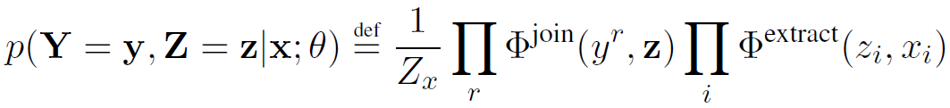

Model
Steve Jobs, Apple:
Y ^{bornIn}
Y ^{founder}
Y ^{locatedIn}
Y ^{capitalOf}
0
1
0
0
{0, 1}
0
{0, 1}
1
{0, 1}
0
{0, 1}
0
...
...
{bornIn,…}
{bornIn,…}
{bornIn,…}
CEO-of
founder
CEO-of
founder
founder
founder
Z₁
Z₂
Z₃
Steve Jobs was founder
of Apple.
Steve Jobs, Steve Wozniak and
Ronald Wayne founded Apple.
Steve Jobs is CEO of
Apple.
...
All features at sentence-level
(join factors are deterministic ORs)

Slide 134

Inference
Computing :
Y ^{bornIn}
Y ^{founder}
Y ^{locatedIn}
Y ^{capitalOf}
{0, 1}
0
{0, 1}
1
{0, 1}
0
{0, 1}
1
...
...
?
?
?
Z₁
Z₂
Z₃
bornIn
.5
bornIn
8
bornIn
7
founder
16
founder
11
founder
8
capitalOf
9
capitalOf
7
capitalOf
8
Steve Jobs was founder
of Apple.
Steve Jobs, Steve Wozniak and
Ronald Wayne founded Apple.
Steve Jobs is CEO of
Apple.
...

Slide 135
Inference
Variant of the weighted, edge-cover problem:
Y ^{bornIn}
Y ^{founder}
Y ^{locatedIn}
Y ^{capitalOf}
0
0
...
16
11
8
9
7
8
...
Z₁
Z₂
Z₃
bornIn
.5
bornIn
8
bornIn
7
founder
16
founder
11
founder
8
capitalOf
9
capitalOf
7
capitalOf
8
Steve Jobs was founder
of Apple.
Steve Jobs, Steve Wozniak and
Ronald Wayne founded Apple.
Steve Jobs is CEO of
Apple.
...

Slide 136




Learning
Training set , where
  corresponds to a particular entity pair
  contains all sentences with mentions of pair
  bit vector of facts about pair from database
Maximize Likelihood

Slide 137
Sentential vs. Aggregate Extraction
Sentential
Aggregate
Input: one sentence
1
Steve Jobs is
CEO of Apple, …
E
2
CEO-of(1,2)
Steve Jobs was founder
of Apple.
Input: one entity pair
<Steve Jobs,
Apple>
E
Steve Jobs, Steve Wozniak and
Ronald Wayne founded Apple.
CEO-of(1,2)
Steve Jobs is CEO of
Apple.
...

Slide 138
Distant Supervision: Related Work
Mintz, Bills, Snow, Jurafsky 09:
  Extraction at aggregate level
  Features: conjunctions of lexical, syntactic, and entity type info along dependency path
Riedel, Yao, McCallum 10:
  Extraction at aggregate level
  Latent variable on sentence
Bunescu, Mooney 07:
  Multi-instance learning for relation extraction
  Kernel-based approach

Slide 139
Experimental Setup
Data as in Riedel et al. 10:
  LDC NYT corpus, 2005-06 (training), 2007 (testing)
  Data first tagged with Stanford NER system
  Entities matched to Freebase, ~ top 50 relations
  Mention-level features as in Mintz et al. 09
Systems:
  MultiR: proposed approach
  SoloR: re-implementation of Riedel et al. 2010

Slide 140
Sentential Extraction

Slide 141
Distant Supervision:
Conclusion
Widely used in the IE community nowadays.
A much cheaper way of obtaining training data
Still, there‘s room for improvement:
    what about entities that are not in Freebase?
  what if entities are in Freebase, but no relation is recorded?

Slide 142
Recent Advances in IE:
Latent Variable Modeling

Slide 143
Universal Schema
    Riedel et al., NAACL 2013. Relation Extraction with Matrix Factorization and Universal Schemas.
    Motivation: use matrix representation for relation extraction.
    Idea: put all training and testing data into a matrix, and fill in the missing values.
    Jointly learn latent factor representation for surface patterns and multiple relations.

Slide 144

Universal Schema
    Rows: pair of entities.
    e.g., (William, CMU)
    Columns: surface
    patterns and relations.
    e.g.,
    X-is_a_professor_at-Y
    teaches (X, Y)

Slide 145
Matrix Factorization
    Approach: Bayesian Personalized Ranking
    (Rendle et al., 2009)
    Requires: negative training data.
    How to collect negative data: both entities of the entity pair occur in Freebase, however, Freebase does not say there is a relation between them.

Slide 146

Performance
    Dataset: Freebase + NewYorkTimes.

Slide 147
Universal Schema
    Pros:
        language, schema independent
        joint learning of surface patterns and relations
        scalability
    Cons:
    explainability
    requires negative examples

Slide 148
Course Outline
Basic theories and practices on named entity recognition: supervised and semi-supervised.
Recent advances in relation extraction:
  distant supervision
  latent variable models
Scalable IE and reasoning with first-order logics.

Slide 149
Joint IE and Reasoning

Slide 150
A Motivating Example…
An elementary school student was sent to detention by his Math teacher after school. When he got home, his father said: “Ma Yun, what happen to you at school today?” Ma: “Sorry dad, I was playing with a magnet, but it attracted Mrs. Smith’s golden ring. Then, Mrs. Smith went out to cry, and slapped the P.E. teacher in the face.”
Query:
Who is most likely the husband of Mrs. Smith?
This example was adapted from Weibo.

Slide 151

Reasoning
An elementary school student was sent to detention by his Math teacher after school. When he got home, his father said: “Ma Yun, what happen to you at school today?” : “Sorry dad, I was playing with a magnet, but it attracted Mrs. Smith’s golden ring. Then, Mrs. Smith went out to cry, and slapped the P.E. teacher in the face.”
attract (magnet, golden_ring)
conflict (iron, golden_ring)
attract (magnet, iron)
slap (Mrs. Smith, P.E. Teacher)
husband (Mrs. Smith, P.E. Teacher)
This example was adapted from Weibo.

Slide 152
Issues with Modern IE Systems
No relational KB inference is performed at extraction time (or no inference at all).
Classification is not the panacea.
Big pipeline: error cascades.

Slide 153
Motivations
To deal with complexity, we need first-order logics to perform reasoning.
To deal with uncertainty, we need statistical/probabilistic approaches, at the same time.

Slide 154

Knowledge Base Inference

Slide 155

Issues with KB Reasoning Systems
Often done using relational triples (e.g., wife(barack,michelle)) after IE, and key contextual information is lost.
E.g., Path-Ranking Algorithm (Ni et al., 2010)

Slide 156
Our Approach
presents a joint IE and reasoning model in a statistical relational learning setting;
incorporates latent contexts into probabilistic first-order logics.

Slide 157
Agenda
Motivation
Background: ProPPR
Datasets
Joint IE and Structure Learning
Experiments
Conclusion

Slide 158

Wait, Why Not Markov Logic Network?
network size is O(nª), where a = #arity.
e.g., holdStock(person,company)
Inference time often depends on graph size.

Slide 159
Programming with Personalized PageRank (ProPPR)
CIKM 2013 best paper honorable mention
is a probabilistic first-order logic
can be used in:
    entity resolution, classification (Wang et al., 2013)
    dependency parsing (Wang et al., 2014 EMNLP)
    large-scale KB inference (Wang et al., 2015 MLJ)
    logic programming (Wang et al., 2015 IJCAI)

Slide 160

Inference Time Comparison
ProPPR’s inference time is independent of the size of the graph (Wang et al., 2013).

Slide 161

Accuracy: Citation Matching
Our rules
UW rules
AUC scores: 0.0=low, 1.0=hi
w=1 is before learning
(i.e., heuristic matching rules,
weighted with PPR)

Slide 162

ProPPR Example
Input:
Query: about(a,?)

Slide 163

An Example ProPPR Program
Feature Vector
Feature Template

Slide 164


Query: about (a,Z)
DB
Program + DB + Query define a proof graph, where nodes are conjunctions of goals and edges are labeled with sets of features.
Program (label propagation)
LHS ➔ features

Slide 165
Every node has an implicit reset link
Low probability
High probability
Short, direct paths from root
Longer, indirect paths from root
Transition probabilities, Pr(child|parent), plus Personalized PageRank (aka Random-Walk-With-Reset) define a distribution over nodes.
Very fast approximate methods for PPR
Transition probabilities, Pr(child|parent), are defined by weighted sum of edge features, followed by normalization.
Learning via pSGD

Slide 166
Approximate Inference in ProPPR
Score for a query soln (e.g., “Z=sport” for “about(a,Z)”) depends on probability of reaching a ☐ node*
“Grounding” (proof tree) size is O(1/αε) … ie independent of DB size ➔ fast approx incremental inference (Reid,Lang,Chung, 08)
---
α is reset probability
*as in Stochastic Logic Programs
[Cussens, 2001]
Basic idea: incrementally expand the tree from the query node until all nodes v accessed have weight below ε/degree(v)

Slide 167


Parameter Learning in ProPPR
PPR probabilities are a stationary distribution of a Markov chain
reset
Transition probabilities u→v are derived by linearly combining features of an edge, applying a squashing function f, and normalizing
f is exp, truncated tanh, ReLU…

Slide 168

Parameter Learning in ProPPR
PPR probabilities are a stationary distribution of a Markov chain
Learning uses gradient descent: derivative d^{t} of p^{t} is :
Overall algorithm not unlike backprop…we use parallel SGD

Slide 169
Where Does the Program Come From?
Traditionally by hand.
We use structure learning to automatically learn first-order logic clauses from data.
Idea (CIKM 2014):
  build a second-order abductive logic
  whose parameters correspond to 1st-order theory
  reduce the structure learning to parameter learning.

Slide 170
Logic program is an interpreter for a program containing all possible rules from a sublanguage
Query₀: sibling(malia,Z)
DB₀: sister(malia,sasha), mother(malia,michelle), …
Query: interp(sibling,malia,Z)
DB: rel(sister,malia,sasha), rel(mother,malia,michelle), …
Interpreter for all clauses of the form P(X,Y) :- Q(X,Y):
interp(P,X,Y) :- rel(P,X,Y).
interp(P,X,Y) :- interp(Q,X,Y), assumeRule(P,Q).
assumeRule(P,Q) :- true # f(P,Q). // P(X,Y):-Q(X,Y)
interp(sibling,malia,Z)
rel(Q,malia,Z), assumeRule(sibling,Q),…
Features correspond to specific rules
assumeRule(sibling,sister),…
assumeRule(sibling,mother),…
f(sibling,sister)
f(sibling,mother)
…
…
Z=sasha
Z=michelle

Slide 171
Logic program is an interpreter for a program containing all possible rules from a sublanguage
Features ~ rules. For example:
f(sibling,sister) ~ sibling(X,Y):-sister(X,Y).
Gradient of parameters (feature weights) informs you about what rules could be added to the theory…
Query: interp(sibling,malia,Z)
DB: rel(sister,malia,sasha), rel(mother,malia,michelle), …
Interpreter for all clauses of the form P(X,Y) :- Q(X,Y):
interp(P,X,Y) :- rel(P,X,Y).
interp(P,X,Y) :- interp(Q,X,Y), assumeRule(P,Q).
assumeRule(P,Q) :- true # f(P,Q). // P(X,Y):-Q(X,Y)
interp(sibling,malia,Z)
rel(Q,malia,Z), assumeRule(sibling,Q),…
Added rule:
Interp(sibling,X,Y) :- interp(sister,X,Y).
assumeRule(sibling,sister),…
assumeRule(sibling,mother),…
f(sibling,sister)
f(sibling,mother)
…
…
Z=sasha
Z=michelle

Slide 172
Joint IE and
Structure learning

Slide 173

Data Collection

Slide 174

Joint IE+SL Theory

Slide 175
Experiments
Task: KB Completion.
Three Wikipedia Datasets:
  royal, geo, american.
  67K, 12K, and 43K links respectively.
 | 10% deleted | 50% deleted
ProPPR/SL | 79.5 | 61.9
ProPPR/IE | 81.1 | 70.6
  Results on Royal, similar results on two other InfoBox datasets.

Slide 176
Joint Relation Learning IE in ProPPR
Experiment
  Combine IE and SL rules
 | 10% deleted | 50% deleted
ProPPR/SL | 79.5 | 61.9
ProPPR/IE | 81.1 | 70.6
ProPPR/Joint IE,SL | 82.8 | 78.6
  Similar results on two other InfoBox datasets

Slide 177

Joint IE and Relation Learning
Baselines: MLNs (Richardson and Domingos, 2006), Universal Schema (Riedel et al., 2013), IE- and structure-learning-only models.

Slide 178

Latent Context Invention
Making the classifier more powerful: introduce latent classes (analogous to invented predicates) which can be combined with the context words in the features used by the classifier.

Slide 179
Joint IE and Relation Learning
Task: Knowledge Base Completion.
Baselines: MLNs (Richardson and Domingos, 2006), Universal Schema (Riedel et al., 2013), IE- and structure-learning-only models.

Slide 180

Explaining the Parameters

Slide 181
Discussions
Comparing to latent variable models, our method is explainable.
This is multi-instance multi-relation distant supervision with logic.
This framework allows us to recursively learn relations, and jointly reason with IE clauses.
Our structure learning method is efficient: according to Kok & Domingos‘s (2010, ICML), LSM sometimes takes 28 days to learn on a moderate-small dataset, where as our method needs a few minutes on a similar-sized dataset.

Slide 182
Conclusion
We introduce a probabilistic logic programming method for joint IE and reasoning.
We briefly show how to incorporate latent classes in first-order logic.
Our system outperforms state-of-the-art IE systems.

Slide 183
ProPPR Demo

Slide 184
Course Conclusion
Basic theories and practices on named entity recognition: supervised, semi-supervised, and unsupervsed.
Recent advances in relation extraction:
  distant supervision
  latent variable models
Scalable IE and reasoning with first-order logics.

Slide 185
Acknowledgement
CIPS Executives
Peking University
General Chair: Prof. Le Sun
PC Chair: Prof. Heng Ji
Org. Chairs: Profs. Wang, Zhao, and Sui.
Volunteers
Participants

Slide 186
Ask Me Anything! yww@cs.cmu.edu

