Slide 1
JICOS’s Abstract Distributed Service Component
Peter Cappello
Computer Science Department
UC Santa Barbara

Slide 2
Introduction
Designing distributed systems correctly is hard.
Object-orientation simplifies design.
Reusable classes increase productivity.
Abstraction leads to reusable classes.
Presenting … an abstract distributed service component (ADSC).

Slide 3
Introduction …
Focus on some design issues.
Why present this?
  The design is non-trivial.
  Enhancements described in terms of base design.
  Different implementations benefit from issue elucidation.
  Download the foundation package:
    https://github.com/charlesmunger/jpregel-aws
    http://cs.ucsb.edu/projects/jicos

Slide 4
Jicos Architecture
Jicos is designed to:
Support scalable, adaptively parallel computation
Tolerate basic faults
Hide communication latency

Slide 5
Jicos Architecture …
Jicos comprises 3 service component classes:
Hosting Service Provider (HSP):
  clients interact solely with the HSP.
  HSP manages other service components
Task server
  A task space
Host
  Executes tasks

Slide 6
Architecture …
Hosting
Service
Provider
Client

Slide 7
Issue Priority
Correctness
Elegant Object-Oriented Design
Programmability
Performance
Reliability
Administratable
Security

Slide 8
The ADSC is ServiceImpl
ServiceImpl
Service
Host
Hsp
TaskServer

Slide 9
Anatomy of an ADSC
A finite state machine
  Takes commands from neighbor service components as input
  For each command:
    Update its state
    Output command[s] to neighbor service components.
Command
Command
Command
Finite
State
Machine
With Output
Command
Command
Command

Slide 10
Anatomy of an ADSC
Command
Processor
COMMANDS
COMMANDS
STATE

Slide 11
Anatomy of an ADSC
Decouple communication from computation
via multi-threading
RMI Thread
executing
receiveCommands()
Command
Processor
Thread
Thread
invoking
receiveCommands()
RMI Thread
executing
receiveCommands()
RMI Thread
executing
receiveCommands()
Input
Command
Queue
Output
Command
Queue
Output
Command
Queue
Output
Command
Queue

Slide 12
Input
Command
Queue
RMI Thread
executing
receiveCommands()
Command
Processor
Thread
invoking
receiveCommands()
RMI Thread
executing
receiveCommands()
RMI Thread
executing
receiveCommands()
Output
command
queue
Output
command
queue
Output
Command
Queue

Slide 13
Anatomy of an ADSC
Improve network & processor efficiency
via multi-threading
RMI Thread
executing
receiveCommands()
Command
Processor
Thread
Thread
invoking
receiveCommands()
RMI Thread
executing
receiveCommands()
Command
Processor
Thread
Thread
invoking
receiveCommands()
RMI Thread
executing
receiveCommands()
Command
Processor
Thread
Thread
invoking
receiveCommands()
Input
Command
Queue
Output
Command
Queue
Output
Command
Queue
Output
Command
Queue

Slide 14
Anatomy of an ADSC
Partitioning Command Classes
Department
Input
Command
Queue
Command
Processor
Output
queue
Command
Processor
Output
queue
Command
Processors
Output
Command
Queues
State

Slide 15
Service Component
State
RMI Thread
executing
receiveCommands()
Command
Processor
RMI Thread
executing
receiveCommands()
Command
Processor
RMI Threads
executing
receiveCommands()
Departments
Output
queue
RMI Thread
executing
receiveCommands()
Output
queue
RMI Thread
executing
receiveCommands()
Output
Command
Queues
Threads
invoking
receiveCommands()

Slide 16
Command
Processor
Processor
Communication
Processor
Communication
Processor
Pool
Department
Q
Mail
Proxy
Manager
Command
Service
Proxy
Command
List
ServiceImpl
Command
Synchronous

Slide 17
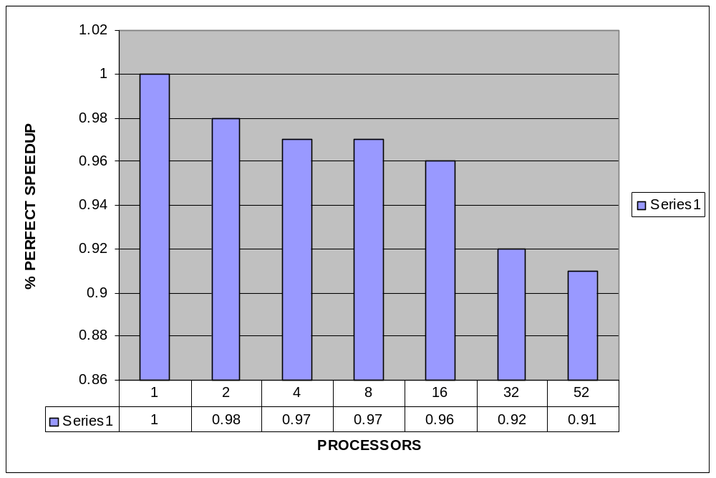
JANET Speedup:150-City TSP
1 processor: 6 hours, 18 minutes
52 processors: 8 minutes
16K Tasks, average task time: 1.5 seconds

Slide 18
Thanks!
Questions? http://cs.ucsb.edu/projects/jicos

Slide 19
