Slide 1
Recursive Definitions &
Structural Induction:
Selected Exercises

Slide 2
Exercise 10
  Give a recursive definition of S_{m}( n ), the sum of integer m + nonnegative integer n.

Slide 3
Exercise 10 Solution
  Give a recursive definition of S_{m}( n ), the sum of integer m + nonnegative integer n.
  S_{m}( n ) = ( n == 0 ) ? m : 1 + S_{m}( n – 1 );

Slide 4
Exercise 20
  Give a recursive definition of the functions max & min so that max( a₁, a₂, …, a_{n} ) & min( a₁, a₂, …, a_{n} ) are the maximum & minimum of a₁, a₂, …, a_{n}, respectively.

Slide 5
Exercise 20 Solution
  Give a recursive definition of the functions max & min so that max( a₁, a₂, …, a_{n} ) & min( a₁, a₂, …, a_{n} ) are the maximum & minimum of a₁, a₂, …, a_{n}, respectively.
  max( a₁ ) = a₁;
  max( a₁, a₂ ) = (a₁ ≤ a₂ ) ? a₂ : a₁; (Why is this needed?)
  max( a₁, a₂, …, a_{n} ) = max (max( a₁, a₂, …, a_{n-1} ) , a_{n} )
  The min function is defined similarly.

Slide 6
Exercise 30
  Prove that in any bit string, the string 01 occurs at most 1 more time than the string 10.

Slide 7
Exercise 30
Prove that in any bit string “01” occurs at most 1 more time than the “10”.
Can we prove it by induction?
Can we base the induction on the length of the bit string?
If we
  Show it’s true for | s | = 1
  Assume it’s true for | s | < n
We try to show it’s true for | s | = n.
  We break the string into bit string r = the 1st n – 1 bits, followed by the last bit.
  Apply the induction hypothesis to r.
  Induction step: 4 cases, depending on the last bit of r & the last bit of s.
  The case fails when the last bit of r is 1 & the last bit of s is 0.
What to do?

Slide 8
Exercise 30 Proof
Basis: |s| = 1: #01(s) = 0 ≤ 1 = #10(s) + 1
Assume: |s| < n → #01(s) ≤ #10(s) + 1
Show: |s| = n → #01(s) ≤ #10(s) + 1
  (Decomposing s arbitrarily into 2 smaller strings, fails. Try it.)
Case: s does not contain substring “10”:
    It is of the form 0*1*.
    #01(s) ≤ 1 = #10(s) + 1.

Slide 9
Case: s does contain substring “10”:
  Break s into 2 strings, t and u, between a “10”
  E.g., 100111011000 is broken into (100111)(011000 )
    t ends in “1”; u begins with “0”.
    #01(t) ≤ #10(t) + 1 (S.I.H.)
    #01(u) ≤ #10(u) + 1 (S.I.H.)
    #01(s) = #01(t) + #01(u) ≤ #10(t) + #10(u) + 2 = #10(s) + 1.

Slide 10
Exercise 40
  To recursively define a set:
  Define it to have some “initial” elements;
  Give rules that compose new elements from pre-existing elements.
  Recursively define the set S of bit strings with more 0s than 1s.

Slide 11
Exercise 40 Solution
  Recursively define the set S of bit strings that have more 0s than 1s.
  0 ∈ S.
  x, y ∈ S → xy, 1xy, x1y, xy1 ∈ S.
  This recursive definition of set S is like a context free grammar.
  S is a context-free language.
  These grammars & languages are studied in CMPSC 138.
  We use them to define the syntax of programming languages, like C, & C++, Java, Python, Ruby, Scala, Haskell, etc.

Slide 12
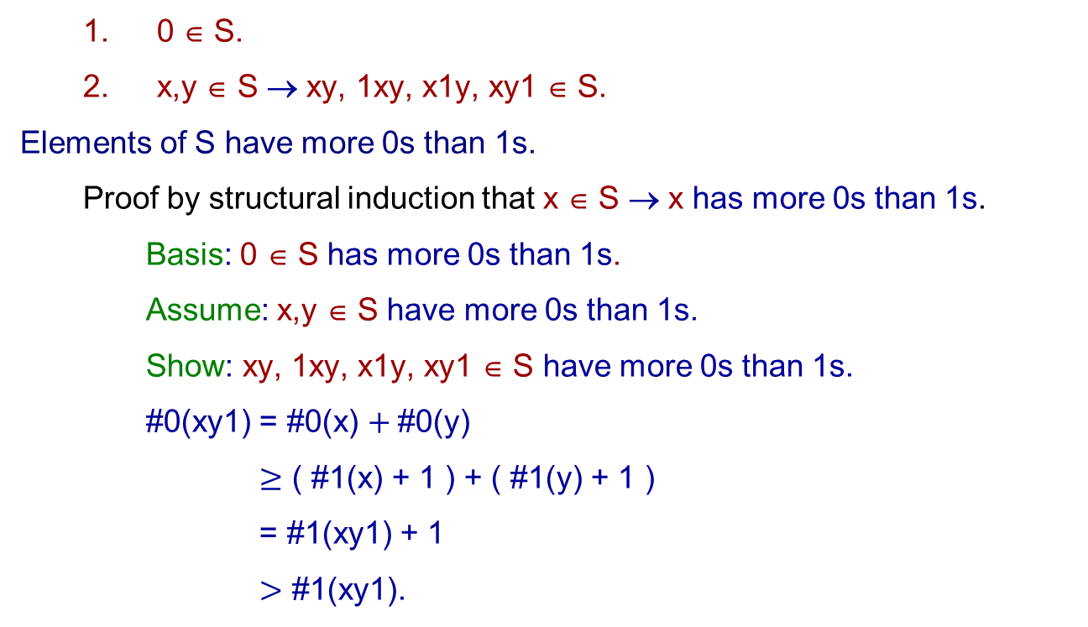
  0 ∈ S.
  x,y ∈ S → xy, 1xy, x1y, xy1 ∈ S.
Elements of S have more 0s than 1s.
  Proof by structural induction that x ∈ S → x has more 0s than 1s.
    Basis: 0 ∈ S has more 0s than 1s.
    Assume: x,y ∈ S have more 0s than 1s.
    Show: xy, 1xy, x1y, xy1 ∈ S have more 0s than 1s.
    #0(xy1) = #0(x) $+ \text{\#0(}\text{y}\text{)}$
    $≥$ ( #1(x) + 1 ) + ( #1(y) + 1 )
    = #1(xy1) + 1
    $>$ #1(xy1).

Slide 13
Exercise 50
Ackermann’s function is defined as follows:
    A( m, n ) = 2n, if m = 0;
    = 0, if m ≥ 1 ∧ n = 0
    = 2, if m ≥ 1 ∧ n = 1
    = A( m – 1, A( m, n – 1 ) ), if m ≥ 1 ∧ n ≥ 2.
Show that A( 1, k ) = 2^{k}, for k ≥ 1.

Slide 14
Exercise 50 Solution
    Ackermann’s function is defined as follows:
    A( m, n ) = 2n, if m = 0;
    = 0, if m ≥ 1 ∧ n = 0
    = 2, if m ≥ 1 ∧ n = 1
    = A( m – 1, A( m, n – 1 ) ), if m ≥ 1 ∧ n ≥ 2.
  Show that, for k ≥ 1, A( 1, k ) = 2^{k}.
  Basis k = 1: A( 1, 1 ) = 2 = 2¹.
  Show A( 1, k ) = 2^{k} → A( 1, k + 1 ) = 2^{k+1}, for k ≥ 1.
    Assume A( 1, k ) = 2^{k}.
    Prove A( 1, k + 1 ) = 2^{k+1}:
      A( 1, k + 1) = A( 0, A( 1, k ) ) = A( 0, 2^{k} ) = 2 . 2^{k} = 2^{k+1}.

Slide 15
End

Slide 16
A Bijection between Z⁺ & Rooted Trees
The discussion below is based on
  Peter Cappello. A New Bijection between Natural Numbers and Rooted Trees. 4th SIAM Conf. on Discrete Mathematics, San Francisco, June 1988.
Let P denote the set of prime numbers.
Let T denote the set of rooted trees.
Let p: Z⁺, → P, where p( n ) is the n^{th} prime
  (e.g., p( 4 ) = 7 and p⁻¹( 7 ) = 4 ).
p⁻¹( n ) < n.

