Slide 1
Google and the Random Surfer
How does Google figure out which web pages are most important?
An important page is one that lots of pages point to?
No …

Slide 2
Google and the Random Surfer
How does Google figure out which web pages are most important?
An important page is one that lots of important pages point to.

Slide 3
Google and the Random Surfer
How does Google figure out which web pages are most important?
An important page is one that lots of important pages point to.
Start at any web page and follow links at random. Forever.
You’ll see “important” pages more often than unimportant ones.

Slide 4
Analyzing the Web with graphs and matrices
1
2
1
2
3
4
5
6
7
1
2
Matrix
Graph
3
4
7
5
4
5
6
3
6
7
Graph nodes are web pages
Arrows between nodes are links between web pages
Matrix entries are links from “column” pages to “row” pages
The Page Rank comes from algebra on the matrix

Slide 5
Analyzing the Web with graphs and matrices
1
2
1
2
3
4
5
6
7
1
2
Matrix
Graph
3
4
7
5
4
5
6
3
6
7
Graph nodes are web pages
Arrows between nodes are links between web pages
Matrix entries are links from “column” pages to “row” pages
The Page Rank comes from algebra on the matrix
The matrix has over 30,000,000,000,000 rows & columns

Slide 6
Random Surfer Rule
An important page is one that many important pages point to.
If there are no links out of this page, choose a page at random.
Otherwise, with probability p (= .85), follow a random link out of this page.
Or, with probability m = 1 - p (= .15), choose a page at random.

Slide 7
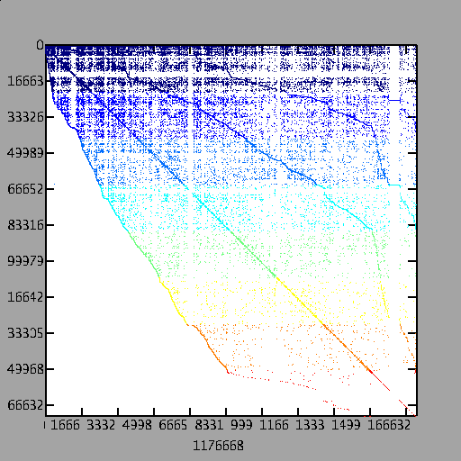
A Page Rank Matrix
Importance ranking of web pages
Stationary distribution of a Markov chain
Power method: matvec and vector arithmetic
Page rank matrix from a web crawl of mit.edu (170,000 pages)

