Slide 1
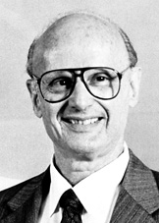
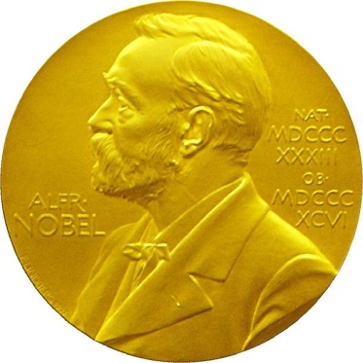
Combinatorial Scientific Computing
“I observed that most of the coefficients in our matrices were zero; i.e., the nonzeros were ‘sparse’ in the matrix, and that typically the triangular matrices associated with the forward and back solution provided by Gaussian elimination would remain sparse if pivot elements were chosen with care”
- Harry Markowitz, describing the 1950s work on portfolio theory that won the 1990 Nobel Prize for Economics

Slide 2
Sparse Cholesky factorization to solve Ax = b
Preorder: replace A by PAP^{T} and b by Pb
Independent of numerics
Symbolic Factorization: build static data structure
Elimination tree
Nonzero counts
Supernodes
Nonzero structure of L
Numeric Factorization: A = LL^{T}
Static data structure
Supernodes use BLAS3 to reduce memory traffic
Triangular Solves: solve Ly = b, then L^{T}x = y

Slide 3
Sparse Gaussian elimination and chordal completion [Parter, Rose]
3
1
3
1
2
2
4
4
5
5
Ax = b
A = L₁L₁^{T}
5
5
2
2
3
3
4
4
1
1
(PAP^{T}) (Px) = (Pb)
PAP^{T} = L₂L₂^{T}

Slide 4
Graphs and sparse matrices: Cholesky factorization A = LL^{T}
Fill: new nonzeros in factor
1
3
7
1
3
7
Symmetric Gaussian elimination:
for j = 1 to n add edges between j’s higher-numbered neighbors
8
6
8
6
4
10
4
10
9
5
2
9
5
2
G(A)
G(L) [chordal]

Slide 5
Sparse Gaussian elimination and chordal completion [Parter, Rose]
Repeat:
Choose a vertex v and mark it;
Add edges between unmarked neighbors of v;
Until: Every vertex is marked
Goal: End up with as few edges as possible.
Or, add fewest possible edges to make the graph chordal.
Space = edges + vertices = Σ_{vertices} (1 + # higher neighbors)
Time = flops = Σ_{vertices} (1+ # higher neighbors)²

Slide 6
Complexity measures for sparse Cholesky
Space:
Measured by fill, which is nnz(G⁺(A))
Number of off-diagonal nonzeros in Cholesky factor (need to store about n + nnz(G⁺(A)) real numbers).
Sum over vertices of G⁺(A) of (# of higher neighbors).
Time:
Measured by number of flops (multiplications, say)
Sum over vertices of G⁺(A) of (# of higher neighbors)²
Front size:
Related to the amount of “fast memory” required
Max over vertices of G⁺(A) of (# of higher neighbors).

Slide 7
The (2-dimensional) model problem
n^{1/2}
Graph is a regular square grid with n = k² vertices.
Corresponds to matrix for regular 2D finite difference mesh.
Gives good intuition for behavior of sparse matrix algorithms on many 2-dimensional physical problems.
There’s also a 3-dimensional model problem.

Slide 8
Permutations of the 2-D model problem
Theorem 1: With the natural permutation, the n-vertex model problem has exactly O(n^{3/2}) fill.
Theorem 2: With a nested dissection permutation, the n-vertex model problem has exactly O(n log n) fill.
Theorem 3: With any permutation, the n-vertex model problem has at least O(n log n) fill.
See course notes for proofs.

Slide 9
Complexity of direct methods
Time and space to solve any problem on any well-shaped finite element mesh
n^{1/2}
n^{1/3}
 | 2D | 3D
Space (fill): | O(n log n) | O(n ^{4/3} )
Time (flops): | O(n ^{3/2} ) | O(n ² )

Slide 10
The Landscape of Sparse Ax=b Solvers
Direct
A = LU
Iterative
y’ = Ay
More General
Non-
symmetric
Symmetric
positive
definite
More Robust
More Robust
Less Storage
D

Slide 11
Complexity of linear solvers
Time to solve model problem (Poisson’s equation) on regular mesh
n^{1/2}
n^{1/3}
 | 2D | 3D
Dense Cholesky: | O(n³ ) | O(n³ )
Sparse Cholesky: | O(n^{1.5} ) | O(n² )
CG, exact arithmetic: | O(n² ) | O(n² )
CG, no precond: | O(n^{1.5} ) | O(n^{1.33} )
CG, modified IC: | O(n^{1.25} ) | O(n^{1.17} )
CG, support trees: | O(n¹⁺ ) | O(n¹⁺ )
Multigrid: | O(n) | O(n)

