Slide 1
CS 140 : Jan 27 – Feb 3, 2010 Multicore (and Shared Memory) Programming with Cilk++
Multicore and NUMA architectures
Multithreaded Programming
Cilk++ as a concurrency platform
Divide and conquer paradigm for Cilk++
Thanks to Charles E. Leiserson for some of these slides

Slide 2
Multicore Architecture
Memory
I/O
Network
…
$
$
$
core
core
core
Chip Multiprocessor (CMP)
Notes:
Multithreaded Programming in Cilk Lecture 1
July 13, 2006
2

Slide 3
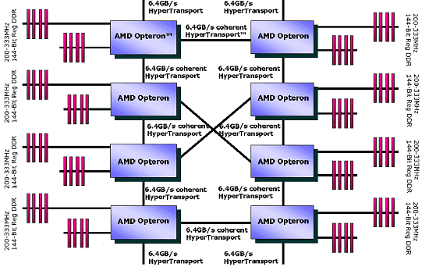
cc-NUMA Architectures
AMD 8-way Opteron Server (neumann@cs.ucsb.edu)
A processor (CMP) with 2/4 cores
Memory bank local to a processor

Slide 4
cc-NUMA Architectures
No Front Side Bus
Integrated memory controller
On-die interconnect among CMPs
Main memory is physically distributed among CMPs (i.e. each piece of memory has an affinity to a CMP)
NUMA: Non-uniform memory access.
For multi-socket servers only
Your desktop is safe (well, for now at least)
Triton nodes are also NUMA !

Slide 5
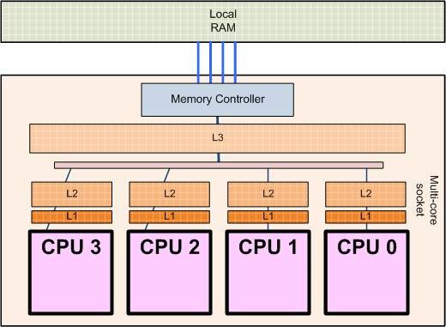
Desktop Multicores Today
This is your AMD Shangai or Intel Core i7 (Nehalem) !
On-die interconnect
Private cache: Cache coherence is required

Slide 6
Multithreaded Programming
A thread of execution is a fork of a computer program into two or more concurrently running tasks.
POSIX Threads (Pthreads) is a set of threading interfaces developed by the IEEE
Assembly of shared memory programming
Programmer has to manually:
Create and terminating threads
Wait for threads to complete
Manage the interaction between threads using mutexes, condition variables, etc.

Slide 7
Concurrency Platforms
Ahh!
Sigh!
Programming directly on PThreads is painful and error-prone.
With PThreads, you either sacrifice memory usage or load-balance among processors
A concurrency platform provides linguistic support and handles load balancing.
Examples:
Threading Building Blocks (TBB)
OpenMP
Cilk++

Slide 8
Cilk vs. PThreads
How will the following code execute in PThreads? In Cilk?
for (i=1; i<1000000000; i++) {
spawn-or-fork foo(i);
}
sync-or-join;
What if foo contains code that waits (e.g., spins) on a variable being set by another instance of foo?
This different is a liveness property:
Cilk threads are spawned lazily, “may” parallelism
PThreads are spawned eagerly, “must” parallelism

Slide 9
Cilk vs. OpenMP
Cilk++ guarantees space bounds. On P processors, Cilk++ uses no more than P times the stack space of a serial execution.
Cilk++ has serial semantics.
Cilk++ has a solution for global variables (a construct called "hyperobjects")
Cilk++ has nested parallelism that works and provides guaranteed speed-up.
Cilk++ has a race detector for debugging and software release.

Slide 10
Great, how do we program it?
Cilk++ is a faithful extension of C++
Programmer implement algorithms mostly in the divide-and-conquer (DAC) paradigm. Two hints to the compiler:
cilk_spawn: the following function can run in parallel with the caller.
cilk_sync: all spawned children must return before program execution can continue
Third keyword for programmer convenience only (compiler converts it to spawns/syncs under the covers)
cilk_for

Slide 11
Nested Parallelism
Example: Quicksort
The named child function may execute in parallel with the parent caller.
template <typename T>
void qsort(T begin, T end) {
if (begin != end) {
T middle = partition(
begin,
end,
bind2nd( less<typename iterator_traits<T>::value_type>(),
*begin )
);
cilk_spawn qsort(begin, middle);
qsort(max(begin + 1, middle), end);
cilk_sync;
}
}
Control cannot pass this point until all spawned children have returned.
Notes:
11

Slide 12
Cilk++ Loops
Example: Matrix transpose
cilk_for (int i=1; i<n; ++i) {
cilk_for (int j=0; j<i; ++j) {
B[i][j] = A[j][i];
}
}
A cilk_for loop’s iterations execute in parallel.
The index must be declared in the loop initializer.
The end condition is evaluated exactly once at the beginning of the loop.
Loop increments should be a const value
Notes:
12

Slide 13
Serial Correctness
The serialization is the code with the Cilk++ keywords replaced by null or C++ keywords.
int fib (int n) {
if (n<2) return (n);
else {
int x,y;
x = cilk_spawn fib(n-1);
y = fib(n-2);
cilk_sync;
return (x+y);
}
}
Cilk++ Compiler
Conventional
Compiler
Cilk++ source
Linker
int fib (int n) {
if (n<2) return (n);
else {
int x,y;
x = fib(n-1);
y = fib(n-2);
return (x+y);
}
}
Binary
Serialization
Serial correctness can be debugged and verified by running the multithreaded code on a single processor.
Cilk++ Runtime
Library
Conventional
Regression Tests
Reliable Single-Threaded Code
Notes:
13

Slide 14
Serialization
How to seamlessly switch between serial c++ and parallel cilk++ programs?
Add to the beginning of your program
#ifdef CILKPAR
#include <cilk.h>
#else
#define cilk_for for
#define cilk_main main
#define cilk_spawn
#define cilk_sync
#endif
Compile !
cilk++ -DCILKPAR –O2 –o parallel.exe main.cpp
g++ –O2 –o serial.exe main.cpp

Slide 15
Parallel Correctness
int fib (int n) {
if (n<2) return (n);
else {
int x,y;
x = cilk_spawn fib(n-1);
y = fib(n-2);
cilk_sync;
return (x+y);
}
}
Cilk++ Compiler
Conventional
Compiler
Cilk++ source
Linker
Binary
Cilkscreen Race Detector
Parallel correctness can be debugged and verified with the Cilkscreen race detector, which guarantees to find inconsistencies with the serial code quickly.
Parallel
Regression Tests
Reliable Multi-Threaded Code
Notes:
15

Slide 16
Race Bugs
Definition. A determinacy race occurs when two logically parallel instructions access the same memory location and at least one of the instructions performs a write.
Example
A
int x = 0;
A
int x = 0;
cilk_for(int i=0, i<2, ++i) {
x++;
}
assert(x == 2);
x++;
x++;
B
C
B
C
D
assert(x == 2);
D
Dependency Graph
Notes:
16

Slide 17
Race Bugs
Definition. A determinacy race occurs when two logically parallel instructions access the same memory location and at least one of the instructions performs a write.
1
x = 0;
A
int x = 0;
2
r1 = x;
4
r2 = x;
x++;
x++;
B
C
3
r1++;
5
r2++;
assert(x == 2);
7
x = r1;
6
x = r2;
D
8
assert(x == 2);
Notes:
17

Slide 18
Types of Races
Suppose that instruction A and instruction B both access a location x, and suppose that A∥B (A is parallel to B).
A | B | Race Type
read | read | none
read | write | read race
write | read | read race
write | write | write race
Two sections of code are independent if they have no determinacy races between them.
Notes:
18

Slide 19
Avoiding Races
All the iterations of a cilk_for should be independent.
Between a cilk_spawn and the corresponding cilk_sync, the code of the spawned child should be independent of the code of the parent, including code executed by additional spawned or called children.
Ex.
cilk_spawn qsort(begin, middle);
qsort(max(begin + 1, middle), end);
cilk_sync;
Note: The arguments to a spawned function are evaluated in the parent before the spawn occurs.
Notes:
19

Slide 20
Cilkscreen
Cilkscreen runs off the binary executable:
Compile your program with the –fcilkscreen option to include debugging information.
Go to the directory with your executable and execute cilkscreen your_program [options]
Cilkscreen prints information about any races it detects.
For a given input, Cilkscreen mathematically guarantees to localize a race if there exists a parallel execution that could produce results different from the serial execution.
It runs about 20 times slower than real-time.
Notes:
20

Slide 21
Complexity Measures
T_{P} = execution time on P processors
T₁ = work
T∞ = span*
WORK LAW
T_{P} ≥T₁/P
SPAN LAW
T_{P} ≥ T∞
* Also called critical-path length
or computational depth.
Notes:
Multithreaded Programming in Cilk Lecture 1
July 13, 2006
21

Slide 22
Series Composition
A
B
Work: T₁(A∪B) =
Work: T₁(A∪B) = T₁(A) + T₁(B)
Span: T∞(A∪B) = T∞(A) +T∞(B)
Span: T∞(A∪B) =

Slide 23
Parallel Composition
A
B
Work: T₁(A∪B) =
Work: T₁(A∪B) = T₁(A) + T₁(B)
Span: T∞(A∪B) = max{T∞(A), T∞(B)}
Span: T∞(A∪B) =

Slide 24
Speedup
Def. T₁/T_{P} = speedup on P processors.
If T₁/T_{P} = Θ(P), we have linear speedup,
= P, we have perfect linear speedup,
> P, we have superlinear speedup,
which is not possible in this performance model, because of the Work Law T_{P} ≥ T₁/P.
Notes:
Multithreaded Programming in Cilk Lecture 1
July 13, 2006
24

Slide 25
Parallelism
Because the Span Law dictates that T_{P} ≥ T∞, the maximum possible speedup given T₁ and T∞ is
T₁/T∞ = parallelism
= the average amount of work per step along the span.
Notes:
Multithreaded Programming in Cilk Lecture 1
July 13, 2006
25

Slide 26
Three Tips on Parallelism
Minimize the span to maximize parallelism. Try to generate 10 times more parallelism than processors for near-perfect linear speedup.
If you have plenty of parallelism, try to trade some if it off for reduced work overheads.
Use divide-and-conquer recursion or parallel loops rather than spawning one small thing off after another.
Do this:
cilk_for (int i=0; i<n; ++i) {
foo(i);
}
Not this:
for (int i=0; i<n; ++i) {
cilk_spawn foo(i);
}
cilk_sync;

Slide 27
Three Tips on Overheads
Make sure that work/#spawns is not too small.
Coarsen by using function calls and inlining near the leaves of recursion rather than spawning.
Parallelize outer loops if you can, not inner loops. If you must parallelize an inner loop, coarsen it, but not too much.
500 iterations should be plenty coarse for even the most meager loop.
Fewer iterations should suffice for “fatter” loops.
Use reducers only in sufficiently fat loops.

Slide 28
Sorting
Sorting is possibly the most frequently executed operation in computing!
Quicksort is the fastest sorting algorithm in practice with an average running time of O(N log N), (but O(N²) worst case performance)
Mergesort has worst case performance of O(N log N) for sorting N elements
Both based on the recursive divide-and-conquer paradigm

Slide 29
QUICKSORT
Basic Quicksort sorting an array S works as follows:
If the number of elements in S is 0 or 1, then return.
Pick any element v in S. Call this pivot.
Partition the set S-{v} into two disjoint groups:
S₁ = {x ε S-{v} | x ≤ v}
S₂ = {x ε S-{v} | x ≥ v}
Return quicksort(S₁) followed by v followed by quicksort(S₂)

Slide 30
QUICKSORT
13
45
14
56
34
32
31
21
78
Select Pivot
13
45
14
56
34
32
31
21
78

Slide 31
QUICKSORT
13
45
14
56
34
32
31
21
78
Partition around Pivot
13
31
21
56
34
45
14
32
78

Slide 32
QUICKSORT
13
31
21
56
34
45
14
32
78
Quicksort recursively
13
14
21
31
32
34
45
56
78
13
14
21
31
32
34
45
56
78

