Slide 1


Sparse Matrices for High-Performance Graph Analytics
John R. Gilbert
University of California, Santa Barbara
Oak Ridge National Laboratory
October 3, 2014
Support: Intel, Microsoft, DOE Office of Science, NSF

Slide 2
Thanks …
Lucas Bang (UCSB), Jon Berry (Sandia), Eric Boman (Sandia), Aydin Buluc (LBL), John Conroy (CCS), Kevin Deweese (UCSB), Erika Duriakova (Dublin), Armando Fox (UCB),
Shoaib Kamil (MIT), Jeremy Kepner (MIT),
Tristan Konolige (UCSB), Adam Lugowski (UCSB),
Tim Mattson (Intel), Brad McRae (TNC), Dave Mizell (YarcData), Lenny Oliker (LBL), Carey Priebe (JHU),
Steve Reinhardt (YarcData), Lijie Ren (Google), Eric Robinson (Lincoln), Viral Shah (UIDAI), Veronika Strnadova (UCSB), Yun Teng (UCSB), Joshua Vogelstein (Duke),
Drew Waranis (UCSB), Sam Williams (LBL)

Slide 3
Outline
Motivation: Graph applications
Mathematics: Sparse matrices for graph algorithms
Software: CombBLAS, QuadMat, KDT
Standards: Graph BLAS Forum

Slide 4
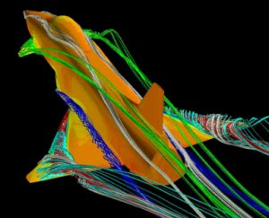
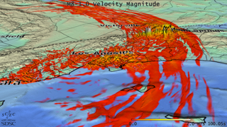
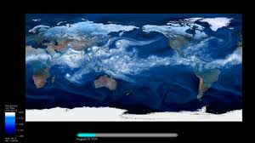
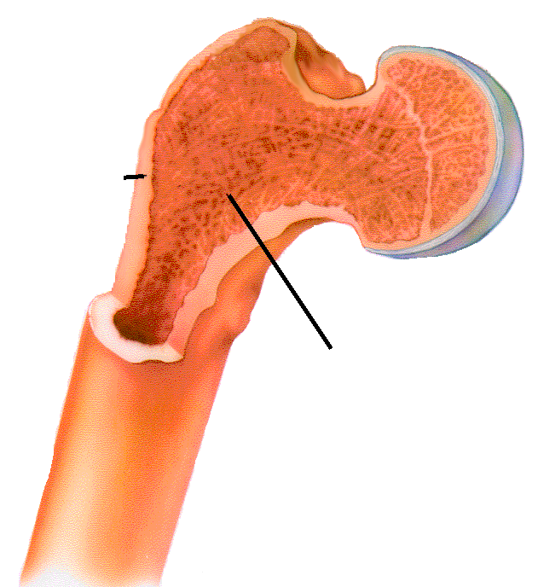
Computational models of the physical world
Cortical bone
Trabecular bone

Slide 5

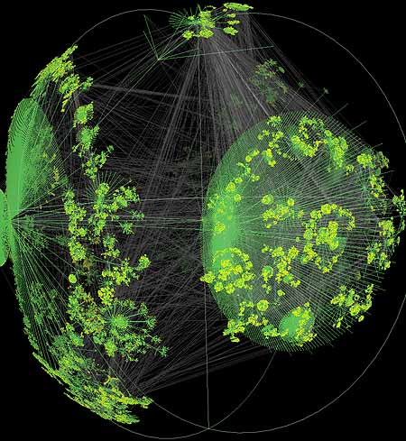
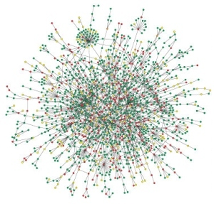

Large graphs are everywhere…
Internet structure
Social interactions
Scientific datasets: biological, chemical, cosmological, ecological, …
WWW snapshot, courtesy Y. Hyun
Yeast protein interaction network, courtesy H. Jeong
Notes:
Details on the types of computations here -> Pagerank (web), betweenness centrality (biological)
Both are huge, sparse graphs

Slide 6
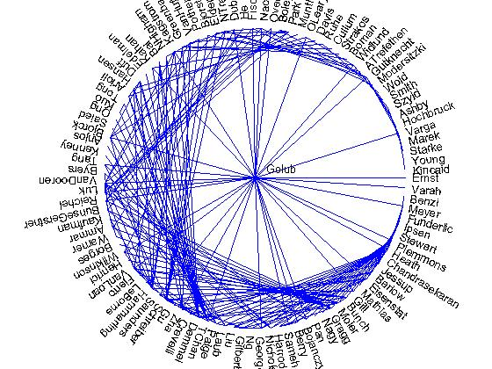
Social network analysis (1993)
Co-author graph
from 1993
Householder
symposium

Slide 7
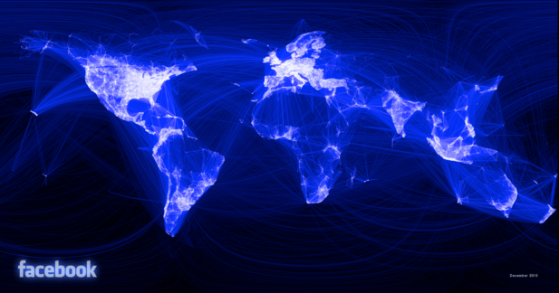
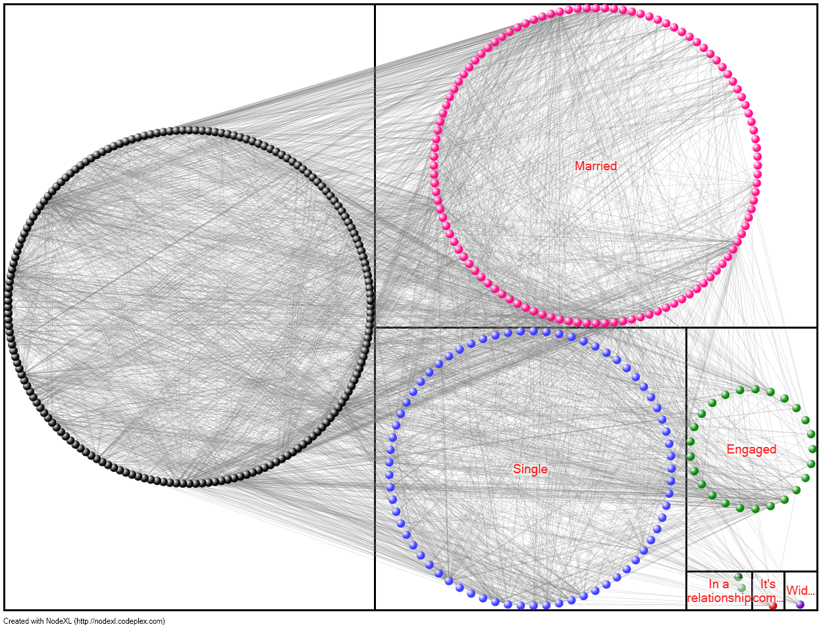
Social network analysis (2014)
Facebook graph:
> 1,000,000,000 vertices

Slide 8
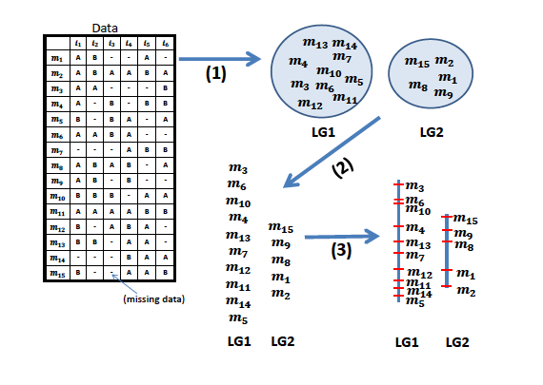
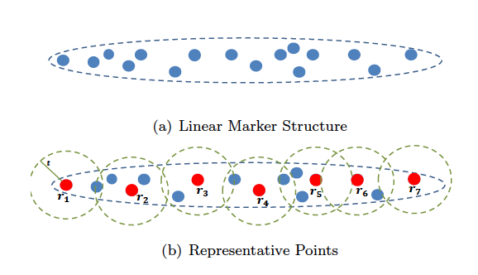
Large-scale genomic mapping and sequencing
[Strnadova, Buluc, Chapman, G, Gonzalez, Jegelska,
Rokhsar, Oliker 2014]
  Problem: scale to millions of markers times thousands of individuals, with “unknown” rates > 50%
  Tools used or desired: spanning trees, approximate TSP, incremental connected components, spectral and custom clustering, k-nearest neighbors
  Results: using more data gives better genomic maps

Slide 9
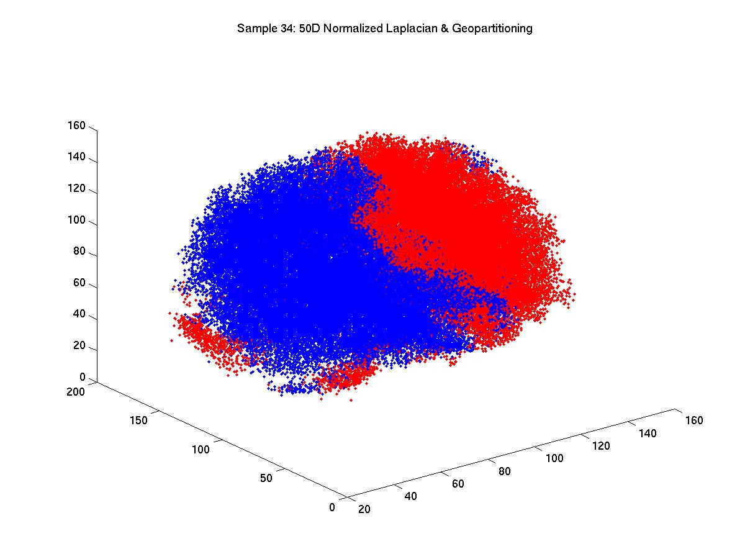
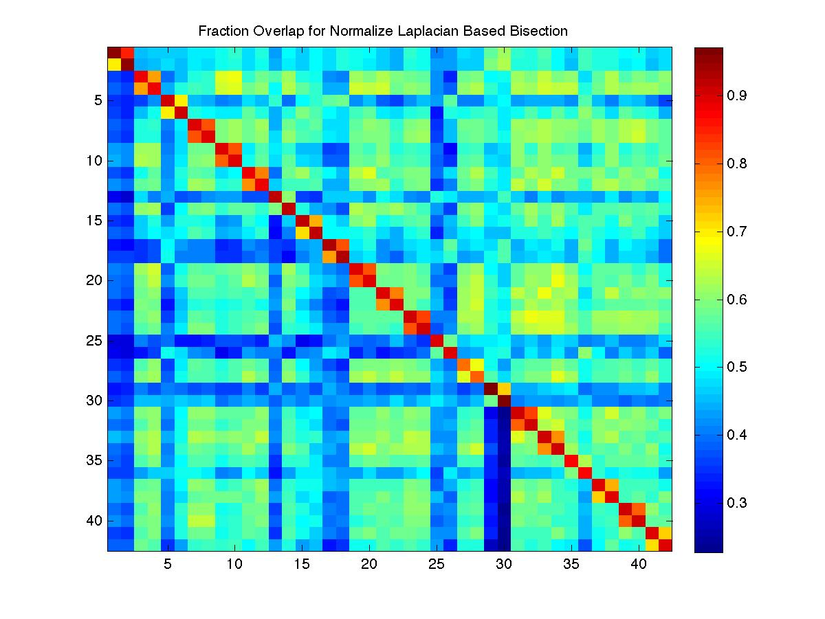
  Alignment and matching of brain scans
  [Conroy, G, Kratzer, Lyzinski, Priebe, Vogelstein 2014]
  Problem: match functional regions across individuals
  Tools: Laplacian eigenvectors, geometric spectral partitioning, clustering, and more. . .

Slide 10
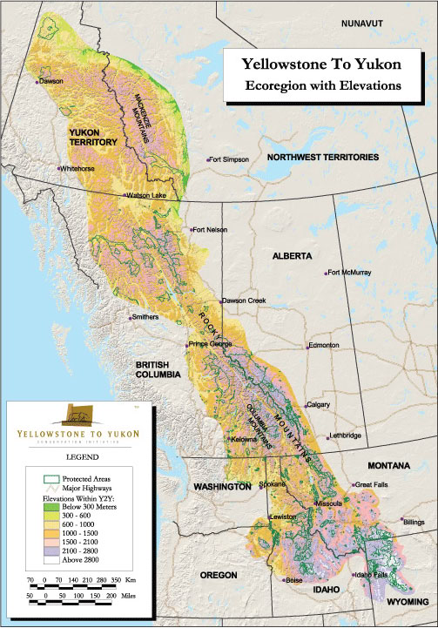
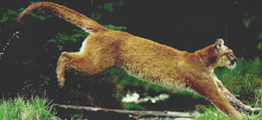
Landscape connectivity modeling
[McRae et al.]
Habitat quality, gene flow, corridor identification, conservation planning
Targeting larger problems: Yellowstone-to-Yukon corridor
Tools: Graph contraction, connected components,
Laplacian linear systems
Figures courtesy of Brad McRae, NCEAS

Slide 11
  Combinatorial acceleration of Laplacian solvers
  [Boman, Deweese, G 2014]
  (B^{-1/2} A B^{-1/2}) (B^{1/2} x) = B^{-1/2} b
  Problem: approximate target graph by sparse subgraph
  Ax = b in nearly linear time in theory [ST08, KMP10, KOSZ13]
  Tools: spanning trees, subgraph extraction and contraction, breadth-first search, shortest paths, . . .

Slide 12
The middleware challenge for graph analysis
Continuous
physical modeling
Discrete
structure analysis
Linear algebra
Graph theory
Computers
Computers

Slide 13
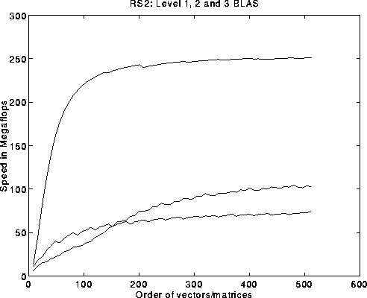
The middleware challenge for graph analysis
By analogy to numerical
scientific computing. . .
What should the combinatorial BLAS look like?
Basic Linear Algebra Subroutines (BLAS):
Ops/Sec vs. Matrix Size
C = A*B
y = A*x
μ = x^{T} y

Slide 14
Identification of Primitives
Sparse array primitives for graph manipulation
Sparse matrix-matrix
multiplication (SpGEMM)
Element-wise operations
Sparse matrix-dense vector multiplication
  Sparse matrix indexing
×
×
.*
Matrices over various semirings: (+ . x), (min . +), (or . and), …

Slide 15
Multiple-source breadth-first search
1
2
4
7
5
3
6
A^{T}
X

Slide 16
Multiple-source breadth-first search
1
2
→
4
5
7
3
6
A^{T}
X
A^{T}X
Sparse array representation => space efficient
Sparse matrix-matrix multiplication => work efficient
Three possible levels of parallelism: searches, vertices, edges
Notes:
What we do here is parallelism on the edge level, 2D partitioning is actually edge partitioning.

Slide 17
Examples of semirings in graph algorithms
( edge/vertex attributes, vertex data aggregation, edge data processing ) | Schema for user-specified computation at vertices and edges
Real field: (R, +, *) | Numerical linear algebra
Boolean algebra: ({0 1}, |, &) | Graph traversal
Tropical semiring: (R U {∞}, min, +) | Shortest paths
(S, select, select) | Select subgraph, or contract nodes to form quotient graph

Slide 18
Graph contraction via sparse triple product
A1
1
2
Contract
A1
6
A3
A2
4
A2
A3
5
3
1
2
3
4
5
6
1
2
3
4
5
6
1
1
1
0
0
0
0
1
1
1
0
0
0
1
0
1
0
x
x
1
0
1
=
2
2
3
0
0
0
1
0
1
3
0
1
0
4
1
1
1
1
5
0
0
1
6
Notes:
All with sparse matrix triples products

Slide 19
Subgraph extraction via sparse triple product
1
2
Extract
3
6
2
4
1
5
3
1
2
3
4
5
6
1
2
3
4
5
6
1
1
1
1
0
0
0
1
1
1
0
0
0
1
1
1
0
x
x
1
0
1
=
2
2
3
0
0
0
1
0
1
3
1
1
0
4
1
1
1
1
5
0
0
1
6
Notes:
More with sparse matrix triples products: Vertex relabeling, batch graph updates, etc.

Slide 20
Counting triangles (clustering coefficient)
A
Clustering coefficient:
Pr (wedge i-j-k makes a triangle with edge i-k)
3 * # triangles / # wedges
3 * 4 / 19 = 0.63 in example
may want to compute for each vertex j
3
5
4
6
1
2
Notes:
More with sparse matrix triples products: Vertex relabeling, batch graph updates, etc.

Slide 21
Counting triangles (clustering coefficient)
A
Clustering coefficient:
Pr (wedge i-j-k makes a triangle with edge i-k)
3 * # triangles / # wedges
3 * 4 / 19 = 0.63 in example
may want to compute for each vertex j
3
5
4
6
1
2
Cohen’s algorithm to count triangles:
  - Count triangles by lowest-degree vertex.
  - Enumerate “low-hinged” wedges.
  - Keep wedges that close.
hi
hi
lo
hi
hi
lo
hi
hi
lo
Notes:
More with sparse matrix triples products: Vertex relabeling, batch graph updates, etc.

Slide 22
Counting triangles (clustering coefficient)
A
B, C
A = L + U (hi->lo + lo->hi)
L × U = B (wedge, low hinge)
A ∧ B = C (closed wedge)
sum(C)/2 = 4 triangles
3
3
1
4
5
4
5
2
1
6
6
1
2
1
2
A
L
U
C
1
1
1
2
1
2
Notes:
More with sparse matrix triples products: Vertex relabeling, batch graph updates, etc.

Slide 23
A few other graph algorithms we’ve implemented in linear algebraic style
Maximal independent set (KDT/SEJITS) [BDFGKLOW 2013]
Peer-pressure clustering (SPARQL) [DGLMR 2013]
Time-dependent shortest paths (CombBLAS) [Ren 2012]
Gaussian belief propagation (KDT) [LABGRTW 2011]
Markoff clustering (CombBLAS, KDT) [BG 2011, LABGRTW 2011]
Betweenness centrality (CombBLAS) [BG 2011]
Hybrid BFS/bully connected components (CombBLAS) [Konolige, in progress]
Geometric mesh partitioning (Matlab ☺) [GMT 1998]

Slide 24
Graph algorithms in the language of linear algebra
Kepner et al. study [2006]: fundamental graph algorithms including min spanning tree, shortest paths, independent set, max flow, clustering, …
SSCA#2 / centrality [2008]
Basic breadth-first search / Graph500 [2010]
Beamer et al. [2013] direction-optimizing breadth-first search, implemented in CombBLAS

Slide 25
Combinatorial BLAS
http://gauss.cs.ucsb.edu/~aydin/CombBLAS
An extensible distributed-memory library offering a small but powerful set of linear algebraic operations specifically targeting graph analytics.
Aimed at graph algorithm designers/programmers who are not expert in mapping algorithms to parallel hardware.
Flexible templated C++ interface.
Scalable performance from laptop to 100,000-processor HPC.
Open source software.
Version 1.4.0 released January 2014.

Slide 26
Combinatorial BLAS in distributed memory
Combinatorial BLAS
functions and operators
DistMat
CommGrid
FullyDistVec
... HAS A
Polymorphism
DenseDistMat
SpDistMat
SpMat
SpDistVec
DenseDistVec
Enforces interface only
DCSC
CSC
Triples
CSB
Notes:
Naming might be in flux (e.g., SpDistMat is currently SpParMat and there are two distributed vectors) but will stabilize.
Highly templated C++
Operations on arbitrary semirings.
Extendible architecture (e.g., CommGrid handles communication, currently: perfect square, future: arbitrary rectangular grids)

Slide 27
2D Layout for Sparse Matrices & Vectors
Matrix/vector distributions,
interleaved on each other.
Default distribution in Combinatorial BLAS.
Scalable with increasing number of processes
5
8
- 2D matrix layout wins over 1D with large core counts
and with limited bandwidth/compute
- 2D vector layout sometimes important for load balance

Slide 28
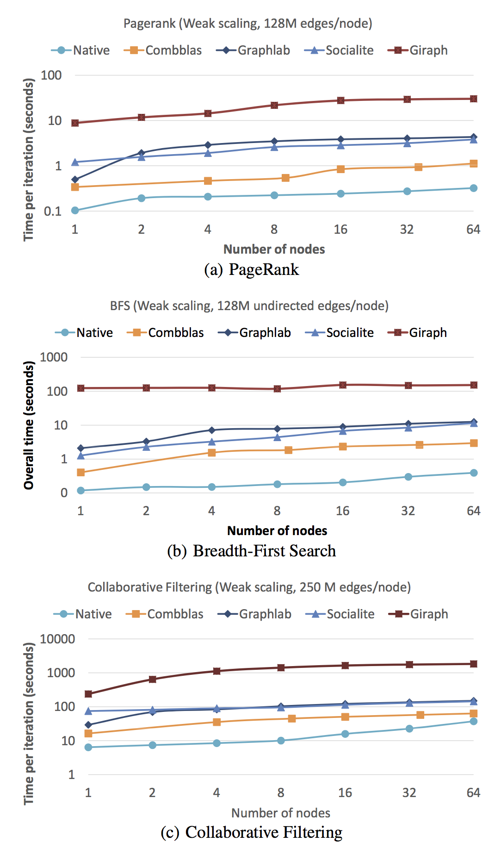
Benchmarking graph analytics frameworks
Satish et al., Navigating the Maze of Graph Analytics Frameworks Using Massive Graph Datasets, SIGMOD 2014.
Combinatorial BLAS was fastest of all tested graph processing frameworks on 3 out of 4 benchmarks.
Notes:
(the fourth one is an API limitation to be fixed)

Slide 29
Combinatorial BLAS “users” (Sep 2014)
IBM (T.J.Watson, Zurich, & Tokyo)
Intel
Cray
Microsoft
Stanford
UC Berkeley
Carnegie-Mellon
Georgia Tech
Ohio State
U Texas Austin
Columbia
U Minnesota
NC State
UC San Diego
Sandia Labs
SEI
Paradigm4
IHPC (Singapore)
King Fahd U (Saudi Arabia)
Tokyo Inst of Technology
Chinese Academy of Sciences
U Ghent (Belgium)
Bilkent U (Turkey)
U Canterbury (New Zealand)
Purdue
Indiana U
UC Merced
Mississippi State

Slide 30
QuadMat shared-memory data structure
[Lugowski, G]
subdivide by dimension
on power of 2 indices
m rows
Blocks store enough matrix elements for meaningful computation; denser parts of matrix have more blocks.
n columns

Slide 31
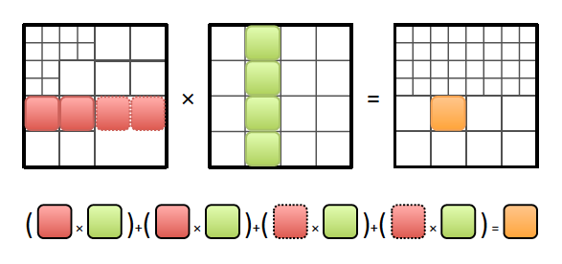
Pair-List QuadMat SpGEMM algorithm
Problem: Natural recursive matrix multiplication is inefficient due to deep tree of sparse matrix additions.
Solution: Rearrange into block inner product pair lists.
A single matrix element can participate in pair lists with different block sizes.
Symbolic phase followed by computational phase
Multithreaded implementation in Intel TBB

Slide 32
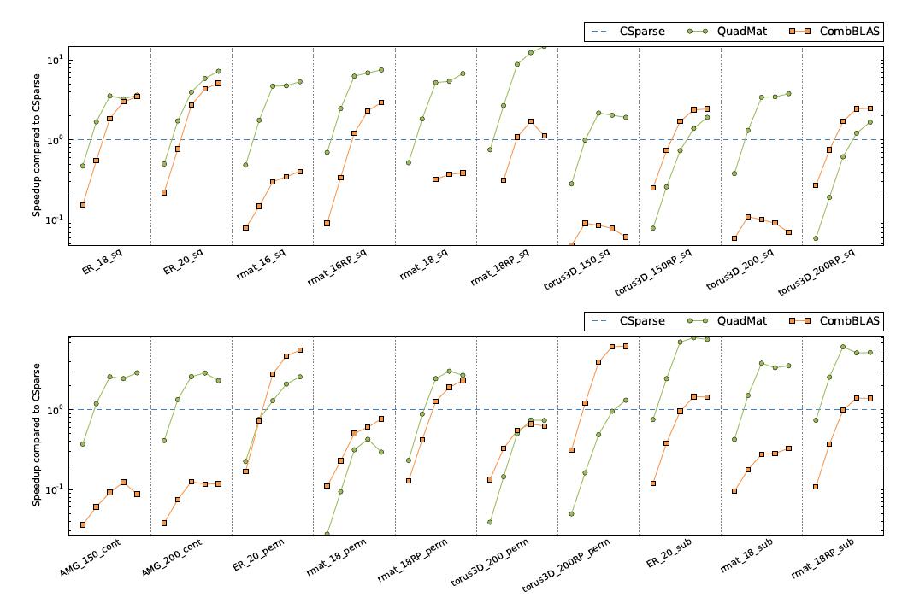
QuadMat compared to Csparse & CombBLAS

Slide 33
Knowledge
Discovery
Toolbox
http://kdt.sourceforge.net/
A general graph library with operations based on linear algebraic primitives
Aimed at domain experts who know their problem well but don’t know how to program a supercomputer
Easy-to-use Python interface
Runs on a laptop as well as a cluster with 10,000 processors
Open source software (New BSD license)

Slide 34
Attributed semantic graphs and filters
def onlyEngineers (self):
return self.position == Engineer
def timedEmail (self, sTime, eTime):
return ((self.type == email) and
(self.Time > sTime) and
(self.Time < eTime))
G.addVFilter(onlyEngineers)
G.addEFilter(timedEmail(start, end))
# rank via centrality based on recent
email transactions among engineers
bc = G.rank(’approxBC’)
Example:
Vertex types: Person, Phone, Camera, Gene, Pathway
Edge types: PhoneCall, TextMessage, CoLocation, SequenceSimilarity
Edge attributes: Time, Duration
Calculate centrality just for emails among engineers sent between given start and end times

Slide 35
SEJITS for filter/semiring acceleration
Embedded DSL: Python for the whole application
Introspect, translate Python to equivalent C++ code
Call compiled/optimized C++ instead of Python

Slide 36
Filtered BFS with SEJITS
Time (in seconds) for a single BFS iteration on scale 25 RMAT (33M vertices, 500M edges) with 10% of elements passing filter. Machine is NERSC’s Hopper.

Slide 37
The (original) BLAS
The Basic Linear Algebra Subroutines
had a revolutionary impact
on computational linear algebra.
BLAS 1 | vector ops | Lawson, Hanson, Kincaid, Krogh, 1979 | LINPACK
BLAS 2 | matrix-vector ops | Dongarra, Du Croz, Hammarling, Hanson, 1988 | LINPACK on vector machines
BLAS 3 | matrix-matrix ops | Dongarra, Du Croz, Hammarling, Hanson, 1990 | LAPACK on cache based machines
Experts in mapping algorithms to hardware tune BLAS for specific platforms.
Experts in numerical linear algebra build software on top of the BLAS to get
high performance “for free.”
Today every computer, phone, etc. comes with /usr/lib/libblas

Slide 38
Can we standardize a “Graph BLAS”?
No, it’s not reasonable to define a universal set of building blocks.
  Huge diversity in matching graph algorithms to hardware platforms.
  No consensus on data structures or linguistic primitives.
  Lots of graph algorithms remain to be discovered.
  Early standardization can inhibit innovation.
Yes, it is reasonable to define a common set of building blocks…
… for graphs as linear algebra.
  Representing graphs in the language of linear algebra is a mature field.
  Algorithms, high level interfaces, and implementations vary.
  But the core primitives are well established.

Slide 39
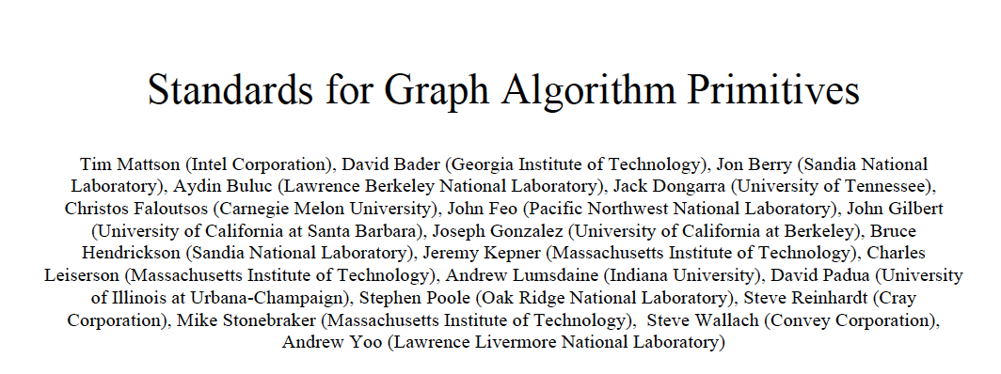
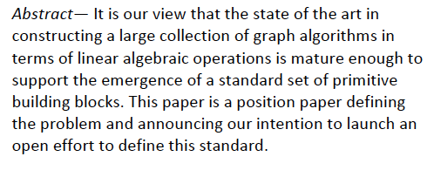
Graph BLAS Forum: http://istc-bigdata.org/GraphBlas/

Slide 40
Matrix times matrix over semiring
Inputs
matrix A: S^{MxN} (sparse or dense)
matrix B: S^{NxL} (sparse or dense)
Optional Inputs
matrix C: S^{MxL} (sparse or dense)
scalar “add” function ⊕
scalar “multiply” function ⊗
transpose flags for A, B, C
Outputs
matrix C: S^{MxL} (sparse or dense)
Implements C ⊕= A ⊕.⊗ B
for j = 1 : N
C(i,k) = C(i,k) ⊕ (A(i,j) ⊗ B(j,k))
If input C is omitted, implements
C = A ⊕.⊗ B
Transpose flags specify operation
on A^{T}, B^{T}, and/or C^{T} instead
Notes
S is the set of scalars, user-specified
S defaults to IEEE double float
⊕ defaults to floating-point +
⊗ defaults to floating-point *
Specific cases and function names:
SpGEMM: sparse matrix times sparse matrix
SpMSpV: sparse matrix times sparse vector
SpMV: Sparse matrix times dense vector
SpMM: Sparse matrix times dense matrix

Slide 41
Conclusion
Matrix computation is beginning to repay a 50-year debt to graph algorithms.
Graphs in the language of linear algebra are sufficiently mature to support a standard set of BLAS.
It helps to look at things from two directions.

