Slide 1
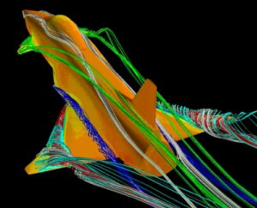
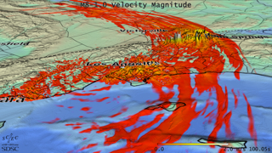

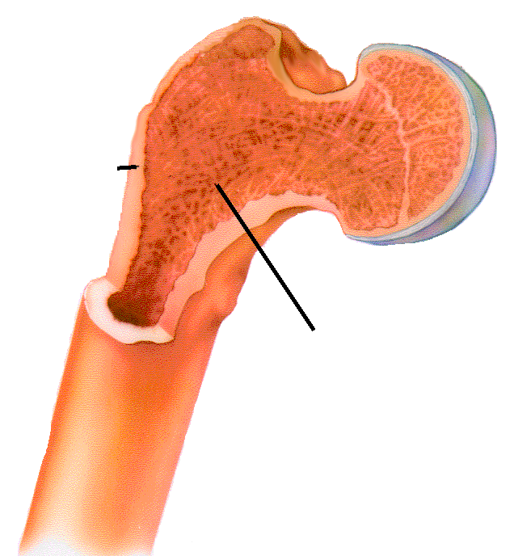
Computational models of the physical world
Cortical bone
Trabecular bone

Slide 2
“The unreasonable effectiveness of mathematics”
As the “middleware”
of scientific computing,
linear algebra has supplied
or enabled:
Mathematical tools
“Impedance match” to
computer operations
High-level primitives
High-quality software libraries
Ways to extract performance
from computer architecture
Interactive environments
Continuous
physical modeling
Linear algebra
Computers

Slide 3
Top 500 List (November 2014)
Top500 Benchmark:
Solve a large system
of linear equations
by Gaussian elimination
P
A
U
=
L
x

Slide 4
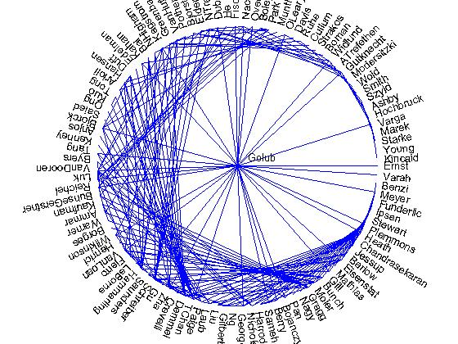
Social network analysis (1993)
Co-author graph
from 1993
Householder
symposium

Slide 5

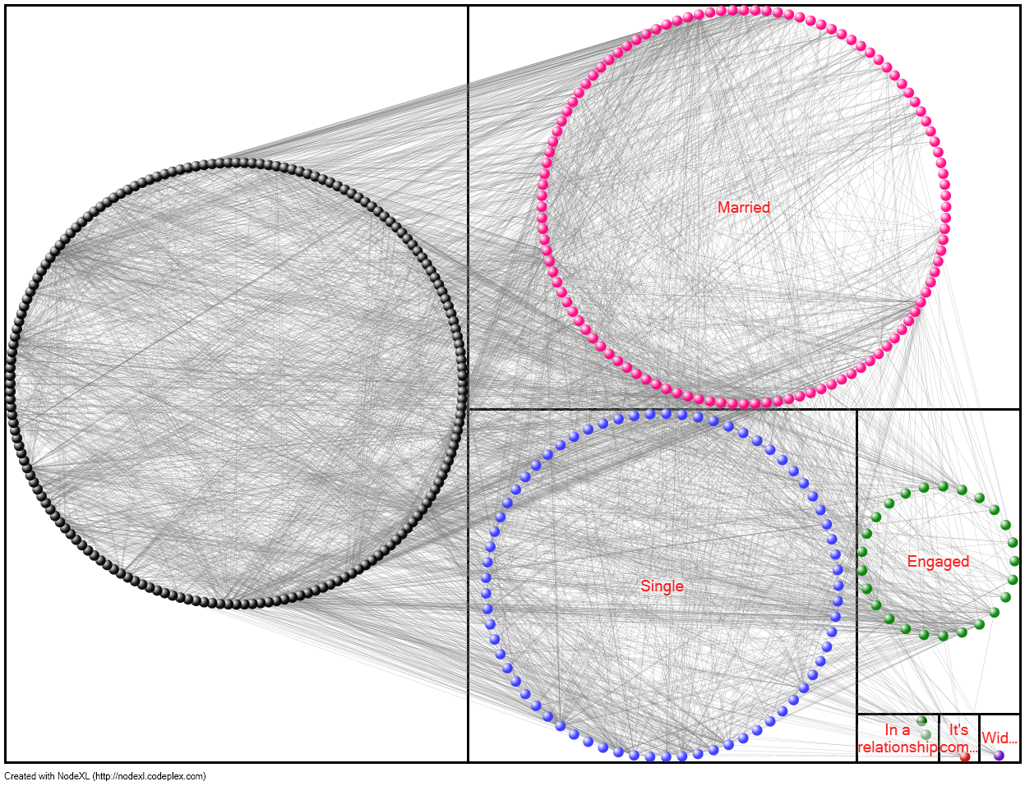
Social network analysis (2015)
Facebook graph:
> 1,000,000,000 vertices

Slide 6
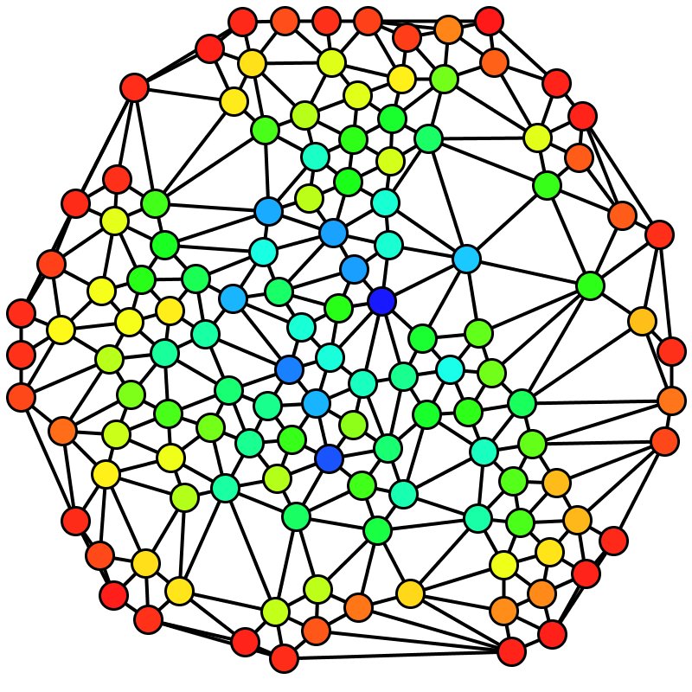
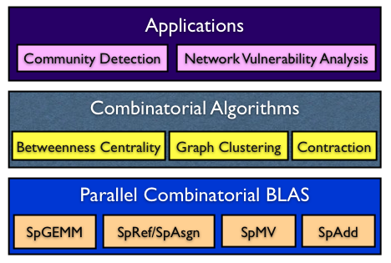


Social network analysis
Betweenness Centrality (BC)
C_{B}(v): Among all the shortest paths, what fraction of them pass through the node of interest?
A typical software stack for an application enabled with the Combinatorial BLAS
Brandes’ algorithm
Notes:
Why betweenness centrality?
It has a lot of applications in identifying important vertices
It’s a standard graph benchmark to compare implementations.

Slide 7
An analogy?
Continuous
physical modeling
Discrete
structure analysis
Linear algebra
Graph theory
Computers
Computers

Slide 8

Graph 500 List (November 2014)
Graph500 Benchmark:
Breadth-first search
in a large
power-law graph
1
2
4
7
5
3
6

Slide 9
Floating-Point vs. Graphs, November 2014
34 Petaflops
24 Terateps
U
1
2
P
A
=
L
x
4
7
5
3
6
34 Peta / 24 Tera is about 1,400

Slide 10
Floating-Point vs. Graphs, November 2014
34 Petaflops
24 Terateps
U
1
2
P
A
=
L
x
4
7
5
3
6
Nov 2014: 34 Peta / 24 Tera ~ 1,400
Nov 2010: 2.5 Peta / 6.6 Giga ~ 380,000

Slide 11
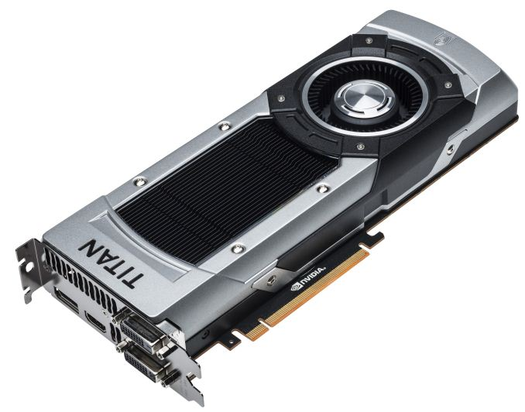
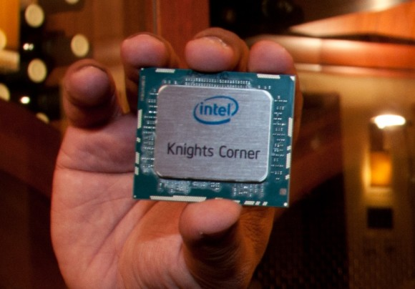
Parallel Computers Today
Oak Ridge / Cray Titan
17.6 PFLOPS
61-processor
Intel Xeon Phi:
1.0 TFLOPS
Nvidia
GK110 GPU:
1.7 TFLOPS
TFLOPS = 10¹² floating point ops/sec
PFLOPS = 1,000,000,000,000,000 / sec

Slide 12
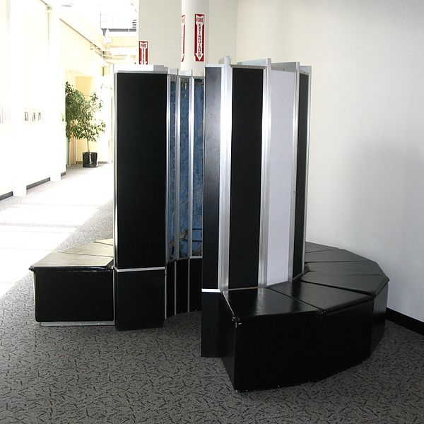
Supercomputers 1976: Cray-1, 133 MFLOPS (10⁶)

Slide 13
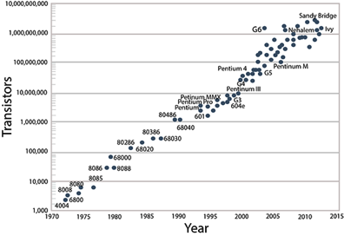
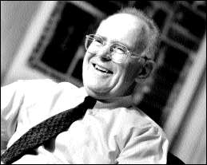
Technology Trends: Microprocessor Capacity
Gordon Moore (Intel co-founder) predicted in 1965 that the transistor density of semiconductor chips would double roughly every 18 months.
Moore’s Law: # transistors / chip doubles every 1.5 years
Microprocessors keep getting smaller, denser, and more powerful.

Slide 14
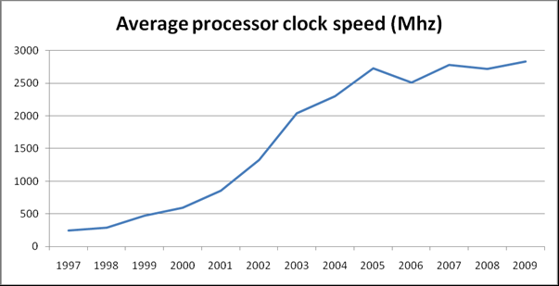
Trends in processor clock speed
Triton’s clockspeed is still only 2600 Mhz in 2015!

Slide 15
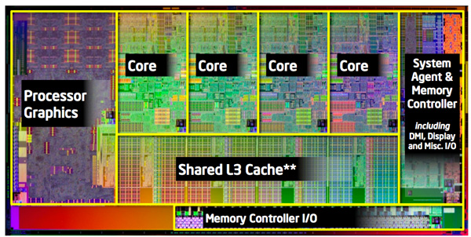
4-core Intel Sandy Bridge
(Triton uses an 8-core version)
2600 Mhz clock speed

Slide 16
Generic Parallel Machine Architecture
Storage
Hierarchy
Proc
Proc
Proc
Cache
Cache
Cache
L2 Cache
L2 Cache
L2 Cache
L3 Cache
L3 Cache
L3 Cache
potential
interconnects
Memory
Memory
Memory
Key architecture question: Where and how fast are the interconnects?
Key algorithm question: Where is the data?

Slide 17
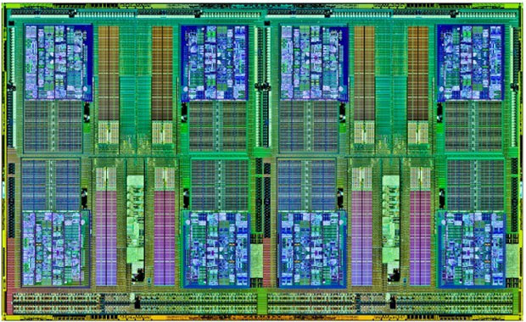
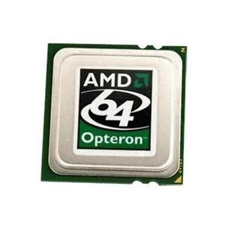
Triton memory hierarchy: I (Chip level)
(AMD Opteron 8-core Magny-Cours, similar to Triton’s Intel Sandy Bridge)
Proc
Proc
Proc
Proc
Proc
Proc
Proc
Proc
Cache
Cache
Cache
Cache
Cache
Cache
Cache
Cache
L2 Cache
L2 Cache
L2 Cache
L2 Cache
L2 Cache
L2 Cache
L2 Cache
L2 Cache
L3 Cache (8MB)
Chip sits in socket, connected to the rest of the node . . .

Slide 18
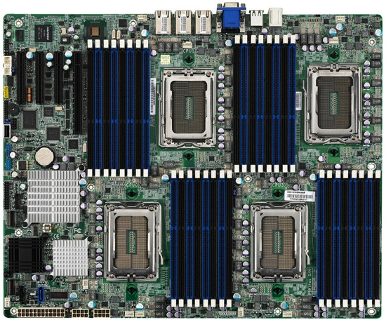
Triton memory hierarchy II (Node level)
Node
P
L1/L2
P
L1/L2
P
L1/L2
P
L1/L2
P
L1/L2
P
L1/L2
P
L1/L2
P
L1/L2
Chip
L3 Cache (8 MB)
P
L1/L2
P
L1/L2
P
L1/L2
P
L1/L2
P
L1/L2
P
L1/L2
P
L1/L2
P
L1/L2
Chip
L3 Cache (8 MB)
P
L1/L2
P
L1/L2
P
L1/L2
P
L1/L2
P
L1/L2
P
L1/L2
P
L1/L2
P
L1/L2
Shared
Node
Memory
(64GB)
Chip
L3 Cache (8 MB)
P
L1/L2
P
L1/L2
P
L1/L2
P
L1/L2
P
L1/L2
P
L1/L2
P
L1/L2
P
L1/L2
Chip
L3 Cache (8 MB)
<- Infiniband interconnect to other nodes ->

Slide 19
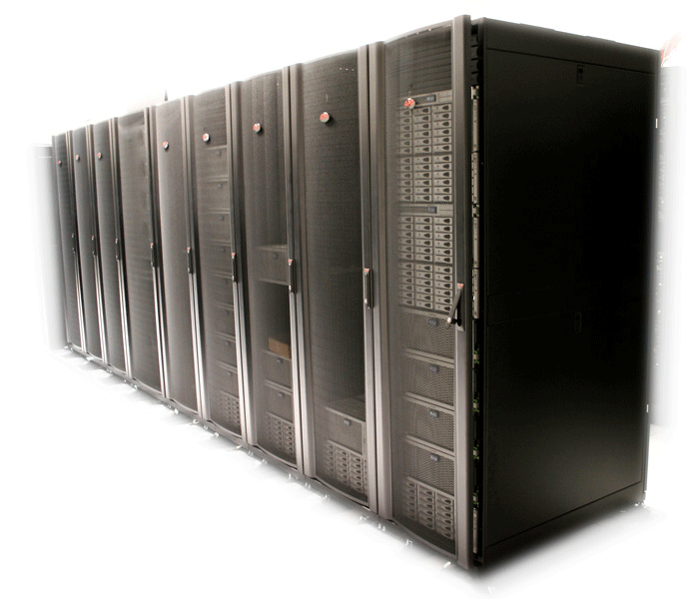
Triton memory hierarchy III (System level)
Node
Node
Node
Node
Node
Node
Node
Node
64GB
64GB
64GB
64GB
64GB
64GB
64GB
64GB
64GB
64GB
64GB
64GB
64GB
64GB
64GB
64GB
Node
Node
Node
Node
Node
Node
Node
Node
324 nodes, message-passing communication, no shared memory

Slide 20
Some models of parallel computation
Computational model
Shared memory
SPMD / Message passing
SIMD / Data parallel
PGAS / Partitioned global
Loosely coupled
Hybrids …
Languages
Cilk, OpenMP, Pthreads …
MPI
Cuda, Matlab, OpenCL, …
UPC, CAF, Titanium
Map/Reduce, Hadoop, …
???

Slide 21
Parallel programming languages
Many have been invented – *much* less consensus on what are the best languages than in the sequential world.
Could have a whole course on them; we’ll look just a few.
Languages you’ll use in homework:
C with MPI (very widely used, very old-fashioned)
Cilk Plus (a newer upstart)
You will choose a language for the final project

Slide 22
Generic Parallel Machine Architecture
Storage
Hierarchy
Proc
Proc
Proc
Cache
Cache
Cache
L2 Cache
L2 Cache
L2 Cache
L3 Cache
L3 Cache
L3 Cache
potential
interconnects
Memory
Memory
Memory
Key architecture question: Where and how fast are the interconnects?
Key algorithm question: Where is the data?

