Slide 1
CS 140: Models of parallel programming: Distributed memory and MPI

Slide 2
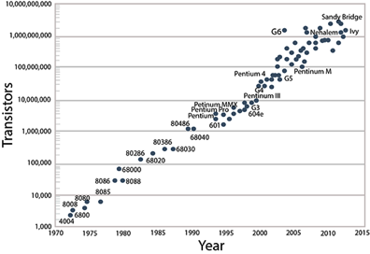
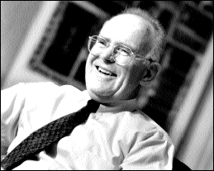
Technology Trends: Microprocessor Capacity
Gordon Moore (Intel co-founder) predicted in 1965 that the transistor density of semiconductor chips would double roughly every 18 months.
Moore’s Law: # transistors / chip doubles every 1.5 years
Microprocessors keep getting smaller, denser, and more powerful.

Slide 3
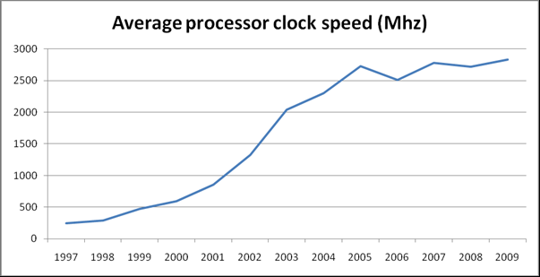
Trends in processor clock speed
Triton’s clockspeed is still only 2600 Mhz in 2015!

Slide 4
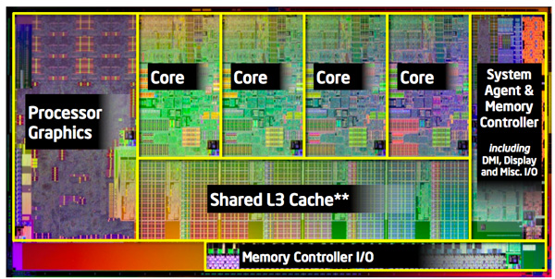
4-core Intel Sandy Bridge (Triton uses an 8-core version)
2600 Mhz clock speed

Slide 5
Generic Parallel Machine Architecture
Storage
Hierarchy
Proc
Proc
Proc
Cache
Cache
Cache
L2 Cache
L2 Cache
L2 Cache
L3 Cache
L3 Cache
L3 Cache
potential
interconnects
Memory
Memory
Memory
Key architecture question: Where and how fast are the interconnects?
Key algorithm question: Where is the data?

Slide 6
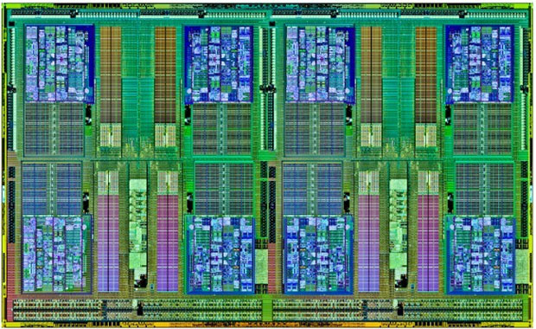
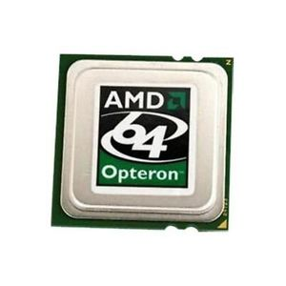
Triton memory hierarchy: I (Chip level)
(AMD Opteron 8-core Magny-Cours, similar to Triton’s Intel Sandy Bridge)
Proc
Proc
Proc
Proc
Proc
Proc
Proc
Proc
Cache
Cache
Cache
Cache
Cache
Cache
Cache
Cache
L2 Cache
L2 Cache
L2 Cache
L2 Cache
L2 Cache
L2 Cache
L2 Cache
L2 Cache
L3 Cache (8MB)
Chip sits in socket, connected to the rest of the node . . .

Slide 7
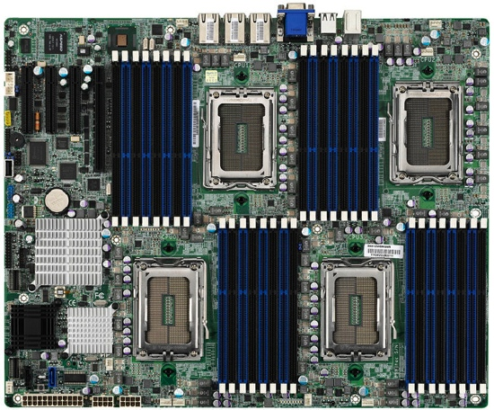
Triton memory hierarchy II (Node level)
Node
P L1/L2
P L1/L2
P L1/L2
P L1/L2
L3 Cache (20 MB)
Chip
P L1/L2
P L1/L2
P L1/L2
P L1/L2
P L1/L2
P L1/L2
P L1/L2
P L1/L2
Shared Node Memory
(64GB)
L3 Cache (20 MB)
Chip
P L1/L2
P L1/L2
P L1/L2
P L1/L2
<- Infiniband interconnect to other nodes ->

Slide 8
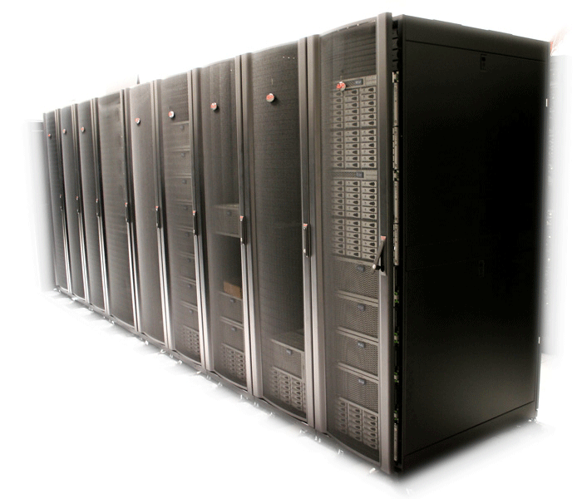
Triton memory hierarchy III (System level)
Node
Node
Node
Node
Node
Node
Node
Node
64GB
64GB
64GB
64GB
64GB
64GB
64GB
64GB
64GB
64GB
64GB
64GB
64GB
64GB
64GB
64GB
Node
Node
Node
Node
Node
Node
Node
Node
324 nodes, message-passing communication, no shared memory

Slide 9
Triton memory hierarchy III (System level)
Node
Node
Node
Node
Node
Node
Node
Node
64GB
64GB
64GB
64GB
64GB
64GB
64GB
64GB
64GB
64GB
64GB
64GB
64GB
64GB
64GB
64GB
Node
Node
Node
Node
Node
Node
Node
Node
324 nodes, message-passing communication, no shared memory

Slide 10
Some models of parallel computation
Computational model
Shared memory
SPMD / Message passing
SIMD / Data parallel
PGAS / Partitioned global
Loosely coupled
Hybrids …
Languages
Cilk, OpenMP, Pthreads …
MPI
Cuda, Matlab, OpenCL, …
UPC, CAF, Titanium
Map/Reduce, Hadoop, …
???

Slide 11
Parallel programming languages
Many have been invented – *much* less consensus on what are the best languages than in the sequential world.
Could have a whole course on them; we’ll look just a few.
Languages you’ll use in homework:
C with MPI (very widely used, very old-fashioned)
Cilk Plus (a newer upstart)
You will choose a language for the final project

Slide 12
Generic Parallel Machine Architecture
Storage
Hierarchy
Proc
Proc
Proc
Cache
Cache
Cache
L2 Cache
L2 Cache
L2 Cache
L3 Cache
L3 Cache
L3 Cache
potential
interconnects
Memory
Memory
Memory
Key architecture question: Where and how fast are the interconnects?
Key algorithm question: Where is the data?

Slide 13
Message-passing programming model
P0
NI
P1
NI
Pn
NI
memory
memory
memory
. . .
interconnect
Architecture: Each processor has its own memory and cache but cannot directly access another processor’s memory.
Language: MPI (“Message-Passing Interface”)
A least common denominator based on 1980s technology
Links to documentation on course home page
SPMD = “Single Program, Multiple Data”

Slide 14
Hello, world in MPI
#include <stdio.h>
#include "mpi.h"
int main( int argc, char *argv[])
{
int rank, size;
MPI_Init( &argc, &argv );
MPI_Comm_size( MPI_COMM_WORLD, &size );
MPI_Comm_rank( MPI_COMM_WORLD, &rank );
printf( "Hello world from process %d of %d\n", rank, size );
MPI_Finalize();
return 0;
}

Slide 15
MPI in nine routines (all you really need)
MPI_Init Initialize
MPI_Finalize Finalize
MPI_Comm_size How many processes?
MPI_Comm_rank Which process am I?
MPI_Wtime Timer
MPI_Send Send data to one proc
MPI_Recv Receive data from one proc
MPI_Bcast Broadcast data to all procs
MPI_Reduce Combine data from all procs

Slide 16
Ten more MPI routines (sometimes useful)
More collective ops (like Bcast and Reduce):
MPI_Alltoall, MPI_Alltoallv
MPI_Scatter, MPI_Gather
Non-blocking send and receive:
MPI_Isend, MPI_Irecv
MPI_Wait, MPI_Test, MPI_Probe, MPI_Iprobe
Synchronization:
MPI_Barrier

Slide 17
Example: Send an integer x from proc 0 to proc 1
MPI_Comm_rank(MPI_COMM_WORLD,&myrank); /* get rank */
int msgtag = 1;
if (myrank == 0) {
int x = 17;
MPI_Send(&x, 1, MPI_INT, 1, msgtag, MPI_COMM_WORLD);
} else if (myrank == 1) {
int x;
MPI_Recv(&x, 1, MPI_INT,0,msgtag,MPI_COMM_WORLD,&status);
}

Slide 18
Some MPI Concepts
Communicator
A set of processes that are allowed to communicate among themselves.
Kind of like a “radio channel”.
Default communicator: MPI_COMM_WORLD
A library can use its own communicator, separated from that of a user program.

Slide 19
Some MPI Concepts
Data Type
What kind of data is being sent/recvd?
Mostly just names for C data types
MPI_INT, MPI_CHAR, MPI_DOUBLE, etc.

Slide 20
Some MPI Concepts
Message Tag
Arbitrary (integer) label for a message
Tag of Send must match tag of Recv
Useful for error checking & debugging

Slide 21
Parameters of blocking send
MPI_Send(buf, count, datatype, dest, tag, comm)
Address of
Datatype of
Message tag
send b
uff
er
each item
Number of items
Rank of destination
Comm
unicator
to send
process

Slide 22
Parameters of blocking receive
MPI_Recv(buf, count, datatype, src, tag, comm, status)
Address of
Message tag
Status
receiv
e b
uff
er
Datatype of
after oper
ation
each item
Maxim
um n
umber
Rank of source
Comm
unicator
of items to receiv
e
process

Slide 23
Example: Send an integer x from proc 0 to proc 1
MPI_Comm_rank(MPI_COMM_WORLD,&myrank); /* get rank */
int msgtag = 1;
if (myrank == 0) {
int x = 17;
MPI_Send(&x, 1, MPI_INT, 1, msgtag, MPI_COMM_WORLD);
} else if (myrank == 1) {
int x;
MPI_Recv(&x, 1, MPI_INT,0,msgtag,MPI_COMM_WORLD,&status);
}

