Slide 1
CS 140 : Feb 2, 2015
Multicore (and Shared Memory) Programming with Cilk Plus
Multicore and shared memory
Cilk Plus and the divide & conquer paradigm
Data races
Analyzing performance in Cilk Plus
Thanks to Charles E. Leiserson for some of these slides

Slide 2
Multicore Architecture
Memory
I/O
Network
…
$
$
$
core
core
core
Chip Multiprocessor
Notes:
Multithreaded Programming in Cilk Lecture 1
July 13, 2006
2

Slide 3
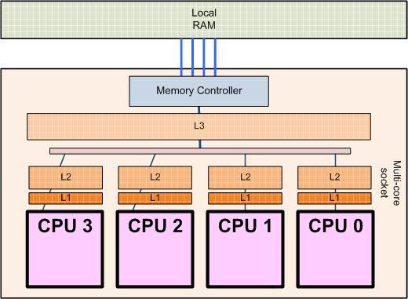
Desktop Multicores Today
This is your AMD Shangai or Intel Core i7 (Nehalem) !
On-chip interconnect
Private cache: Cache coherence is required

Slide 4

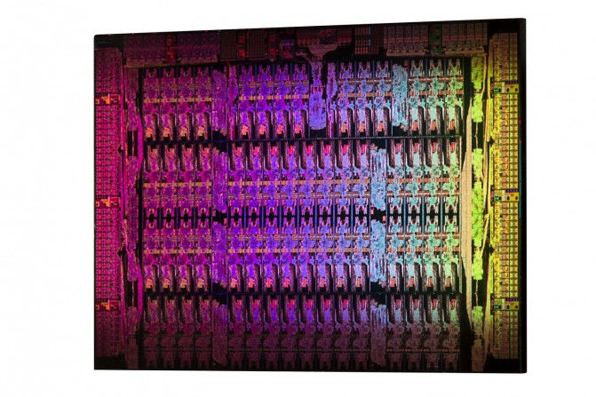
62-core Xeon Phi chip

Slide 5
Cilk (Plus)
Cilk Plus is a faithful extension of C++
Programs use the divide-and-conquer paradigm. Two hints to the compiler:
  cilk_spawn: this function can run in parallel with its caller.
  cilk_sync: all spawned children must return before execution passes this point.
Third hint for convenience only (compiler converts it to cilk_spawn and cilk_sync)
  cilk_for: loop iterations can run in parallel.
Cilk also has reducers to avoid data races in global variables.

Slide 6
History (and names) of Cilk
MIT Cilk: 1994 – 2006
  Cilk started as a research project at MIT…
Cilk Arts Cilk++: 2006 – 2009
  Then Leiserson & co. built a commercial compiler…
Intel Cilk++: 2009 - 2010
  … then Intel bought Cilk++ from Cilk Arts …
Intel Cilk Plus: 2010 – now
  … and made it part of “Intel Parallel Building Blocks”
  Cilk Plus is also a branch of gcc++ now.
Intel Cilk Plus is the one you are using on Triton!
  There are also free downloads of old Cilk++ around.

Slide 7
QUICKSORT
13
45
14
56
34
32
31
21
78
Partition around Pivot
13
31
21
56
34
45
14
32
78

Slide 8
QUICKSORT
13
31
21
56
34
45
14
32
78
Quicksort recursively
13
14
21
31
32
34
45
56
78
13
14
21
31
32
34
45
56
78

Slide 9

Nested Parallelism
Example: Quicksort
template <typename T>
void qsort(T begin, T end) {
if (begin != end) {
T middle = partition(begin, end, …);
cilk_spawn qsort(begin, middle);
qsort(max(begin + 1, middle), end);
cilk_sync;
}
}
Notes:
9

Slide 10
Nested Parallelism
Example: Quicksort
The named child function may execute in parallel with the parent caller.
template <typename T>
void qsort(T begin, T end) {
if (begin != end) {
T middle = partition(begin, end, …);
cilk_spawn qsort(begin, middle);
qsort(max(begin + 1, middle), end);
cilk_sync;
}
}
Control cannot pass this point until all spawned children have returned.
Notes:
10

Slide 11
Cilk Loops
Example: Matrix transpose
cilk_for (int i=1; i<n; ++i) {
cilk_for (int j=0; j<i; ++j) {
B[i][j] = A[j][i];
}
}
A cilk_for loop’s iterations execute in parallel.
Loop index must be declared in the cilk_for( ).
End condition is evaluated just once,
at the beginning of the loop.
Loop increment must be a const value.
No “break” or “return” allowed inside the loop.
Notes:
11

Slide 12


Serial Correctness
The serialization is the code with the Cilk keywords replaced by null or C++ keywords.
int fib (int n) {
if (n<2) return (n);
else {
int x,y;
x = cilk_spawn fib(n-1);
y = fib(n-2);
cilk_sync;
return (x+y);
}
}
Cilk Plus
Compiler
Conventional
Compiler
Cilk source
Linker
int fib (int n) {
if (n<2) return (n);
else {
int x,y;
x = fib(n-1);
y = fib(n-2);
return (x+y);
}
}
Binary
Serialization
Serial correctness can be debugged and verified by running the multithreaded code on a single processor.
Cilk Plus Runtime
Library
Conventional
Regression Tests
Reliable Single-Threaded Code
Notes:
12

Slide 13
Serialization
How to seamlessly switch between serial c++ and parallel cilk plus programs?
Add to the beginning of your program
#ifdef CILKPAR
#include <cilk.h>
#else
#define cilk_for for
#define cilk_main main
#define cilk_spawn
#define cilk_sync
#endif
Compile !
cilk++ -DCILKPAR –O2 –o parallel.exe main.cpp
g++ –O2 –o serial.exe main.cpp

Slide 14
Parallel Correctness
int fib (int n) {
if (n<2) return (n);
else {
int x,y;
x = cilk_spawn fib(n-1);
y = fib(n-2);
cilk_sync;
return (x+y);
}
}
Cilk Plus
Compiler
Conventional
Compiler
Cilk source
Linker
Binary
Cilkscreen
Race Detector
Parallel correctness can be debugged and verified with the Cilkscreen race detector, which guarantees to find inconsistencies with the serial code quickly.
Parallel
Regression Tests
Reliable Multi-Threaded Code
Notes:
14

Slide 15
Race Bugs
Definition. A determinacy race occurs when two logically parallel instructions access the same memory location and at least one of the instructions performs a write.
Example
A
int x = 0;
A
int x = 0;
cilk_for(int i=0, i<2, ++i) {
x++;
}
assert(x == 2);
x++;
x++;
B
C
B
C
D
assert(x == 2);
D
Dependency Graph
Notes:
15

Slide 16
Race Bugs
Definition. A determinacy race occurs when two logically parallel instructions access the same memory location and at least one of the instructions performs a write.
1
x = 0;
A
int x = 0;
2
r1 = x;
4
r2 = x;
x++;
x++;
B
C
3
r1++;
5
r2++;
assert(x == 2);
7
x = r1;
6
x = r2;
D
8
assert(x == 2);
Notes:
16

Slide 17
Types of Races
Suppose that instruction A and instruction B both access a location x, and suppose that A∥B (A is parallel to B).
A | B | Race Type
read | read | none
read | write | read race
write | read | read race
write | write | write race
Two sections of code are independent if they have no determinacy races between them.
Notes:
17

Slide 18
Avoiding Races
All the iterations of a cilk_for should be independent.
Between a cilk_spawn and the corresponding cilk_sync, the code of the spawned child should be independent of the code of the parent, including code executed by additional spawned or called children.
Ex.
cilk_spawn qsort(begin, middle);
qsort(max(begin + 1, middle), end);
cilk_sync;
Note: The arguments to a spawned function are evaluated in the parent before the spawn occurs.
Notes:
18

Slide 19
Cilk Reducers
A reducer is one kind of Cilk hyperobject.
Mostly a solution to global variables, but also broader applications.
int result = 0;
cilk_for (int i = 0; i < N; ++i) {
result += MyFunc(i);
}
Data race !
#include <cilk/reducer_opadd.h>
…
cilk::reducer< cilk::opadd<int> > result;
cilk_for (int i = 0; i < N; ++i) {
result += MyFunc(i);
}
Race free !
This uses one of the predefined reducers, but you can also write your own reducer easily

Slide 20
Cilk analysis tools
Cilkscreen race detector:
  Runs off the executable (compiled specially).
  Reports any possibility of a data race in a particular execution with particular input data.
  Quite a bit slower than real time.
Cilkview scalability analyzer:
  Runs off the executable (compiled specially).
  Reports potential parallelism, burdened parallelism, etc. in theory by counting operations (not by actual clock time); quite a bit slower than real time.
  Compare results to measured clock times to understand the scaling of your code.
Notes:
20

Slide 21
Cilkscreen
Cilkscreen runs off the binary executable:
  Compile your program with the –fcilkscreen option to include debugging information.
  Go to the directory with your executable and execute cilkscreen your_program [options]
  Cilkscreen prints information about any races it detects.
For a given input, Cilkscreen mathematically guarantees to localize a race if there exists a parallel execution that could produce results different from the serial execution.
It runs about 20 times slower than real-time.
Notes:
21

Slide 22
Complexity Measures
T_{P} = execution time on P processors
T₁ = work
T∞ = span*
WORK LAW
  T_{P} ≥T₁/P
  SPAN LAW
  T_{P} ≥ T∞
* Also called critical-path length
or computational depth.
Notes:
Multithreaded Programming in Cilk Lecture 1
July 13, 2006
22

Slide 23
Speedup
Def. T₁/T_{P} = speedup on P processors.
If T₁/T_{P} = Θ(P), we have linear speedup,
= P, we have perfect linear speedup,
> P, we have superlinear speedup,
which is not possible in this performance model, because of the Work Law T_{P} ≥ T₁/P.
Notes:
Multithreaded Programming in Cilk Lecture 1
July 13, 2006
23

Slide 24
(Potential) Parallelism
Because the Span Law dictates that T_{P} ≥ T∞, the maximum possible speedup given T₁ and T∞ is
T₁/T∞ = parallelism
= the average
amount of work
per step along
the span.
Notes:
Multithreaded Programming in Cilk Lecture 1
July 13, 2006
24

Slide 25
Three Tips on Parallelism
Minimize the span to maximize parallelism. Try to generate 10 times more parallelism than processors for near-perfect linear speedup.
If you have plenty of parallelism, try to trade some of it off for reduced work overheads.
Use divide-and-conquer recursion or parallel loops rather than spawning one small thing off after another.
Do this:
cilk_for (int i=0; i<n; ++i) {
foo(i);
}
Not this:
for (int i=0; i<n; ++i) {
cilk_spawn foo(i);
}
cilk_sync;

Slide 26
Three Tips on Overheads
Make sure that work/#spawns is not too small.
  Coarsen by using function calls and inlining near the leaves of recursion rather than spawning.
Parallelize outer loops if you can, not inner loops. If you must parallelize an inner loop, coarsen it, but not too much.
  500 iterations should be plenty coarse for even the most meager loop.
  Fewer iterations should suffice for “fatter” loops.
Use reducers only in sufficiently fat loops.

