Slide 1
Conjugate gradients, sparse matrix-vector multiplication, graphs, and meshes
  Thanks to Aydin Buluc, Umit Catalyurek, Alan Edelman, and Kathy Yelick
  for some of these slides.

Slide 2
The middleware of scientific computing
Continuous
physical modeling
Ax = b
Linear algebra
Computers

Slide 3

Example: The Temperature Problem
A cabin in the snow
Wall temperature is 0°, except for a radiator at 100°
What is the temperature in the interior?

Slide 4
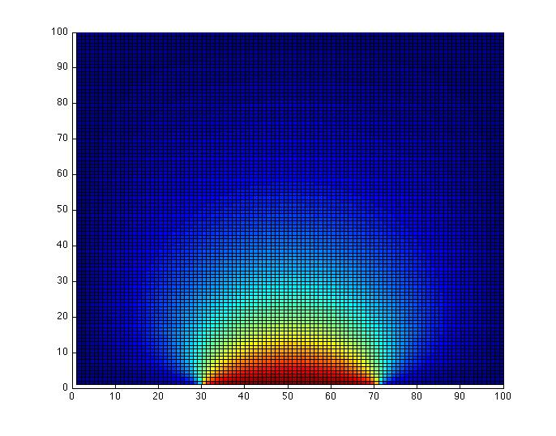
Example: The Temperature Problem
A cabin in the snow (a square region ☺)
Wall temperature is 0°, except for a radiator at 100°
What is the temperature in the interior?

Slide 5
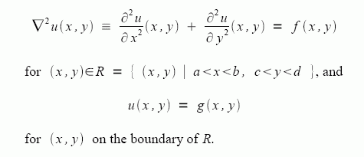
The physics: Poisson’s equation

Slide 6
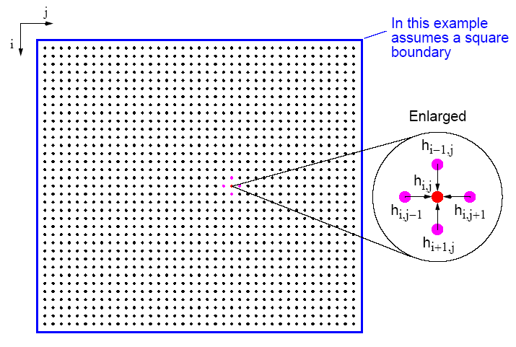
Many Physical Models Use Stencil Computations
  PDE models of heat, fluids, structures, …
  Weather, airplanes, bridges, bones, …
  Game of Life
  many, many others
6.43

Slide 7
Model Problem: Solving Poisson’s equation for temperature
k = n^{1/2}
Discrete approximation to Poisson’s equation:
t(i) = ¼ ( t(i-k) + t(i-1) + t(i+1) + t(i+k) )
Intuitively:
  Temperature at a point is the average
  of the temperatures at surrounding points

Slide 8
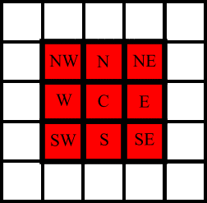
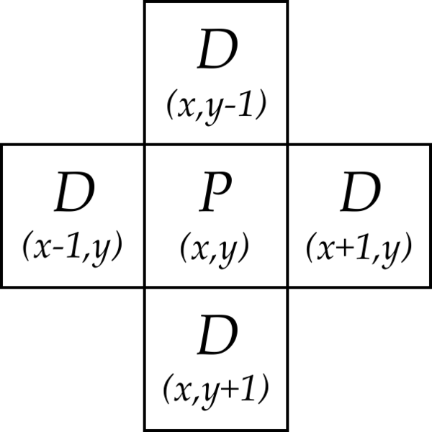
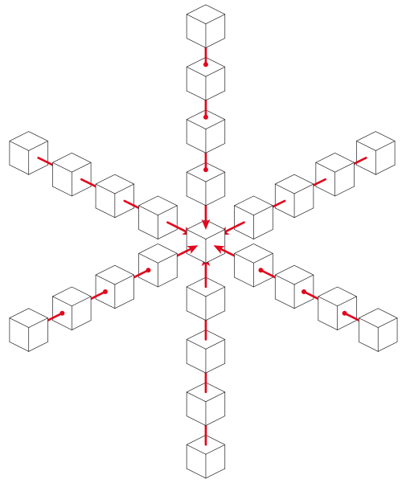
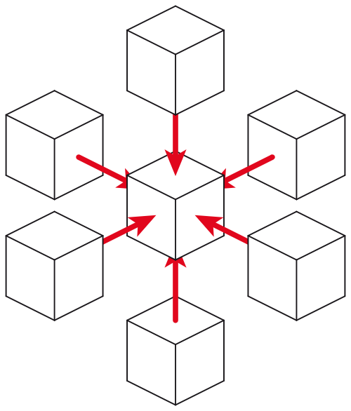
Examples of stencils
9-point stencil in 2D
(game of Life)
5-point stencil in 2D
(temperature problem)
25-point stencil in 3D
(seismic modeling)
7-point stencil in 3D
(3D temperature problem)
… and many more

Slide 9
Parallelizing Stencil Computations
Parallelism is simple
  Grid is a regular data structure
  Even decomposition across processors gives load balance
Spatial locality limits communication cost
  Communicate only boundary values from neighboring patches
Communication volume
  v = total # of boundary cells between patches

Slide 10
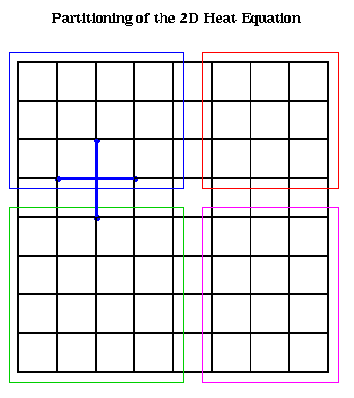
Two-dimensional block decomposition
n mesh cells, p processors
Each processor has a patch of n/p cells
Block row (or block col) layout: v = 2 * p * sqrt(n)
2-dimensional block layout: v = 4 * sqrt(p) * sqrt(n)

Slide 11
Detailed complexity measures for data movement I:
Latency/Bandwidth Model
Moving data between processors by message-passing
Machine parameters:
  α or t_{startup} latency (message startup time in seconds)
  β or t_{data} inverse bandwidth (in seconds per word)
  between nodes of Triton, α ∼ 2.2 × 10⁻⁶ and β ∼ 6.4 × 10⁻⁹
Time to send & recv or bcast a message of w words: α + w*β
t_{comm} total commmunication time
t_{comp} total computation time
Total parallel time: t_{p} = t_{comp} + t_{comm}

Slide 12
Ghost Nodes in Stencil Computations
Comm cost = α * (#messages) + β * (total size of messages)
Keep a ghost copy of neighbors’ boundary nodes
Communicate every second iteration, not every iteration
Reduces #messages, not total size of messages
Costs extra memory and computation
Can also use more than one layer of ghost nodes
Green = my interior nodes
Blue = my boundary nodes
Yellow
= neighbors’ boundary nodes
= my “ghost nodes”

Slide 13
Parallelism in Regular meshes
Computing a Stencil on a regular mesh
  need to communicate mesh points near boundary to neighboring processors.
    Often done with ghost regions
  Surface-to-volume ratio keeps communication down, but
    Still may be problematic in practice
Implemented using “ghost” regions.
Adds memory overhead

Slide 14
Model Problem: Solving Poisson’s equation for temperature
k = n^{1/2}
Discrete approximation to Poisson’s equation:
t(i) = ¼ ( t(i-k) + t(i-1) + t(i+1) + t(i+k) )
Intuitively:
  Temperature at a point is the average
  of the temperatures at surrounding points

Slide 15
Model Problem: Solving Poisson’s equation for temperature
k = n^{1/2}
For each i from 1 to n, except on the boundaries:
– t(i-k) – t(i-1) + 4*t(i) – t(i+1) – t(i+k) = 0
n equations in n unknowns: A*t = b
Each row of A has at most 5 nonzeros
In three dimensions, k = n^{1/3} and each row has at most 7 nzs

Slide 16
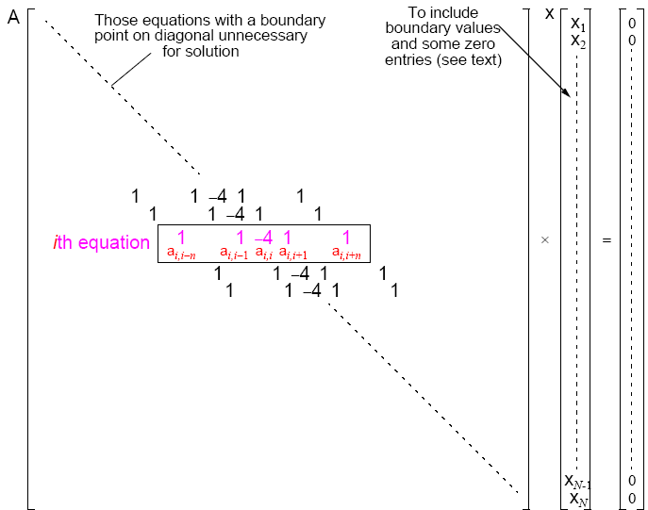
A Stencil Computation Solves a System of Linear Equations
  Solve Ax = b for x
  Matrix A, right-hand side vector b, unknown vector x
  A is sparse: most of the entries are 0

Slide 17
Conjugate gradient iteration to solve A*x=b
x₀ = 0, r₀ = b, d₀ = r₀ (these are all vectors)
for k = 1, 2, 3, . . .
α_{k} = (r^{T}_{k-1}r_{k-1}) / (d^{T}_{k-1}Ad_{k-1}) step length
x_{k} = x_{k-1} + α_{k} d_{k-1} approximate solution
r_{k} = r_{k-1} – α_{k} Ad_{k-1} residual = b - Ax_{k}
β_{k} = (r^{T}_{k} r_{k}) / (r^{T}_{k-1}r_{k-1}) improvement
d_{k} = r_{k} + β_{k} d_{k-1} search direction
One matrix-vector multiplication per iteration
Two vector dot products per iteration
Four n-vectors of working storage

Slide 18
Vector and matrix primitives for CG
DAXPY: v = α*v + β*w (vectors v, w; scalars α, β)
  Broadcast the scalars α and β, then independent * and +
  comm volume = 2p, span = log n
DDOT: α = v^{T}*w = Σ_{j} v[j]*w[j] (vectors v, w; scalar α)
  Independent *, then + reduction
  comm volume = p, span = log n
Matvec: v = A*w (matrix A, vectors v, w)
  The hard part
  But all you need is a subroutine to compute v from w
  Sometimes you don’t need to store A (e.g. temperature problem)
  Usually you do need to store A, but it’s sparse ...

Slide 19
Broadcast and reduction
Broadcast of 1 value to p processors in log p time
Reduction of p values to 1 in log p time
Takes advantage of associativity in +, *, min, max, etc.
α
Broadcast
1 3 1 0 4 -6 3 2
Add-reduction
8

Slide 20
Where’s the data (temperature problem)?
The matrix A: Nowhere!!
The vectors x, b, r, d:
  Each vector is one value per stencil point
  Divide stencil points among processors, n/p points each
How do you divide up the sqrt(n) by sqrt(n) region of points?
Block row (or block col) layout: v = 2 * p * sqrt(n)
2-dimensional block layout: v = 4 * sqrt(p) * sqrt(n)

Slide 21
How do you partition the sqrt(n) by sqrt(n) stencil points?
  First version: number the grid by rows
  Leads to a block row decomposition of the region
  v = 2 * p * sqrt(n)
6.43

Slide 22
How do you partition the sqrt(n) by sqrt(n) stencil points?
  Second version: 2D block decomposition
  Numbering is a little more complicated
  v = 4 * sqrt(p) * sqrt(n)
6.43

Slide 23
Where’s the data (temperature problem)?
The matrix A: Nowhere!!
The vectors x, b, r, d:
  Each vector is one value per stencil point
  Divide stencil points among processors, n/p points each
How do you divide up the sqrt(n) by sqrt(n) region of points?
Block row (or block col) layout: v = 2 * p * sqrt(n)
2-dimensional block layout: v = 4 * sqrt(p) * sqrt(n)

Slide 24
The Landscape of Ax = b Algorithms
Gaussian
elimination
Iterative
More General
Any
matrix
Symmetric
positive
definite
matrix
More Robust
More Robust
Less Storage

Slide 25
Conjugate gradient in general
CG can be used to solve any system Ax = b, if …

Slide 26
Conjugate gradient in general
CG can be used to solve any system Ax = b, if …
The matrix A is symmetric (a_{ij} = a_{ji}) …
… and positive definite (all eigenvalues > 0).

Slide 27
Conjugate gradient in general
CG can be used to solve any system Ax = b, if …
The matrix A is symmetric (a_{ij} = a_{ji}) …
… and positive definite (all eigenvalues > 0).
Symmetric positive definite matrices occur a lot
in scientific computing & data analysis!

Slide 28
Conjugate gradient in general
CG can be used to solve any system Ax = b, if …
The matrix A is symmetric (a_{ij} = a_{ji}) …
… and positive definite (all eigenvalues > 0).
Symmetric positive definite matrices occur a lot
in scientific computing & data analysis!
But usually the matrix isn’t just a stencil.
Now we do need to store the matrix A. Where’s the data?

Slide 29
Conjugate gradient in general
CG can be used to solve any system Ax = b, if …
The matrix A is symmetric (a_{ij} = a_{ji}) …
… and positive definite (all eigenvalues > 0).
Symmetric positive definite matrices occur a lot
in scientific computing & data analysis!
But usually the matrix isn’t just a stencil.
Now we do need to store the matrix A. Where’s the data?
The key is to use graph data structures and algorithms.

Slide 30
Vector and matrix primitives for CG
DAXPY: v = α*v + β*w (vectors v, w; scalars α, β)
  Broadcast the scalars α and β, then independent * and +
  comm volume = 2p, span = log n
DDOT: α = v^{T}*w = Σ_{j} v[j]*w[j] (vectors v, w; scalar α)
  Independent *, then + reduction
  comm volume = p, span = log n
Matvec: v = A*w (matrix A, vectors v, w)
  The hard part
  But all you need is a subroutine to compute v from w
  Sometimes you don’t need to store A (e.g. temperature problem)
  Usually you do need to store A, but it’s sparse ...

Slide 31
Graphs and Sparse Matrices
Sparse matrix is a representation of a (sparse) graph
1 2 3 4 5 6
1 1 1
2 1 1 1
3 1 1 1
4 1 1
5 1 1
6 1 1
3
2
4
1
6
5
Matrix entries are edge weights
Number of nonzeros per row is the vertex degree
Edges represent data dependencies in matrix-vector multiplication

Slide 32
Parallel Dense Matrix-Vector Product (Review)
y = A*x, where A is a dense matrix
Layout:
  1D by rows
Algorithm:
  Foreach processor j
  Broadcast X(j)
  Compute A(p)*x(j)
A(i) is the n by n/p block row that processor Pi owns
Algorithm uses the formula
  Y(i) = A(i)*X = Σ_{j} A(i)*X(j)
P0 P1 P2 P3
x
P0
P1
P2
P3
y

Slide 33
Parallel sparse matrix-vector product
Lay out matrix and vectors by rows
y(i) = sum(A(i,j)*x(j))
Only compute terms with A(i,j) ≠ 0
Algorithm
  Each processor i:
  Broadcast x(i)
  Compute y(i) = A(i,:)*x
Optimizations
  Only send each proc the parts of x it needs, to reduce comm
  Reorder matrix for better locality by graph partitioning
  Worry about balancing number of nonzeros / processor,
  if rows have very different nonzero counts
P0 P1 P2 P3
x
P0
P1
P2
P3
y

Slide 34
Data structure for sparse matrix A (stored by rows)
31 | 53 | 59 | 41 | 26
31 | 0 | 53
0 | 59 | 0
41 | 26 | 0
1 | 3 | 2 | 1 | 2
  Full matrix:
    2-dimensional array of real or complex numbers
    (nrows*ncols) memory
Sparse matrix:
  compressed row storage
  about (2*nzs + nrows) memory

Slide 35
Distributed-memory sparse matrix data structure
P₀
P₁
Each processor stores:
# of local nonzeros
range of local rows
nonzeros in CSR form
P₂
P_{n}

Slide 36
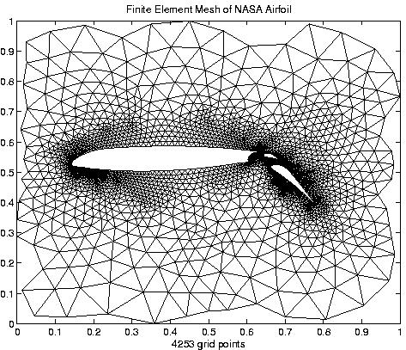
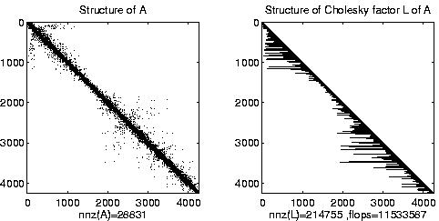
Irregular mesh: NASA Airfoil in 2D

Slide 37
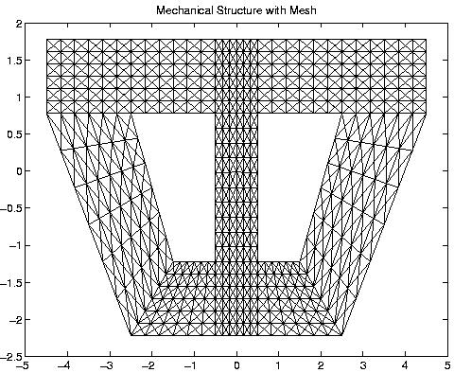
Composite Mesh from a Mechanical Structure

Slide 38
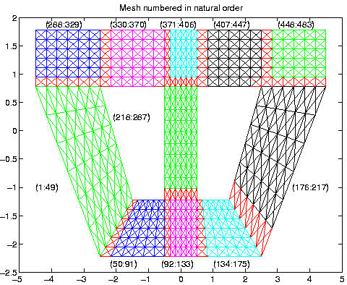
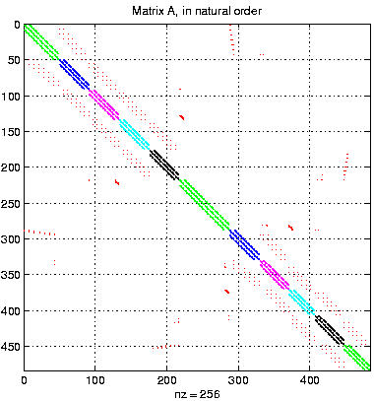
Converting the Mesh to a Matrix

Slide 39
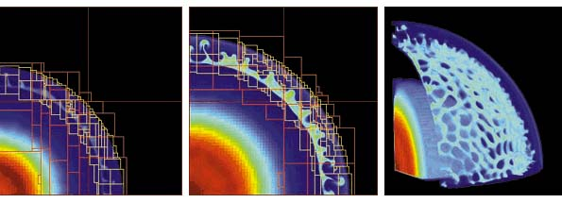
Adaptive Mesh Refinement (AMR)
Adaptive mesh around an explosion
Refinement done by calculating errors

Slide 40
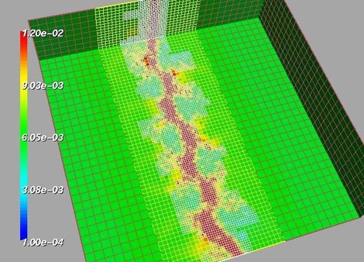
Adaptive Mesh
fluid density
Shock waves in a gas dynamics using AMR (Adaptive Mesh Refinement) See: http://www.llnl.gov/CASC/SAMRAI/

Slide 41
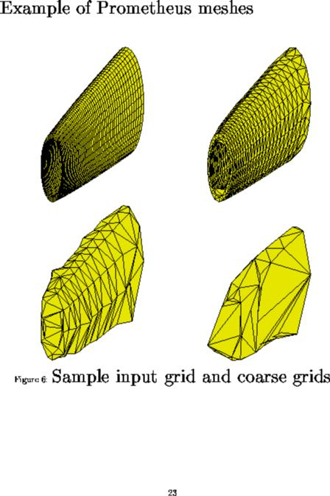
Irregular mesh: Tapered Tube (Multigrid)

Slide 42
Scientific computation and data analysis
Continuous
physical modeling
Linear algebra
Computers

Slide 43
Scientific computation and data analysis
Continuous
physical modeling
Discrete
structure analysis
Linear algebra
Graph theory
Computers
Computers

Slide 44
Scientific computation and data analysis
Continuous
physical modeling
Discrete
structure analysis
Linear algebra & graph theory
Computers

