Slide 1
CS 140:
Sparse Matrix-Vector Multiplication and Graph Partitioning

Slide 2
Parallel sparse matrix-vector product
Lay out matrix and vectors by rows
y(i) = sum(A(i,j)*x(j))
Only compute terms with A(i,j) ≠ 0
Algorithm
  Each processor i:
  Broadcast x(i)
  Compute y(i) = A(i,:)*x
  Comm volume v = p*n (way too much!)
Reducing communication volume
  Only send each proc the parts of x it needs
  Reorder matrix for better locality by graph partitioning
P0 P1 P2 P3
x
P0
P1
P2
P3
y

Slide 3
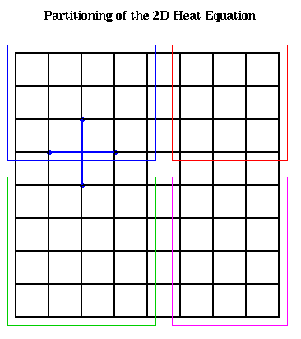
2D block decomposition for 5-point stencil
n stencil cells, p processors
Each processor has a patch of n/p cells
Block row (or block col) layout: v = 2 * p * sqrt(n)
2-dimensional block layout: v = 4 * sqrt(p) * sqrt(n)

Slide 4
Graphs and Sparse Matrices
Sparse matrix is a representation of a (sparse) graph
1 2 3 4 5 6
1 1 1
2 1 1 1
3 1 1 1
4 1 1
5 1 1
6 1 1
3
2
4
1
6
5
Matrix entries are edge weights
Number of nonzeros per row is the vertex degree
Edges represent data dependencies in matrix-vector multiplication

Slide 5
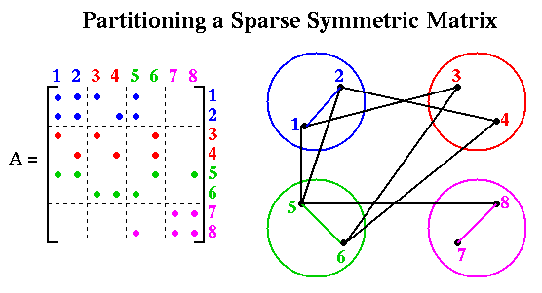
Sparse Matrix Vector Multiplication

Slide 6
Graph partitioning
Assigns subgraphs to processors
Determines parallelism and locality.
Tries to make subgraphs all same size (load balance)
Tries to minimize edge crossings (communication).
Exact minimization is NP-complete.
edge crossings = 6
edge crossings = 10
Notes:
Nodes and edges in graph may be weighted
Optimal graph partitioning is NP-complete (define for non-CS audience)
Good graph partitioning techniques exist
More on this in a later lecture

Slide 7
Applications of graph partitioning
Telephone network design
  The original application! 1970 algorithm due to Kernighan & Lin
Sparse Matrix times Vector Multiplication
  To solve Ax = b, partial differential equations, eigenvalue problems, …
  N = {1,…,n}, (j,k) in E if A(j,k) nonzero,
  W_{N}(j) = #nonzeros in row j, W_{E}(j,k) = 1
Data mining and clustering
Physical Mapping of DNA
VLSI Layout
Sparse Gaussian Elimination
  Reorder matrix rows and columns to decrease “fill” in factors
  Load Balancing while Minimizing Communication
. . .

Slide 8
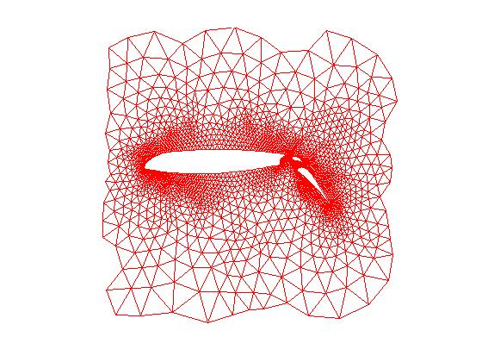
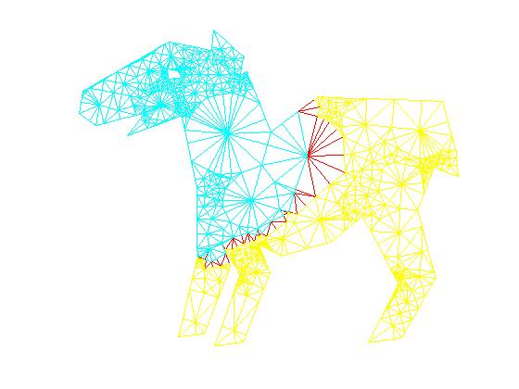
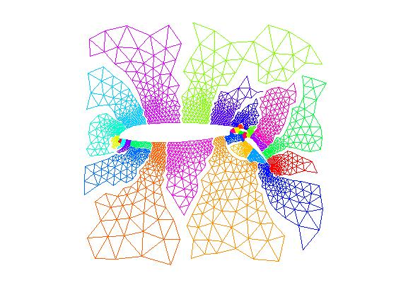
Graph partitioning demo
> load meshes
> gplotg(Airfoil,Axy)
> specdice(Airfoil,Axy,5)
> meshdemo
spectral bisection
32-way partition

Slide 9
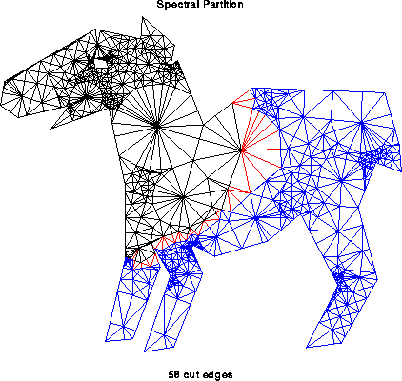
Partitioning by Repeated Bisection
To partition into 2^{k} parts, bisect graph recursively k times

Slide 10
Recursive Bisection
Recursive bisection approach:
  Partition data into two sets.
  Recursively subdivide each set into two sets.
  Only minor modifications needed to allow P ≠ 2^{n}.
Umit V. Catalyurek
Notes:
10

Slide 11
  CS 240A: Graph and hypergraph partitioning
  (excerpts)
  Thanks to Aydin Buluc, Umit Catalyurek,
  Alan Edelman, and Kathy Yelick for some of these slides.
  The whole CS240A partitioning lecture is at http://cs.ucsb.edu/~gilbert/cs240a/slides/cs240a-partitioning.pdf

Slide 12
Graph partitioning in practice
Graph partitioning heuristics have been an active research area for many years, often motivated by partitioning for parallel computation.
Some techniques:
  Iterative-swapping (Kernighan-Lin, Fiduccia-Matheysses)
  Spectral partitioning (uses eigenvectors of Laplacian matrix of graph)
  Geometric partitioning (for meshes with specified vertex coordinates)
  Breadth-first search (fast but dated)
Many popular modern codes (e.g. Metis, Chaco, Zoltan) use multilevel iterative swapping

Slide 13
Iterative swapping:
Kernighan/Lin, Fiduccia/Mattheyses
Take a initial partition and iteratively improve it
  Kernighan/Lin (1970), cost = O(|N|³) but simple
  Fiduccia/Mattheyses (1982), cost = O(|E|) but more complicated
Start with a weighted graph and a partition A U B, where |A| = |B|
  T = cost(A,B) = Σ {weight(e): e connects nodes in A and B}
  Find subsets X of A and Y of B with |X| = |Y|
  Swapping X and Y should decrease cost:
    newA = A - X U Y and newB = B - Y U X
    newT = cost(newA , newB) < cost(A,B)
Compute newT efficiently for many possible X and Y, (not time to do all possible), then choose smallest
Notes:
What else did Kernighan invent?

Slide 14
Simplified Fiduccia-Mattheyses: Example (1)
1
0
a
b
Red nodes are in Part1; black nodes are in Part2.
The initial partition into two parts is arbitrary. In this case it cuts 8 edges.
The initial node gains are shown in red.
-1
1
0
c
2
d
e
f
g
h
3
0
Nodes tentatively moved (and cut size after each pair):
none (8);

Slide 15
Simplified Fiduccia-Mattheyses: Example (2)
1
0
The node in Part1 with largest gain is g. We tentatively move it to Part2 and recompute the gains of its neighbors.
Tentatively moved nodes are hollow circles. After a node is tentatively moved its gain doesn’t matter any more.
a
b
-3
1
-2
c
2
d
e
f
g
h
-2
Nodes tentatively moved (and cut size after each pair):
none (8); g,

Slide 16
Simplified Fiduccia-Mattheyses: Example (3)
-1
-2
The node in Part2 with largest gain is d. We tentatively move it to Part1 and recompute the gains of its neighbors.
After this first tentative swap, the cut size is 4.
a
b
-1
-2
c
0
d
e
f
g
h
0
Nodes tentatively moved (and cut size after each pair):
none (8); g, d (4);

Slide 17
Simplified Fiduccia-Mattheyses: Example (4)
-1
-2
The unmoved node in Part1 with largest gain is f. We tentatively move it to Part2 and recompute the gains of its neighbors.
a
b
-1
-2
c
d
e
f
g
h
-2
Nodes tentatively moved (and cut size after each pair):
none (8); g, d (4); f

Slide 18
Simplified Fiduccia-Mattheyses: Example (5)
-3
-2
The unmoved node in Part2 with largest gain is c. We tentatively move it to Part1 and recompute the gains of its neighbors.
After this tentative swap, the cut size is 5.
a
b
0
c
d
e
f
g
h
0
Nodes tentatively moved (and cut size after each pair):
none (8); g, d (4); f, c (5);

Slide 19
Simplified Fiduccia-Mattheyses: Example (6)
-1
The unmoved node in Part1 with largest gain is b. We tentatively move it to Part2 and recompute the gains of its neighbors.
a
b
0
c
d
e
f
g
h
0
Nodes tentatively moved (and cut size after each pair):
none (8); g, d (4); f, c (5); b

Slide 20
Simplified Fiduccia-Mattheyses: Example (7)
-1
There is a tie for largest gain between the two unmoved nodes in Part2. We choose one (say e) and tentatively move it to Part1. It has no unmoved neighbors so no gains are recomputed.
After this tentative swap the cut size is 7.
a
b
c
d
e
f
g
h
0
Nodes tentatively moved (and cut size after each pair):
none (8); g, d (4); f, c (5); b, e (7);

Slide 21
Simplified Fiduccia-Mattheyses: Example (8)
The unmoved node in Part1 with the largest gain (the only one) is a. We tentatively move it to Part2. It has no unmoved neighbors so no gains are recomputed.
a
b
c
d
e
f
g
h
0
Nodes tentatively moved (and cut size after each pair):
none (8); g, d (4); f, c (5); b, e (7); a

Slide 22
Simplified Fiduccia-Mattheyses: Example (9)
The unmoved node in Part2 with the largest gain (the only one) is h. We tentatively move it to Part1.
The cut size after the final tentative swap is 8, the same as it was before any tentative moves.
a
b
c
d
e
f
g
h
Nodes tentatively moved (and cut size after each pair):
none (8); g, d (4); f, c (5); b, e (7); a, h (8)

Slide 23
Simplified Fiduccia-Mattheyses: Example (10)
After every node has been tentatively moved, we look back at the sequence and see that the smallest cut was 4, after swapping g and d. We make that swap permanent and undo all the later tentative swaps.
This is the end of the first improvement step.
a
b
c
d
e
f
g
h
Nodes tentatively moved (and cut size after each pair):
none (8); g, d (4); f, c (5); b, e (7); a, h (8)

Slide 24
Simplified Fiduccia-Mattheyses: Example (11)
Now we recompute the gains and do another improvement step starting from the new size-4 cut. The details are not shown.
The second improvement step doesn’t change the cut size, so the algorithm ends with a cut of size 4.
In general, we keep doing improvement steps as long as the cut size keeps getting smaller.
a
b
c
d
e
f
g
h

Slide 25
Spectral Bisection
Based on theory of Fiedler (1970s),
rediscovered several times in different communities
Motivation I: analogy to a vibrating string
Motivation II: continuous relaxation of discrete optimization problem
Implementation: eigenvectors via Lanczos algorithm
  To optimize sparse-matrix-vector multiply, we graph partition
  To graph partition, we find an eigenvector of a matrix
  To find an eigenvector, we do sparse-matrix-vector multiply
  No free lunch ...

Slide 26
Laplacian Matrix
Definition: The Laplacian matrix L(G) of a graph G is a symmetric matrix, with one row and column for each node. It is defined by
  L(G) (i,i) = degree of node i (number of incident edges)
  L(G) (i,j) = -1 if i != j and there is an edge (i,j)
  L(G) (i,j) = 0 otherwise
1
4
2 -1 -1 0 0
-1 2 -1 0 0
-1 -1 4 -1 -1
0 0 -1 2 -1
0 0 -1 -1 2
G =
L(G) =
2
3
5

Slide 27
Properties of Laplacian Matrix
Theorem: L(G) has the following properties
  L(G) is symmetric.
    This implies the eigenvalues of L(G) are real,
    and its eigenvectors are real and orthogonal.
  Rows of L sum to zero:
    Let e = [1,…,1]^{T}, i.e. the column vector of all ones.
    Then L(G)*e=0.
  The eigenvalues of L(G) are nonnegative:
    0 = λ₁ <= λ₂ <= … <= λ_{n}
  The number of connected components of G is equal to the number of λ_{i} that are 0.

Slide 28
Spectral Bisection Algorithm
Spectral Bisection Algorithm:
  Compute eigenvector v₂ corresponding to λ₂(L(G))
  Partition nodes around the median of v₂(n)
Why in the world should this work?
Intuition: vibrating string or membrane
Heuristic: continuous relaxation of discrete optimization

Slide 29
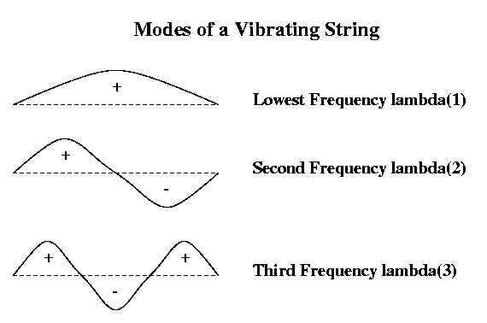
Motivation for Spectral Bisection
Vibrating string
Think of G = 1D mesh as masses (nodes) connected by springs (edges), i.e. a string that can vibrate
Vibrating string has modes of vibration, or harmonics
Label nodes by whether mode - or + to partition into N- and N+
Same idea for other graphs (eg planar graph ~ trampoline)

Slide 30
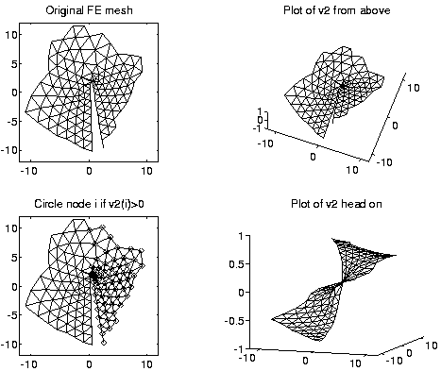
2nd eigenvector of L(planar mesh)

Slide 31
Multilevel Partitioning
If G is too big for our algorithms, what can we do?
  (1) Replace G by a coarse approximation
  G_{c}, and partition G_{c} instead
  (2) Use partition of G_{c} to get a rough partitioning of G,
  and then iteratively improve it
What if G_{c} is still too big?
  Apply same idea recursively

Slide 32
Multilevel Partitioning - High Level Algorithm
(N+,N- ) = Multilevel_Partition( N, E )
… recursive partitioning routine returns N+ and N- where N = N+ U N-
if |N| is small
(1) Partition G = (N,E) directly to get N = N+ U N-
Return (N+, N- )
else
(2) Coarsen G to get an approximation G_{c} = (N_{c}, E_{c})
(3) (N_{c}+ , N_{c}- ) = Multilevel_Partition( N_{c}, E_{c} )
(4) Expand (N_{c}+ , N_{c}- ) to a partition (N+ , N- ) of N
(5) Improve the partition ( N+ , N- )
Return ( N+ , N- )
endif
“V - cycle:”
(5)
How do we
Coarsen?
Expand?
Improve?
(2,3)
(4)
(5)
(2,3)
(4)
(5)
(2,3)
(4)
(1)

Slide 33
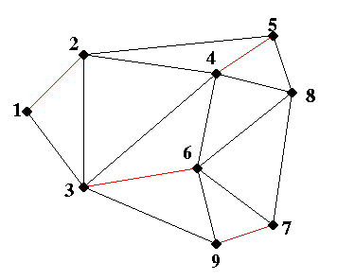
Coarsening by Maximal Matching

Slide 34
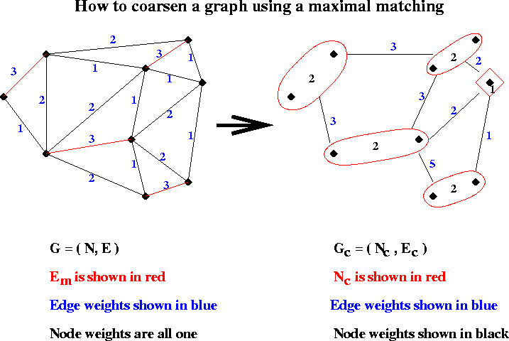
Example of Coarsening

Slide 35
At bottom of recursion, Partition the coarsest graph
  …Using spectral bisection, say.
1
4
2 -1 -1 0 0
-1 2 -1 0 0
-1 -1 4 -1 -1
0 0 -1 2 -1
0 0 -1 -1 2
G =
L(G) =
2
3
5

Slide 36
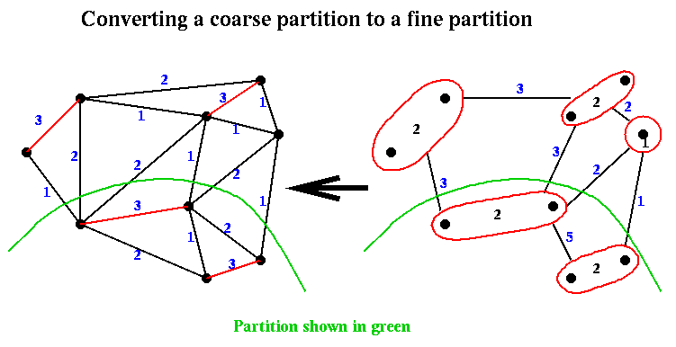
Expand a partition of G_{c} to a partition of G

Slide 37
After each expansion, Improve the partition…
… by iterative swapping.
1
0
a
b
a
b
-1
1
0
e
c
2
c
d
d
f
e
f
e
g
h
g
h
3
0

