Slide 1
Conjugate gradient iteration to solve A*x=b
x₀ = 0, r₀ = b, d₀ = r₀ (these are all vectors)
for k = 1, 2, 3, . . .
α_{k} = (r^{T}_{k-1}r_{k-1}) / (d^{T}_{k-1}Ad_{k-1}) step length
x_{k} = x_{k-1} + α_{k} d_{k-1} approximate solution
r_{k} = r_{k-1} – α_{k} Ad_{k-1} residual = b - Ax_{k}
β_{k} = (r^{T}_{k} r_{k}) / (r^{T}_{k-1}r_{k-1}) improvement
d_{k} = r_{k} + β_{k} d_{k-1} search direction
One matrix-vector multiplication per iteration
Two vector dot products per iteration
Four n-vectors of working storage

Slide 2
Vector and matrix primitives for CG
DAXPY: v = α*v + β*w (vectors v, w; scalars α, β)
  Broadcast the scalars α and β, then independent * and +
  comm volume = 2p, span = log n
DDOT: α = v^{T}*w = Σ_{j} v[j]*w[j] (vectors v, w; scalar α)
  Independent *, then + reduction
  comm volume = p, span = log n
Matvec: v = A*w (matrix A, vectors v, w)
  The hard part
  But all you need is a subroutine to compute v from w
  Sometimes you don’t need to store A (e.g. temperature problem)
  Usually you do need to store A, but it’s sparse ...

Slide 3
Broadcast and reduction
Broadcast of 1 value to p processors in log p time
Reduction of p values to 1 in log p time
Takes advantage of associativity in +, *, min, max, etc.
α
Broadcast
1 3 1 0 4 -6 3 2
Add-reduction
8

Slide 4
Parallel sparse matrix-vector product
Lay out matrix and vectors by rows
y(i) = sum(A(i,j)*x(j))
Only compute terms with A(i,j) ≠ 0
Algorithm
  Each processor i:
  Broadcast x(i)
  Compute y(i) = A(i,:)*x
Optimizations
  Only send each proc the parts of x it needs, to reduce comm
  Reorder matrix for better locality by graph partitioning
  Worry about balancing number of nonzeros / processor,
  if rows have very different nonzero counts
P0 P1 P2 P3
x
P0
P1
P2
P3
y

Slide 5
Data structure for sparse matrix A (stored by rows)
31 | 53 | 59 | 41 | 26
31 | 0 | 53
0 | 59 | 0
41 | 26 | 0
1 | 3 | 2 | 1 | 2
  Full matrix:
    2-dimensional array of real or complex numbers
    (nrows*ncols) memory
Sparse matrix:
  compressed row storage
  about (2*nzs + nrows) memory

Slide 6
Distributed-memory sparse matrix data structure
P₀
P₁
Each processor stores:
# of local nonzeros
range of local rows
nonzeros in CSR form
P₂
P_{n}

Slide 7
Graphs and Sparse Matrices
Sparse matrix is a representation of a (sparse) graph
1 2 3 4 5 6
1 1 1
2 1 1 1
3 1 1 1
4 1 1
5 1 1
6 1 1
3
2
4
1
6
5
Matrix entries are edge weights
Number of nonzeros per row is the vertex degree
Edges represent data dependencies in matrix-vector multiplication

Slide 8
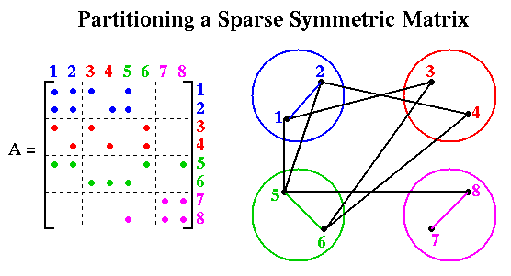
Sparse Matrix Vector Multiplication

Slide 9
CS 240A: Graph and hypergraph partitioning
Motivation and definitions
  Motivation from parallel computing
  Theory of graph separators
Heuristics for graph partitioning
  Iterative swapping
  Spectral
  Geometric
  Multilevel
Beyond graphs
  Shortcomings of the graph partitioning model
  Hypergraph models of communication in MatVec
Parallel methods for partitioning hypergraphs

Slide 10
CS 240A: Graph and hypergraph partitioning
Motivation and definitions
  Motivation from parallel computing
  Theory of graph separators
Heuristics for graph partitioning
  Iterative swapping
  Spectral
  Geometric
  Multilevel
Beyond graphs
  Shortcomings of the graph partitioning model
  Hypergraph models of communication in MatVec
Parallel methods for partitioning hypergraphs

Slide 11
Sparse Matrix Vector Multiplication

Slide 12
Definition of Graph Partitioning
Given a graph G = (N, E, W_{N}, W_{E})
  N = nodes (or vertices),
  E = edges
  W_{N} = node weights
  W_{E} = edge weights
Often nodes are tasks, edges are communication, weights are costs
Choose a partition N = N₁ U N₂ U … U N_{P} such that
  Total weight of nodes in each part is “about the same”
  Total weight of edges connecting nodes in different parts is small
Balance the work load, while minimizing communication
Special case of N = N₁ U N₂: Graph Bisection
2 (2)
1
3 (1)
1 (2)
4
2
4 (3)
2
3
1
2
5 (1)
1
8 (1)
5
6
6 (2)
7 (3)

Slide 13
Applications
Telephone network design
  Original application, algorithm due to Kernighan
Load Balancing while Minimizing Communication
Sparse Matrix times Vector Multiplication
  Solving PDEs
  N = {1,…,n}, (j,k) in E if A(j,k) nonzero,
  W_{N}(j) = #nonzeros in row j, W_{E}(j,k) = 1
VLSI Layout
  N = {units on chip}, E = {wires}, W_{E}(j,k) = wire length
Sparse Gaussian Elimination
  Used to reorder rows and columns to increase parallelism, and to decrease “fill-in”
Data mining and clustering
Physical Mapping of DNA

Slide 14
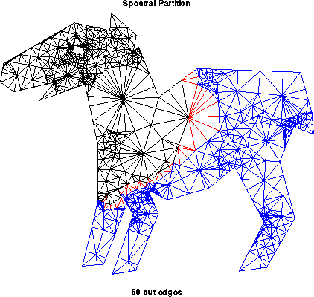
Partitioning by Repeated Bisection
To partition into 2^{k} parts, bisect graph recursively k times

Slide 15
Separators in theory
If G is a planar graph with n vertices, there exists a set of at most sqrt(6n) vertices whose removal leaves no connected component with more than 2n/3 vertices.
(“Planar graphs have sqrt(n)-separators.”)
“Well-shaped” finite element meshes in 3 dimensions have n^{2/3} - separators.
Also some others – trees, graphs of bounded genus, chordal graphs, bounded-excluded-minor graphs, …
Mostly these theorems come with efficient algorithms, but they aren’t used much.
“Random graphs” don’t have good separators.
  e.g. Erdos-Renyi random graphs have only n - separators.

Slide 16
CS 240A: Graph and hypergraph partitioning
Motivation and definitions
  Motivation from parallel computing
  Theory of graph separators
Heuristics for graph partitioning
  Iterative swapping
  Spectral
  Geometric
  Multilevel
Beyond graphs
  Shortcomings of the graph partitioning model
  Hypergraph models of communication in MatVec
Parallel methods for partitioning hypergraphs

Slide 17
Separators in practice
Graph partitioning heuristics have been an active research area for many years, often motivated by partitioning for parallel computation.
Some techniques:
  Iterative-swapping (Kernighan-Lin, Fiduccia-Matheysses)
  Spectral partitioning (uses eigenvectors of Laplacian matrix of graph)
  Geometric partitioning (for meshes with specified vertex coordinates)
  Breadth-first search (fast but dated)
Many popular modern codes (e.g. Metis, Chaco, Zoltan) use multilevel iterative swapping

Slide 18
Iterative swapping:
Kernighan/Lin, Fiduccia/Mattheyses
Take a initial partition and iteratively improve it
  Kernighan/Lin (1970), cost = O(|N|³) but simple
  Fiduccia/Mattheyses (1982), cost = O(|E|) but more complicated
Start with a weighted graph and a partition A U B, where |A| = |B|
  T = cost(A,B) = Σ {weight(e): e connects nodes in A and B}
  Find subsets X of A and Y of B with |X| = |Y|
  Swapping X and Y should decrease cost:
    newA = A - X U Y and newB = B - Y U X
    newT = cost(newA , newB) < cost(A,B)
Compute newT efficiently for many possible X and Y, (not time to do all possible), then choose smallest
Notes:
What else did Kernighan invent?

Slide 19
Simplified Fiduccia-Mattheyses: Example (1)
1
0
a
b
Red nodes are in Part1; black nodes are in Part2.
The initial partition into two parts is arbitrary. In this case it cuts 8 edges.
The initial node gains are shown in red.
-1
1
0
c
2
d
e
f
g
h
3
0
Nodes tentatively moved (and cut size after each pair):
none (8);

Slide 20
Simplified Fiduccia-Mattheyses: Example (2)
1
0
The node in Part1 with largest gain is g. We tentatively move it to Part2 and recompute the gains of its neighbors.
Tentatively moved nodes are hollow circles. After a node is tentatively moved its gain doesn’t matter any more.
a
b
-3
1
-2
c
2
d
e
f
g
h
-2
Nodes tentatively moved (and cut size after each pair):
none (8); g,

Slide 21
Simplified Fiduccia-Mattheyses: Example (3)
-1
-2
The node in Part2 with largest gain is d. We tentatively move it to Part1 and recompute the gains of its neighbors.
After this first tentative swap, the cut size is 4.
a
b
-1
-2
c
0
d
e
f
g
h
0
Nodes tentatively moved (and cut size after each pair):
none (8); g, d (4);

Slide 22
Simplified Fiduccia-Mattheyses: Example (4)
-1
-2
The unmoved node in Part1 with largest gain is f. We tentatively move it to Part2 and recompute the gains of its neighbors.
a
b
-1
-2
c
d
e
f
g
h
-2
Nodes tentatively moved (and cut size after each pair):
none (8); g, d (4); f

Slide 23
Simplified Fiduccia-Mattheyses: Example (5)
-3
-2
The unmoved node in Part2 with largest gain is c. We tentatively move it to Part1 and recompute the gains of its neighbors.
After this tentative swap, the cut size is 5.
a
b
0
c
d
e
f
g
h
0
Nodes tentatively moved (and cut size after each pair):
none (8); g, d (4); f, c (5);

Slide 24
Simplified Fiduccia-Mattheyses: Example (6)
-1
The unmoved node in Part1 with largest gain is b. We tentatively move it to Part2 and recompute the gains of its neighbors.
a
b
0
c
d
e
f
g
h
0
Nodes tentatively moved (and cut size after each pair):
none (8); g, d (4); f, c (5); b

Slide 25
Simplified Fiduccia-Mattheyses: Example (7)
-1
There is a tie for largest gain between the two unmoved nodes in Part2. We choose one (say e) and tentatively move it to Part1. It has no unmoved neighbors so no gains are recomputed.
After this tentative swap the cut size is 7.
a
b
c
d
e
f
g
h
0
Nodes tentatively moved (and cut size after each pair):
none (8); g, d (4); f, c (5); b, e (7);

Slide 26
Simplified Fiduccia-Mattheyses: Example (8)
The unmoved node in Part1 with the largest gain (the only one) is a. We tentatively move it to Part2. It has no unmoved neighbors so no gains are recomputed.
a
b
c
d
e
f
g
h
0
Nodes tentatively moved (and cut size after each pair):
none (8); g, d (4); f, c (5); b, e (7); a

Slide 27
Simplified Fiduccia-Mattheyses: Example (9)
The unmoved node in Part2 with the largest gain (the only one) is h. We tentatively move it to Part1.
The cut size after the final tentative swap is 8, the same as it was before any tentative moves.
a
b
c
d
e
f
g
h
Nodes tentatively moved (and cut size after each pair):
none (8); g, d (4); f, c (5); b, e (7); a, h (8)

Slide 28
Simplified Fiduccia-Mattheyses: Example (10)
After every node has been tentatively moved, we look back at the sequence and see that the smallest cut was 4, after swapping g and d. We make that swap permanent and undo all the later tentative swaps.
This is the end of the first improvement step.
a
b
c
d
e
f
g
h
Nodes tentatively moved (and cut size after each pair):
none (8); g, d (4); f, c (5); b, e (7); a, h (8)

Slide 29
Simplified Fiduccia-Mattheyses: Example (11)
Now we recompute the gains and do another improvement step starting from the new size-4 cut. The details are not shown.
The second improvement step doesn’t change the cut size, so the algorithm ends with a cut of size 4.
In general, we keep doing improvement steps as long as the cut size keeps getting smaller.
a
b
c
d
e
f
g
h

Slide 30
Spectral Bisection
Based on theory of Fiedler (1970s),
rediscovered several times in different communities
Motivation I: analogy to a vibrating string
Motivation II: continuous relaxation of discrete optimization problem
Implementation: eigenvectors via Lanczos algorithm
  To optimize sparse-matrix-vector multiply, we graph partition
  To graph partition, we find an eigenvector of a matrix
  To find an eigenvector, we do sparse-matrix-vector multiply
  No free lunch ...

Slide 31
Laplacian Matrix
Definition: The Laplacian matrix L(G) of a graph G(N,E) is an |N| by |N| symmetric matrix, with one row and column for each node. It is defined by
  L(G) (i,i) = degree of node I (number of incident edges)
  L(G) (i,j) = -1 if i != j and there is an edge (i,j)
  L(G) (i,j) = 0 otherwise
1
4
2 -1 -1 0 0
-1 2 -1 0 0
-1 -1 4 -1 -1
0 0 -1 2 -1
0 0 -1 -1 2
G =
L(G) =
2
3
5

Slide 32
Properties of Laplacian Matrix
Theorem: L(G) has the following properties
  L(G) is symmetric.
    This implies the eigenvalues of L(G) are real,
    and its eigenvectors are real and orthogonal.
  Rows of L sum to zero:
    Let e = [1,…,1]^{T}, i.e. the column vector of all ones.
    Then L(G)*e=0.
  The eigenvalues of L(G) are nonnegative:
    0 = λ₁ <= λ₂ <= … <= λ_{n}
  The number of connected components of G is equal to the number of λ_{i} that are 0.

Slide 33
Spectral Bisection Algorithm
Spectral Bisection Algorithm:
  Compute eigenvector v₂ corresponding to λ₂(L(G))
  Partition nodes around the median of v₂(n)
Why in the world should this work?
Intuition: vibrating string or membrane
Heuristic: continuous relaxation of discrete optimization

Slide 34
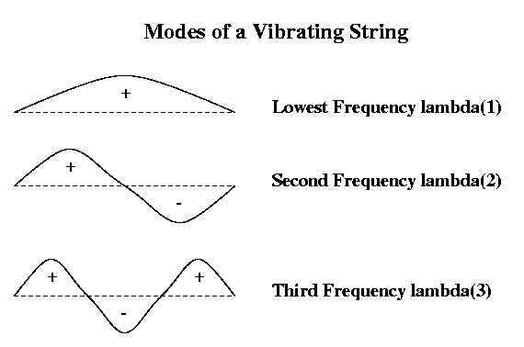
Motivation for Spectral Bisection
Vibrating string
Think of G = 1D mesh as masses (nodes) connected by springs (edges), i.e. a string that can vibrate
Vibrating string has modes of vibration, or harmonics
Label nodes by whether mode - or + to partition into N- and N+
Same idea for other graphs (eg planar graph ~ trampoline)

Slide 35
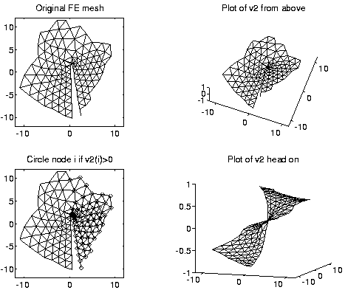
2nd eigenvector of L(planar mesh)

Slide 36
Geometric Partitioning (for meshes in space)
Use “near neighbor” idea of planar graphs in higher dimension
Intuition from regular 3D mesh:
k by k by k mesh of n = k³ nodes
  Edges to 6 nearest neighbors
  Partition by taking plane parallel to axes
  Cuts k² = n^{2/3} edges
For general “3D” graphs
  Need a notion of well-shaped
  (Any graph fits in 3D without crossings!)

Slide 37
Generalizing planar separators to higher dimensions
Theorem (Miller, Teng, Thurston, Vavasis, 1993): Let G=(N,E) be an (α,k) overlap graph in d dimensions with n=|N|. Then there is a vertex separator N_{s} such that
  N = N₁ U N_{s} U N₂ and
  N₁ and N₂ each has at most n*(d+1)/(d+2) nodes
  N_{s} has at most O(α * k^{1/d} * n^{(d-1)/d} ) nodes
When d=2, same as Lipton/Tarjan
Algorithm:
  Choose a sphere S in R^{d}
  Edges that S “cuts” form edge separator E_{s}
  Build N_{s} from E_{s}
  Choose “randomly”, so that it satisfies Theorem with high probability

Slide 38
Random Spheres: Well Shaped Graphs
Approach due to Miller, Teng, Thurston, Vavasis
Def: A k-ply neighborhood system in d dimensions is a set {D₁,…,D_{n}} of closed disks in R^{d} such that no point in R^{d} is strictly interior to more than k disks
Def: An (α,k) overlap graph is a graph defined in terms of α >= 1 and a k-ply neighborhood system {D₁,…,D_{n}}: There is a node for each D_{j}, and an edge from j to i if expanding the radius of the smaller of D_{j} and D_{i} by >α causes the two disks to overlap
An n-by-n mesh is a (1,1) overlap graph
Every planar graph is (a,k) overlap for some a,k
2D Mesh is
(1,1) overlap
graph
Notes:
So a 1-ply neighborhood is a set of non-intersecting disks
a 2-ply neighborhood has disk intersections of no more than 2 disks each
An (alpha, 1) overlap graph has a set of non-overlapping disks
if we grow a disks by more than alpha

Slide 39
Stereographic Projection
Stereographic projection from plane to sphere
  In d=2, draw line from p to North Pole, projection p’ of p is where the line and sphere intersect
  Similar in higher dimensions
p’
p
p = (x,y) p’ = (2x,2y,x² + y² –1) / (x² + y² + 1)

Slide 40
Choosing a Random Sphere
Do stereographic projection from R^{d} to sphere in R^{d+1}
Find centerpoint of projected points
  Any plane through centerpoint divides points ~evenly
  There is a linear programming algorithm, cheaper heuristics
Conformally map points on sphere
  Rotate points around origin so centerpoint at (0,…0,r) for some r
  Dilate points (unproject, multiply by sqrt((1-r)/(1+r)), project)
    this maps centerpoint to origin (0,…,0)
Pick a random plane through origin
  Intersection of plane and sphere is circle
Unproject circle
  yields desired circle C in R^{d}
Create N_{s}: j belongs to N_{s} if α*D_{j} intersects C

Slide 41
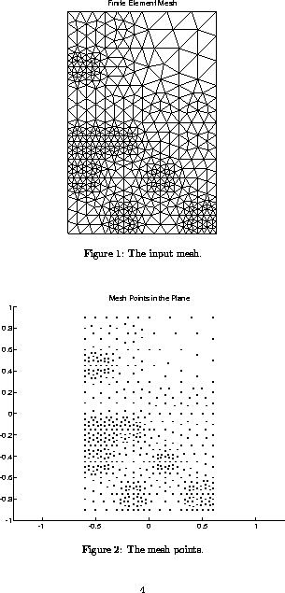
Random Sphere Algorithm

Slide 42
Random Sphere Algorithm

Slide 43
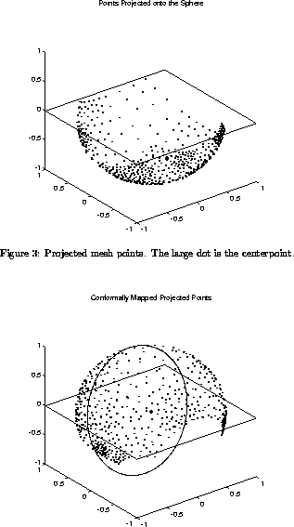
Random Sphere Algorithm

Slide 44
Random Sphere Algorithm

Slide 45
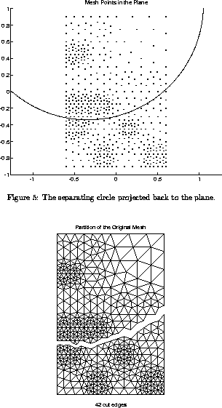
Random Sphere Algorithm

Slide 47
Multilevel Partitioning
If G(N,E) is too big for our algorithms, what can we do?
  (1) Replace G(N,E) by a coarse approximation
  G_{c}(N_{c},E_{c}), and partition G_{c} instead
  (2) Use partition of G_{c} to get a rough partitioning of G,
  and then iteratively improve it
What if G_{c} is still too big?
  Apply same idea recursively

Slide 48
Multilevel Partitioning - High Level Algorithm
(N+,N- ) = Multilevel_Partition( N, E )
… recursive partitioning routine returns N+ and N- where N = N+ U N-
if |N| is small
(1) Partition G = (N,E) directly to get N = N+ U N-
Return (N+, N- )
else
(2) Coarsen G to get an approximation G_{c} = (N_{c}, E_{c})
(3) (N_{c}+ , N_{c}- ) = Multilevel_Partition( N_{c}, E_{c} )
(4) Expand (N_{c}+ , N_{c}- ) to a partition (N+ , N- ) of N
(5) Improve the partition ( N+ , N- )
Return ( N+ , N- )
endif
“V - cycle:”
(5)
How do we
Coarsen?
Expand?
Improve?
(2,3)
(4)
(5)
(2,3)
(4)
(5)
(2,3)
(4)
(1)

Slide 49
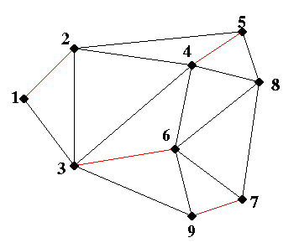
Maximal Matching: Example

Slide 50
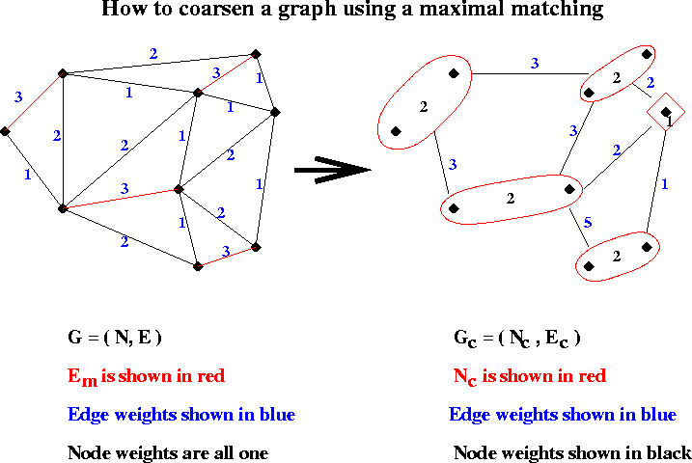
Example of Coarsening

Slide 51
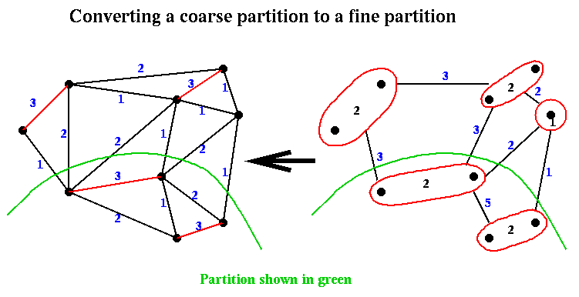
Expanding a partition of G_{c} to a partition of G

Slide 52
CS 240A: Graph and hypergraph partitioning
Motivation and definitions
  Motivation from parallel computing
  Theory of graph separators
Heuristics for graph partitioning
  Iterative swapping
  Spectral
  Geometric
  Multilevel
Beyond graphs
  Shortcomings of the graph partitioning model
  Hypergraph models of communication in MatVec
Parallel methods for partitioning hypergraphs

Slide 53
Most of the following slides adapted from:
Dynamic Load Balancing for Adaptive Scientific Computations via Hypergraph Repartitioning
Ümit V. Çatalyürek
Department of Biomedical Informatics
The Ohio State University

Slide 54

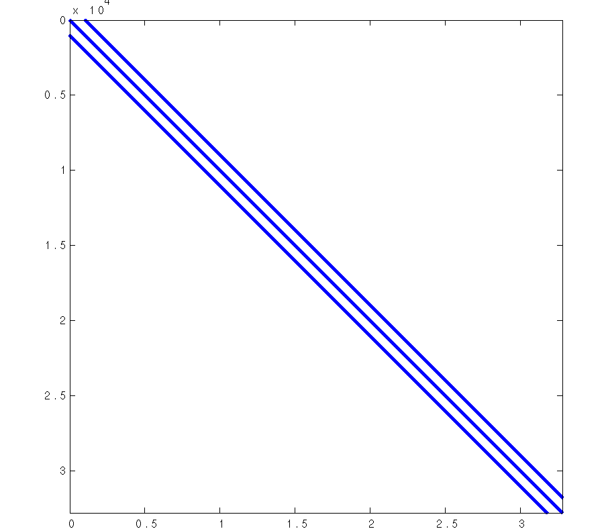
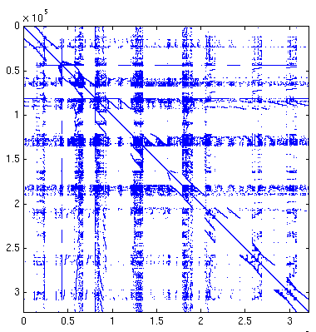
Graph Models:
Approximate Communication Metric for SpMV
Graph models assume
  Weight of edge cuts = Communication volume.
But edge cuts only approximate communication volume.
Good enough for many PDE applications.
Not good enough for irregular problems
P₁
P₂
V_{j}
V_{i}
V_{k}
V_{l}
V_{m}
V_{h}
Hexahedral finite
element matrix
Xyce ASIC matrix
P₃
P₄
Umit V. Catalyurek
Notes:
54

Slide 55
Graph Model for Sparse Matrices
P
P
1
2
3
4
5
6
7
8
9
10
1
2
1
1
1
v
2
v
1
v
4
2
4
2
4
6
2
2
2
2
3
P
3
3
2
2
2
4
1
4
4
v
2
v
5
=
5
5
v
4
2
5
4
2
4
8
2
4
v
9
3
6
6
6
2
7
7
7
2
2
2
8
P
8
8
9
2
9
9
v
4
2
5
2
v
4
10
10
10
5
v
7
10
y
A
x
edge (v_{i}, v_{j}) ∈ E ⇒
y(i) ← y(i) + A(i,j) x(j) and y(j) ← y(j) + A(j,i) x(i)
P₁ performs: y(4) ← y(4) + A(4,7) x(7) and
y(5) ← y(5) + A(5,7) x(7)
x(7) only needs to be communicated once !

Slide 56
Hypergraph Model for Sparse Matrices
P
n₆
P
1
2
3
4
5
6
7
8
9
10
1
2
1
1
1
v
1
n₁
2
2
2
4
4
v₆
3
P
3
3
4
v₉
4
1
4
4
v₂
n₄
v
5
=
5
5
4
v₄
5
4
8
6
6
6
v
7
7
7
3
4
v₅
8
P
8
8
v₇
4
9
2
9
9
4
n₇
5
v₁₀
10
10
10
y
A
x
n₅
n₈
Column-net model for block-row distributions
Rows are vertices, columns are nets (hyperedges)
Each {vertex, net} pair represents unique nonzero net-cut metric: cutsize(Π) = Σ_{n ∈ NE} w(n_{i})
connectivity-1 metric: cutsize(Π) = Σ_{n ∈ NE} w(n_{i}) (c(n_{j}) - 1)

Slide 57
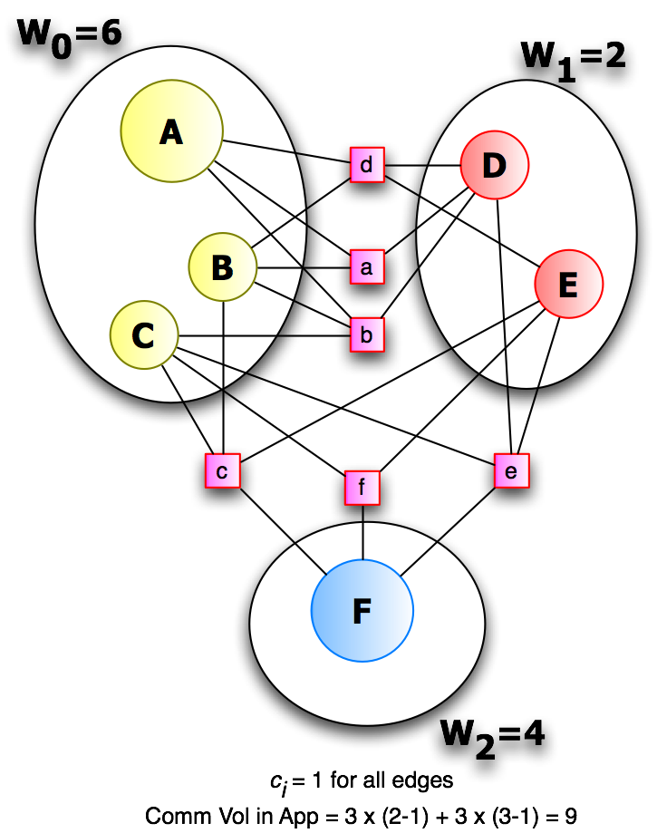
Hypergraph Model
H=(V, E) is Hypergraph
w_{i} vertex weight, c_{i} edge cost
P = {V₁, V₂, … , V_{k}} is k-way partition
: #parts edge e_{i} connects
cut(P)=
cut(P) = total comm volume

Slide 58
CS 240A: Graph and hypergraph partitioning
Motivation and definitions
  Motivation from parallel computing
  Theory of graph separators
Heuristics for graph partitioning
  Iterative swapping
  Spectral
  Geometric
  Multilevel
Beyond graphs
  Shortcomings of the graph partitioning model
  Hypergraph models of communication in MatVec
Parallel methods for partitioning hypergraphs

Slide 59
Multilevel Scheme (Serial & Parallel)
Multilevel hypergraph partitioning (Çatalyürek, Karypis)
  Analogous to multilevel graph partitioning
  (Bui&Jones, Hendrickson&Leland, Karypis&Kumar).
  Coarsening: reduce HG to smaller representative HG.
  Coarse partitioning: assign coarse vertices to partitions.
  Refinement: improve balance and cuts at each level.
Initial HG
Final Partition
Coarsening
Refinement
…
Coarse
Partitioning
…
Coarse HG
Coarse Partition
Multilevel Partitioning V-cycle
Umit V. Catalyurek
Notes:
59

Slide 60
Recursive Bisection
Recursive bisection approach:
  Partition data into two sets.
  Recursively subdivide each set into two sets.
  Only minor modifications needed to allow P ≠ 2^{n}.
Two split options:
  Split only the data into two sets; use all processors to compute each branch.
  Split both the data and processors into two sets; solve branches in parallel.
Umit V. Catalyurek
Notes:
60

Slide 61
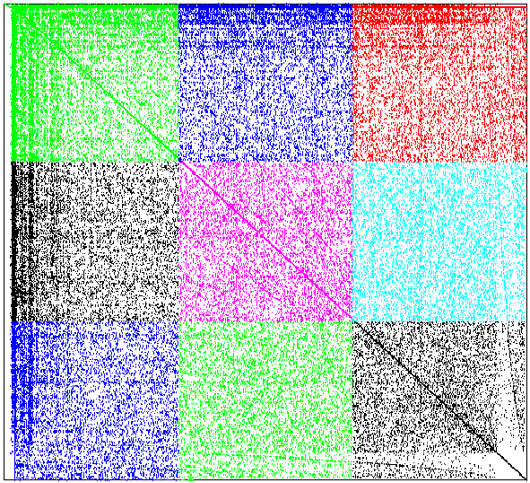
Data Layout
Matrix representation of Hypergraphs (Çatalyürek & Aykanat)
  vertices == columns
  nets (hyperedges) == rows
2D data layout within partitioner
Vertex/hyperedge broadcasts to only sqrt(P) processors.

Slide 62
Coarsening via
Parallel Matching in 2D Data Layout
Greedy maximal weight matching
  Heavy connectivity matching (Çatalyürek)
  Inner-product matching (Bisseling)
  Match columns (vertices) with greatest inner product ⇒ greatest similarity in connectivity
Each processor, on each round:
  Broadcast candidate vertices along processor row
  Compute (partial) inner products of received candidates with local vertices
  Accrue inner products in processor column
  Identify best local matches for received candidates
  Send best matches to candidates’ owners
  Select best global match for each owned candidate
  Send “match accepted” messages to processors owning matched vertices
Notes:
62

Slide 63
Coarsening (cont.)
The previous loop repeats until all unmatched vertices
have been sent as candidates
j
X
=
i
A
A
A^{T}_{1i}A_{ij}+ A^{T}_{2i}A_{ij}+ A^{T}_{3i}A_{ij}+ A^{T}_{4i}A_{ij}
X
=A_{i1}A_{ij}+ A_{i2}A_{ij}+ A_{i3}A_{ij}+ A_{i4}A_{ij}
Notes:
63

Slide 64
Decomposition Quality
64 partitions; p = 1, 2, 4, 8, 16, 32, 64
Much better decomposition quality with hypergraphs.

Slide 65
Parallel Performance
64 partitions; p = 1, 2, 4, 8, 16, 32, 64
Execution time can be higher with hypergraphs, but not always.
Zoltan PHG scales as well as or better than graph partitioner.

Slide 66
Zoltan 2D Distribution: Decomposition Quality
Processor configurations: 1x64, 2x32, 4x16, 8x8, 16x4, 32x2, 64x1.
Configuration has little affect on decomposition quality.

Slide 67
Zoltan 2D Distribution: Parallel Performance
Processor configurations 1x64, 2x32, 4x16, 8x8, 16x4, 32x2, 64x1.
Configurations 2x32, 4x16, 8x8 are best.

