Slide 1
Complexity of linear solvers
Time to solve model problem (Poisson’s equation) on regular mesh
n^{1/2}
n^{1/3}
 | 2D | 3D
Sparse Cholesky: | O(n^{1.5} ) | O(n² )
CG, exact arithmetic: | O(n² ) | O(n² )
CG, no precond: | O(n^{1.5} ) | O(n^{1.33} )
CG, modified IC: | O(n^{1.25} ) | O(n^{1.17} )
CG, support trees: | O(n^{1.20}) | O(n^{1.31} )
Current theory: | O~(n) | O~(n)
Multigrid: | O(n) | O(n)

Slide 2
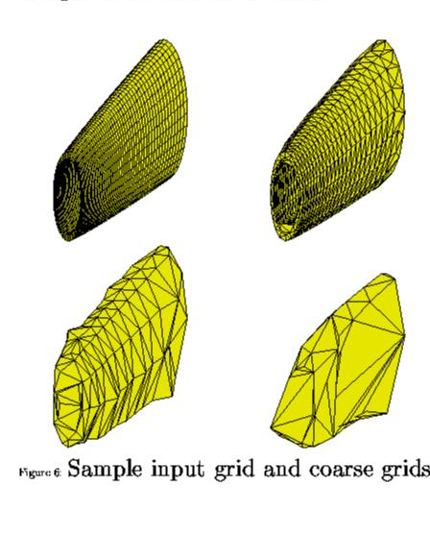
Multigrid
Find an approximate solution on a coarser mesh, and then improve it on a finer mesh
Reduce smooth fine-mesh error by using coarse mesh again
Use idea recursively on hierarchy of meshes
Solves the model problem in linear time!
Often useful when hierarchy of meshes can be built
This is just the intuition – lots of theory and technology

Slide 3
Irregular mesh: Tapered Tube (Multigrid)

