Slide 1


Graph Algorithms in the Language of Linear Algebra: How did we get here, where do we go next?
John R. Gilbert
University of California, Santa Barbara
IPDPS Graph Algorithms Building Blocks
May 21, 2018
Support: Intel, Microsoft, DOE Office of Science, NSF

Slide 2
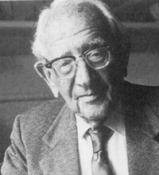
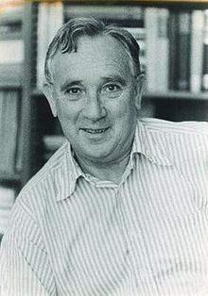
George Pólya on how to give a mathematical talk
(as described by John Todd)
“Pólya’s recipe was as follows:
The first quarter should be understandable to absolutely everyone, the second quarter should include kind words about your friends (especially those in the audience), and then it doesn’t matter what you say in the last half hour.”

Slide 3
George Pólya on how to give a mathematical talk
(as described by John Todd)
“Pólya’s recipe was as follows:
The first quarter should be understandable to absolutely everyone, the second quarter should include kind words about your friends (especially those in the audience), and then it doesn’t matter what you say in the last half hour.”
“I [Todd] adjust this by adding,
sit down after a quarter hour.”

Slide 4
Prehistory
In the year 1961 ...

Slide 5
Prehistory: A 1-person game on graphs
[S. Parter 1961]

Slide 6
Prehistory: A 1-person game on graphs
Mark a vertex.

Slide 7
Prehistory: A 1-person game on graphs
Mark a vertex.
Connect its unmarked neighbors.

Slide 8
Prehistory: A 1-person game on graphs
Mark a vertex.
Connect its unmarked neighbors.
Repeat.

Slide 9
Prehistory: A 1-person game on graphs
Mark a vertex.
Connect its unmarked neighbors.
Repeat.

Slide 10
Prehistory: A 1-person game on graphs
Mark a vertex.
Connect its unmarked neighbors.
Repeat.

Slide 11
Prehistory: A 1-person game on graphs
Mark a vertex.
Connect its unmarked neighbors.
Repeat.

Slide 12
Prehistory: A 1-person game on graphs
Mark a vertex.
Connect its unmarked neighbors.
Repeat.

Slide 13
Prehistory: A 1-person game on graphs
Mark a vertex.
Connect its unmarked neighbors.
Repeat.

Slide 14
Prehistory: A 1-person game on graphs
Mark a vertex.
Connect its unmarked neighbors.
Repeat.
Goal: End up with as few edges as possible.

Slide 15
Prehistory: A 1-person game on graphs
Mark a vertex.
Connect its unmarked neighbors.
Repeat.
Goal: End up with as few edges as possible.

Slide 16
Prehistory: A 1-person game on graphs
Mark a vertex.
Connect its unmarked neighbors.
Repeat.
Goal: End up with as few edges as possible.

Slide 17
Prehistory: A 1-person game on graphs
Mark a vertex.
Connect its unmarked neighbors.
Repeat.
Goal: End up with as few edges as possible.

Slide 18
Prehistory: A 1-person game on graphs
Mark a vertex.
Connect its unmarked neighbors.
Repeat.
Goal: End up with as few edges as possible.

Slide 19
Prehistory: A 1-person game on graphs
Mark a vertex.
Connect its unmarked neighbors.
Repeat.
Goal: End up with as few edges as possible.

Slide 20
Prehistory: A 1-person game on graphs
Mark a vertex.
Connect its unmarked neighbors.
Repeat.
Goal: End up with as few edges as possible.

Slide 21
Vertex elimination game (or chordal completion)
[Parter, Rose]
Repeat:
Choose a vertex v and mark it;
Add edges between unmarked neighbors of v;
Until: Every vertex is marked
Goal: End up with as few edges as possible.
Best play is NP-complete [Yannakakis 1981]
The final graph is always chordal (every cycle has a shortcut edge).
Perfect play is possible iff the initial graph is chordal.
Changing “fewest edges” to “smallest complete subgraph” gives the graph’s treewidth, which shows up in lots of graph algorithms.

Slide 22
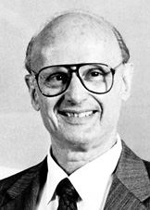
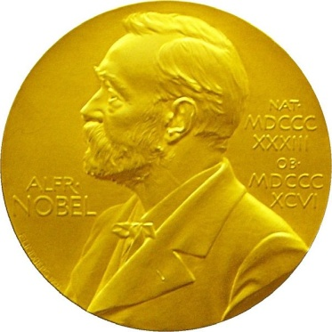
Combinatorics in the service of linear algebra
“I observed that most of the coefficients in our matrices were zero; i.e., the nonzeros were ‘sparse’ in the matrix, and that typically the triangular matrices associated with the forward and back solution provided by Gaussian elimination would remain sparse if pivot elements were chosen with care”
- Harry Markowitz, describing the 1950s work on portfolio theory that won
the 1990 Nobel Prize for Economics

Slide 23
Cholesky factorization: A = LL^{T}
[Parter, Rose]
Fill: new nonzeros in factor
1
3
7
1
3
7
Symmetric Gaussian elimination:
for j = 1 to n
add edges between j’s
higher-numbered neighbors
8
6
8
6
4
10
4
10
9
5
2
9
5
2
G(A)
G⁺(A)
[chordal]

Slide 24
Complexity measures for chordal completion
1
3
7
Elimination degree:
d_{j} = # higher neighbors of j in G⁺
d = (2, 2, 2, 2, 2, 2, 1, 2, 1, 0)
8
6
G⁺(A)
4
10
9
5
2
Nonzeros = edges = Σ_{j} d_{j} (moment 1)
Work = flops = Σ_{j} (d_{j})² (moment 2)
Front size ~ fast memory = max_{j} d_{j} (moment ∞)
(minimum possible front size is the same as treewidth)

Slide 25
Aside: Matrix structure prediction
Computing the nonzero structure of Cholesky factor L is much cheaper than computing L itself.
Cost to compute nnz(L) is almost linear in nnz(A). [G, Ng, Peyton]
Not so for sparse matrix product (SpGEMM); computing nnz(B*C) seems to be as hard as computing B*C.
Can estimate nnz(B*C) accurately in time linear in nnz(B, C)! [E. Cohen 1998]
Lots of cool recent work on sampling algorithms to estimate statistics of matrix functions.

Slide 26
Aside: Matrix structure prediction
Computing the nonzero structure of Cholesky factor L is much cheaper than computing L itself.
Cost to compute nnz(L) is almost linear in nnz(A). [G, Ng, Peyton]
Not so for sparse matrix product (SpGEMM); computing nnz(B*C) seems to be as hard as computing B*C.
Can estimate nnz(B*C) accurately in time linear in nnz(B, C)! [E. Cohen 1998]
Lots of cool recent work on sampling algorithms to estimate statistics of matrix functions.

Slide 27
Aside: Matrix structure prediction
Computing the nonzero structure of Cholesky factor L is much cheaper than computing L itself.
Cost to compute nnz(L) is almost linear in nnz(A). [G, Ng, Peyton]
Not so for sparse matrix product (SpGEMM); computing nnz(B*C) seems to be as hard as computing B*C.
Can estimate nnz(B*C) accurately in time linear in nnz(B, C)! [E. Cohen 1998]
Lots of cool recent work on sampling algorithms to estimate statistics of matrix functions.

Slide 28
Orderings for sparse Gaussian elimination
3
1
3
1
2
2
4
4
5
5
Ax = b
A = L₁L₁^{T}
5
5
2
2
3
3
4
4
1
1
(PAP^{T}) (Px) = (Pb)
PAP^{T} = L₂L₂^{T}

Slide 29
Nested dissection and graph partitioning
[George 1973, many extensions]
Heuristic: Find small vertex separator, put it last, recurse on subgraphs
Theory: Approx optimal separators => approx optimal fill
Practice: Lots of work on heuristics for graph partitioning!

Slide 30
Prehistory: Graph algorithms for sparse matrices
Many, many graph algorithms have been used, invented, implemented at large scale for sparse matrix computation:
Symmetric problems: elimination tree, nonzero structure prediction, sparse triangular solve, sparse matrix-matrix multiplication, min-height etree, …
Nonsymmetric problems: sparse triangular solve, bipartite matching (weighted and unweighted), Dulmage-Mendelsohn decomposition / strong components, …
Iterative methods: graph partitioning again, independent set, low-stretch spanning trees, …

Slide 31
History
In the year 1992 ...

Slide 32
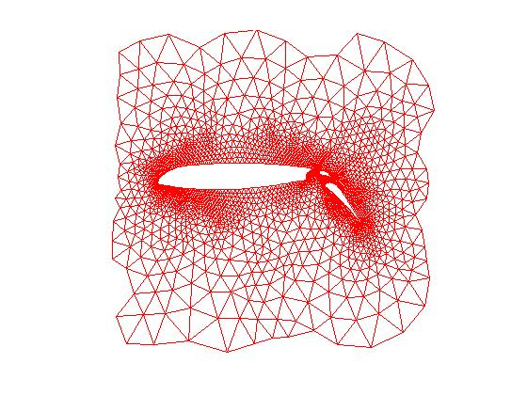
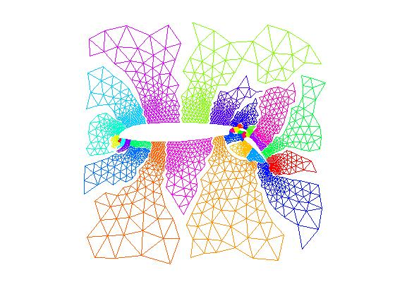
History: Mesh partitioning for scientific computing, circa 1992
Both for nested dissection and for parallel sparse matvec
Spectral partitioning: Laplacian eigenvectors
Recursive coarsening: Chaco [Hendrickson/Leland], Metis [Karypis/Kumar]
...

Slide 33
History: Mesh partitioning for scientific computing, circa 1992
Both for nested dissection and for parallel sparse matvec
Spectral partitioning: Laplacian eigenvectors
Recursive coarsening: Chaco [Hendrickson/Leland], Metis [Karypis/Kumar]
Geometric partitioning: Shang-Hua Teng’s PhD thesis ...

Slide 34
History: Mesh partitioning for scientific computing, circa 1992
Both for nested dissection and for parallel sparse matvec
Spectral partitioning: Laplacian eigenvectors
Recursive coarsening: Chaco [Hendrickson/Leland], Metis [Karypis/Kumar]
Geometric partitioning: Shang-Hua Teng’s PhD thesis ...
... and sparse matrices had just been added to Matlab ...

Slide 35
Geometric partitioning in Matlab [G, Miller, Teng]
5. Projected Back Down
1. Original Mesh
3.Stereographic Projection
Projected D
Projected D
Projected D
ted D
6. Partitioned Mesh
2. Mesh Points
4. Conformal Mapping
Projected D

Slide 36
History
In the year 2002
(and soon after) ...

Slide 37
History
In the year 2002
(and soon after) ...
(In 2002, JRG shared an office with Jeremy Kepner at MIT.)

Slide 38


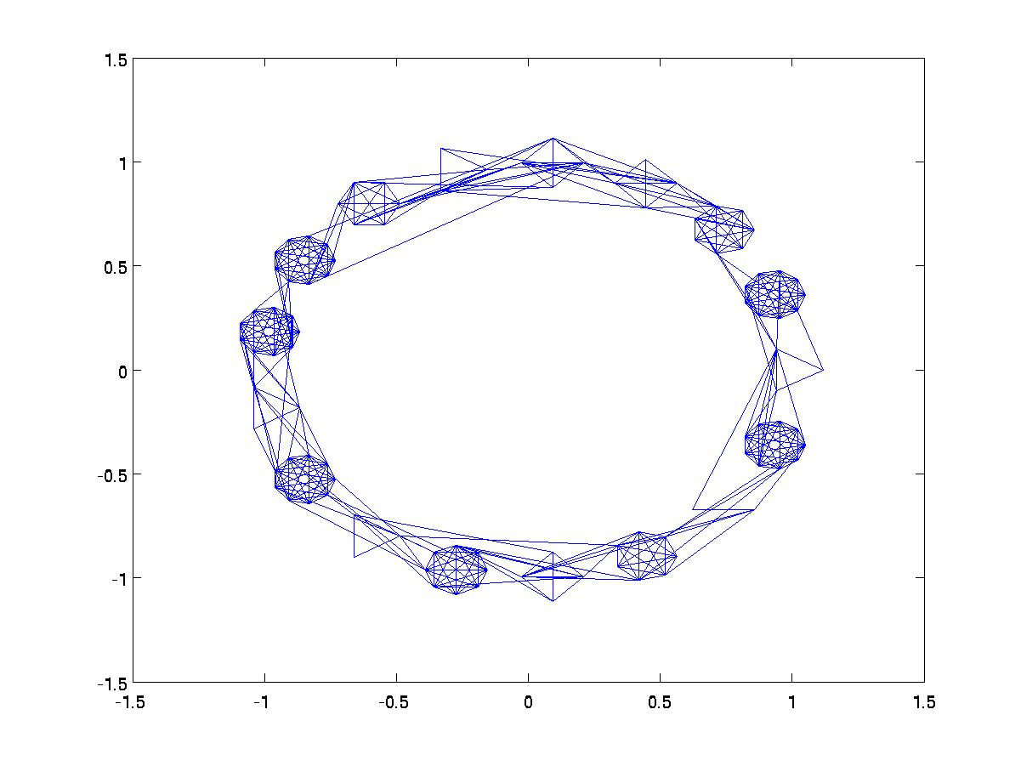
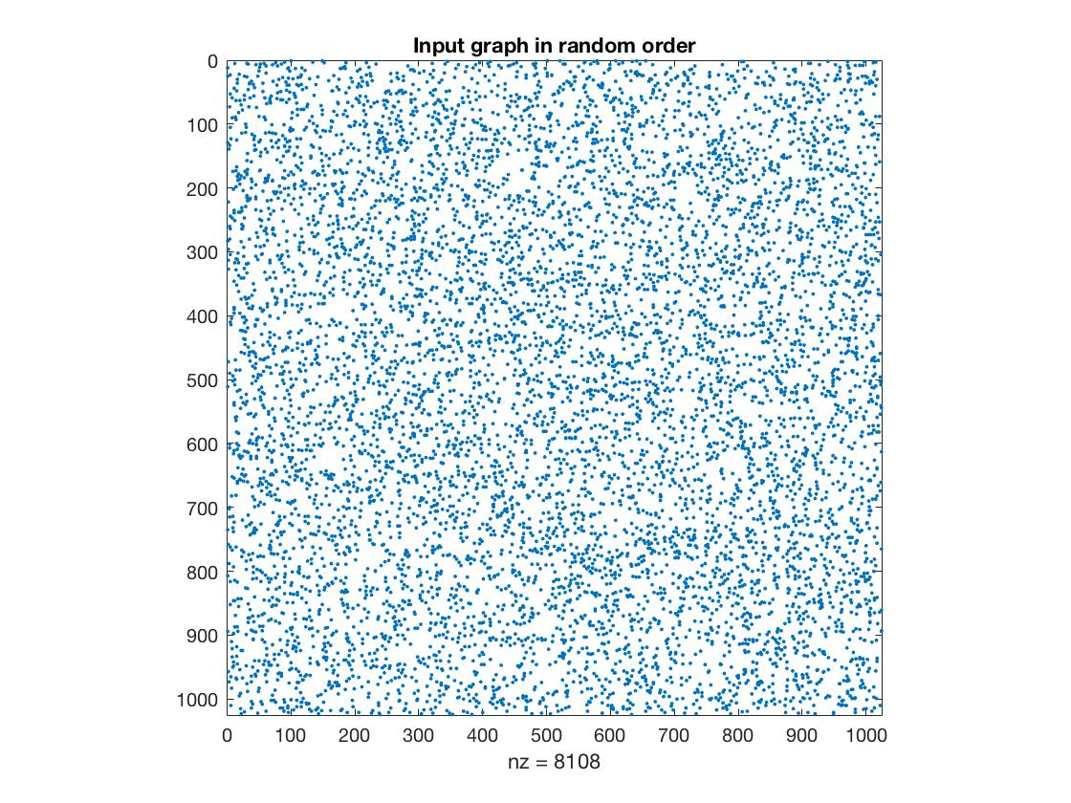
First draft of HPCS graph analysis benchmark
[circa 2004]
Many tight clusters, loosely interconnected
Input data is edge triples < i, j, a >
Vertices and edges permuted randomly

Slide 39
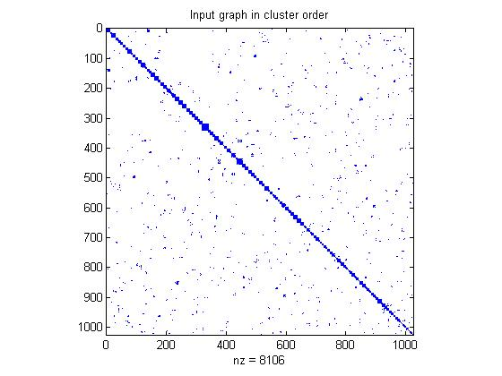
Greedy clustering by breadth-first search
Grow local clusters from many seeds in parallel
Breadth-first search by sparse matrix * matrix
Cluster vertices connected by many short paths
% Grow each seed to vertices
% reached by at least k
% paths of length 1 or 2
C = sparse(seeds, 1:ns, 1, n, ns);
C = A * C;
C = C + A * C;
C = C >= k;

Slide 40
Multiple-source breadth-first search
1
2
4
7
5
3
6
A^{T}
B

Slide 41
Multiple-source breadth-first search
1
2
→
4
5
7
3
6
A^{T}
B
A^{T} B
Sparse array representation => space efficient
Sparse matrix-matrix multiplication => work efficient
Three possible levels of parallelism: searches, vertices, edges
Notes:
What we do here is parallelism on the edge level, 2D partitioning is actually edge partitioning.

Slide 42
Multiple-source breadth-first search
1
2
→
4
5
7
3
6
A^{T}
B
A^{T} B
The final HPCS graph analysis benchmark (SSCA2) was betweenness centrality, not clustering -- but the main primitive was still multiple-source breadth-first search!
Notes:
What we do here is parallelism on the edge level, 2D partitioning is actually edge partitioning.

Slide 43
History
In the year 2010
(and soon after) ...

Slide 44
Matrix-based graph processor design at MIT-LL
[Song, Kepner, et al. 2010]

Slide 45
Combinatorial BLAS [2010]
gauss.cs.ucsb.edu/~aydin/CombBLAS
[Azad, Buluc, G, Lugowski, …]
An extensible distributed-memory library offering a small but powerful set of linear algebraic operations specifically targeting graph analytics.
Aimed at graph algorithm designers/programmers who are not expert in mapping algorithms to parallel hardware.
Flexible templated C++ interface.
Scalable performance from laptop to 100,000-processor HPC.
Open source software.
Version 1.6.2 released April 2018.

Slide 46

Sparse array primitives for graphs
Sparse matrix-sparse matrix multiplication
Sparse matrix-sparse vector multiplication
*
*
Element-wise operations
  Sparse matrix indexing
.*
Matrices over various semirings: (+, ×), (and, or), (min, +), …
Notes:
Many of these primitives (except for element-wise operations) are very understudied due to their lack of applications in numerical linear algebra.

Slide 47
Examples of semirings in graph algorithms
“values”: edge/vertex attributes, “add”: vertex data aggregation, “multiply”: edge data processing | General schema for user-specified computation at vertices and edges
Real field: (R, +, *) | Numerical linear algebra
Boolean algebra: ({0 1}, |, &) | Graph traversal
Tropical semiring: (R U {∞}, min, +) | Shortest paths
(S, select, select) | Select subgraph, or contract nodes to form quotient graph

Slide 48
Graph algorithms in the language of linear algebra
Kepner et al. study [2006]: fundamental graph algorithms including min spanning tree, shortest paths, independent set, max flow, clustering, …
SSCA#2 / centrality [2008]
Basic breadth-first search / Graph500 [2010]
Combinatorial BLAS [2010]
[2011]

Slide 49
History: D4M and Graphulo [Kepner et al., MIT & UW 2011 - 2015]
Linear algebra on associative arrays for heterogeneous distributed databases & graphs

Slide 50
History: Jon Berry challenge problems [2013]
Clustering coefficient (triangle counting)
Connected components (bully algorithm)
Maximum independent set (NP-hard)
Maximal independent set (Luby algorithm)
Single-source shortest paths
Special betweenness (for subgraph isomorphism)

Slide 51
Counting triangles (clustering coefficient)
A
Clustering coefficient:
Pr (wedge i-j-k makes a triangle with edge i-k)
3 * # triangles / # wedges
3 * 4 / 19 = 0.63 in example
may want to compute for each vertex j
3
5
4
6
1
2
Notes:
More with sparse matrix triples products: Vertex relabeling, batch graph updates, etc.

Slide 52
Counting triangles (clustering coefficient)
A
Clustering coefficient:
Pr (wedge i-j-k makes a triangle with edge i-k)
3 * # triangles / # wedges
3 * 4 / 19 = 0.63 in example
may want to compute for each vertex j
3
5
4
6
1
2
“Cohen’s” algorithm to count triangles:
  - Count triangles by lowest-degree vertex.
  - Enumerate “low-hinged” wedges.
  - Keep wedges that close.
hi
hi
lo
hi
hi
lo
hi
hi
lo
Notes:
More with sparse matrix triples products: Vertex relabeling, batch graph updates, etc.

Slide 53
Counting triangles (clustering coefficient)
A
B, C
A = L + U (hi->lo + lo->hi)
L × U = B (wedge, low hinge)
A ∧ B = C (closed wedge)
sum(C)/2 = 4 triangles
3
3
1
4
5
4
5
2
1
6
6
1
2
1
2
A
L
U
C
1
1
1
2
1
2
Notes:
More with sparse matrix triples products: Vertex relabeling, batch graph updates, etc.

Slide 54
Counting triangles (clustering coefficient)
A
B, C
A = L + U (hi->lo + lo->hi)
L × U = B (wedge, low hinge)
A ∧ B = C (closed wedge)
sum(C)/2 = 4 triangles
3
3
1
4
5
4
5
2
1
6
6
1
2
1
2
A
L
U
C
1
1
1
2
1
2
Spoiler: (L × L) ^ L works better in practice [Wolf et al. 2017]
Notes:
More with sparse matrix triples products: Vertex relabeling, batch graph updates, etc.

Slide 55
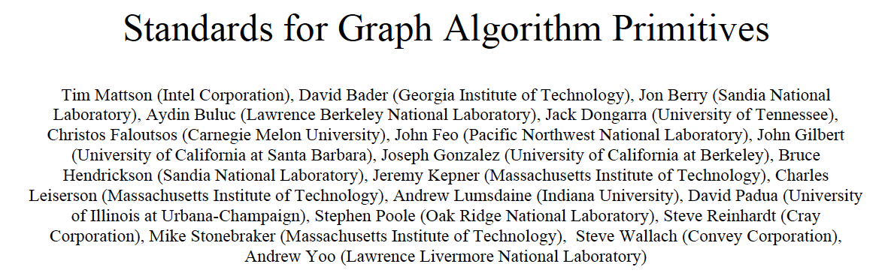
History: The Graph BLAS Forum
http://graphblas.org
Manifesto,
HPEC 2013:
Foundations,
HPEC 2016:
Abstract-- It is our view that the state of the art in constructing a large collection of graph algorithms in terms of linear algebraic operations is mature enough to support the emergence of a standard set of primitive building blocks. This paper is a position paper defining the problem and announcing our intention to launch an open effort to define this standard.

Slide 56
The Present
In the year 2018 ....

Slide 57
The Present GABB 2018 Talks

Slide 58
The Future
In the years 2019 —

Slide 59
What do we hope for in the future?
More basic capabilities
  Streaming and dynamic-graph algorithms
  “Priority queue” algorithms: strong components, top k vertices, etc.
  Not materializing intermediate results (eg, incidence matrix methods)
  Laplacian paradigm for graph algorithms

Slide 60
Question: Not materializing big matrix products
In sparse Gaussian elimination, for nonsymmetric A, one can find . . .
  column nested dissection or min degree permutation
  column elimination tree T(A^{T}A)
  row and column counts for G⁺(A^{T}A)
  supernodes of G⁺(A^{T}A)
  nonzero structure of G⁺(A^{T}A)
. . . efficiently, without ever forming A^{T}A explicitly.
How generally can we do graph algorithms in linear algebra without storing intermediate results?
Can we do fine-grained scheduling of vertex and edge operations to break out of bulk synchronous execution?
Can we reason directly about products of sparse matrices?

Slide 61
Storing A, operating implicitly on A^{T}A
CombBLAS represents graphs as adjacency matrices.
D4M represents graphs as incidence matrices;
matrix A represents G(A^{T}A):
A
column = vertex
row = hyperedge

Slide 62
Storing A, operating implicitly on A^{T}A
Many other cases:
  Optimization: KKT systems, interior point methods.
  Automatic differentiation: distance-2 coloring.
  Linear equations: QR factorization, structure prediction for LU factorization with partial pivoting.
Question: What can you do fast on G(A^{T}A) just from G(A)?

Slide 63
Statistics for A^{T}A itself are harder!
nnz(A^{T}A) seems to be as hard as computing A^{T}A.
  but randomized estimate is possible [Cohen 1998]
  Sampling algorithms are possible too, e.g. diamond sampling for k largest elements of A^{T}A (or B*C in general) [Ballard/Kolda/Pinar/Seshadri 2015]
Ballard et al. ICDM 2015

Slide 64
What do we hope for in the future?
More basic capabilities
  Streaming and dynamic algorithms
  “Priority queue” algorithms: strong components, top k vertices, etc.
  Not materializing intermediate results (eg, incidence matrix methods)
  Laplacian paradigm for graph algorithms

Slide 65
Laplacian matrix of a graph
Graph Laplacian: Symmetric, positive semidefinite, weighted.
Laplacian paradigm: Use Ax = b as a subroutine in graph algorithms
[Kelner, Teng, many others]
Laplacian eigenvectors for partitioning, embedding, and clustering
[Fiedler, Pothen/Simon, Spielman/Teng, many others]
Interesting new ideas coming from theoretical computer science.

Slide 66
What do we hope for in the future?
More basic capabilities
  Streaming and dynamic algorithms
  “Priority queue” algorithms: strong components, top k vertices, etc.
  Not materializing intermediate results (eg, incidence matrix methods)
  Laplacian paradigm for graph algorithms

Slide 67
What do we hope for in the future?
More basic capabilities
  Streaming and dynamic algorithms
  “Priority queue” algorithms: strong components, top k vertices, etc.
  Not materializing intermediate results (eg, incidence matrix methods)
  Laplacian paradigm for graph algorithms
More directions
  Integration with numerical matrix libraries
  Statistical perspective: random objects, stochastic graphs, etc.
  Deep neural networks (more)
  Signal processing on graphs

Slide 68
What do we hope for in the future?
More basic capabilities
  Streaming and dynamic algorithms
  “Priority queue” algorithms: strong components, top k vertices, etc.
  Not materializing intermediate results (eg, incidence matrix methods)
  Laplacian paradigm for graph algorithms
More directions
  Integration with numerical matrix libraries
  Statistical perspective: random objects, stochastic graphs, etc.
  Deep neural networks (more)
  Signal processing on graphs
More uptake
  By hardware vendors
  By software vendors

Slide 69
Summary: Past 60 Years
As the “middleware”
of scientific computing,
linear algebra has given us:
Mathematical tools
High-level primitives
High-quality software libraries
High-performance kernels
for computer architectures
Interactive environments
Continuous
Physical Modeling
Linear Algebra
Computers

Slide 70
Today
Continuous
Physical Modeling
Discrete
Structure Analysis
Linear Algebra
Graph Theory
Computers
Computers

Slide 71
Today
Continuous
Physical Modeling
Discrete
Structure Analysis
Linear Algebra & Graph Theory
Computers
Computers

Slide 72
Tomorrow
Continuous
Physical Modeling
Discrete
Structure Analysis
Extracting Sense
from Data
Linear Algebra
Graph Theory
Mae Learning?
Computers
Computers
Computers

Slide 73
Tomorrow
Continuous
Physical Modeling
Discrete
Structure Analysis
Extracting Sense
from Data
Linear Algebra
Graph Theory
Statistics ?
Computers
Computers
Computers

Slide 74
Tomorrow
Continuous
Physical Modeling
Discrete
Structure Analysis
Extracting Sense
from Data
Linear Algebra
Graph Theory
Deep Learning ?
Computers
Computers
Computers

Slide 75
Tomorrow
Continuous
Physical Modeling
Discrete
Structure Analysis
Extracting Sense
from Data
Linear Algebra
Graph Theory
Neuromorphics ?
Computers
Computers
Computers

Slide 76
Tomorrow
Continuous
Physical Modeling
Discrete
Structure Analysis
Extracting Sense
from Data
Linear Algebra
Graph Theory
xxaine???earngx
Computers
Computers
Computers

Slide 77
Tomorrow
Continuous
Physical Modeling
Discrete
Structure Analysis
Extracting Sense
from Data
Linear Algebra & Graph Theory & ???
Computers
Computers
Computers

Slide 78
Thanks …
Ariful Azad, David Bader, Jon Berry, Eric Boman, Aydin Buluc, Ben Chang, John Conroy, Tim Davis, Kevin Deweese, Erika Duriakova, Assefaw Gebremedhin, Shoaib Kamil, Jeremy Kepner, Tammy Kolda, Tristan Konolige, Manoj Kumar, Adam Lugowski, Tim Mattson, Scott McMillan, Henning Meyerhenke, Jose Moreira, Esmond Ng, Lenny Oliker, Weimin Ouyang, Ali Pinar, Alex Pothen, Carey Priebe, Steve Reinhardt, Lijie Ren, Eric Robinson, Viral Shah, Veronika Strnadova-Neeley, Blair Sullivan, Shang-Hua Teng, Yun Teng, Sam Williams
… and Intel, Microsoft, NSF, DOE Office of Science

