Slide 1


Sparse Matrices for
High Performance Graph Analytics
John R. Gilbert
University of California, Santa Barbara
Purdue University
January 27, 2016
Support at UCSB: Intel, Microsoft, DOE Office of Science, NSF

Slide 2
Thanks …
Ariful Azad, David Bader, Lucas Bang, Jon Berry, Eric Boman, Aydin Buluc, John Conroy, Kevin Deweese, Erika Duriakova, Armando Fox, Joey Gonzalez, Shoaib Kamil, Jeremy Kepner, Tristan Konolige, Manoj Kumar, Adam Lugowski, Tim Mattson, Brad McRae, Henning Meyerhenke, Dave Mizell, Jose Moreira, Lenny Oliker, Carey Priebe, Steve Reinhardt, Lijie Ren, Eric Robinson, Viral Shah, Veronika Strnadova-Neely, Yun Teng, Joshua Vogelstein, Drew Waranis, Sam Williams

Slide 3
Outline
Motivation: Graph applications
Mathematics: Sparse matrices for graph algorithms
Software: CombBLAS, KDT, QuadMat
Standards: The Graph BLAS effort

Slide 4
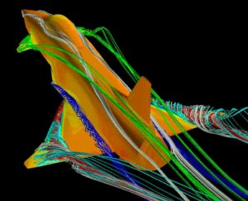
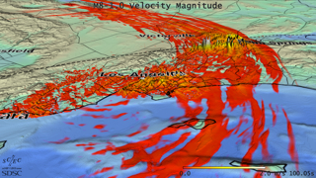
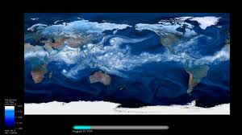
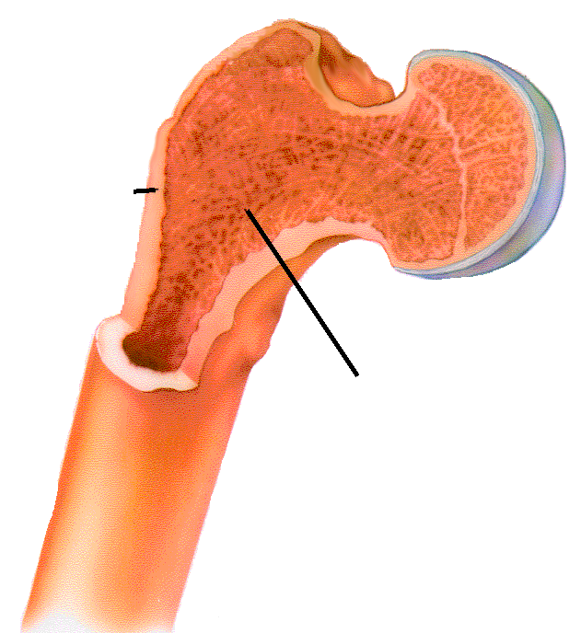
Computational models of the physical world
Cortical bone
Trabecular bone

Slide 5
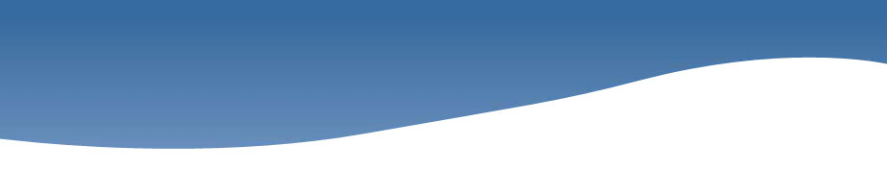
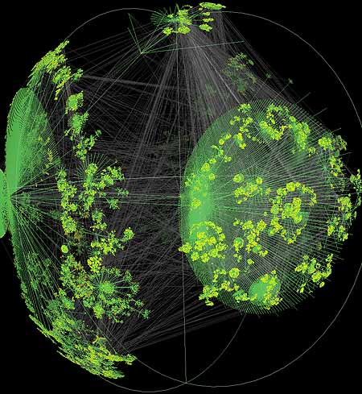
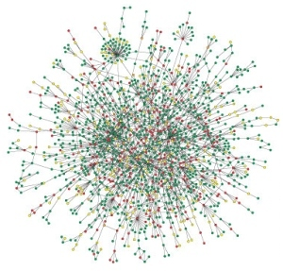

Large graphs are everywhere…
Internet structure
Social interactions
Scientific datasets: biological, chemical, cosmological, ecological, …
WWW snapshot, courtesy Y. Hyun
Yeast protein interaction network, courtesy H. Jeong
Notes:
Details on the types of computations here -> Pagerank (web), betweenness centrality (biological)
Both are huge, sparse graphs

Slide 6
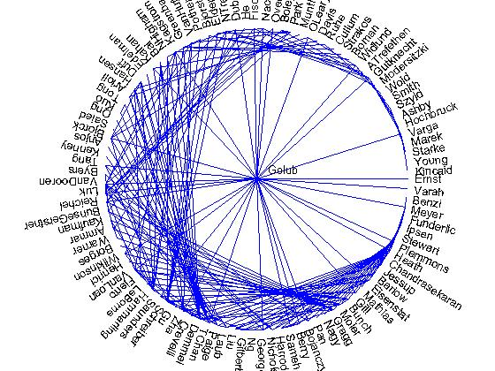
Social network analysis (1993)
Co-author graph
from 1993
Householder
symposium

Slide 7
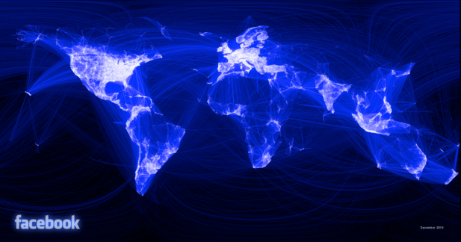
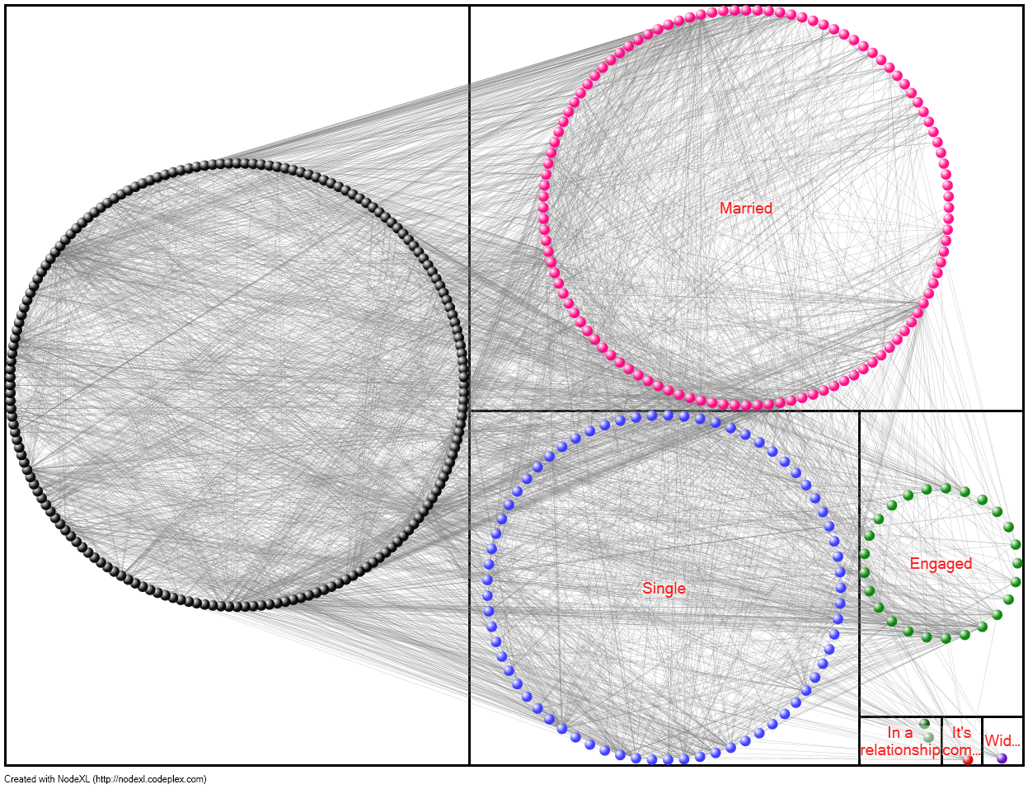
Social network analysis (2016)
Facebook graph:
> 1,200,000,000 vertices

Slide 8
The middleware challenge for graph analysis
Continuous
physical modeling
Discrete
structure analysis
Linear algebra
Graph theory
Computers
Computers

Slide 9
Top 500 List (November 2015)
Top500 Benchmark:
Solve a large system
of linear equations
by Gaussian elimination
P
A
U
=
L
x

Slide 10

Graph 500 List (November 2015)
Graph500 Benchmark:
Breadth-first search
in a large
power-law graph
1
2
4
7
5
3
6

Slide 11
Floating-Point vs. Graphs, November 2015
34 Petaflops
38 Terateps
U
1
2
P
A
=
L
x
4
7
5
3
6
34 Peta / 38 Tera is about 900.

Slide 12
Floating-Point vs. Graphs, November 2015
34 Petaflops
38 Terateps
U
1
2
P
A
=
L
x
4
7
5
3
6
Nov 2015: 34 Peta / 38 Tera ~ 900
Nov 2010: 2.5 Peta / 6.6 Giga ~ 380,000

Slide 13
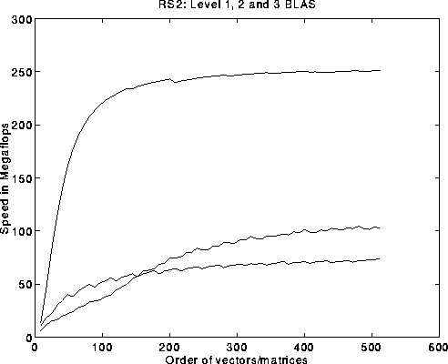
The middleware challenge for graph analysis
By analogy to numerical
scientific computing. . .
What should the combinatorial BLAS look like?
Basic Linear Algebra Subroutines (BLAS):
Ops/Sec vs. Matrix Size
C = A*B
y = A*x
μ = x^{T} y

Slide 14
The case for sparse matrices
Coarse-grained parallelism can be exploited
by abstractions at the right level.
Vertex/edge graph computations | Graphs in the language of linear algebra
Unpredictable, data-driven communication patterns | Fixed communication patterns
Irregular data accesses, with poor locality | Matrix block operations exploit memory hierarchy
Fine grained data accesses, dominated by latency | Coarse grained parallelism, limited by bandwidth not latency
Notes:
And that “proper level” happens to be the sparse matrix operations level
It is all about primitives

Slide 15
Sparse array primitives for graphs
Sparse matrix-sparse matrix multiplication
Sparse matrix-sparse vector multiplication
*
*
Element-wise operations
  Sparse matrix indexing
.*
Matrices over various semirings: (+, ×), (and, or), (min, +), …
Notes:
Many of these primitives (except for element-wise operations) are very understudied due to their lack of applications in numerical linear algebra.

Slide 16
Multiple-source breadth-first search
1
2
4
7
5
3
6
A^{T}
B

Slide 17
Multiple-source breadth-first search
1
2
→
4
5
7
3
6
A^{T}
B
A^{T} B
Sparse array representation => space efficient
Sparse matrix-matrix multiplication => work efficient
Three possible levels of parallelism: searches, vertices, edges
Notes:
What we do here is parallelism on the edge level, 2D partitioning is actually edge partitioning.

Slide 18
Examples of semirings in graph algorithms
( “values”: edge/vertex attributes, “add”: vertex data aggregation, “multiply”: edge data processing ) | General schema for user-specified computation at vertices and edges
Real field: (R, +, *) | Numerical linear algebra
Boolean algebra: ({0 1}, |, &) | Graph traversal
Tropical semiring: (R U {∞}, min, +) | Shortest paths
(S, select, select) | Select subgraph, or contract nodes to form quotient graph

Slide 19
Graph contraction via sparse triple product
A1
1
2
Contract
A1
6
A3
A2
4
A2
A3
5
3
1
2
3
4
5
6
1
2
3
4
5
6
1
1
1
0
0
0
0
1
1
1
0
0
0
1
0
1
0
x
x
1
0
1
=
2
2
3
0
0
0
1
0
1
3
0
1
0
4
1
1
1
1
5
0
0
1
6
Notes:
All with sparse matrix triples products

Slide 20
Subgraph extraction via sparse triple product
1
2
Extract
3
6
2
4
1
5
3
1
2
3
4
5
6
1
2
3
4
5
6
1
1
1
1
0
0
0
1
1
1
0
0
0
1
1
1
0
x
x
1
0
1
=
2
2
3
0
0
0
1
0
1
3
1
1
0
4
1
1
1
1
5
0
0
1
6
Notes:
More with sparse matrix triples products: Vertex relabeling, batch graph updates, etc.

Slide 21
Counting triangles (clustering coefficient)
A
Clustering coefficient:
Pr (wedge i-j-k makes a triangle with edge i-k)
3 * # triangles / # wedges
3 * 4 / 19 = 0.63 in example
may want to compute for each vertex j
3
5
4
6
1
2
Notes:
More with sparse matrix triples products: Vertex relabeling, batch graph updates, etc.

Slide 22
Counting triangles (clustering coefficient)
A
Clustering coefficient:
Pr (wedge i-j-k makes a triangle with edge i-k)
3 * # triangles / # wedges
3 * 4 / 19 = 0.63 in example
may want to compute for each vertex j
3
5
4
6
1
2
“Cohen’s” algorithm to count triangles:
  - Count triangles by lowest-degree vertex.
  - Enumerate “low-hinged” wedges.
  - Keep wedges that close.
hi
hi
lo
hi
hi
lo
hi
hi
lo
Notes:
More with sparse matrix triples products: Vertex relabeling, batch graph updates, etc.

Slide 23
Counting triangles (clustering coefficient)
A
B, C
A = L + U (hi->lo + lo->hi)
L × U = B (wedge, low hinge)
A ∧ B = C (closed wedge)
sum(C)/2 = 4 triangles
3
3
1
4
5
4
5
2
1
6
6
1
2
1
2
A
L
U
C
1
1
1
2
1
2
Notes:
More with sparse matrix triples products: Vertex relabeling, batch graph updates, etc.

Slide 24
Combinatorial BLAS
http://gauss.cs.ucsb.edu/~aydin/CombBLAS
An extensible distributed-memory library offering a small but powerful set of linear algebraic operations specifically targeting graph analytics.
Aimed at graph algorithm designers/programmers who are not expert in mapping algorithms to parallel hardware.
Flexible, templated C++ interface.
Scalable performance from laptop to 100,000-processor HPC.
Open source software, version 1.6.2 released April 2018.

Slide 25
Combinatorial BLAS in distributed memory
Combinatorial BLAS
functions and operators
DistMat
CommGrid
FullyDistVec
... HAS A
Polymorphism
DenseDistMat
SpDistMat
SpMat
SpDistVec
DenseDistVec
Enforces interface only
DCSC
CSC
Triples
CSB
Notes:
Naming might be in flux (e.g., SpDistMat is currently SpParMat and there are two distributed vectors) but will stabilize.
Highly templated C++
Operations on arbitrary semirings.
Extendible architecture (e.g., CommGrid handles communication, currently: perfect square, future: arbitrary rectangular grids)

Slide 26
2D Layout for Sparse Matrices & Vectors
Matrix/vector distributions,
interleaved on each other.
Default distribution in Combinatorial BLAS.
Scalable with increasing number of processes
5
8
- 2D matrix layout wins over 1D with large core counts
and with limited bandwidth/compute
- 2D vector layout sometimes important for load balance

Slide 27
Parallel sparse matrix-matrix multiplication: SpGEMM
C_{ij} += HyperSparseGEMM(A^{recv}, B^{recv})
25K
100K
5K
25K
x
=
100K
A
C
5K
B
2D algorithm: Sparse SUMMA (based on dense SUMMA)
General implementation that handles rectangular matrices

Slide 28

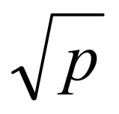
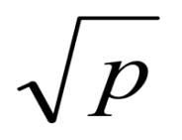
Submatrices are “hypersparse” (i.e. nnz << n)
Node-level considerations
blocks
Average of c nonzeros per column
Total Storage:
blocks
A data structure or algorithm that depends on matrix dimension n (e.g. CSR or CSC) is asymptotically too wasteful for submatrices
Use doubly-compressed (DCSC) or compressed
sparse block (CSB) data structures instead.
Notes:
CSC (and CSR) are vertex based data structures, they are just isomorphic to adjacency list representation. There is a dense array of vertices and one chain of incoming edges per array element. However, 2D distribution is based on edges, so using CSC with 2D distributed data is forcing a vertex based representation on edge distributed data.
Result: unnecessary replication of vertex heads.

Slide 29
1D vs. 2D scaling for sparse matrix-matrix multiplication
SpSUMMA = 2-D data layout (Combinatorial BLAS)
EpetraExt = 1-D data layout (Trilinos)
2D algorithms have the potential to scale, but not linearly.
Notes:
Explicitly say what axes are – x is number of processors, y is seconds.
\beta and \alpha are latency and bandwidth, both expressed in terms of time for a floating point operation and its associated costs.

Slide 30
Scaling to more processors…
Almost linear scaling until bandwidth costs starts to dominate
Scaling proportional to √p afterwards

Slide 31
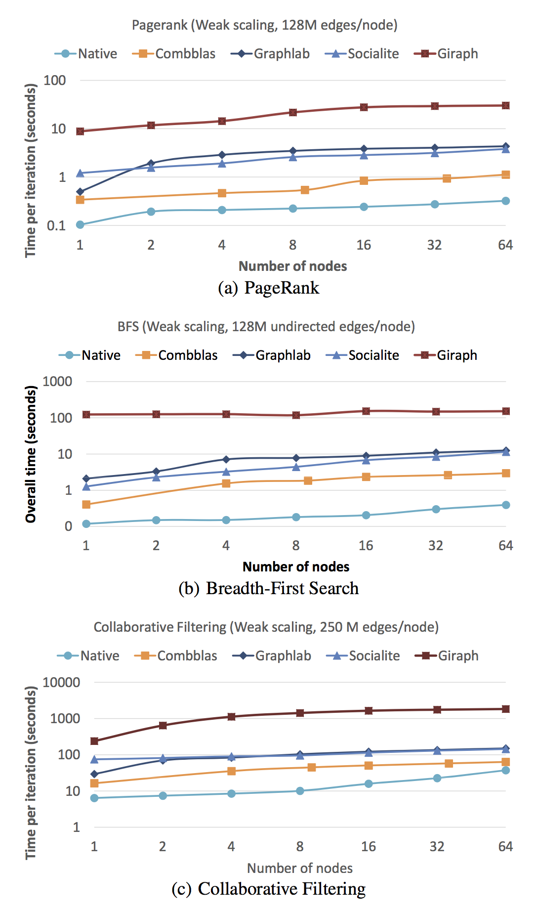
Benchmarking graph analytics frameworks
Combinatorial BLAS was fastest
among all tested
graph processing frameworks
on 3 out of 4 benchmarks
in an independent study by Intel.
Satish et al. "Navigating the Maze of Graph Analytics Frameworks using Massive Graph Datasets”,
in SIGMOD’14
Notes:
(the fourth one is an API limitation to be fixed)

Slide 32
Combinatorial BLAS “users” (Jan 2016)
Berkeley Lab
Sandia Labs
Columbia
U Minnesota
Duke
Indiana U
Mississippi State
SEI
Paradigm4
Mellanox
IHPC (Singapore)
Tokyo Inst of Technology
Chinese Academy of Sciences
U Canterbury (New Zealand)
King Fahd U (Saudi Arabia)
Bilkent U (Turkey)
U Ghent (Belgium)
IBM (T.J.Watson, Zurich, & Tokyo)
Intel
Cray
Microsoft
Stanford
MIT
UC Berkeley
Carnegie-Mellon
Georgia Tech
Purdue
Ohio State
U Texas Austin
NC State
UC San Diego
UC Merced
UC Santa Barbara

Slide 33
Knowledge
Discovery
Toolbox
http://kdt.sourceforge.net/
A general graph library with operations based on linear algebraic primitives
Aimed at domain experts who know their problem well but don’t know how to program a supercomputer
Easy-to-use Python interface
Runs on a laptop as well as a cluster with 10,000 processors
Open source software (New BSD license)

Slide 34
Attributed semantic graphs and filters
def onlyEngineers (self):
return self.position == Engineer
def timedEmail (self, sTime, eTime):
return ((self.type == email) and
(self.Time > sTime) and
(self.Time < eTime))
G.addVFilter(onlyEngineers)
G.addEFilter(timedEmail(start, end))
# rank via centrality based on recent
email transactions among engineers
bc = G.rank(’approxBC’)
Example:
Vertex types: Person, Phone, Camera, Gene, Pathway
Edge types: PhoneCall, TextMessage, CoLocation, SequenceSimilarity
Edge attributes: Time, Duration
Calculate centrality just for emails among engineers sent between given start and end times

Slide 35
SEJITS for filter/semiring acceleration
Embedded DSL: Python for the whole application
Introspect, translate Python to equivalent C++ code
Call compiled/optimized C++ instead of Python

Slide 36
Filtered BFS with SEJITS
Time (in seconds) for a single BFS iteration on scale 25 RMAT (33M vertices, 500M edges) with 10% of elements passing filter. Machine is NERSC’s Hopper.

Slide 37
A few other graph algorithms we’ve implemented in linear algebraic style
Maximal independent set (KDT/SEJITS) [BDFGKLOW 2013]
Peer-pressure clustering (SPARQL) [DGLMR 2013]
Time-dependent shortest paths (CombBLAS) [Ren 2012]
Gaussian belief propagation (KDT) [LABGRTW 2011]
Markoff clustering (CombBLAS, KDT) [BG 2011, LABGRTW 2011]
Betweenness centrality (CombBLAS) [BG 2011]
Geometric mesh partitioning (Matlab ☺) [GMT 1998]

Slide 38
The (original) BLAS
The Basic Linear Algebra Subroutines
had a revolutionary impact
on computational linear algebra.
BLAS 1 | vector ops | Lawson, Hanson, Kincaid, Krogh, 1979 | LINPACK
BLAS 2 | matrix-vector ops | Dongarra, Du Croz, Hammarling, Hanson, 1988 | LINPACK on vector machines
BLAS 3 | matrix-matrix ops | Dongarra, Du Croz, Duff, Hammarling, 1990 | LAPACK on cache based machines
Experts in mapping algorithms to hardware tune BLAS for specific platforms.
Experts in numerical linear algebra build software on top of the BLAS to get
high performance “for free.”
Today every computer, phone, etc. comes with /usr/lib/libblas

Slide 39
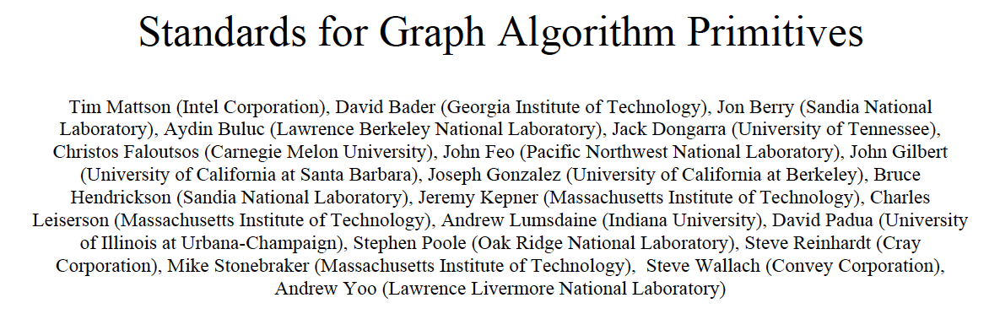
The Graph BLAS effort
Manifesto,
HPEC 2013:
Workshops at IPDPS, HPEC, SC
Periodic working group telecons and meetings
Graph BLAS Forum: http://graphblas.org
Abstract-- It is our view that the state of the art in constructing a large collection of graph algorithms in terms of linear algebraic operations is mature enough to support the emergence of a standard set of primitive building blocks. This paper is a position paper defining the problem and announcing our intention to launch an open effort to define this standard.

Slide 40
GraphBLAS Base Operations
Operation | Math | Out | Inputs
mxm | C(¬M) ⊕= A^{T} ⊕.⊗ B^{T} | C | ¬, M, ⊕, A, T, ⊕.⊗, B, T
mxv (vxm) | c(¬m) ⊕= A^{T} ⊕.⊗ b | c | ¬, m, ⊕, A, T, ⊕.⊗, b
eWiseMult | C(¬M) ⊕= A^{T} ⊗ B^{T} | C | ¬, M, ⊕, A, T, ⊗, B, T
eWiseAdd | C(¬M) ⊕= A^{T} ⊕ B^{T} | C | ¬, M, ⊕, A, T, ⊕, B, T
reduce (row) | c(¬m) ⊕= ⊕_{j} A^{T}(:,j) | c | ¬, m, ⊕, A, T, ⊕
apply | C(¬M) ⊕= f(A^{T}) | C | ¬, M, ⊕, A, T, f
transpose | C(¬M) ⊕= A^{T} | C | ¬, M, ⊕, A (T)
extract | C(¬M) ⊕= A^{T}(i,j) | C | ¬, M, ⊕, A, T, i, j
assign | C(¬M) (i,j) ⊕= A^{T} | C | ¬, M, ⊕, A, T, i, j
buildMatrix | C(¬M) ⊕= S^{mxn}(i,j,v,⊕) | C | ¬, M, ⊕, ⊕, m, n, i, j, v
extractTuples | (i,j,v) = A(¬M) | i,j,v | ¬, M, A
Notation: i,j – index arrays, v – scalar array, m – 1D mask, other bold-lower – vector (column),
M – 2D mask, other bold-caps – matrix, T – transpose, ¬ - structural complement,
⊕ monoid/binary function, ⊕.⊗ semiring,
blue – optional parameters, red – optional modifiers (using Descriptors)

Slide 41
Breadth-first search with Graph BLAS (draft C API spec)

