Slide 1
CS 240A: Solving Ax = b in parallel
Dense A: Gaussian elimination with partial pivoting
Same flavor as matrix * matrix, but more complicated
Sparse A: Iterative methods – Conjugate gradient etc.
Sparse matrix times dense vector
Sparse A: Gaussian elimination – Cholesky, LU, etc.
Graph algorithms
Sparse A: Preconditioned iterative methods and multigrid
Mixture of lots of things

Slide 2
CS 240A: Solving Ax = b in parallel
Dense A: Gaussian elimination with partial pivoting
Same flavor as matrix * matrix, but more complicated
Sparse A: Iterative methods – Conjugate gradient etc.
Sparse matrix times dense vector
Sparse A: Gaussian elimination – Cholesky, LU, etc.
Graph algorithms
Sparse A: Preconditioned iterative methods and multigrid
Mixture of lots of things

Slide 3
Dense Linear Algebra (Excerpts)
James Demmel
http://www.cs.berkeley.edu/~demmel/cs267_221001.ppt

Slide 4
Motivation
3 Basic Linear Algebra Problems
Linear Equations: Solve Ax=b for x
Least Squares: Find x that minimizes Σ r_{i}² where r=Ax-b
Eigenvalues: Find λ and x where Ax = λ x
Lots of variations depending on structure of A (eg symmetry)
Why dense A, as opposed to sparse A?
Aren’t “most” large matrices sparse?
Dense algorithms easier to understand
Some applications yields large dense matrices
Ax=b: Computational Electromagnetics
Ax = λx: Quantum Chemistry
Benchmarking
“How fast is your computer?” = “How fast can you solve dense Ax=b?”
Large sparse matrix algorithms often yield smaller (but still large) dense problems

Slide 5
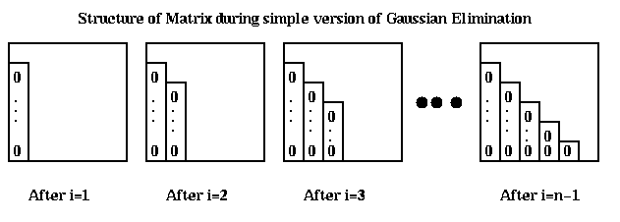
Review of Gaussian Elimination (GE) for solving Ax=b
Add multiples of each row to later rows to make A upper triangular
Solve resulting triangular system Ux = c by substitution
… for each column i
… zero it out below the diagonal by adding multiples of row i to later rows
for i = 1 to n-1
… for each row j below row i
for j = i+1 to n
… add a multiple of row i to row j
for k = i to n
A(j,k) = A(j,k) - (A(j,i)/A(i,i)) * A(i,k)

Slide 6
Refine GE Algorithm (1)
Initial Version
Remove computation of constant A(j,i)/A(i,i) from inner loop
… for each column i
… zero it out below the diagonal by adding multiples of row i to later rows
for i = 1 to n-1
… for each row j below row i
for j = i+1 to n
… add a multiple of row i to row j
for k = i to n
A(j,k) = A(j,k) - (A(j,i)/A(i,i)) * A(i,k)
for i = 1 to n-1
for j = i+1 to n
m = A(j,i)/A(i,i)
for k = i to n
A(j,k) = A(j,k) - m * A(i,k)

Slide 7
Refine GE Algorithm (2)
Last version
Don’t compute what we already know: zeros below diagonal in column i
for i = 1 to n-1
for j = i+1 to n
m = A(j,i)/A(i,i)
for k = i to n
A(j,k) = A(j,k) - m * A(i,k)
for i = 1 to n-1
for j = i+1 to n
m = A(j,i)/A(i,i)
for k = i+1 to n
A(j,k) = A(j,k) - m * A(i,k)

Slide 8
Refine GE Algorithm (3)
Last version
Store multipliers m below diagonal in zeroed entries for later use
for i = 1 to n-1
for j = i+1 to n
m = A(j,i)/A(i,i)
for k = i+1 to n
A(j,k) = A(j,k) - m * A(i,k)
for i = 1 to n-1
for j = i+1 to n
A(j,i) = A(j,i)/A(i,i)
for k = i+1 to n
A(j,k) = A(j,k) - A(j,i) * A(i,k)

Slide 9
Refine GE Algorithm (4)
Last version
for i = 1 to n-1
for j = i+1 to n
A(j,i) = A(j,i)/A(i,i)
for k = i+1 to n
A(j,k) = A(j,k) - A(j,i) * A(i,k)
Split Loop
for i = 1 to n-1
for j = i+1 to n
A(j,i) = A(j,i)/A(i,i)
for j = i+1 to n
for k = i+1 to n
A(j,k) = A(j,k) - A(j,i) * A(i,k)

Slide 10
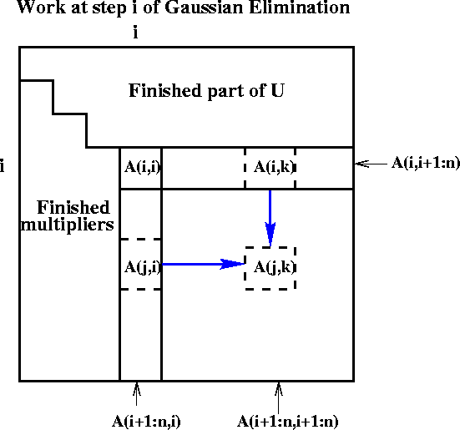
Refine GE Algorithm (5)
for i = 1 to n-1
for j = i+1 to n
A(j,i) = A(j,i)/A(i,i)
for j = i+1 to n
for k = i+1 to n
A(j,k) = A(j,k) - A(j,i) * A(i,k)
Last version
Express using matrix operations (BLAS)
for i = 1 to n-1
A(i+1:n,i) = A(i+1:n,i) * ( 1 / A(i,i) )
A(i+1:n,i+1:n) = A(i+1:n , i+1:n )
- A(i+1:n , i) * A(i , i+1:n)

Slide 11
What GE really computes
Call the strictly lower triangular matrix of multipliers M, and let L = I+M
Call the upper triangle of the final matrix U
Lemma (LU Factorization): If the above algorithm terminates (does not divide by zero) then A = L*U
Solving A*x=b using GE
Factorize A = L*U using GE (cost = 2/3 n³ flops)
Solve L*y = b for y, using substitution (cost = n² flops)
Solve U*x = y for x, using substitution (cost = n² flops)
Thus A*x = (L*U)*x = L*(U*x) = L*y = b as desired
for i = 1 to n-1
A(i+1:n,i) = A(i+1:n,i) / A(i,i)
A(i+1:n,i+1:n) = A(i+1:n , i+1:n ) - A(i+1:n , i) * A(i , i+1:n)

Slide 12
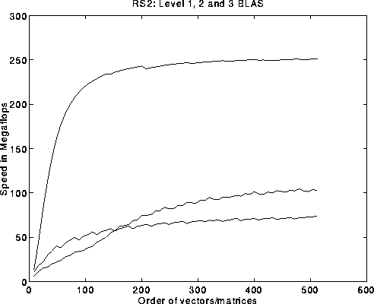
Problems with basic GE algorithm
What if some A(i,i) is zero? Or very small?
Result may not exist, or be “unstable”, so need to pivot
Current computation all BLAS 1 or BLAS 2, but we know that BLAS 3 (matrix multiply) is fastest (earlier lectures…)
for i = 1 to n-1
A(i+1:n,i) = A(i+1:n,i) / A(i,i) … BLAS 1 (scale a vector)
A(i+1:n,i+1:n) = A(i+1:n , i+1:n ) … BLAS 2 (rank-1 update)
- A(i+1:n , i) * A(i , i+1:n)
Peak
BLAS 3
BLAS 2
BLAS 1

Slide 13
Pivoting in Gaussian Elimination
A = [ 0 1 ] fails completely, even though A is “easy”
[ 1 0 ]
Illustrate problems in 3-decimal digit arithmetic:
A = [ 1e-4 1 ] and b = [ 1 ], correct answer to 3 places is x = [ 1 ]
[ 1 1 ] [ 2 ] [ 1 ]
Result of LU decomposition is
L = [ 1 0 ] = [ 1 0 ] … No roundoff error yet
[ fl(1/1e-4) 1 ] [ 1e4 1 ]
U = [ 1e-4 1 ] = [ 1e-4 1 ] … Error in 4th decimal place
[ 0 fl(1-1e4*1) ] [ 0 -1e4 ]
Check if A = L*U = [ 1e-4 1 ] … (2,2) entry entirely wrong
[ 1 0 ]
Algorithm “forgets” (2,2) entry, gets same L and U for all |A(2,2)|<5
Numerical instability
Computed solution x totally inaccurate
Cure: Pivot (swap rows of A) so entries of L and U bounded

Slide 14
Gaussian Elimination with Partial Pivoting (GEPP)
Partial Pivoting: swap rows so that each multiplier
|L(i,j)| = |A(j,i)/A(i,i)| <= 1
for i = 1 to n-1
find and record k where |A(k,i)| = max{i <= j <= n} |A(j,i)|
… i.e. largest entry in rest of column i
if |A(k,i)| = 0
exit with a warning that A is singular, or nearly so
elseif k != i
swap rows i and k of A
end if
A(i+1:n,i) = A(i+1:n,i) / A(i,i) … each quotient lies in [-1,1]
A(i+1:n,i+1:n) = A(i+1:n , i+1:n ) - A(i+1:n , i) * A(i , i+1:n)
Lemma: This algorithm computes A = P*L*U, where P is a
permutation matrix
Since each entry of |L(i,j)| <= 1, this algorithm is considered
numerically stable
For details see LAPACK code at www.netlib.org/lapack/single/sgetf2.f

Slide 15
Converting BLAS2 to BLAS3 in GEPP
Blocking
Used to optimize matrix-multiplication
Harder here because of data dependencies in GEPP
Delayed Updates
Save updates to “trailing matrix” from several consecutive BLAS2 updates
Apply many saved updates simultaneously in one BLAS3 operation
Same idea works for much of dense linear algebra
Open questions remain
Need to choose a block size b
Algorithm will save and apply b updates
b must be small enough so that active submatrix consisting of b columns of A fits in cache
b must be large enough to make BLAS3 fast

Slide 16
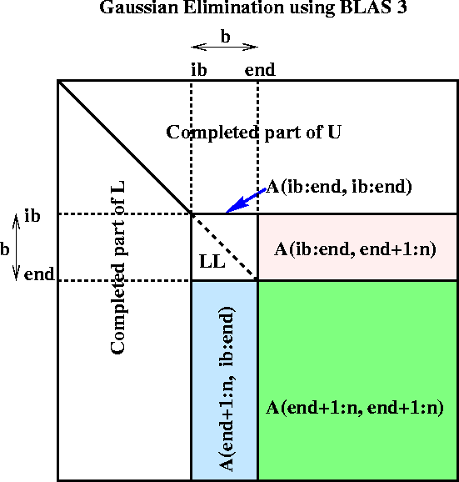
Blocked GEPP (www.netlib.org/lapack/single/sgetrf.f)
for ib = 1 to n-1 step b … Process matrix b columns at a time
end = ib + b-1 … Point to end of block of b columns
apply BLAS2 version of GEPP to get A(ib:n , ib:end) = P’ * L’ * U’
… let LL denote the strict lower triangular part of A(ib:end , ib:end) + I
A(ib:end , end+1:n) = LL⁻¹ * A(ib:end , end+1:n) … update next b rows of U
A(end+1:n , end+1:n ) = A(end+1:n , end+1:n )
- A(end+1:n , ib:end) * A(ib:end , end+1:n)
… apply delayed updates with single matrix-multiply
… with inner dimension b

Slide 17
Overview of LAPACK
Standard library for dense/banded linear algebra
Linear systems: A*x=b
Least squares problems: min_{x} || A*x-b ||₂
Eigenvalue problems: Ax = λx, Ax = λBx
Singular value decomposition (SVD): A = UΣV^{T}
Algorithms reorganized to use BLAS3 as much as possible
Basis of math libraries on many computers, Matlab 6
Many algorithmic innovations remain
Automatic optimization
Quadtree matrix data structures for locality
New eigenvalue algorithms

Slide 18
Parallelizing Gaussian Elimination
Recall parallelization steps from earlier lecture
Decomposition: identify enough parallel work, but not too much
Assignment: load balance work among threads
Orchestrate: communication and synchronization
Mapping: which processors execute which threads
Decomposition
In BLAS 2 algorithm nearly each flop in inner loop can be done in parallel, so with n² processors, need 3n parallel steps
This is too fine-grained, prefer calls to local matmuls instead
Need to discuss parallel matrix multiplication
Assignment
Which processors are responsible for which submatrices?
for i = 1 to n-1
A(i+1:n,i) = A(i+1:n,i) / A(i,i) … BLAS 1 (scale a vector)
A(i+1:n,i+1:n) = A(i+1:n , i+1:n ) … BLAS 2 (rank-1 update)
- A(i+1:n , i) * A(i , i+1:n)

Slide 19
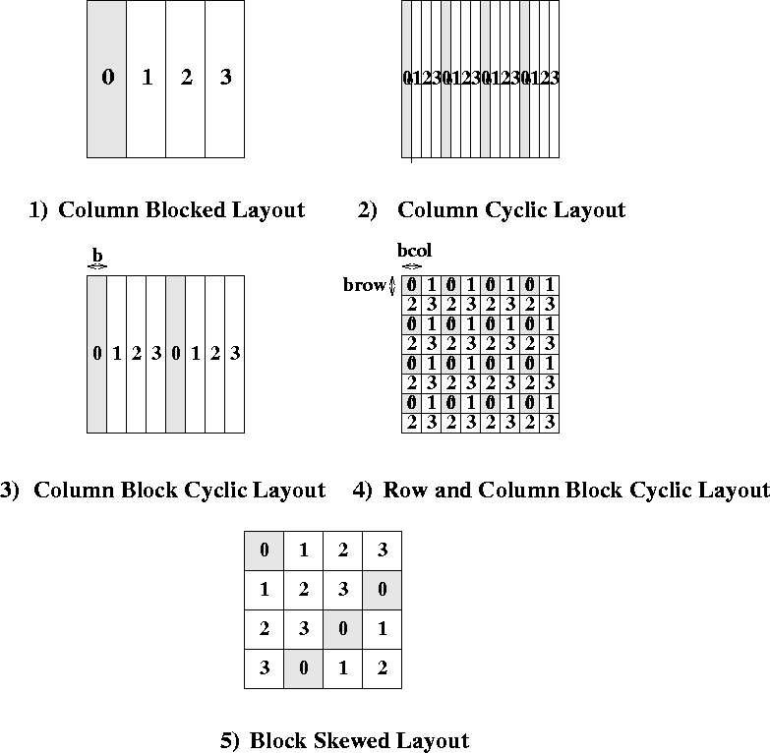
Different Data Layouts for Parallel GE (on 4 procs)
Bad load balance:
P0 idle after first
n/4 steps
Load balanced, but can’t easily
use BLAS2 or BLAS3
Can trade load balance
and BLAS2/3
performance by
choosing b, but
factorization of block
column is a bottleneck
The winner!
Complicated addressing

Slide 20
Review: BLAS 3 (Blocked) GEPP
for ib = 1 to n-1 step b … Process matrix b columns at a time
end = ib + b-1 … Point to end of block of b columns
apply BLAS2 version of GEPP to get A(ib:n , ib:end) = P’ * L’ * U’
… let LL denote the strict lower triangular part of A(ib:end , ib:end) + I
A(ib:end , end+1:n) = LL⁻¹ * A(ib:end , end+1:n) … update next b rows of U
A(end+1:n , end+1:n ) = A(end+1:n , end+1:n )
- A(end+1:n , ib:end) * A(ib:end , end+1:n)
… apply delayed updates with single matrix-multiply
… with inner dimension b
BLAS 3

Slide 21
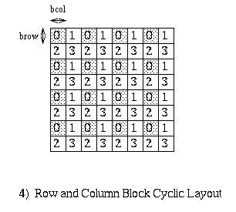
Review: Row and Column Block Cyclic Layout
processors and matrix blocks
are distributed in a 2d array
pcol-fold parallelism
in any column, and calls to the
BLAS2 and BLAS3 on matrices of
size brow-by-bcol
serial bottleneck is eased
need not be symmetric in rows and
columns

Slide 22
Distributed GE with a 2D Block Cyclic Layout
block size b in the algorithm and the block sizes brow
and bcol in the layout satisfy b=brow=bcol.
shaded regions indicate busy processors or
communication performed.
unnecessary to have a barrier between each
step of the algorithm, e.g.. step 9, 10, and 11 can be
pipelined

Slide 23
Distributed GE with a 2D Block Cyclic Layout

Slide 24
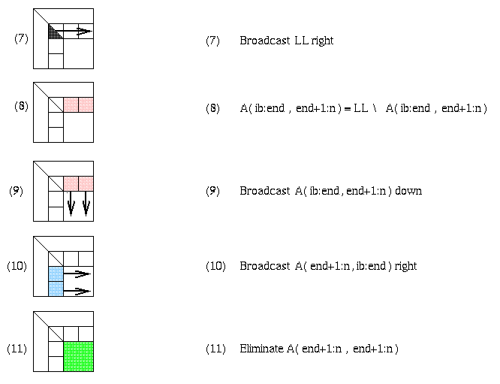
Matrix multiply of
green = green - blue * pink

Slide 25
