Slide 1
CS240A: Computation on Graphs

Slide 2
Graphs and Sparse Matrices
Sparse matrix is a representation of a (sparse) graph
1 2 3 4 5 6
1 1 1
2 1 1 1
3 1 1 1
4 1 1
5 1 1
6 1 1
3
2
4
1
6
5
Matrix entries can be just 1’s, or edge weights
Diagonal can represent self-loops or vertex weights
Nnz per row (off diagonal) is vertex out-degree

Slide 3
Sparse matrix data structure (stored by rows, CSR)
value:
31 | 53 | 59 | 41 | 26
31 | 0 | 53
0 | 59 | 0
41 | 26 | 0
col:
1 | 3 | 2 | 1 | 2
rowstart:
1 | 3 | 4 | 6
Full storage:
  2-dimensional array of real or complex numbers
  (nrows*ncols) memory
Sparse storage:
  compressed storage by rows (CSR)
  three 1-dimensional arrays
  (2*nzs + ncols + 1) memory
  similarly, CSC

Slide 4
Compressed graph data structure (CSR)
Like matrix CSR, but indices & vertex numbers start at 0
0
1
nbr:
1 | 2 | 0 | 2 | 3 | 3 | 2
firstnbr:
0 | 2 | 5 | 6 | 7
2
3
CSR graph storage:
  three 1-dimensional arrays
  digraph: ne + nv + 1 memory
  undirected graph: 2*ne + nv + 1 memory;
  edge {v,w} appears once for v, once for w
  firstnbr[0] = 0; for a digraph, firstnbr[nv] = ne

Slide 5
Graph (or sparse matrix) in distributed memory, CSR
P₀
P₁
Row-wise decomposition
Each processor stores:
# of local edges (nonzeros)
range of local vertices (rows)
edges (nonzeros) in CSR form
Alternative: 2D decomposition
P₂
P_{n}

Slide 6
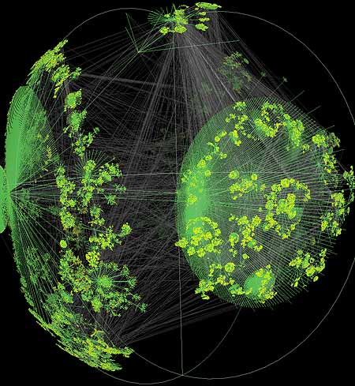
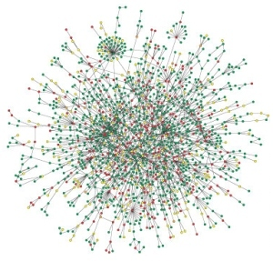

Large graphs are everywhere…
Internet structure
Social interactions
Scientific datasets: biological, chemical, cosmological, ecological, …
WWW snapshot, courtesy Y. Hyun
Yeast protein interaction network, courtesy H. Jeong
Notes:
Details on the types of computations here -> Pagerank (web), betweenness centrality (biological)
Both are huge, sparse graphs

Slide 7
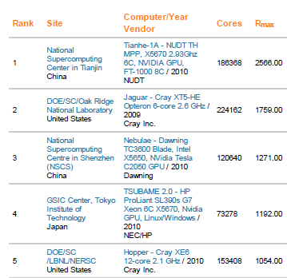
Top 500 List (November 2010)
Top500 Benchmark:
Solve a large system
of linear equations
by Gaussian elimination
P
A
U
=
L
x

Slide 8

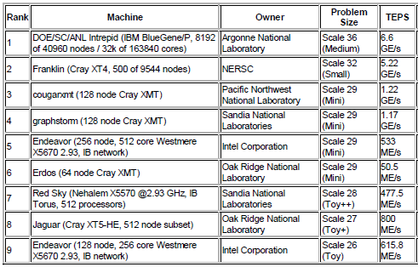
Graph 500 List (November 2010)
Graph500 Benchmark:
Breadth-first search
in a large
power-law graph
1
2
4
7
5
3
6

Slide 9
Floating-Point vs. Graphs
2.5 Petaflops
6.6 Gigateps
U
1
2
P
A
=
L
x
4
7
5
3
6
2.5 Peta / 6.6 Giga is about 380,000!

Slide 10
Node-to-node searches in graphs …
Who are my friends’ friends?
How many hops from A to B? (six degrees of Kevin Bacon)
What’s the shortest route to Las Vegas?
Am I related to Abraham Lincoln?
Who likes the same movies I do, and what other movies do they like?
. . .
See breadth-first search example slides

Slide 11
Breadth-first search
BFS example slides
BFS sequential code example
BFS Cilk slides

Slide 12
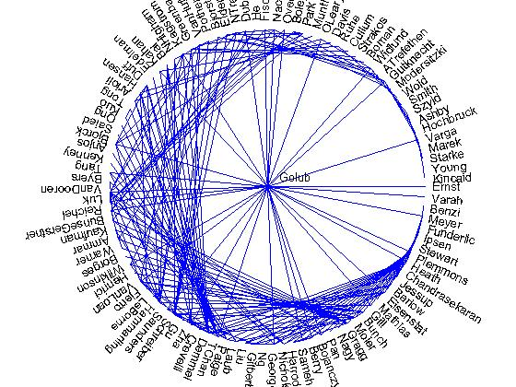
Social Network Analysis in Matlab: 1993
Co-author graph
from 1993
Householder
symposium

Slide 13
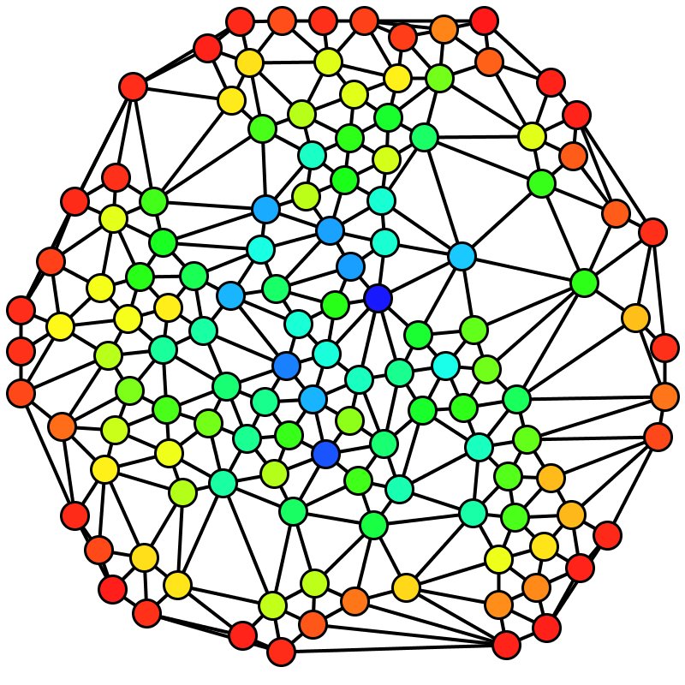
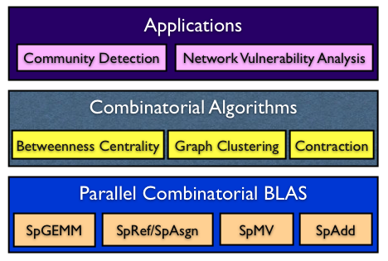

Social network analysis
Betweenness Centrality (BC)
C_{B}(v): Among all the shortest paths, what fraction of them pass through the node of interest?
A typical software stack for an application enabled with the Combinatorial BLAS
Brandes’ algorithm
Notes:
Why betweenness centrality?
It has a lot of applications in identifying important vertices
It’s a standard graph benchmark to compare implementations.

Slide 14
Betweenness centrality
BC example from Robinson slides
BC sequential algorithm from Brandes paper
BC demo
Several potential sources of parallelism in BC

Slide 15
A graph problem: Maximal Independent Set
Graph with vertices V = {1,2,…,n}
A set S of vertices is independent if no
two vertices in S are neighbors.
An independent set S is maximal if it is
impossible to add another vertex and
stay independent
An independent set S is maximum
if no other independent set has more
vertices
Finding a maximum independent set is
intractably difficult (NP-hard)
Finding a maximal independent set is
easy, at least on one processor.
1
2
3
4
5
6
7
8
The set of red vertices
S = {4, 5} is independent and is maximal
but not maximum

Slide 16
Sequential Maximal Independent Set Algorithm
S = empty set;
for vertex v = 1 to n {
if (v has no neighbor in S) {
add v to S
}
}
1
2
3
4
5
6
7
8
S = { }

Slide 17
Sequential Maximal Independent Set Algorithm
S = empty set;
for vertex v = 1 to n {
if (v has no neighbor in S) {
add v to S
}
}
1
2
3
4
5
6
7
8
S = { 1 }

Slide 18
Sequential Maximal Independent Set Algorithm
S = empty set;
for vertex v = 1 to n {
if (v has no neighbor in S) {
add v to S
}
}
1
2
3
4
5
6
7
8
S = { 1, 5 }

Slide 19
Sequential Maximal Independent Set Algorithm
S = empty set;
for vertex v = 1 to n {
if (v has no neighbor in S) {
add v to S
}
}
1
2
3
4
5
6
7
8
S = { 1, 5, 6 }
work ~ O(n), but span ~O(n)

Slide 20
Parallel, Randomized MIS Algorithm [Luby]
1
2
S = empty set; C = V;
while C is not empty {
label each v in C with a random r(v);
for all v in C in parallel {
if r(v) < min( r(neighbors of v) ) {
move v from C to S;
remove neighbors of v from C;
}
}
}
3
4
5
6
7
8
S = { }
C = { 1, 2, 3, 4, 5, 6, 7, 8 }

Slide 21
Parallel, Randomized MIS Algorithm [Luby]
1
2
S = empty set; C = V;
while C is not empty {
label each v in C with a random r(v);
for all v in C in parallel {
if r(v) < min( r(neighbors of v) ) {
move v from C to S;
remove neighbors of v from C;
}
}
}
3
4
5
6
7
8
S = { }
C = { 1, 2, 3, 4, 5, 6, 7, 8 }

Slide 22
Parallel, Randomized MIS Algorithm [Luby]
2.6
4.1
1
2
S = empty set; C = V;
while C is not empty {
label each v in C with a random r(v);
for all v in C in parallel {
if r(v) < min( r(neighbors of v) ) {
move v from C to S;
remove neighbors of v from C;
}
}
}
5.9
3.1
4
5.8
3
5
1.2
6
7
8
9.7
9.3
S = { }
C = { 1, 2, 3, 4, 5, 6, 7, 8 }

Slide 23
Parallel, Randomized MIS Algorithm [Luby]
2.6
4.1
1
2
S = empty set; C = V;
while C is not empty {
label each v in C with a random r(v);
for all v in C in parallel {
if r(v) < min( r(neighbors of v) ) {
move v from C to S;
remove neighbors of v from C;
}
}
}
5.9
3.1
4
5.8
3
5
1.2
6
7
8
9.7
9.3
S = { 1, 5 }
C = { 6, 8 }

Slide 24
Parallel, Randomized MIS Algorithm [Luby]
1
2
S = empty set; C = V;
while C is not empty {
label each v in C with a random r(v);
for all v in C in parallel {
if r(v) < min( r(neighbors of v) ) {
move v from C to S;
remove neighbors of v from C;
}
}
}
4
2.7
3
5
6
7
8
1.8
S = { 1, 5 }
C = { 6, 8 }

Slide 25
Parallel, Randomized MIS Algorithm [Luby]
1
2
S = empty set; C = V;
while C is not empty {
label each v in C with a random r(v);
for all v in C in parallel {
if r(v) < min( r(neighbors of v) ) {
move v from C to S;
remove neighbors of v from C;
}
}
}
4
2.7
3
5
6
7
8
1.8
S = { 1, 5, 8 }
C = { }

Slide 26
Parallel, Randomized MIS Algorithm [Luby]
1
2
S = empty set; C = V;
while C is not empty {
label each v in C with a random r(v);
for all v in C in parallel {
if r(v) < min( r(neighbors of v) ) {
move v from C to S;
remove neighbors of v from C;
}
}
}
3
4
5
6
7
8
Theorem: This algorithm “very probably” finishes within O(log n) rounds.
work ~ O(n log n), but span ~O(log n)

Slide 27
Connected components of undirected graph
Sequential: use any search (BFS, DFS, etc.); work O(nv+ne):
Parallel:
  Various heuristics using BFS, e.g. “bully algorithm” (Berry et al. paper); most with worst-case span O(n) but okay in practice.
  Linking / pointer-jumping algorithms with theoretical span O(log n)
  or O(log² n) (Greiner paper).
for vertex v = 1 to n
if (v is not labeled)
search from v to label a component

Slide 28
Strongly connected components
1
2
4
7
5
3
6
1
1
2
2
4
7
4
7
5
5
3
6
3
6
Symmetric permutation to block triangular form
Find P in linear time by depth-first search [Tarjan]

Slide 29
Strongly connected components of directed graph
Sequential: depth-first search (Tarjan paper); work O(nv+ne).
DFS seems to be inherently sequential.
Parallel: divide-and-conquer and BFS (Fleischer et al. paper); worst-case span O(n) but good in practice on many graphs.

Slide 30
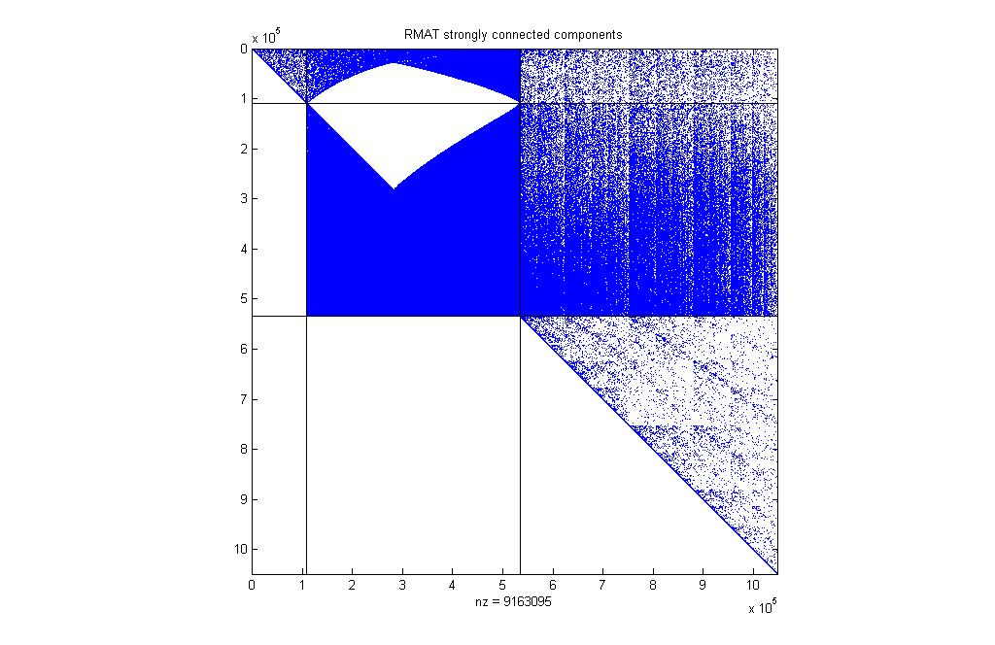
Strongly Connected Components

Slide 31
EXTRA SLIDES

Slide 32
Characteristics of graphs
Vertex degree histogram
Average shortest path length
Clustering coefficient
  c = 3*(# triangles) / (# connected triples)
Separator size
Gaussian elimination fill (chordal completion size)
Finite element meshes
Circuit simulation graphs
Relationship network graphs
Erdos-Renyi random graphs
Small world graphs
Power law graphs
RMAT graph generator

Slide 33
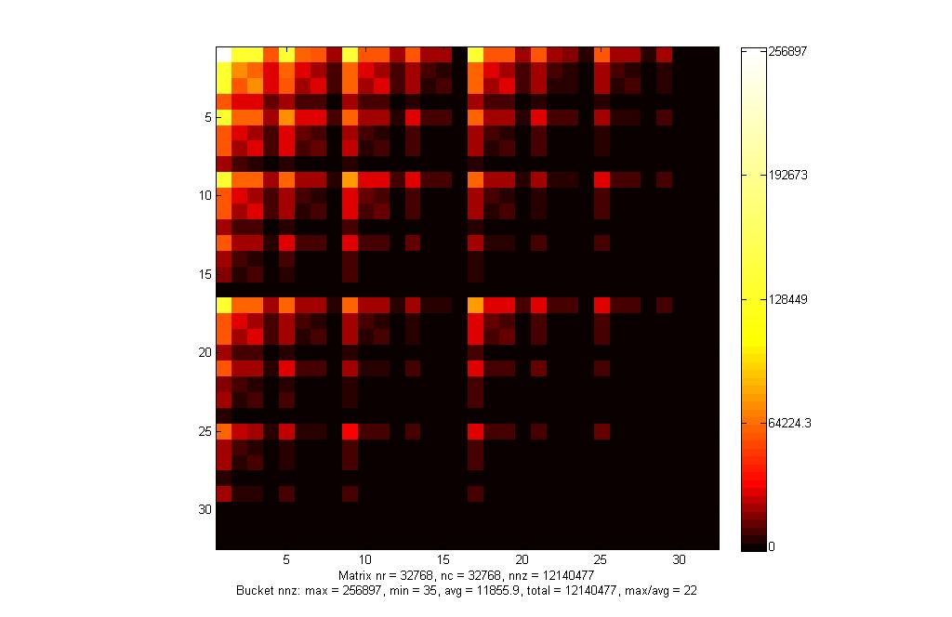
RMAT Approximate Power-Law Graph

Slide 34
Strongly Connected Components

Slide 35
Graph partitioning
Assigns subgraphs to processors
Determines parallelism and locality.
Tries to make subgraphs all same size (load balance)
Tries to minimize edge crossings (communication).
Exact minimization is NP-complete.
edge crossings = 6
edge crossings = 10
Notes:
Nodes and edges in graph may be weighted
Optimal graph partitioning is NP-complete (define for non-CS audience)
Good graph partitioning techniques exist
More on this in a later lecture

Slide 36
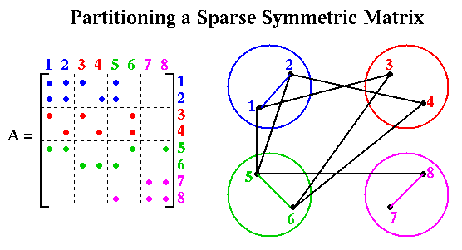
Sparse Matrix-Vector Multiplication

Slide 37
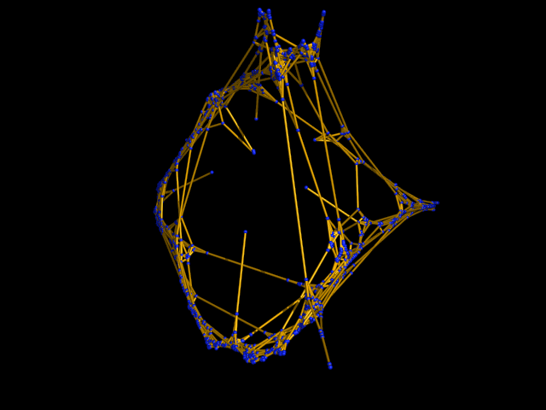
Clustering benchmark graph

Slide 38
Example: Web graph and matrix
1
2
3
4
5
6
7
1
2
1
2
3
4
7
5
4
5
6
3
6
7
Web page = vertex
Link = directed edge
Link matrix: A_{ij} = 1 if page i links to page j

Slide 39
Web graph: PageRank (Google) [Brin, Page]
An important page is one that many important pages point to.
Markov process: follow a random link most of the time;
otherwise, go to any page at random.
Importance = stationary distribution of Markov process.
Transition matrix is p*A + (1-p)*ones(size(A)),
scaled so each column sums to 1.
Importance of page i is the i-th entry in the principal eigenvector of the transition matrix.
But the matrix is 1,000,000,000,000 by 1,000,000,000,000.

Slide 40
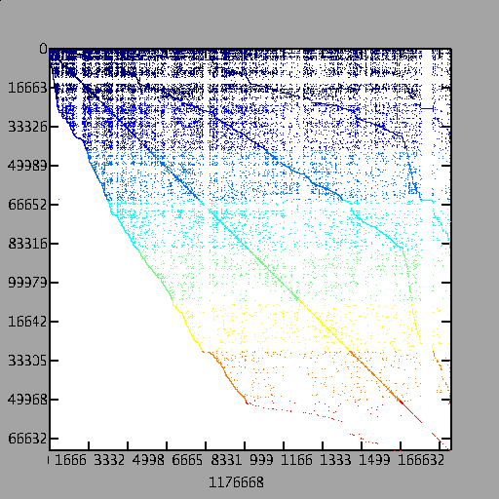
A Page Rank Matrix
Importance ranking
of web pages
Stationary distribution
of a Markov chain
Power method: matvec
and vector arithmetic
Matlab*P page ranking
demo (from SC’03) on
a web crawl of mit.edu
(170,000 pages)

Slide 41
Social Network Analysis in Matlab: 1993
Co-author graph
from 1993
Householder
symposium

Slide 42
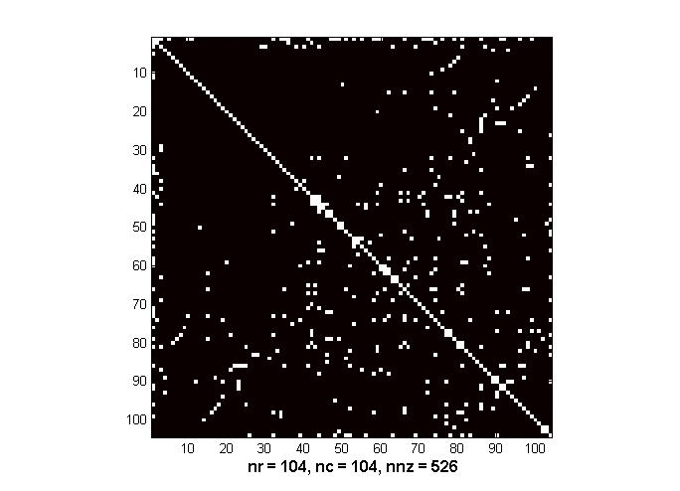
Social Network Analysis in Matlab: 1993
Sparse Adjacency Matrix
Which author has
the most collaborators?
>>[count,author] = max(sum(A))
count = 32
author = 1
>>name(author,:)
ans = Golub

Slide 43
Social Network Analysis in Matlab: 1993
Have Gene Golub and Cleve Moler ever been coauthors?
>> A(Golub,Moler)
ans = 0
No.
But how many coauthors do they have in common?
>> AA = A^2;
>> AA(Golub,Moler)
ans = 2
And who are those common coauthors?
>> name( find ( A(:,Golub) .* A(:,Moler) ), :)
ans =
Wilkinson
VanLoan

Slide 44
Breadth-First Search: Sparse mat * vec
1
2
→
4
7
5
3
6
A^{T}
x
A^{T}x
Multiply by adjacency matrix → step to neighbor vertices
Work-efficient implementation from sparse data structures

Slide 45
Breadth-First Search: Sparse mat * vec
1
2
→
4
7
5
3
6
A^{T}
x
A^{T}x
Multiply by adjacency matrix → step to neighbor vertices
Work-efficient implementation from sparse data structures

Slide 46
Breadth-First Search: Sparse mat * vec
1
2
→
→
4
7
5
3
6
A^{T}
x
A^{T}x
(A^{T})²x
Multiply by adjacency matrix → step to neighbor vertices
Work-efficient implementation from sparse data structures

