Slide 1
CS240A: Classes of Graphs and Their Properties slides under construction – see the Matlab transcript for what I actually did in class

Slide 2
Some graph statistics (and Matlab tools)
Vertex degree histogram: dhist.m
Avg shortest path length or BFS level profile: bfslevels.m
Clustering coefficient: ccoeff.m
  c = 3*(# triangles) / (# connected triples)
Laplacian eigenvalues (and vectors): meshpart toolbox
Separator size: meshpart toolbox
Fill (chordal completion size): analyze.m and amd.m

Slide 3
Some classes of graphs
Graphs observed in the wild (see Florida collection for many examples):
  Finite element meshes: CGmats.m
  Circuit simulation graphs: circuit_3.mat
  Relationship networks: coAuthorsDBLP.mat, PGPgiantcompo.mat
  … many others!
Classifications of graphs:
  Power-law graphs
  Small-world graphs
  Planar graphs
  Overlap graphs
Generators for classes of graphs:
  Erdos-Renyi (flat) random graphs: sprandsym.m
  RMAT random graph generator: rmat.m
  2-D and 3-D mesh generators: grid5.m etc. in meshpart toolbox

Slide 4
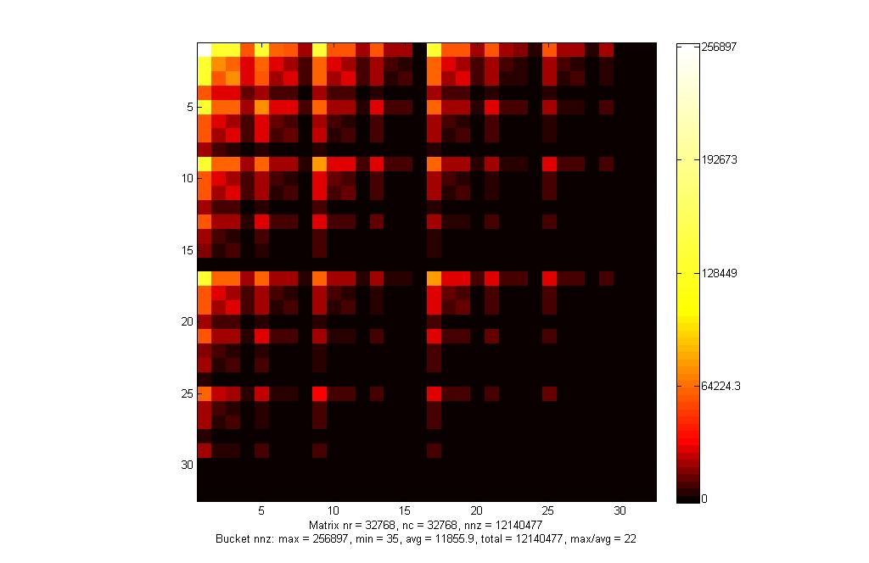
RMAT Approximate Power-Law Graph

Slide 5
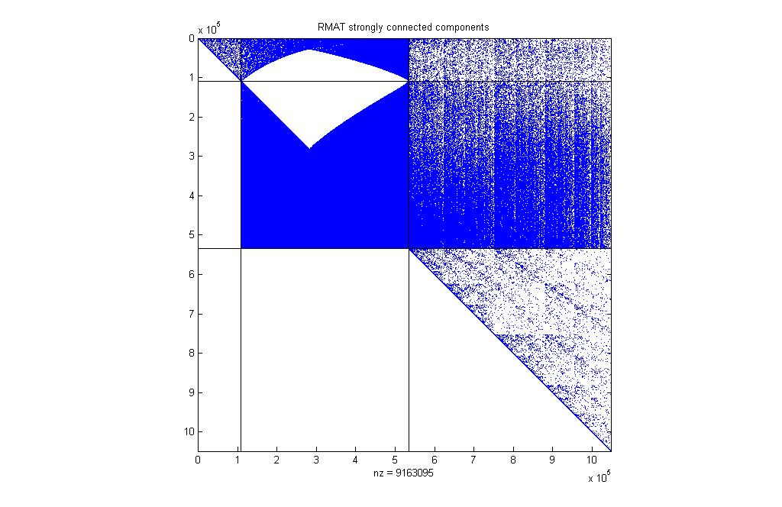
Strongly Connected Components

