Slide 1
CS 240A
Applied Parallel Computing
John R. Gilbert
gilbert@cs.ucsb.edu
http://www.cs.ucsb.edu/~cs240a
Thanks to Kathy Yelick and Jim Demmel at UCB for some of their slides.

Slide 2
Course bureacracy
Read course home page http://www.cs.ucsb.edu/~cs240a/homepage.html
Join Google discussion group (see course home page)
Accounts on Triton, San Diego Supercomputing Center:
  Use “ssh –keygen –t rsa” and then email your “id_rsa.pub” file to Stefan Boeriu, stefan@engineering.ucsb.edu
  If you weren’t signed up for the course as of last week, email me your registration info right away
Triton logon demo & tool intro coming soon– watch Google group for details

Slide 3
Homework 1
See course home page for details.
Find an application of parallel computing and build a web page describing it.
  Choose something from your research area.
  Or from the web or elsewhere.
Create a web page describing the application.
  Describe the application and provide a reference (or link)
  Describe the platform where this application was run
  Find peak and LINPACK performance for the platform and its rank on the TOP500 list
  Find the performance of your selected application
  What ratio of sustained to peak performance is reported?
  Evaluate the project: How did the application scale, ie was speed roughly proportional to the number of processors? What were the major difficulties in obtaining good performance? What tools and algorithms were used?
Send us (John and Matt) the link -- we will post them
Due next Monday, April 4

Slide 4
Why are we here?
Computational science
  The world’s largest computers have always been used for simulation and data analysis in science and engineering.
Performance
  Getting the most computation for the least cost (in time, hardware, or energy)
Architectures
  All big computers (and most little ones) are parallel
Algorithms
  The building blocks of computation

Slide 5
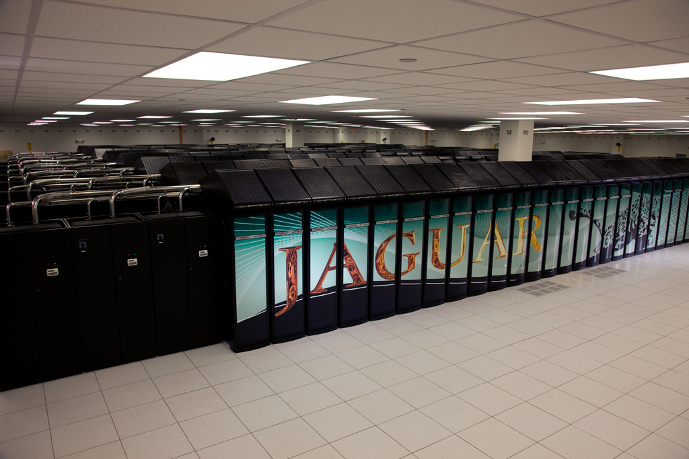
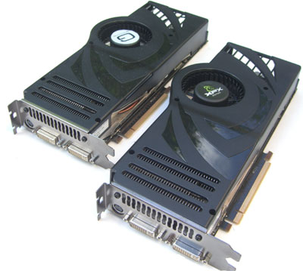
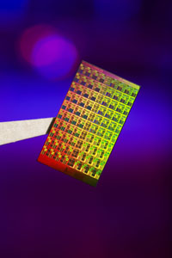
Parallel Computers Today
Two Nvidia 8800 GPUs
> 1 TFLOPS
Oak Ridge / Cray Jaguar
> 1.75 PFLOPS
Intel 80-core chip
> 1 TFLOPS
TFLOPS = 10¹² floating point ops/sec
PFLOPS = 1,000,000,000,000,000 / sec
(10¹⁵)

Slide 6
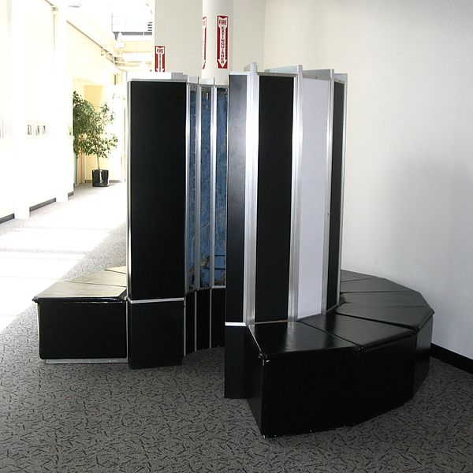
Supercomputers 1976: Cray-1, 133 MFLOPS (10⁶)

Slide 7
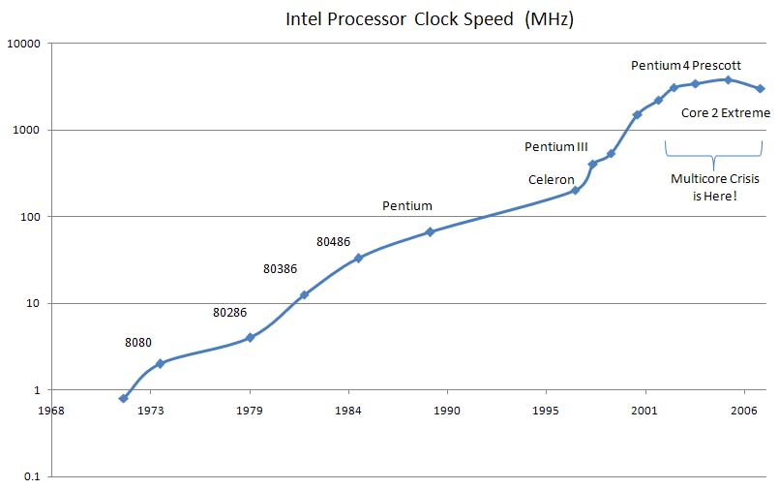
Trends in processor clock speed

Slide 8
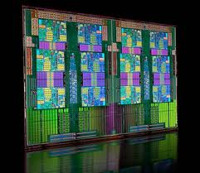
AMD Opteron 12-core chip

Slide 9
Generic Parallel Machine Architecture
Storage
Hierarchy
Proc
Proc
Proc
Cache
Cache
Cache
L2 Cache
L2 Cache
L2 Cache
L3 Cache
L3 Cache
L3 Cache
potential
interconnects
Memory
Memory
Memory
Key architecture question: Where is the interconnect, and how fast?
Key algorithm question: Where is the data?

Slide 10
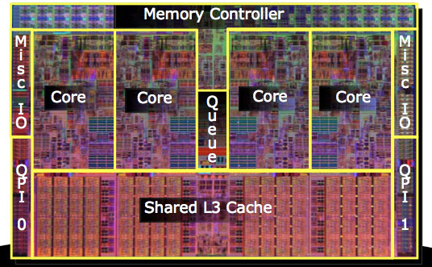
4-core Intel Nehalem chip (2 per Triton node):

Slide 11
Triton memory hierarchy
Node
Chip
Chip
Proc
Proc
Proc
Proc
Proc
Proc
Proc
Proc
Cache
Cache
Cache
Cache
Cache
Cache
Cache
Cache
L2 Cache
L2 Cache
L2 Cache
L2 Cache
L2 Cache
L2 Cache
L2 Cache
L2 Cache
L3 Cache
L3 Cache
Node Memory
<- Myrinet Interconnect to Other Nodes ->

Slide 12
One kind of big parallel application
Example: Bone density modeling
  Physical simulation
  Lots of numerical computing
  Spatially local
See Mark Adams’s slides…

Slide 13
“The unreasonable effectiveness of mathematics”
As the “middleware”
of scientific computing,
linear algebra has supplied
or enabled:
Mathematical tools
“Impedance match” to
computer operations
High-level primitives
High-quality software libraries
Ways to extract performance
from computer architecture
Interactive environments
Continuous
physical modeling
Linear algebra
Computers

Slide 14
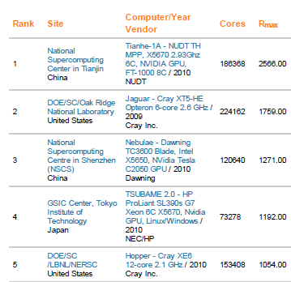
Top 500 List (November 2010)
Top500 Benchmark:
Solve a large system
of linear equations
by Gaussian elimination
P
A
U
=
L
x

Slide 15

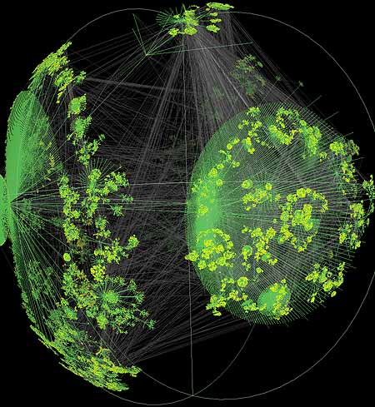
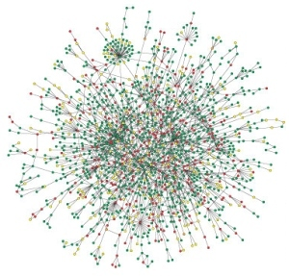

Large graphs are everywhere…
Internet structure
Social interactions
Scientific datasets: biological, chemical, cosmological, ecological, …
WWW snapshot, courtesy Y. Hyun
Yeast protein interaction network, courtesy H. Jeong
Notes:
Details on the types of computations here -> Pagerank (web), betweenness centrality (biological)
Both are huge, sparse graphs

Slide 16
Another kind of big parallel application
Example: Vertex betweenness centrality
  Exploring an unstructured graph
  Lots of pointer-chasing
  Little numerical computing
  No spatial locality
See Eric Robinson’s slides…

Slide 17
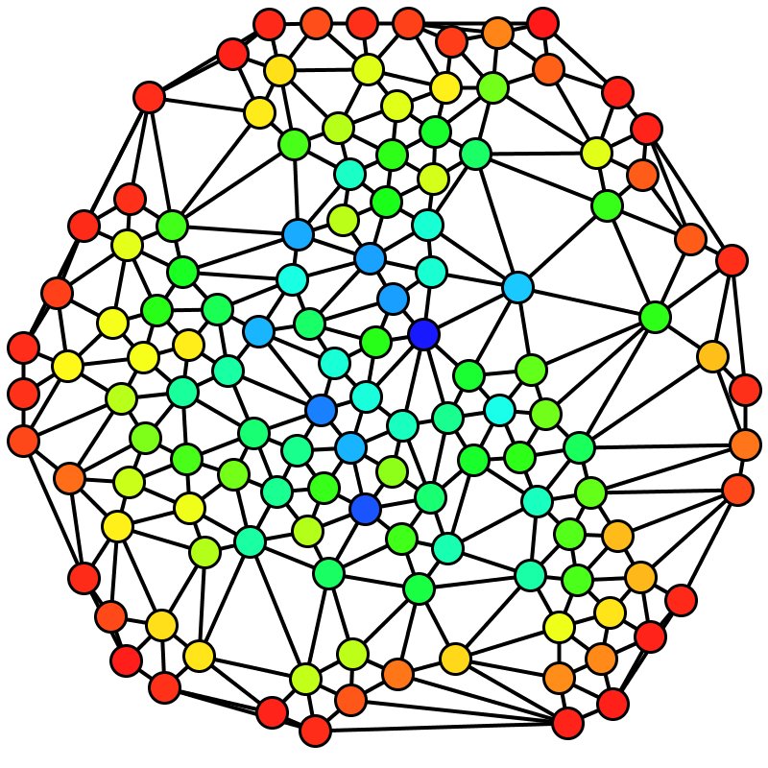
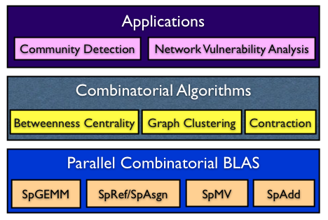

Social network analysis
Betweenness Centrality (BC)
C_{B}(v): Among all the shortest paths, what fraction of them pass through the node of interest?
A typical software stack for an application enabled with the Combinatorial BLAS
Brandes’ algorithm
Notes:
Why betweenness centrality?
It has a lot of applications in identifying important vertices
It’s a standard graph benchmark to compare implementations.

Slide 18
An analogy?
Continuous
physical modeling
Discrete
structure analysis
Linear algebra
Graph theory
Computers
Computers

Slide 19
Node-to-node searches in graphs …
Who are my friends’ friends?
How many hops from A to B? (six degrees of Kevin Bacon)
What’s the shortest route to Las Vegas?
Am I related to Abraham Lincoln?
Who likes the same movies I do, and what other movies do they like?
. . .
See breadth-first search example slides

Slide 20

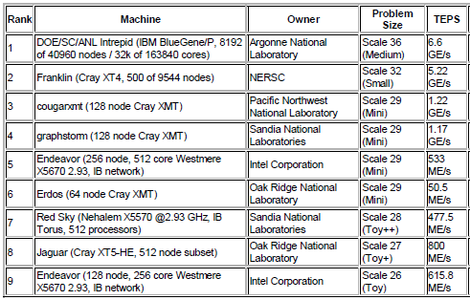
Graph 500 List (November 2010)
Graph500 Benchmark:
Breadth-first search
in a large
power-law graph
1
2
4
7
5
3
6

Slide 21
Floating-Point vs. Graphs
2.5 Petaflops
6.6 Gigateps
U
1
2
P
A
=
L
x
4
7
5
3
6

Slide 22
Floating-Point vs. Graphs
2.5 Petaflops
6.6 Gigateps
U
1
2
P
A
=
L
x
4
7
5
3
6
2.5 Peta / 6.6 Giga is about 380,000!

Slide 23
An analogy? Well, we’re not there yet ….
√ Mathematical tools
? “Impedance match” to
computer operations
? High-level primitives
? High-quality software libs
? Ways to extract performance
from computer architecture
? Interactive environments
Discrete
structure analysis
Graph theory
Computers

