Slide 1
CS 240A: Sources of Parallelism in Physical Simulation
Based on slides from David Culler, Jim Demmel, Kathy Yelick, et al., UCB CS267

Slide 2
Parallelism and Locality in Simulation
Real world problems have parallelism and locality:
Some objects may operate independently of others.
Objects may depend more on nearby than distant objects.
Dependence on distant objects can often be simplified.
Scientific models may introduce more parallelism:
When a continuous problem is discretized, time-domain dependencies are generally limited to adjacent time steps.
Far-field effects can sometimes be ignored or approximated.
Many problems exhibit parallelism at multiple levels
Example: circuits can be simulated at many levels, and within each there may be parallelism within and between subcircuits.
Notes:
Not all problems solved on parallel machines involve simulation, but many do

Slide 3
Multilevel Modeling: Circuit Simulation
Circuits are simulated at many different levels
Level | Primitives | Examples
Instruction level | Instructions | SimOS, SPIM
Cycle level | Functional units | VIRAM-p
Register Transfer Level (RTL) | Register, counter, MUX | VHDL
Gate Level | Gate, flip-flop, memory cell | Thor
Switch level | Ideal transistor | Cosmos
Circuit level | Resistors, capacitors, etc. | Spice
Device level | Electrons, silicon

Slide 4
Basic kinds of simulation
discrete
Discrete event systems
Time and space are discrete
Particle systems
Important special case of lumped systems
Ordinary Differential Equations (ODEs)
Lumped systems
Location/entities are discrete, time is continuous
Partial Different Equations (PDEs)
Time and space are continuous
continuous

Slide 5
Basic Kinds of Simulation
Discrete event systems:
Examples: “Game of Life,” logic level circuit simulation.
Particle systems:
Examples: billiard balls, semiconductor device simulation, galaxies.
Lumped variables depending on continuous parameters:
ODEs, e.g., circuit simulation (Spice), structural mechanics, chemical kinetics.
Continuous variables depending on continuous parameters:
PDEs, e.g., heat, elasticity, electrostatics.
A given phenomenon can be modeled at multiple levels.
Many simulations combine more than one of these techniques.

Slide 6
A Model Problem: Sharks and Fish
Illustration of parallel programming
Original version: WATOR, proposed by Geoffrey Fox
Sharks and fish living in a 2D toroidal ocean
Several variations to show different physical phenomena
Basic idea: sharks and fish living in an ocean
rules for movement
breeding, eating, and death
forces in the ocean
forces between sea creatures
See link on course home page for details

Slide 7
Discrete Event Systems

Slide 8
Discrete Event Systems
Systems are represented as:
finite set of variables.
the set of all variable values at a given time is called the state.
each variable is updated by computing a transition function depending on the other variables.
System may be:
synchronous: at each discrete timestep evaluate all transition functions; also called a state machine.
asynchronous: transition functions are evaluated only if the inputs change, based on an “event” from another part of the system; also called event driven simulation.
Example: The “game of life:”
Also known as Sharks and Fish #3:
Space divided into cells, rules govern cell contents at each step

Slide 9
Sharks and Fish as Discrete Event System
Ocean modeled as a 2D toroidal grid
Each cell occupied by at most one sea creature

Slide 10
Fish-only: the Game of Life
An new fish is born if
a cell is empty
exactly 3 (of 8) neighbors contain fish
A fish dies (of overcrowding) if
cell contains a fish
4 or more neighboring cells are full
A fish dies (of loneliness) if
cell contains a fish
less than 2 neighboring cells are full
Other configurations are stable
The original Wator problem adds sharks that eat fish

Slide 11
Parallelism in Sharks and Fish
The activities in this system are discrete events
The simulation is synchronous
use two copies of the grid (old and new)
the value of each new grid cell in new depends only on the 9 cells (itself plus neighbors) in old grid (“stencil computation”)
Each grid cell update is independent: reordering or parallelism OK
simulation proceeds in timesteps, where (logically) each cell is evaluated at every timestep
old ocean
new ocean

Slide 12
Parallelism in Stencil Computations
Parallelism is straightforward
ocean is regular data structure
even decomposition across processors gives load balance
Locality is achieved by using large patches of the ocean
boundary values from neighboring patches are needed
Optimization: visit only occupied cells (and neighbors)

Slide 13
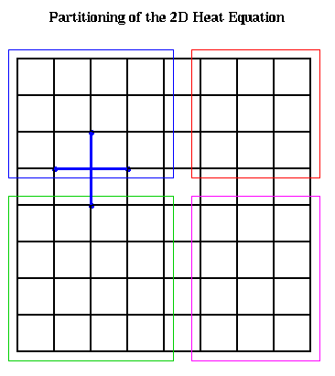
Where’s the data? Two possible answers:
n grid nodes, p processors
Each processor has a patch of n/p nodes
Patch = consecutive rows: v = 2 * p * sqrt(n)
Patch = square block: v = 4 * sqrt(p) * sqrt(n)

Slide 14
Redundant “Ghost” Nodes in Stencil Computations
Size of ghost region (and redundant computation) depends on network/memory speed vs. computation
Can be used on unstructured meshes
To compute green
Copy yellow
Compute blue

Slide 15
Synchronous Circuit Simulation
Circuit is a graph made up of subcircuits connected by wires
Component simulations need to interact if they share a wire.
Data structure is irregular (graph) of subcircuits.
Parallel algorithm is timing-driven or synchronous:
Evaluate all components at every timestep (determined by known circuit delay)
Graph partitioning assigns subgraphs to processors (NP-complete)
Determines parallelism and locality.
Attempts to evenly distribute subgraphs to nodes (load balance).
Attempts to minimize edge crossing (minimize communication).
edge crossings = 6
edge crossings = 10
Notes:
Nodes and edges in graph may be weighted
Optimal graph partitioning is NP-complete (define for non-CS audience)
Good graph partitioning techniques exist
More on this in a later lecture

Slide 16
Asynchronous Simulation
Synchronous simulations may waste time:
Simulate even when the inputs do not change.
Asynchronous simulations update only when an event arrives from another component:
No global time steps, but individual events contain time stamp.
Example: Game of life in loosely connected ponds (don’t simulate empty ponds).
Example: Circuit simulation with delays (events are gates flipping).
Example: Traffic simulation (events are cars changing lanes, etc.).
Asynchronous is more efficient, but harder to parallelize
In MPI, events can be messages …
… but how do you know when to “receive”?

Slide 17
Particle Systems

Slide 18
Particle Systems
A particle system has
a finite number of particles.
moving in space according to Newton’s Laws (i.e. F = ma).
time is continuous.
Examples:
stars in space: laws of gravity.
atoms in a molecule: electrostatic forces.
neutrons in a fission reactor.
electron beam and ion beam semiconductor manufacturing.
cars on a freeway: Newton’s laws + models of driver & engine.
Many simulations combine particle simulation techniques with some discrete event techniques.

Slide 19
Forces in Particle Systems
Force on each particle decomposed into near and far:
force = external_force + nearby_force + far_field_force
External force
ocean current to sharks and fish world (S&F 1).
externally imposed electric field in electron beam.
Nearby force
sharks attracted to eat nearby fish (S&F 5).
balls on a billiard table bounce off of each other.
Van der Waals forces in fluid (1/r⁶).
Far-field force
fish attract other fish by gravity-like (1/r² ) force (S&F 2).
gravity, electrostatics
forces governed by elliptic PDEs.

Slide 20
Parallelism in External Forces
External forces are the simplest to implement.
Force on one particle is independent of other particles.
“Embarrassingly parallel”.
Evenly distribute particles on processors
Any even distribution works.
Locality is not an issue, since no communication.
For each particle on processor, apply external force.

Slide 21
Parallelism in Nearby Forces
Nearby forces require interaction => communication.
Force depends on other particles nearby (e.g. collisions)
Simple algorithm: check every pair for collision: O(n²)
Parallelism by decomposition of physical domain:
O(n/p) particles per processor if evenly distributed.
Better algorithm: only check pairs near boundaries
Need to check for collisions between regions
*often called “domain decomposition,” but the term also refers to a numerical technique.

Slide 22
Parallelism in Nearby Forces
Challenge 1: interactions of particles near boundaries:
Communicate particles near boundary to neighboring processors.
Surface to volume effect limits communication.
Which communicates less: squares (as below) or slabs?
Communicate particles in boundary region to neighbors

Slide 23
Parallelism in Nearby Forces
Challenge 2: load imbalance, if particles cluster together:
Stars in galaxies, for example
To reduce load imbalance, divide space unevenly.
Each region contains roughly equal number of particles.
Quad-tree in 2D, oct-tree in 3D.
Example: each square contains at most 3 particles
See: http://njord.umiacs.umd.edu:1601/users/brabec/quadtree/points/prquad.html

Slide 24
Parallelism in Far-Field Forces
Far-field forces involve all-to-all interaction and communication.
Force on one particle depends on all other particles.
Examples: galaxies (gravity), protein folding (electrostatics)
Simplest algorithm is O(n²) as in S&F 2, 4, 5.
Decomposing space does not help total work or communication, since every particle needs to “visit” every other particle.
Use more clever algorithms to beat O(n²) ?
Implement by rotating particle sets.
Keeps processors busy
All processors see all particles
Just like MGR matrix multiply!

Slide 25
Far-field forces: Tree Decomposition
“Fast multipole” algorithms
Approximate the force from far-away particles
Simplify a group of far-away particles into a single multipole.
Do this at every scale simultaneously (every quadtree level)
Each quadtree node contains an approximation of descendants.
O(n log n) or even O(n) instead of O(n²).
“Top 10 Algorithms of the 20th Century” (resources page)
Possible topic for later lecture.

Slide 26
Summary of Particle Methods
Model contains discrete entities, namely, particles
force = external_force + nearby_force + far_field_force
Time is continuous – is discretized to solve
Simulation follows particles through timesteps
All-pairs algorithm is simple, but inefficient, O(n²)
Particle-mesh methods approximates by moving particles
Tree-based algorithms approximate by treating set of particles as a group, when far away
This is a special case of a “lumped” system . . .

Slide 27
Lumped Systems: ODEs

Slide 28
System of Lumped Variables
Finitely many variables
Depending on a continuous parameter (usually time)
Example 1 – System of chemical reactions:
Each reaction consumes some “compounds” and produces others
Stoichometric matrix S: rows for compounds, cols for reactions
Compound concentrations x(i) in terms of reaction rates v(j):
dx/dt = S * v
Example 2 – Electronic circuit:
Circuit is a graph.
wires are edges.
each edge has resistor, capacitor, inductor or voltage source.
Variables are voltage & current at endpoints of edges.
Related by Ohm’s Law, Kirchoff’s Laws, etc.
Forms a system of ordinary differential equations (ODEs).
Differentiated with respect to time

Slide 29
Example: Stoichiometry Matrix (slide in progress)
System of reacting chemical compounds
Matrix S : row = compound, column = reaction
Linear system: d(concentration)/dt = S * reaction rate
compound A
compound C
compound P
compound CP
compound AP
compound PC
Write as single large system of ODEs (possibly with constraints).
1 v₁
-1 -1 * v₂ = dx₂ -1 v₃ -1 1 1
-1
1 0

Slide 30
Circuit Example
State of the system is represented by
v_{n}(t) node voltages
i_{b}(t) branch currents all at time t
v_{b}(t) branch voltages
Equations include
Kirchoff’s current
Kirchoff’s voltage
Ohm’s law
Capacitance
Inductance
Write as single large system of ODEs (possibly with constraints).
0 M 0 v_{n} 0
M^{T} 0 -I * i_{b} = S
0 R -I v_{b} 0
0 -I C*d/dt 0
0 L*d/dt I 0

Slide 31
Solving ODEs
In most examples, the matrices are sparse:
most array elements are 0.
neither store nor compute on these 0’s.
Given a set of ODEs, two kinds of questions are:
Compute the values of the variables at some time t
Explicit methods
Implicit methods
Compute modes of vibration
Eigenvalue problems
Notes:
Reason is a locality property from physics.

Slide 32
Solving ODEs: Explicit Methods
Rearrange ODE into the form x’(t) = f(x) = A*x, where A is a sparse matrix
Compute x(i*dt) = x[i]
at i=0,1,2,…
Approximate x’(i*dt)
x[i+1]=x[i] + dt*slope
Explicit methods, e.g., (Forward) Euler’s method.
Approximate x’(t)=A*x by (x[i+1] - x[i] )/dt = A*x[i].
x[i+1] = x[i]+dt*A*x[i], i.e. sparse matrix-vector multiplication.
Tradeoffs:
Simple algorithm: sparse matrix vector multiply.
Stability problems: May need to take very small time steps, especially if system is stiff.
Use slope at x[i]

Slide 33
Solving ODEs: Implicit Methods
Assume ODE is x’(t) = f(x) = A*x, where A is a sparse matrix
Compute x(i*dt) = x[i]
at i=0,1,2,…
Approximate x’(i*dt)
x[i+1]=x[i] + dt*slope
Implicit method, e.g., Backward Euler solve:
Approximate x’(t)=A*x by (x[i+1] - x[i] )/dt = A*x[i+1].
(I - dt*A)*x[i+1] = x[i], i.e. we need to solve a sparse linear system of equations.
Trade-offs:
Larger timestep possible: especially for stiff problems
Harder algorithm: need to solve a sparse system at each step
Use slope at x[i+1]

Slide 34
ODEs and Sparse Matrices
All these reduce to sparse matrix problems
Explicit: sparse matrix-vector multiplication.
Implicit: solve a sparse linear system
direct solvers (Gaussian elimination).
iterative solvers (use sparse matrix-vector multiplication).
Eigenvalue/eigenvector algorithms may also be either explicit or implicit.

Slide 35
Partial Differential Equations
(PDEs)

Slide 36
Continuous Variables, Continuous Parameters
Examples:
Parabolic (time-dependent) problems:
Heat flow: Temperature(position, time)
Diffusion: Concentration(position, time)
Elliptic (steady state) problems:
Electrostatic or Gravitational Potential: Potential(position)
Hyperbolic problems (waves):
Quantum mechanics: Wave-function(position,time)
Many problems combine features of above
Fluid flow: Velocity,Pressure,Density(position,time)
Elasticity: Stress,Strain(position,time)

Slide 37
2D Implicit Method
Multiplying by this matrix is just nearest neighbor computation on 2D grid.
To solve this system, there are several techniques.
Graph and “5 point stencil”
4 -1 -1
-1 4 -1 -1
-1 4 -1
-1 4 -1 -1
-1 -1 4 -1 -1
-1 -1 4 -1
-1 4 -1
-1 -1 4 -1
-1 -1 4
-1
-1
4
-1
A =
-1
3D case is analogous (7 point stencil)

Slide 38
The (2-dimensional) model problem
n^{1/2}
Graph is a regular square grid with n = k^2 vertices.
Corresponds to matrix for regular 2D finite difference mesh.
Gives good intuition for behavior of sparse matrix algorithms on many 2-dimensional physical problems.
There’s also a 3-dimensional model problem.

Slide 39
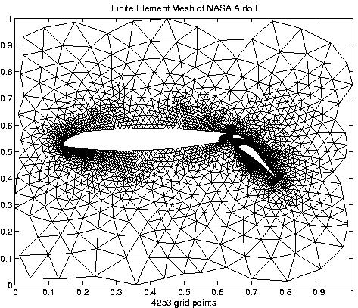
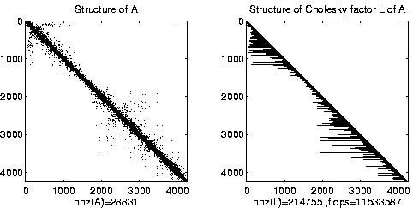
Irregular mesh: NASA Airfoil in 2D

Slide 40
Graphs and Sparse Matrices
Fill: new nonzeros in factor
1
3
7
1
3
7
Symmetric Gaussian elimination:
for j = 1 to n add edges between j’s higher-numbered neighbors
8
6
8
6
4
10
4
10
9
5
2
9
5
2
G(A)
G⁺(A) [chordal]

Slide 41
Challenges of Irregular Meshes for PDE’s
How to generate them in the first place
E.g. Triangle, a 2D mesh generator by Jonathan Shewchuk
3D harder! E.g. QMD by Stephen Vavasis
How to partition them
ParMetis, a parallel graph partitioner
How to design iterative solvers
PETSc, a Portable Extensible Toolkit for Scientific Computing
Prometheus, a multigrid solver for finite element problems on irregular meshes
How to design direct solvers
SuperLU, parallel sparse Gaussian elimination
These are challenges to do sequentially, more so in parallel

Slide 42
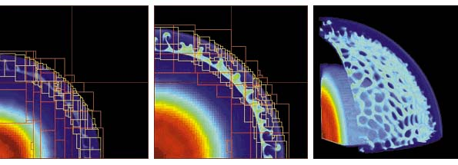
Adaptive Mesh Refinement (AMR)
Adaptive mesh around an explosion
Refinement done by calculating errors
Parallelism
Mostly between “patches,” dealt to processors for load balance
May exploit some within a patch (SMP)

Slide 43
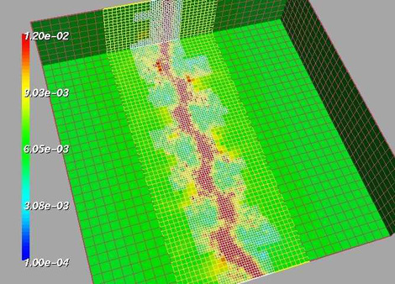
Adaptive Mesh
fluid density
Shock waves in a gas dynamics using AMR (Adaptive Mesh Refinement) See: http://www.llnl.gov/CASC/SAMRAI/

Slide 44
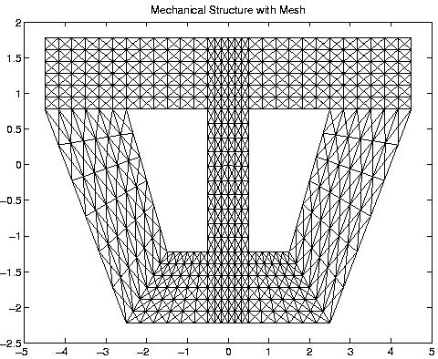
Composite Mesh from a Mechanical Structure

Slide 45
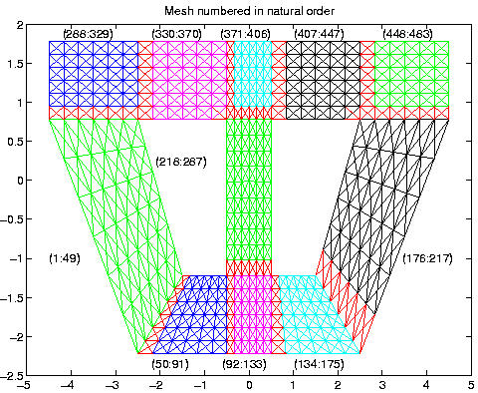
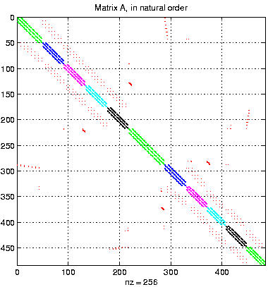
Converting the Mesh to a Matrix

Slide 46
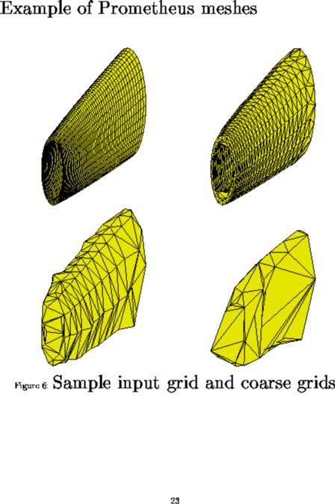
Irregular mesh: Tapered Tube (Multigrid)

