Slide 1


Graph Algorithms in the
Language of Linear Algebra
John R. Gilbert
University of California, Santa Barbara
CS 240A presentation adapted from:
Intel Non-Numeric Computing Workshop
January 17, 2014
Support: Intel, Microsoft, DOE Office of Science, NSF

Slide 2
The middleware of scientific computing
Continuous
physical modeling
Discrete
structure analysis
Linear algebra
Graph theory
Computers
Computers

Slide 3
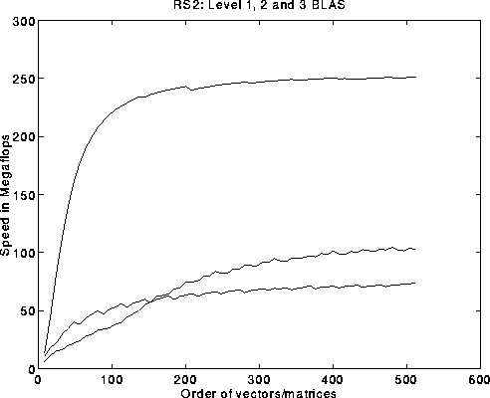
The challenge of the software stack
By analogy to numerical
scientific computing. . .
What should the combinatorial BLAS look like?
Basic Linear Algebra Subroutines (BLAS):
Ops/Sec vs. Matrix Size
C = A*B
y = A*x
μ = x^{T} y

Slide 4
Outline
Motivation
Sparse matrices for graph algorithms
CombBLAS: sparse arrays and graphs on parallel machines
KDT: attributed semantic graphs in a high-level language
Standards for graph algorithm primitives

Slide 5
Multiple-source breadth-first search
1
2
4
7
5
3
6
A^{T}
X

Slide 6
Multiple-source breadth-first search
1
2
→
4
5
7
3
6
A^{T}
X
A^{T}X
Notes:
What we do here is parallelism on the edge level, 2D partitioning is actually edge partitioning.

Slide 7
Multiple-source breadth-first search
1
2
→
4
5
7
3
6
A^{T}
X
A^{T}X
Sparse array representation => space efficient
Sparse matrix-matrix multiplication => work efficient
Three possible levels of parallelism: searches, vertices, edges
Notes:
What we do here is parallelism on the edge level, 2D partitioning is actually edge partitioning.

Slide 8

Graph contraction via
sparse triple product
A1
1
2
Contract
A1
6
A3
A2
4
A2
A3
5
3
1
2
3
4
5
6
1
2
3
4
5
6
1
1
1
0
0
0
0
1
1
1
0
0
0
1
0
1
0
x
x
1
0
1
=
2
2
3
0
0
0
1
0
1
3
0
1
0
4
1
1
1
1
5
0
0
1
6
Notes:
All with sparse matrix triples products

Slide 9
Subgraph extraction via
sparse triple product
1
2
Extract
3
6
2
4
1
5
3
1
2
3
4
5
6
1
2
3
4
5
6
1
1
1
1
0
0
0
1
1
1
0
0
0
1
1
1
0
x
x
1
0
1
=
2
2
3
0
0
0
1
0
1
3
1
1
0
4
1
1
1
1
5
0
0
1
6
Notes:
More with sparse matrix triples products: Vertex relabeling, batch graph updates, etc.

Slide 10
Counting triangles (clustering coefficient)
A
Clustering coefficient:
Pr (wedge i-j-k makes a triangle with edge i-k)
3 * # triangles / # wedges
3 * 4 / 19 = 0.63 in example
may want to compute for each vertex j
3
5
4
6
1
2
Notes:
More with sparse matrix triples products: Vertex relabeling, batch graph updates, etc.

Slide 11
Counting triangles (clustering coefficient)
A
Clustering coefficient:
Pr (wedge i-j-k makes a triangle with edge i-k)
3 * # triangles / # wedges
3 * 4 / 19 = 0.63 in example
may want to compute for each vertex j
3
5
4
6
1
2
Inefficient way to count triangles with matrices:
A = adjacency matrix
# triangles = trace(A³) / 6
but A³ is likely to be pretty dense
A
A³
Notes:
More with sparse matrix triples products: Vertex relabeling, batch graph updates, etc.

Slide 12
Counting triangles (clustering coefficient)
A
Clustering coefficient:
Pr (wedge i-j-k makes a triangle with edge i-k)
3 * # triangles / # wedges
3 * 4 / 19 = 0.63 in example
may want to compute for each vertex j
3
5
4
6
1
2
Cohen’s algorithm to count triangles:
  - Count triangles by lowest-degree vertex.
  - Enumerate “low-hinged” wedges.
  - Keep wedges that close.
hi
hi
lo
hi
hi
lo
hi
hi
lo
Notes:
More with sparse matrix triples products: Vertex relabeling, batch graph updates, etc.

Slide 13
Counting triangles (clustering coefficient)
A
B, C
A = L + U (hi->lo + lo->hi)
L × U = B (wedge, low hinge)
A ∧ B = C (closed wedge)
sum(C)/2 = 4 triangles
3
3
1
4
5
4
5
2
1
6
6
1
2
1
2
A
L
U
C
1
1
1
2
1
2
Notes:
More with sparse matrix triples products: Vertex relabeling, batch graph updates, etc.

Slide 14
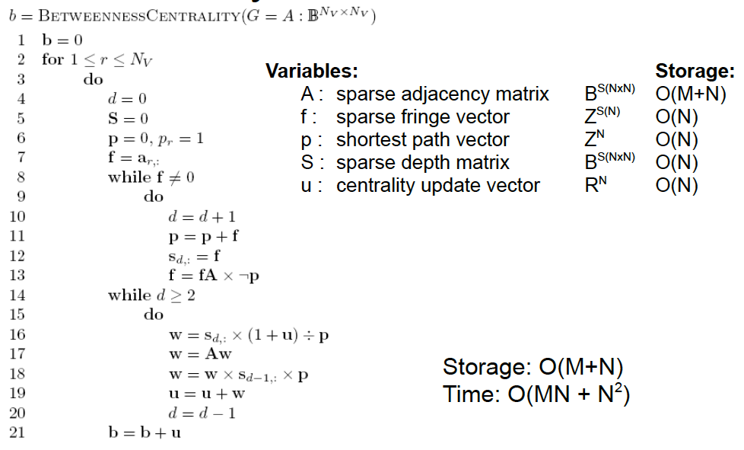
Betweenness centrality [Robinson 2008]
Slide on BC in CombBLAS, or at least array based.

Slide 15
Graph algorithms in the language of linear algebra
Kepner et al. study [2006]: fundamental graph algorithms including min spanning tree, shortest paths, independent set, max flow, clustering, …
SSCA#2 / centrality [2008]
Basic breadth-first search / Graph500 [2010]
Beamer et al. [2013] direction-optimizing breadth-first search, implemented in CombBLAS

Slide 16

Identification of Primitives
Sparse array-based primitives
Sparse matrix-matrix
multiplication (SpGEMM)
Element-wise operations
Sparse matrix-dense vector multiplication
  Sparse matrix indexing
×
×
.*
Matrices over various semirings: (+ . x), (min . +), (or . and), …

Slide 17
The case for sparse matrix graph primitives
Many irregular applications contain
coarse-grained parallelism that can be exploited
by abstractions at the proper level.
Traditional graph computations | Graphs in the language of linear algebra
Data driven, unpredictable communication. | Fixed communication patterns
Irregular and unstructured, poor locality of reference | Operations on matrix blocks exploit memory hierarchy
Fine grained data accesses, dominated by latency | Coarse grained parallelism, bandwidth limited
Notes:
This comes before the BFS example.
say: let's look at a demonstration now !

Slide 18
Matrices over semirings
E.g. matrix multiplication C = AB (or matrix/vector):
C_{i,j} = A_{i,1}×B_{1,j} + A_{i,2}×B_{2,j} + · · · + A_{i,n}×B_{n,j}
Replace scalar operations × and + by
⊗ : associative, distributes over ⊕
⊕ : associative, commutative
Then C_{i,j} = A_{i,1}⊗B_{1,j} ⊕ A_{i,2}⊗B_{2,j} ⊕ · · · ⊕ A_{i,n}⊗B_{n,j}
Examples: ×.+ ; and.or ; +.min ; . . .
Same data reference pattern and control flow
Notes:
2 Sentences describing goals.

Slide 19
Examples of semirings in graph algorithms
(R, +, x) Real Field | Standard numerical linear algebra
({0,1}, |, &) Boolean Semiring | Graph traversal
(R U {∞}, min, +) Tropical Semiring | Shortest paths
(R U {∞}, min, x) | Select subgraph, or contract nodes to form quotient graph
(edge/vertex attributes, vertex data aggregation, edge data processing) | Schema for user-specified computation at vertices and edges

Slide 20
Jon Berry challenge problems for GALA
(all final project possibilities)
Clustering coefficient (triangle counting)
Connected components (bully algorithm)
Maximum independent set (NP-hard)
Maximal independent set (Luby algorithm)
Single-source shortest paths
Special betweenness (for subgraph isomorphism)

Slide 21
Fast Approximate Neighborhood Function (S. Vigna)
(final project possibility)
Distribution of distances between vertices in a graph
  For each vertex v, how many vertices at distance k?
  What’s the average distance (or closeness) between vertices?
Expensive to compute exactly
Nifty but simple data structure gives good approximation fast
Could be implemented as sparse matrix times sparse vector, with the nifty data structure in the semiring
E.g., using Combinatorial BLAS library
Link to paper on course web site

Slide 22
Outline
Motivation
Sparse matrices for graph algorithms
CombBLAS: sparse arrays and graphs on parallel machines
KDT: attributed semantic graphs in a high-level language
Standards for graph algorithm primitives

Slide 23
Combinatorial BLAS
gauss.cs.ucsb.edu/~aydin/CombBLAS
An extensible distributed-memory library offering a small but powerful set of linear algebraic operations specifically targeting graph analytics.
Aimed at graph algorithm designers/programmers who are not expert in mapping algorithms to parallel hardware.
Flexible templated C++ interface.
Scalable performance from laptop to 100,000-processor HPC.
Open source software.
Version 1.4.0 released January 16, 2014.

Slide 24
Combinatorial BLAS: Functions

Slide 25
Combinatorial BLAS: Distributed-memory reference implementation
Combinatorial BLAS
functions and operators
DistMat
CommGrid
FullyDistVec
... HAS A
Polymorphism
DenseDistMat
SpDistMat
SpMat
SpDistVec
DenseDistVec
Enforces interface only
DCSC
CSC
Triples
CSB
Notes:
Naming might be in flux (e.g., SpDistMat is currently SpParMat and there are two distributed vectors) but will stabilize.
Highly templated C++
Operations on arbitrary semirings.
Extendible architecture (e.g., CommGrid handles communication, currently: perfect square, future: arbitrary rectangular grids)

Slide 26
2D layout for sparse matrices & vectors
Matrix/vector distributions,
interleaved on each other.
Default distribution in Combinatorial BLAS.
Scalable with increasing number of processes
5
8
- 2D matrix layout wins over 1D with large core counts
and with limited bandwidth/compute
- 2D vector layout sometimes important for load balance

Slide 27
Parallel sparse matrix-matrix multiplication algorithm
C_{ij} += HyperSparseGEMM(A^{recv}, B^{recv})
25K
100K
5K
25K
x
=
100K
A
C
5K
B
2D algorithm: Sparse SUMMA (based on dense SUMMA)
General implementation that handles rectangular matrices

Slide 28
1D vs. 2D scaling for sparse
matrix-matrix multiplication
Restriction on Freescale matrix
Restriction on GHS psdef/ldoor matrix
SpSUMMA = 2-D data layout (Combinatorial BLAS)
EpetraExt = 1-D data layout
Notes:
Explicitly say what axes are – x is number of processors, y is seconds.
\beta and \alpha are latency and bandwidth, both expressed in terms of time for a floating point operation and its associated costs.

Slide 29
Scaling to more processors…
Almost linear scaling until bandwidth costs starts to dominate
Scaling proportional to √p afterwards

Slide 30
Work In Progress:
QuadMat Shared-memory data structure
subdivide by dimension
on power of 2 indices
m rows
Blocks store a fixed number of elements. More dense parts of matrix have more blocks, but each block has enough data for meaningful computation.
n columns

Slide 31
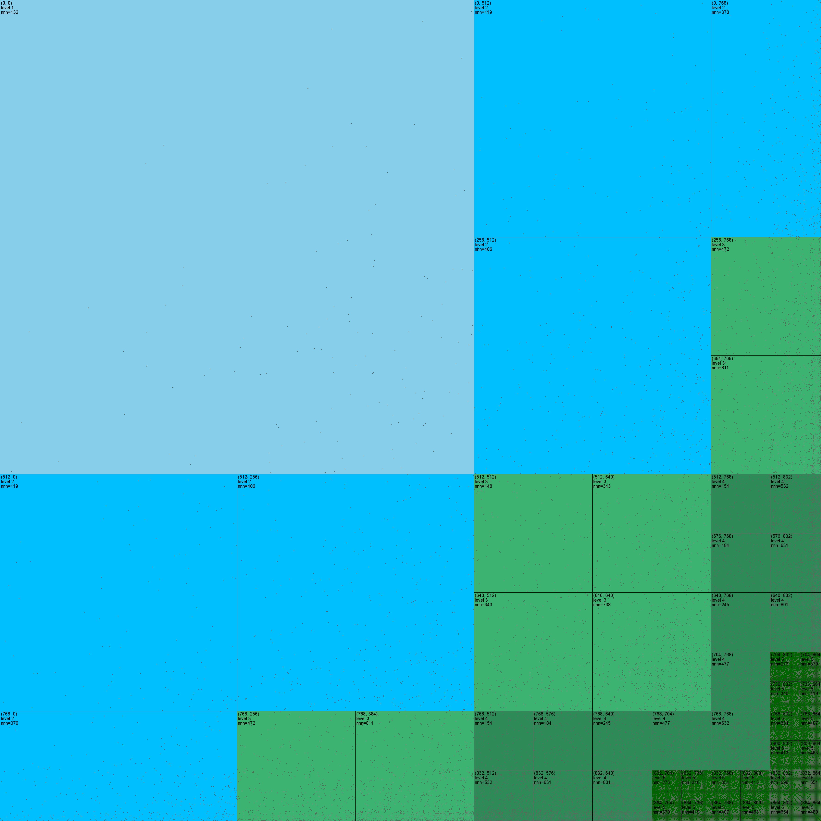
Example
Scale 10 RMAT
(887x887, 21304 non-nulls)
up to 1024 non-nulls per block
Sorted by degree
Blue blocks: uint16_t indices
Green blocks: uint8_t indices
Each (tiny) dot is a non-null

Slide 32
Implementation in templated C++
Parallelized with TBB’s task scheduler.
  Continuation passing style.
Leaf operations are instantiated templates with statically-known data types.
  No virtual functions or other barriers to compiler optimization. Note: slow compilation times due to number of permutations of block types.
Only pay for what you use.
  Sorts are optional.
  Overhead for variable-length data only if used.

Slide 33
Outline
Motivation
Sparse matrices for graph algorithms
CombBLAS: sparse arrays and graphs on parallel machines
KDT: attributed semantic graphs in a high-level language
Standards for graph algorithm primitives

Slide 34
Parallel graph analysis software
Discrete
structure analysis
Graph theory
Computers
Notes:
Why is it sustainable? Because each software layer can be modified independently from others.
An HPC scientist can write a new port to MIC; and all is needed is a Combinatorial BLAS implementation. KDT won’t change a bit.
A graph expert can write a new clustering implementation in KDT; neither the domain scientist, nor the HPC scientist would need to know.

Slide 35
Parallel graph analysis software
Domain scientists
Discrete
structure analysis
Knowledge Discovery Toolbox (KDT)
Graph algorithm developers
Graph theory
Distributed Combinatorial BLAS
HPC scientists and engineers
Shared-address space Combinatorial BLAS
Computers
Communication Support
(MPI, GASNet, etc)
Threading Support
(OpenMP, Cilk, etc))
KDT is higher level (graph abstractions)
Combinatorial BLAS is for performance
Notes:
Why is it sustainable? Because each software layer can be modified independently from others.
An HPC scientist can write a new port to MIC; and all is needed is a Combinatorial BLAS implementation. KDT won’t change a bit.
A graph expert can write a new clustering implementation in KDT; neither the domain scientist, nor the HPC scientist would need to know.

Slide 36
Domain expert vs. graph expert
Input Graph
(Semantic) directed graphs
  constructors, I/O
  basic graph metrics (e.g., degree())
  vectors
Clustering / components
Centrality / authority:
betweenness centrality, PageRank
Hypergraphs and sparse matrices
Graph primitives (e.g., bfsTree())
SpMV / SpGEMM on semirings
Markov
Clustering
Graph of
Clusters
Largest
Component
Notes:
Note that methods need to be self-calibrating for the most part (#iterations before stopping, #clusters to find, …)

Slide 37
Domain expert vs. graph expert
Input Graph
comp = bigG.connComp()
giantComp = comp.hist().argmax()
G = bigG.subgraph(comp==giantComp)
clusters = G.cluster(‘Markov’)
clusNedge = G.nedge(clusters)
smallG = G.contract(clusters)
# visualize
(Semantic) directed graphs
  constructors, I/O
  basic graph metrics (e.g., degree())
  vectors
Clustering / components
Centrality / authority:
betweenness centrality, PageRank
Hypergraphs and sparse matrices
Graph primitives (e.g., bfsTree())
SpMV / SpGEMM on semirings
Markov
Clustering
Graph of
Clusters
Largest
Component
Notes:
Note that methods need to be self-calibrating for the most part (#iterations before stopping, #clusters to find, …)

Slide 38
Domain expert vs. graph expert
Input Graph
comp = bigG.connComp()
giantComp = comp.hist().argmax()
G = bigG.subgraph(comp==giantComp)
clusters = G.cluster(‘Markov’)
clusNedge = G.nedge(clusters)
smallG = G.contract(clusters)
# visualize
(Semantic) directed graphs
  constructors, I/O
  basic graph metrics (e.g., degree())
  vectors
Clustering / components
Centrality / authority:
betweenness centrality, PageRank
Hypergraphs and sparse matrices
Graph primitives (e.g., bfsTree())
SpMV / SpGEMM on semirings
Markov
Clustering
Graph of
Clusters
Largest
Component
[…]
L = G.toSpParMat()
d = L.sum(kdt.SpParMat.Column)
L = -L
L.setDiag(d)
M = kdt.SpParMat.eye(G.nvert()) – mu*L
pos = kdt.ParVec.rand(G.nvert())
for i in range(nsteps):
pos = M.SpMV(pos)
Notes:
Note that methods need to be self-calibrating for the most part (#iterations before stopping, #clusters to find, …)

Slide 39
Knowledge
Discovery
Toolbox
http://kdt.sourceforge.net/
A general graph library with operations based on linear algebraic primitives
Aimed at domain experts who know their problem well but don’t know how to program a supercomputer
Easy-to-use Python interface
Runs on a laptop as well as a cluster with 10,000 processors
Open source software (New BSD license)
V3 release April 2013 (V4 expected spring 2014)

Slide 40
A few KDT applications

Slide 41
Attributed semantic graphs and filters
def onlyEngineers (self):
return self.position == Engineer
def timedEmail (self, sTime, eTime):
return ((self.type == email) and
(self.Time > sTime) and
(self.Time < eTime))
G.addVFilter(onlyEngineers)
G.addEFilter(timedEmail(start, end))
# rank via centrality based on recent
email transactions among engineers
bc = G.rank(’approxBC’)
Example:
Vertex types: Person, Phone, Camera, Gene, Pathway
Edge types: PhoneCall, TextMessage, CoLocation, SequenceSimilarity
Edge attributes: Time, Duration
Calculate centrality just for emails among engineers sent between given start and end times

Slide 42
SEJITS for filter/semiring acceleration
Notes:
At instantiation, source code of filters/semirings is introspected to get the abstract syntax tree, and then is translated into low-level C++.
Subsequent applications of the filter use this low-level implementation, sidestepping the serialization and cost of upcalling into Python.
The semantic model, the intermediate representation that defines the semantics of valid translatable objects, is correct-by-construction.
The filters/semirings fit into the semantic model ←→ they follow the restrictions of what can be translated.

Slide 43
SEJITS for filter/semiring acceleration
Embedded DSL: Python for the whole application
Introspect, translate Python to equivalent C++ code
Call compiled/optimized C++ instead of Python

Slide 44
Filtered BFS with SEJITS
Time (in seconds) for a single BFS iteration on scale 25 RMAT (33M vertices, 500M edges) with 10% of elements passing filter. Machine is NERSC’s Hopper.

Slide 45
SEJITS+KDT multicore performance
MIS= Maximal Independent Set
36 cores of Mirasol (Intel Xeon E7-8870)
Erdős-Rényi (Scale 22, edgefactor=4)
Synthetic data with weighted randomness to match filter permeability
Notation: [semiring impl] / [filter impl]

Slide 46
SEJITS+KDT cluster performance
Breadth-first search
576 cores of Hopper (Cray XE6 at NERSC with AMD Opterons)
R-MAT (Scale 25, edgefactor=16, symmetric)
A roofline model for shows how SEJITS moves KDT analytics from being Python compute bound to being bandwidth bound.

Slide 47
SEJITS+KDT real graph performance
Breadth-first search
16 cores of Mirasol (Intel Xeon E7-8870)

Slide 48
Roofline analysis: Why does SEJITS+KDT work?
Even with SEJITS, there are run-time overheads with function calls via pointers.
How is it so close to the Combinatorial BLAS performance?
Because once we are bandwidth bound, additional complexity does not hurt.

Slide 49
Outline
Motivation
Sparse matrices for graph algorithms
CombBLAS: sparse arrays and graphs on parallel machines
KDT: attributed semantic graphs in a high-level language
Standards for graph algorithm primitives

Slide 50
The (original) BLAS
The Basic Linear Algebra Subroutines
had a revolutionary impact
on computational linear algebra.
BLAS 1 | vector ops | Lawson, Hanson, Kincaid, Krogh, 1979 | LINPACK
BLAS 2 | matrix-vector ops | Dongarra, Du Croz, Hammarling, Hanson, 1988 | LINPACK on vector machines
BLAS 3 | matrix-matrix ops | Dongarra, Du Croz, Hammarling, Hanson, 1990 | LAPACK on cache based machines
Experts in mapping algorithms to hardware tune BLAS for specific platforms.
Experts in numerical linear algebra build software on top of the BLAS to get
high performance “for free.”
Today every computer, phone, etc. comes with /usr/lib/libblas

Slide 51
Can we define and standardize the “Graph BLAS”?
No, it is not reasonable to define a universal set of graph algorithm building blocks:
  Huge diversity in matching algorithms to hardware platforms.
  No consensus on data structures and linguistic primitives.
  Lots of graph algorithms remain to be discovered.
  Early standardization can inhibit innovation.
Yes, it is reasonable to define a common set of graph algorithm building blocks … for Graphs as Linear Algebra:
  Representing graphs in the language of linear algebra is a mature field.
  Algorithms, high level interfaces, and implementations vary.
  But the core primitives are well established.

Slide 52
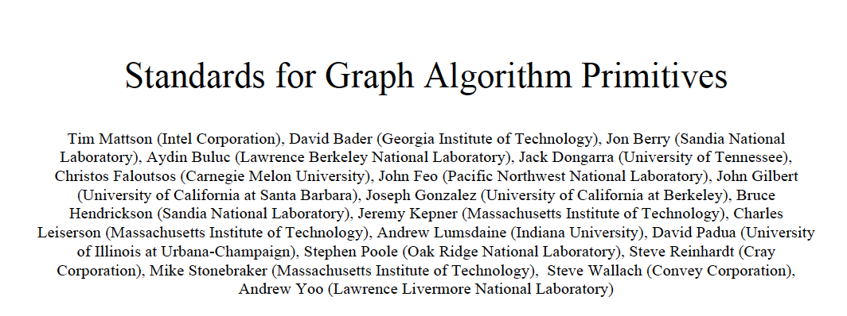
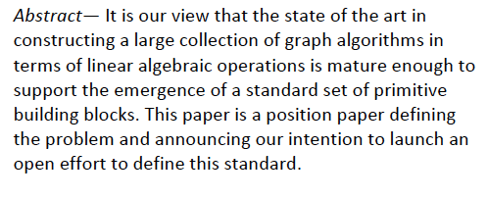
Graph Algorithm Building Blocks workshop: GABB @ IPDPS May 2014

Slide 53
Sparse array attribute survey
Function | Graph BLAS | Comb BLAS | Sparse BLAS | STINGER | D4M | SciDB | Tensor Toolbox | Julia | GraphLab
Version |  | 1.3.0 | 2006 | r633 | 2.5 | 13.9 | 2.5 | 0.2.0 | 2.2
Language | any | C++ | F,C,C++ | C | Matlab | C++ | Matlab, C++ | Julia | C++
Dimension | 2 | 1, 2 | 2 | 1, 2, 3 | 2 | 1 to 100 | 2, 3 | 1,2 | 2
Index Base | 0 or 1 | 0 | 0 or 1 | 0 | 1 | ±N | 1 | 1 | 0
Index Type | uint64 | uint64 | int | int64 | double, string | int64 | double | any int | uint64
Value Type | ? | user | single, double, complex | int64 | logical, double, complex, string | user | logical, double, complex | user | user
Null | 0 | user | 0 | 0 | ≤0 | null | 0 | 0 | int64(-1)
Sparse Format | ? | tuple | undef | linked list | dense, csc, tuple | RLE | dense, csc | csc | csr/csc
Parallel | ? | 2D block | none | block | arbitrary | N-D block, cyclic w/overlap | none | N-D block, cyclic w/overlap | Edge based w/ vertex split
+ operations * operations | user? user? | user user | + * | user user | +,*,max,min,∩,∪ | user user | + * | user user | user user

Slide 54
Matrix times matrix over semiring
Inputs
matrix A: S^{MxN} (sparse or dense)
matrix B: S^{NxL} (sparse or dense)
Optional Inputs
matrix C: S^{MxL} (sparse or dense)
scalar “add” function ⊕
scalar “multiply” function ⊗
transpose flags for A, B, C
Outputs
matrix C: S^{MxL} (sparse or dense)
Implements C ⊕= A ⊕.⊗ B
for j = 1 : N
C(i,k) = C(i,k) ⊕ (A(i,j) ⊗ B(j,k))
If input C is omitted, implements
C = A ⊕.⊗ B
Transpose flags specify operation
on A^{T}, B^{T}, and/or C^{T} instead
Notes
S is the set of scalars, user-specified
S defaults to IEEE double float
⊕ defaults to floating-point +
⊗ defaults to floating-point *
Specific cases and function names:
SpGEMM: sparse matrix times sparse matrix
SpMSpV: sparse matrix times sparse vector
SpMV: Sparse matrix times dense vector
SpMM: Sparse matrix times dense matrix

Slide 55
Sparse matrix indexing & assignment
Inputs
matrix A: S^{MxN} (sparse)
matrix B: S^{|p|x|q|} (sparse)
vector p ⊆ {1, …, M}
vector q ⊆ {1, …, N}
Optional Inputs
none
Outputs
matrix A: S^{MxN} (sparse)
matrix B: S^{|p|x|q|} (sparse)
SpRef Implements B = A(p,q)
for i = 1 : |p|
for j = 1 : |q|
B(i,j) = A(p(i),q(j))
SpAsgn Implements A(p,q) = B
for i = 1 : |p|
for j = 1 : |q|
A(p(i),q(j)) = B(i,j)
Notes
S is the set of scalars, user-specified
S defaults to IEEE double float
|p| = length of vector p
|q| = length of vector q
Specific cases and function names
SpRef: get sub-matrix
SpAsgn: assign to sub-matrix

Slide 56
Element-wise operations
Inputs
matrix A: S^{MxN} (sparse or dense)
matrix B: S^{MxN} (sparse or dense)
Optional Inputs
matrix C: S^{MxN} (sparse or dense)
scalar “add” function ⊕
scalar “multiply” function ⊗
Outputs
matrix C: S^{MxN} (sparse or dense)
Implements C ⊕= A ⊗ B
for i = 1 : M
for j = 1 : N
C(i,j) = C(i,j) ⊕ (A(i,j) ⊗ B(i,j))
If input C is omitted, implements
C = A ⊗ B
Notes
S is the set of scalars, user-specified
S defaults to IEEE double float
⊕ defaults to floating-point +
⊗ defaults to floating-point *
Specific cases and function names:
SpEWiseX: matrix elementwise
M=1 or N=1: vector elementwise
Scale: when A or B is a scalar

Slide 57
Apply/Update
Inputs
matrix A: S^{MxN} (sparse or dense)
Optional Inputs
matrix C: S^{MxN} (sparse or dense)
scalar “add” function ⊕
unary function f()
Outputs
matrix C: S^{MxN} (sparse or dense)
Implements C ⊕= f(A)
for i = 1 : M
for j = 1 : N
if A(i,j) ≠ 0
C(i,j) = C(i,j) ⊕ f(A(i,j))
If input C is omitted, implements
C = f(A)
Notes
S is the set of scalars, user-specified
S defaults to IEEE double float
⊕ defaults to floating-point +
Specific cases and function names:
Apply: matrix apply
M=1 or N=1: vector apply

Slide 58
Conclusion
It helps to look at things from two directions.
Sparse arrays and matrices yield useful primitives and algorithms for high-performance graph computation.
Graphs in the language of linear algebra are sufficiently mature to support a standard set of BLAS.

