Slide 1
CS240A: Conjugate Gradients and the Model Problem

Slide 2
The middleware of scientific computing
Continuous physical modeling
Ax = b
Linear algebra
Computers

Slide 3
Example: The Temperature Problem
A cabin in the snow
Wall temperature is 0°, except for a radiator at 100°
What is the temperature in the interior?

Slide 4
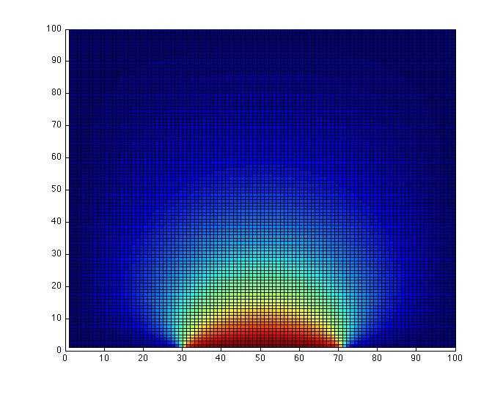
Example: The Temperature Problem
A cabin in the snow (a square region ☺)
Wall temperature is 0°, except for a radiator at 100°
What is the temperature in the interior?

Slide 5
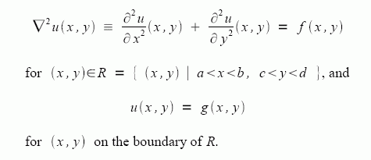
The physics: Poisson’s equation

Slide 6
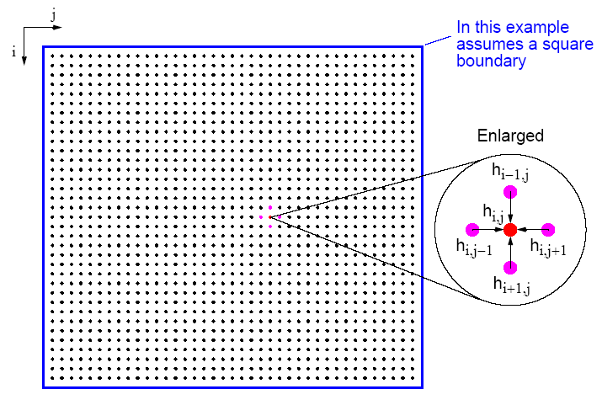
Many Physical Models Use Stencil Computations
PDE models of heat, fluids, structures, …
Weather, airplanes, bridges, bones, …
Game of Life
many, many others
6.43

Slide 7
Model Problem: Solving Poisson’s equation for temperature
k = n^{1/2}
Discrete approximation to Poisson’s equation:
t(i) = ¼ ( t(i-k) + t(i-1) + t(i+1) + t(i+k) )
Intuitively:
Temperature at a point is the average of the temperatures at surrounding points

Slide 8
Model Problem: Solving Poisson’s equation for temperature
k = n^{1/2}
For each i from 1 to n, except on the boundaries:
– t(i-k) – t(i-1) + 4*t(i) – t(i+1) – t(i+k) = 0
n equations in n unknowns: A*t = b
Each row of A has at most 5 nonzeros
In three dimensions, k = n^{1/3} and each row has at most 7 nzs

Slide 9
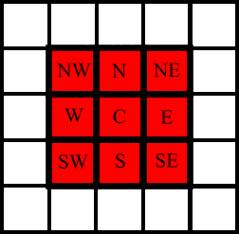
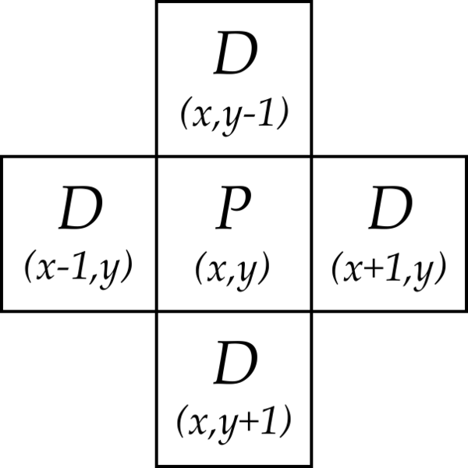
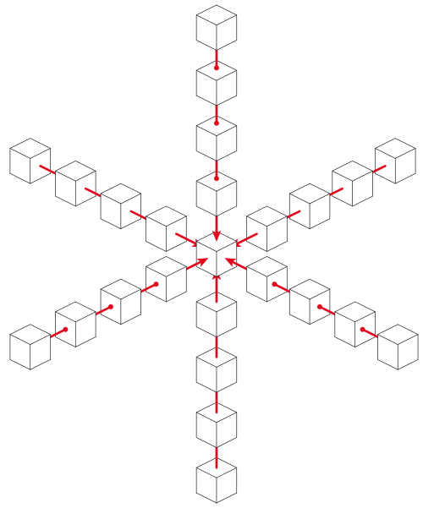
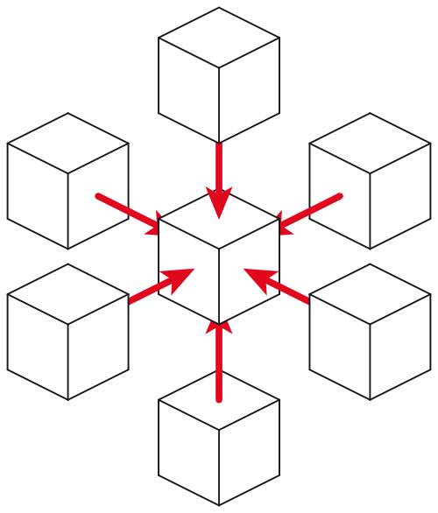
Examples of stencils
9-point stencil in 2D (game of Life)
5-point stencil in 2D (temperature problem)
25-point stencil in 3D
(seismic modeling)
7-point stencil in 3D (3D temperature problem)
… and many more

Slide 10
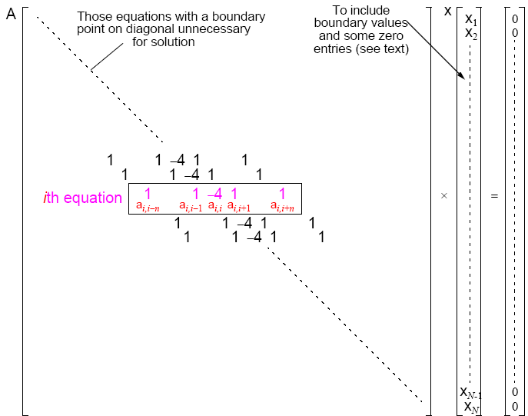
A Stencil Computation Solves a System of Linear Equations
Solve Ax = b for x
Matrix A, right-hand side vector b, unknown vector x
A is sparse: most of the entries are 0

Slide 11
The Landscape of Ax=b Solvers
Direct
A = LU
Iterative
y’ = Ay
More General
Non-
symmetric
Symmetric
positive
definite
More Robust
More Robust
Less Storage (if sparse)

Slide 12
CS 240A: Solving Ax = b in parallel
Dense A: Gaussian elimination with partial pivoting (LU)
See Jim Demmel’s slides
Same flavor as matrix * matrix, but more complicated
Sparse A: Iterative methods – Conjugate gradient, etc.
Sparse matrix times dense vector
Sparse A: Gaussian elimination – Cholesky, LU, etc.
Graph algorithms
Sparse A: Preconditioned iterative methods and multigrid
Mixture of lots of things

Slide 13
CS 240A: Solving Ax = b in parallel
Dense A: Gaussian elimination with partial pivoting
See Jim Demmel’s slides
Same flavor as matrix * matrix, but more complicated
Sparse A: Iterative methods – Conjugate gradient etc.
Sparse matrix times dense vector
Sparse A: Gaussian elimination – Cholesky, LU, etc.
Graph algorithms
Sparse A: Preconditioned iterative methods and multigrid
Mixture of lots of things

Slide 14
Conjugate gradient iteration for Ax = b
x₀ = 0 approx solution
r₀ = b residual = b - Ax
d₀ = r₀ search direction
for k = 1, 2, 3, . . .
x_{k} = x_{k-1} + … new approx solution
r_{k} = … new residual
d_{k} = … new search direction

Slide 15
Conjugate gradient iteration for Ax = b
x₀ = 0 approx solution
r₀ = b residual = b - Ax
d₀ = r₀ search direction
for k = 1, 2, 3, . . .
α_{k} = … step length
x_{k} = x_{k-1} + α_{k} d_{k-1} new approx solution
r_{k} = … new residual
d_{k} = … new search direction

Slide 16
Conjugate gradient iteration for Ax = b
x₀ = 0 approx solution
r₀ = b residual = b - Ax
d₀ = r₀ search direction
for k = 1, 2, 3, . . .
α_{k} = (r^{T}_{k-1}r_{k-1}) / (d^{T}_{k-1}Ad_{k-1}) step length
x_{k} = x_{k-1} + α_{k} d_{k-1} new approx solution
r_{k} = … new residual
d_{k} = … new search direction

Slide 17
Conjugate gradient iteration for Ax = b
x₀ = 0 approx solution
r₀ = b residual = b - Ax
d₀ = r₀ search direction
for k = 1, 2, 3, . . .
α_{k} = (r^{T}_{k-1}r_{k-1}) / (d^{T}_{k-1}Ad_{k-1}) step length
x_{k} = x_{k-1} + α_{k} d_{k-1} new approx solution
r_{k} = … new residual
β_{k} = (r^{T}_{k} r_{k}) / (r^{T}_{k-1}r_{k-1})
d_{k} = r_{k} + β_{k} d_{k-1} new search direction

Slide 18
Conjugate gradient iteration for Ax = b
x₀ = 0 approx solution
r₀ = b residual = b - Ax
d₀ = r₀ search direction
for k = 1, 2, 3, . . .
α_{k} = (r^{T}_{k-1}r_{k-1}) / (d^{T}_{k-1}Ad_{k-1}) step length
x_{k} = x_{k-1} + α_{k} d_{k-1} new approx solution
r_{k} = r_{k-1} – α_{k} Ad_{k-1} new residual
β_{k} = (r^{T}_{k} r_{k}) / (r^{T}_{k-1}r_{k-1})
d_{k} = r_{k} + β_{k} d_{k-1} new search direction

Slide 19
Conjugate gradient iteration to solve A*x=b
x₀ = 0, r₀ = b, d₀ = r₀ (these are all vectors)
for k = 1, 2, 3, . . .
α_{k} = (r^{T}_{k-1}r_{k-1}) / (d^{T}_{k-1}Ad_{k-1}) step length
x_{k} = x_{k-1} + α_{k} d_{k-1} approximate solution
r_{k} = r_{k-1} – α_{k} Ad_{k-1} residual = b - Ax_{k}
β_{k} = (r^{T}_{k} r_{k}) / (r^{T}_{k-1}r_{k-1}) improvement
d_{k} = r_{k} + β_{k} d_{k-1} search direction
One matrix-vector multiplication per iteration
Two vector dot products per iteration
Four n-vectors of working storage

Slide 20
Vector and matrix primitives for CG
DAXPY: v = α*v + β*w (vectors v, w; scalars α, β)
Broadcast the scalars α and β, then independent * and +
comm volume = 2p, span = log n
DDOT: α = v^{T}*w = Σ_{j} v[j]*w[j] (vectors v, w; scalar α)
Independent *, then + reduction
comm volume = p, span = log n
Matvec: v = A*w (matrix A, vectors v, w)
The hard part
But all you need is a subroutine to compute v from w
Sometimes you don’t need to store A (e.g. temperature problem)
Usually you do need to store A, but it’s sparse ...

Slide 21
Broadcast and reduction
Broadcast of 1 value to p processors in log p time
Reduction of p values to 1 in log p time
Takes advantage of associativity in +, *, min, max, etc.
α
Broadcast
1 3 1 0 4 -6 3 2
Add-reduction
8

Slide 22
Where’s the data (temperature problem)?
The matrix A: Nowhere!!
The vectors x, b, r, d:
Each vector is one value per stencil point
Divide stencil points among processors, n/p points each
How do you divide up the sqrt(n) by sqrt(n) region of points?
Block row (or block col) layout: v = 2 * p * sqrt(n)
2-dimensional block layout: v = 4 * sqrt(p) * sqrt(n)

Slide 23
How do you partition the sqrt(n) by sqrt(n) stencil points?
First version: number the grid by rows
Leads to a block row decomposition of the region
v = 2 * p * sqrt(n)
6.43

Slide 24
How do you partition the sqrt(n) by sqrt(n) stencil points?
Second version: 2D block decomposition
Numbering is a little more complicated
v = 4 * sqrt(p) * sqrt(n)
6.43

Slide 25
Where’s the data (temperature problem)?
The matrix A: Nowhere!!
The vectors x, b, r, d:
Each vector is one value per stencil point
Divide stencil points among processors, n/p points each
How do you divide up the sqrt(n) by sqrt(n) region of points?
Block row (or block col) layout: v = 2 * p * sqrt(n)
2-dimensional block layout: v = 4 * sqrt(p) * sqrt(n)

Slide 26
Detailed complexity measures for data movement I: Latency/Bandwidth Model
Moving data between processors by message-passing
Machine parameters:
α latency (message startup time in seconds)
β inverse bandwidth (in seconds per word)
between nodes of Triton, α ∼ 2.2 × 10⁻⁶ and β ∼ 6.4 × 10⁻⁹
Time to send & recv or bcast a message of w words: α + w*β
t_{comm} total commmunication time
t_{comp} total computation time
Total parallel time: t_{p} = t_{comp} + t_{comm}

Slide 27
Ghost Nodes in Stencil Computations
Comm cost = α * (#messages) + β * (total size of messages)
Keep a ghost copy of neighbors’ boundary nodes
Communicate every second iteration, not every iteration
Reduces #messages, not total size of messages
Costs extra memory and computation
Can also use more than one layer of ghost nodes
Green = my interior nodes
Blue = my boundary nodes
Yellow = neighbors’ boundary nodes = my “ghost nodes”

Slide 28
The Landscape of Ax = b Algorithms
Gaussian
elimination
Iterative
More General
Any
matrix
Symmetric
positive
definite
matrix
More Robust
More Robust
Less Storage

Slide 29
Conjugate gradient in general
CG can be used to solve any system Ax = b, if …

Slide 30
Conjugate gradient in general
CG can be used to solve any system Ax = b, if …
The matrix A is symmetric (a_{ij} = a_{ji}) …
… and positive definite (all eigenvalues > 0).

Slide 31
Conjugate gradient in general
CG can be used to solve any system Ax = b, if …
The matrix A is symmetric (a_{ij} = a_{ji}) …
… and positive definite (all eigenvalues > 0).
Symmetric positive definite matrices occur a lot in scientific computing & data analysis!

Slide 32
Conjugate gradient in general
CG can be used to solve any system Ax = b, if …
The matrix A is symmetric (a_{ij} = a_{ji}) …
… and positive definite (all eigenvalues > 0).
Symmetric positive definite matrices occur a lot in scientific computing & data analysis!
But usually the matrix isn’t just a stencil.
Now we do need to store the matrix A. Where’s the data?

Slide 33
Conjugate gradient in general
CG can be used to solve any system Ax = b, if …
The matrix A is symmetric (a_{ij} = a_{ji}) …
… and positive definite (all eigenvalues > 0).
Symmetric positive definite matrices occur a lot in scientific computing & data analysis!
But usually the matrix isn’t just a stencil.
Now we do need to store the matrix A. Where’s the data?
The key is to use graph data structures and algorithms.

Slide 34
Vector and matrix primitives for CG
DAXPY: v = α*v + β*w (vectors v, w; scalars α, β)
Broadcast the scalars α and β, then independent * and +
comm volume = 2p, span = log n
DDOT: α = v^{T}*w = Σ_{j} v[j]*w[j] (vectors v, w; scalar α)
Independent *, then + reduction
comm volume = p, span = log n
Matvec: v = A*w (matrix A, vectors v, w)
The hard part
But all you need is a subroutine to compute v from w
Sometimes you don’t need to store A (e.g. temperature problem)
Usually you do need to store A, but it’s sparse ...

Slide 35
Conjugate gradient: Krylov subspaces
Eigenvalues: Av = λv { λ₁, λ₂ , . . ., λ_{n}}
Cayley-Hamilton theorem:
(A – λ₁I)·(A – λ₂I) · · · (A – λ_{n}I) = 0
Therefore _{Σ} c_{i}A^{i} = 0 for some c_{i}
so A⁻¹ = _{Σ} (–c_{i}/c₀) A^{i–1}
Krylov subspace:
Therefore if Ax = b, then x = A⁻¹ b and
x ∈ span (b, Ab, A²b, . . ., A^{n-1}b) = K_{n} (A, b)
0 ≤ i ≤ n
1 ≤ i ≤ n

Slide 36
Conjugate gradient: Orthogonal sequences
Krylov subspace: K_{i} (A, b) = span (b, Ab, A²b, . . ., A^{i-1}b)
Conjugate gradient algorithm: for i = 1, 2, 3, . . . find x_{i} ∈ K_{i} (A, b) such that r_{i} = (b – Ax_{i}) ⊥ K_{i} (A, b)
Notice r_{i} ∈ K_{i+1} (A, b), so r_{i} ⊥ r_{j} for all j < i
Similarly, the “directions” are A-orthogonal: (x_{i} – x_{i-1} )^{T}·A· (x_{j} – x_{j-1} ) = 0
The magic: Short recurrences. . . A is symmetric => can get next residual and direction from the previous one, without saving them all.

Slide 37
Conjugate gradient: Convergence
In exact arithmetic, CG converges in n steps (completely unrealistic!!)
Accuracy after k steps of CG is related to:
consider polynomials of degree k that are equal to 1 at 0.
how small can such a polynomial be at all the eigenvalues of A?
Thus, eigenvalues close together are good.
Condition number: κ(A) = ||A||₂ ||A⁻¹||₂ = λ_{max}(A) / λ_{min}(A)
Residual is reduced by a constant factor by O(κ^{1/2}(A)) iterations of CG.

Slide 38
Other Krylov subspace methods
Nonsymmetric linear systems:
GMRES: for i = 1, 2, 3, . . . find x_{i} ∈ K_{i} (A, b) such that r_{i} = (Ax_{i} – b) ⊥ K_{i} (A, b) But, no short recurrence => save old vectors => lots more space
(Usually “restarted” every k iterations to use less space.)
BiCGStab, QMR, etc.: Two spaces K_{i} (A, b) and K_{i} (A^{T}, b) w/ mutually orthogonal bases Short recurrences => O(n) space, but less robust
Convergence and preconditioning more delicate than CG
Active area of current research
Eigenvalues: Lanczos (symmetric), Arnoldi (nonsymmetric)

Slide 39
Conjugate gradient iteration
x₀ = 0, r₀ = b, d₀ = r₀
for k = 1, 2, 3, . . .
α_{k} = (r^{T}_{k-1}r_{k-1}) / (d^{T}_{k-1}Ad_{k-1}) step length
x_{k} = x_{k-1} + α_{k} d_{k-1} approx solution
r_{k} = r_{k-1} – α_{k} Ad_{k-1} residual
β_{k} = (r^{T}_{k} r_{k}) / (r^{T}_{k-1}r_{k-1}) improvement
d_{k} = r_{k} + β_{k} d_{k-1} search direction
One matrix-vector multiplication per iteration
Two vector dot products per iteration
Four n-vectors of working storage

