Slide 1
CS 240A
Applied Parallel Computing
John R. Gilbert
gilbert@cs.ucsb.edu
http://www.cs.ucsb.edu/~cs240a
Thanks to Kathy Yelick and Jim Demmel at UCB for some of their slides.

Slide 2
Why are we here?
Computational science
  The world’s largest computers have always been used for simulation and data analysis in science and engineering.
Performance
  Getting the most computation for the least cost (in time, hardware, or energy)
Architectures
  All big computers (and most little ones) are parallel
Algorithms
  The building blocks of computation

Slide 3
Course bureacracy
Read course home page on GauchoSpace
Accounts on Triton/TSCC, San Diego Supercomputing Center:
  Use “ssh –keygen –t rsa” and then email your PUBLIC key file “id_rsa.pub” to Kadir Diri, scc@oit.ucsb.edu
Triton logon demo & tool intro coming soon
Watch (and participate in) the “Discussions, questions, and announcements” forum on the GauchoSpace page.

Slide 4
Homework 1: Two parts
Part A: Find an application of parallel computing and build a web page describing it.
  Choose something from your research area, or from the web.
  Describe the application and provide a reference.
  Describe the platform where this application was run.
  Evaluate the project.
  Send us (John and Veronika) the link -- we will post them.
Part B: Performance tuning exercise.
  Make my matrix multiplication code run faster on 1 processor!
See GauchoSpace page for details.
Both due next Tuesday, January 14.

Slide 5

Trends in parallelism and data
Number of Facebook Users
50 million
500 million
16 X
More cores and data → Need to extract algorithmic parallelism

Slide 6
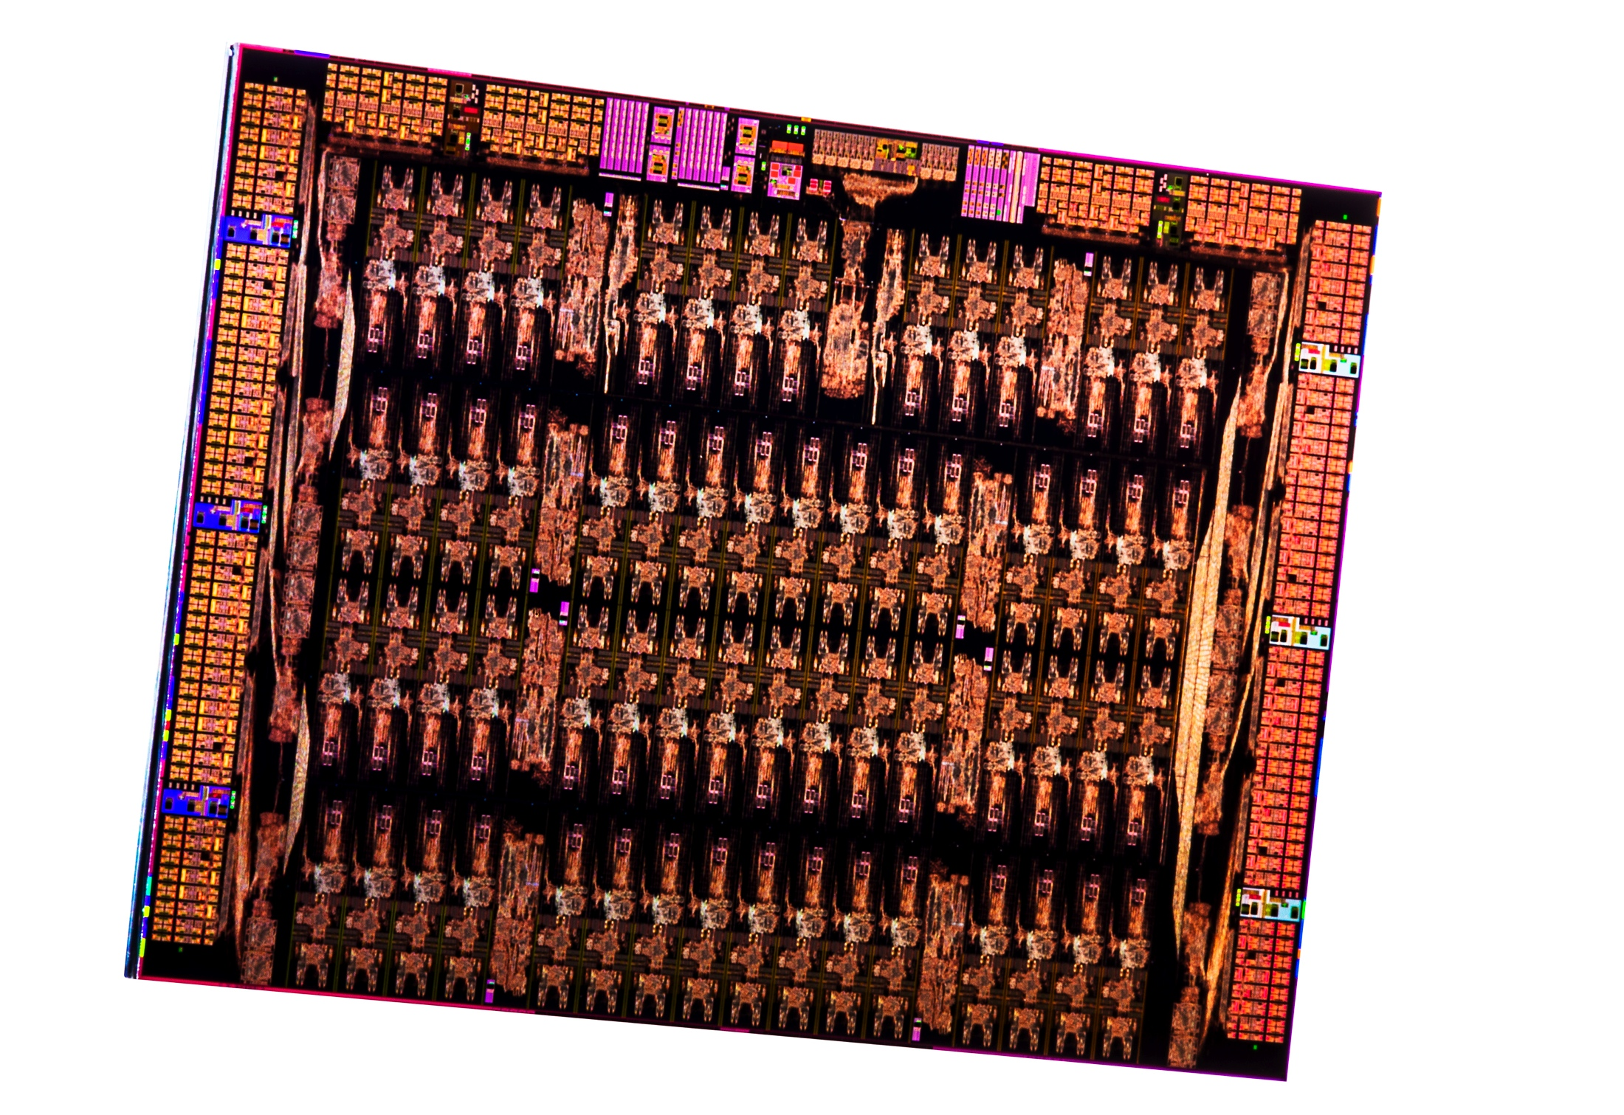
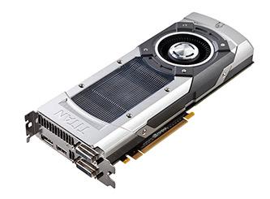
Parallel Computers Today
Oak Ridge / Cray Titan
17 PFLOPS
Intel 61-core Phi chip
1.2 TFLOPS
Nvidia GTX GPU
1.5 TFLOPS
TFLOPS = 10¹² floating point ops/sec
PFLOPS = 1,000,000,000,000,000 / sec (10¹⁵)

Slide 7
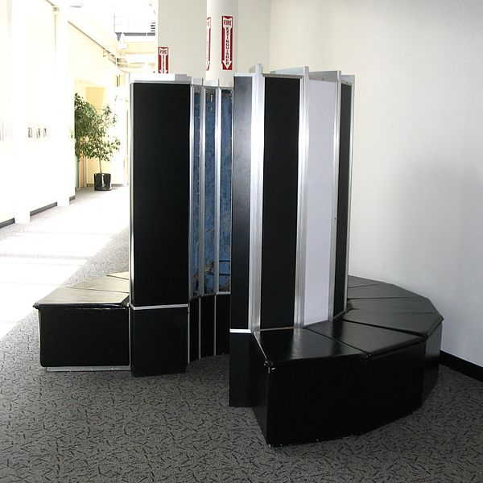
Supercomputers 1976: Cray-1, 133 MFLOPS (10⁶)

Slide 8
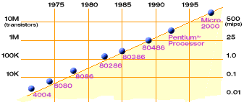
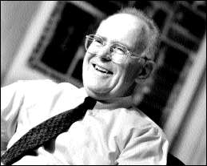
Technology Trends: Microprocessor Capacity
Moore’s Law
Moore’s Law: #transistors/chip doubles every 1.5 years
Gordon Moore (co-founder of Intel) predicted in 1965 that the transistor density of semiconductor chips would double roughly every 18 months.
Microprocessors have become smaller, denser, and more powerful.
Slide source: Jack Dongarra

Slide 9
“Automatic” Parallelism in Modern Machines
Bit level parallelism
  within floating point operations, etc.
Instruction level parallelism
  multiple instructions execute per clock cycle
Memory system parallelism
  overlap of memory operations with computation
OS parallelism
  multiple jobs run in parallel on commodity SMPs
There are limits to all of these -- for very high performance, user must identify, schedule and coordinate parallel tasks

Slide 10
Number of transistors per processor chip

Slide 11
Number of transistors per processor chip
Instruction-Level
Parallelism
Thread-Level
Parallelism?
Bit-Level
Parallelism

Slide 12
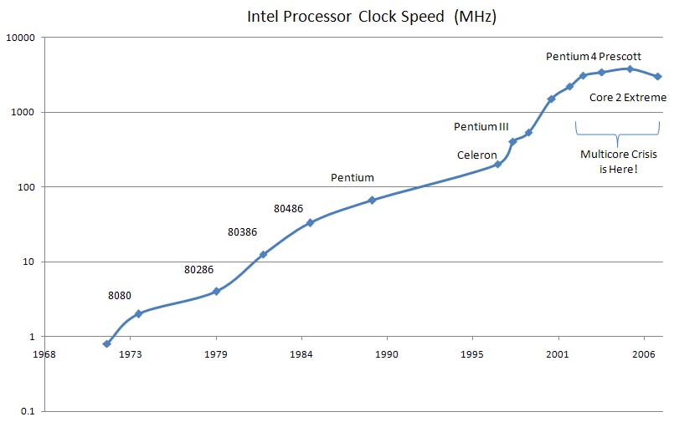
Trends in processor clock speed

Slide 13
Generic Parallel Machine Architecture
Storage
Hierarchy
Proc
Proc
Proc
Cache
Cache
Cache
L2 Cache
L2 Cache
L2 Cache
L3 Cache
L3 Cache
L3 Cache
potential
interconnects
Memory
Memory
Memory
Key architecture question: Where is the interconnect, and how fast?
Key algorithm question: Where is the data?

Slide 14
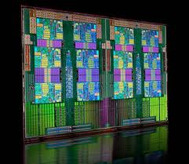
AMD Opteron 12-core chip (e.g. LBL’s Cray XE6 “Hopper”)

Slide 15
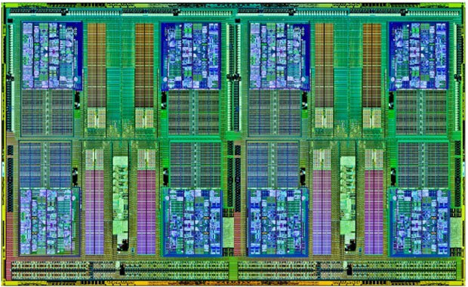
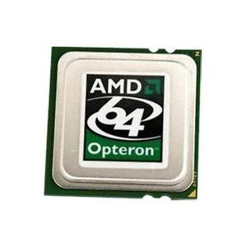
Triton memory hierarchy: I (Chip level)
Chip (AMD Opteron 8-core Magny-Cours)
Proc
Proc
Proc
Proc
Proc
Proc
Proc
Proc
Cache
Cache
Cache
Cache
Cache
Cache
Cache
Cache
L2 Cache
L2 Cache
L2 Cache
L2 Cache
L2 Cache
L2 Cache
L2 Cache
L2 Cache
L3 Cache (8MB)
Chip sits in socket, connected to the rest of the node . . .

Slide 16
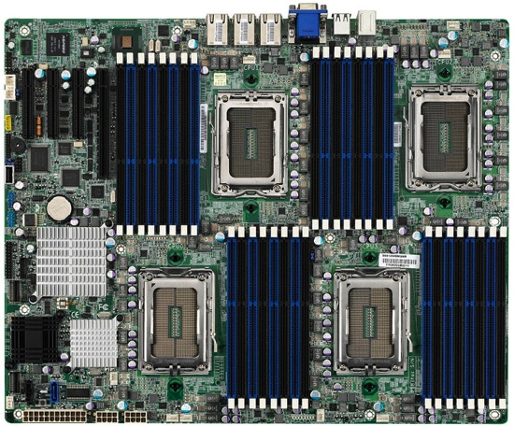
Triton memory hierarchy II (Node level)
Node
P
L1/L2
P
L1/L2
P
L1/L2
P
L1/L2
P
L1/L2
P
L1/L2
P
L1/L2
P
L1/L2
Chip
L3 Cache (8 MB)
P
L1/L2
P
L1/L2
P
L1/L2
P
L1/L2
P
L1/L2
P
L1/L2
P
L1/L2
P
L1/L2
Chip
L3 Cache (8 MB)
P
L1/L2
P
L1/L2
P
L1/L2
P
L1/L2
P
L1/L2
P
L1/L2
P
L1/L2
P
L1/L2
Shared
Node
Memory
(64GB)
Chip
L3 Cache (8 MB)
P
L1/L2
P
L1/L2
P
L1/L2
P
L1/L2
P
L1/L2
P
L1/L2
P
L1/L2
P
L1/L2
Chip
L3 Cache (8 MB)
<- Infiniband interconnect to other nodes ->

Slide 17
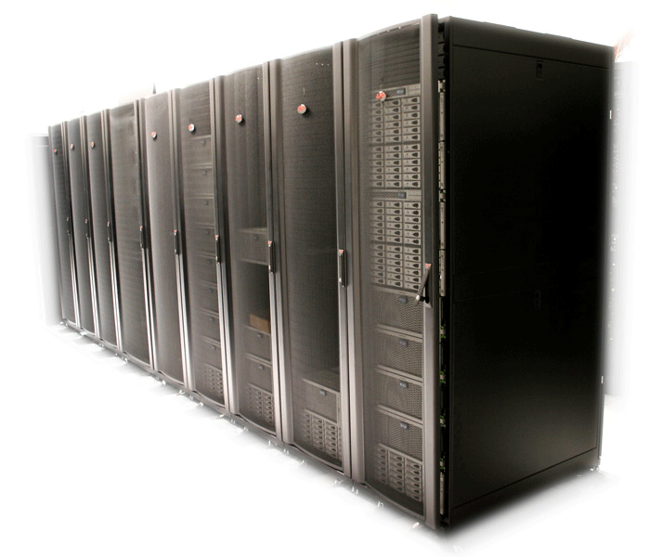
Triton memory hierarchy III (System level)
Node
Node
Node
Node
Node
Node
Node
Node
64GB
64GB
64GB
64GB
64GB
64GB
64GB
64GB
64GB
64GB
64GB
64GB
64GB
64GB
64GB
64GB
Node
Node
Node
Node
Node
Node
Node
Node
324 nodes, message-passing communication, no shared memory

Slide 18
One kind of big parallel application
Example: Bone density modeling
  Physical simulation
  Lots of numerical computing
  Spatially local
See Mark Adams’s slides…

Slide 19
“The unreasonable effectiveness of mathematics”
As the “middleware”
of scientific computing,
linear algebra has supplied
or enabled:
Mathematical tools
“Impedance match” to
computer operations
High-level primitives
High-quality software libraries
Ways to extract performance
from computer architecture
Interactive environments
Continuous
physical modeling
Linear algebra
Computers

Slide 20
Top 500 List (November 2013)
Top500 Benchmark:
Solve a large system
of linear equations
by Gaussian elimination
P
A
U
=
L
x

Slide 21
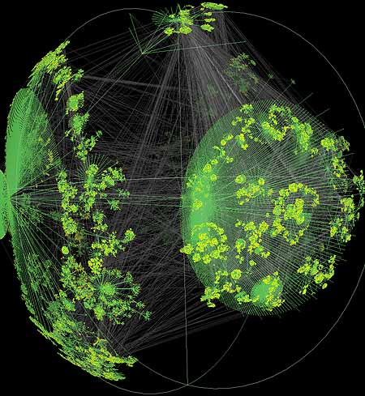
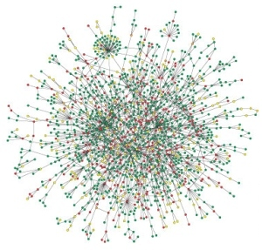

Large graphs are everywhere…
Internet structure
Social interactions
Scientific datasets: biological, chemical, cosmological, ecological, …
WWW snapshot, courtesy Y. Hyun
Yeast protein interaction network, courtesy H. Jeong
Notes:
Details on the types of computations here -> Pagerank (web), betweenness centrality (biological)
Both are huge, sparse graphs

Slide 22
Another kind of big parallel application
Example: Vertex betweenness centrality
  Exploring an unstructured graph
  Lots of pointer-chasing
  Little numerical computing
  No spatial locality
See Eric Robinson’s slides…

Slide 23
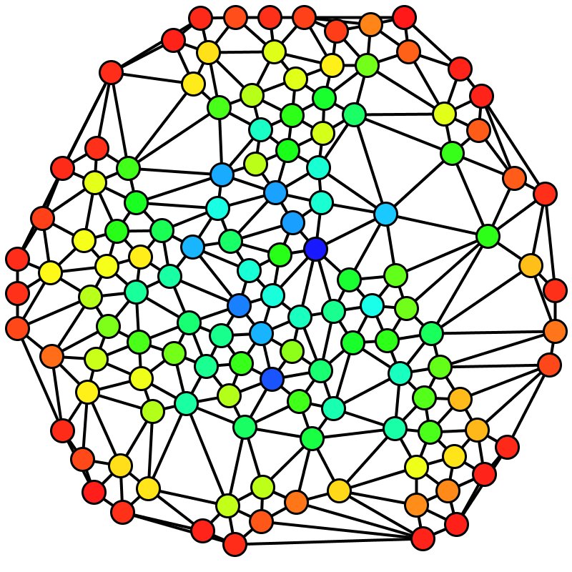
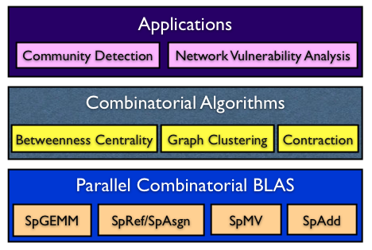

Social network analysis
Betweenness Centrality (BC)
C_{B}(v): Among all the shortest paths, what fraction of them pass through the node of interest?
A typical software stack for an application enabled with the Combinatorial BLAS
Brandes’ algorithm
Notes:
Why betweenness centrality?
It has a lot of applications in identifying important vertices
It’s a standard graph benchmark to compare implementations.

Slide 24
An analogy?
Continuous
physical modeling
Discrete
structure analysis
Linear algebra
Graph theory
Computers
Computers

Slide 25
Node-to-node searches in graphs …
Who are my friends’ friends?
How many hops from A to B? (six degrees of Kevin Bacon)
What’s the shortest route to Las Vegas?
Am I related to Abraham Lincoln?
Who likes the same movies I do, and what other movies do they like?
. . .
See breadth-first search example slides

Slide 26

Graph 500 List (November 2013)
Graph500 Benchmark:
Breadth-first search
in a large
power-law graph
1
2
4
7
5
3
6

Slide 27
Floating-Point vs. Graphs, November 2013
33.8 Petaflops
15.3 Terateps
U
1
2
P
A
=
L
x
4
7
5
3
6
33.8 Peta / 15.3 Tera is about 2200.

Slide 28
Floating-Point vs. Graphs, November 2013
33.8 Petaflops
15.3 Terateps
U
1
2
P
A
=
L
x
4
7
5
3
6
Nov 2013: 33.8 Peta / 15.3 Tera ~ 2,200
Nov 2010: 2.5 Peta / 6.6 Giga ~ 380,000

Slide 29
Course bureacracy
Read course home page on GauchoSpace
Accounts on Triton/TSCC, San Diego Supercomputing Center:
  Use “ssh –keygen –t rsa” and then email your PUBLIC key file “id_rsa.pub” to Kadir Diri, scc@oit.ucsb.edu
Triton logon demo & tool intro coming soon
Watch (and participate in) the “Discussions, questions, and announcements” forum on the GauchoSpace page.

Slide 30
Homework 1: Two parts
Part A: Find an application of parallel computing and build a web page describing it.
  Choose something from your research area, or from the web.
  Describe the application and provide a reference.
  Describe the platform where this application was run.
  Evaluate the project.
  Send us (John and Veronika) the link -- we will post them.
Part B: Performance tuning exercise.
  Make my matrix multiplication code run faster on 1 processor!
See GauchoSpace page for details.
Both due next Tuesday, January 14.

