Slide 1
CS240A: Measurements of Graphs slides under construction – see the Matlab transcript for what I actually did in class

Slide 2
Some classes of graphs
Classifications of graphs:
  Planar graphs (drawable without crossing edges)
  Overlap graphs (physical locality)
  Power-law graphs (hist(vtx degree d) ~ d^{-β} for some β > 0)
  Small-world graphs (small diameter, large cluster coefficient)
Generators for classes of graphs:
  Erdos-Renyi (flat) random graphs: sprandsym.m
  RMAT random graph generator: rmat.m
  2-D and 3-D mesh generators: grid5.m etc. in meshpart toolbox
Graphs observed in the wild (see Florida collection for many examples):
  Finite element meshes: meshes.m
  Circuit simulation graphs: circuit_3.mat
  Relationship networks: coAuthorsDBLP.mat, PGPgiantcompo.mat
  … many others!

Slide 3
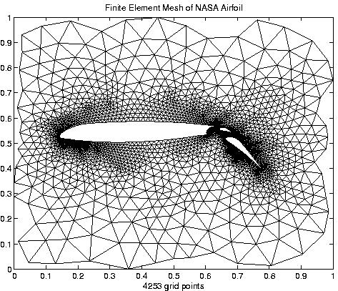
Planar graphs

Slide 4
Overlap Graphs [Miller, Teng, Thurston, Vavasis]
A k-ply neighborhood system in d dimensions is a set {D₁,…,D_{n}} of closed disks in R^{d} such that no point in R^{d} is interior to more than k disks
An (α,k) overlap graph (for α >= 1) has vertices at the centers of the disks {D₁,…,D_{n}} of a k-ply neighborhood system, with an edge (i, j) if expanding the smaller disk (D_{i} or D_{j}) by α makes them overlap
An n-by-n mesh is a (1,1) overlap graph
Every planar graph is (α,k) overlap
2D Mesh is
(1,1) overlap
graph
Notes:
So a 1-ply neighborhood is a set of non-intersecting disks
a 2-ply neighborhood has disk intersections of no more than 2 disks each
An (alpha, 1) overlap graph has a set of non-overlapping disks
if we grow a disks by more than alpha

Slide 5
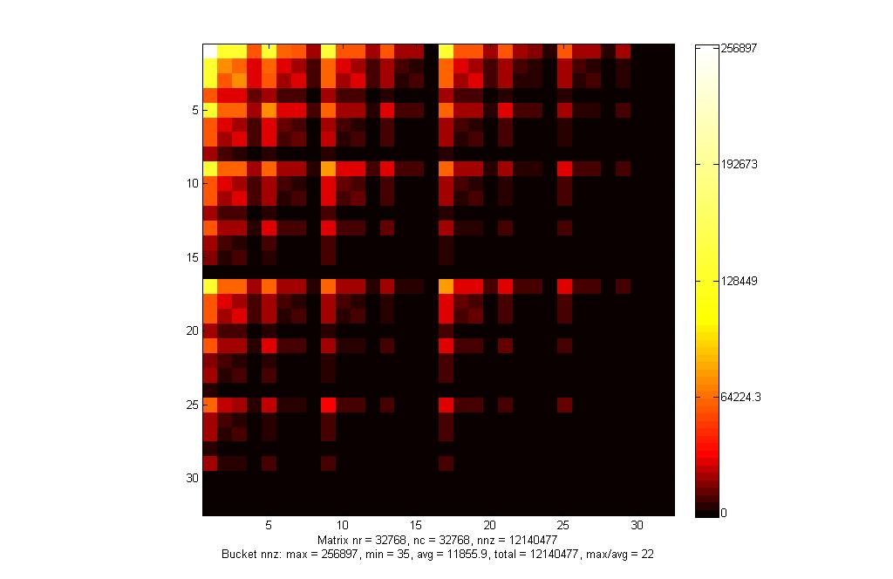
RMAT Approximate Power-Law Graph

Slide 6
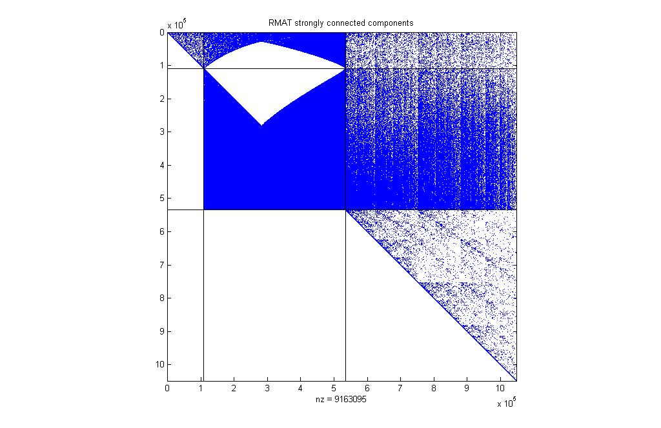
Strongly connected components of an RMAT graph

Slide 7

Diversity of graphs in the wild…
Low diameter graph (R-MAT)
vs.
Long skinny graph (genomics)
Gene linkage map, courtesy Yan et al.
Notes:
The right algorithm depends on the input graph characteristics

Slide 8
Some graph statistics (and Matlab tools)
Vertex degree histogram: dhist.m
BFS level profile, gives a feeling for avg shortest paths :
bfslevels.m
Clustering coefficient: ccoeff.m
  c = 3*(# triangles) / (# connected triples)
Laplacian eigenvalues (and vectors): meshpart toolbox,
eigs(laplacian(A),5,’lm’)
Separator size: meshpart toolbox
Fill (chordal completion size): analyze.m and amd.m

