Slide 1
CS 240A:
Parallelism in
Physical Simulation
Partly based on slides from David Culler,
Jim Demmel, Kathy Yelick, et al., UCB CS267

Slide 2
Parallelism and Locality in Simulation
Real world problems have parallelism and locality:
  Some objects may operate independently of others.
  Objects may depend more on nearby than distant objects.
  Dependence on distant objects can often be simplified.
Scientific models may introduce more parallelism:
  When a continuous problem is discretized, time-domain dependencies are generally limited to adjacent time steps.
  Far-field effects can sometimes be ignored or approximated.
Many problems exhibit parallelism at multiple levels
  Example: circuits can be simulated at many levels, and within each there may be parallelism within and between subcircuits.
Notes:
Not all problems solved on parallel machines involve simulation, but many do

Slide 3
Multilevel Modeling: Circuit Simulation
Circuits are simulated at many different levels
Level | Primitives | Examples
Instruction level | Instructions | SimOS, SPIM
Cycle level | Functional units | VIRAM-p
Register Transfer Level (RTL) | Register, counter, MUX | VHDL
Gate Level | Gate, flip-flop, memory cell | Thor
Switch level | Ideal transistor | Cosmos
Circuit level | Resistors, capacitors, etc. | Spice
Device level | Electrons, silicon

Slide 4
Basic kinds of simulation
discrete
Discrete event systems
  Time and space are discrete
Particle systems
  Important special case of lumped systems
Ordinary Differential Equations (ODEs)
  Lumped systems
  Location/entities are discrete, time is continuous
Partial Different Equations (PDEs)
  Time and space are continuous
continuous

Slide 5
Basic Kinds of Simulation
Discrete event systems:
  Examples: “Game of Life,” logic level circuit simulation.
Particle systems:
  Examples: billiard balls, semiconductor device simulation, galaxies.
Lumped variables depending on continuous parameters:
  ODEs, e.g., circuit simulation (Spice), structural mechanics, chemical kinetics.
Continuous variables depending on continuous parameters:
  PDEs, e.g., heat, elasticity, electrostatics.
A given phenomenon can be modeled at multiple levels.
Many simulations combine more than one of these techniques.

Slide 6
A Model Problem: Sharks and Fish
Illustration of parallel programming
  Original version: WATOR, proposed by Geoffrey Fox
  Sharks and fish living in a 2D toroidal ocean
Several variations to show different physical phenomena
Basic idea: sharks and fish living in an ocean
  rules for movement
  breeding, eating, and death
  forces in the ocean
  forces between sea creatures
See link on course home page for details

Slide 7
Discrete Event Systems

Slide 8
Discrete Event Systems
Systems are represented as:
  finite set of variables.
  the set of all variable values at a given time is called the state.
  each variable is updated by computing a transition function depending on the other variables.
System may be:
  synchronous: at each discrete timestep evaluate all transition functions; also called a state machine.
  asynchronous: transition functions are evaluated only if the inputs change, based on an “event” from another part of the system; also called event driven simulation.
Example: The “game of life:”
  Also known as Sharks and Fish #3:
  Space divided into cells, rules govern cell contents at each step

Slide 9
Sharks and Fish as Discrete Event System
Ocean modeled as a 2D toroidal grid
Each cell occupied by at most one sea creature

Slide 10
Fish-only: the Game of Life
An new fish is born if
  a cell is empty
  exactly 3 (of 8) neighbors contain fish
A fish dies (of overcrowding) if
  cell contains a fish
  4 or more neighboring cells are full
A fish dies (of loneliness) if
  cell contains a fish
  less than 2 neighboring cells are full
Other configurations are stable
The original Wator problem adds sharks that eat fish

Slide 11
Parallelism in Sharks and Fish
The activities in this system are discrete events
The simulation is synchronous
  use two copies of the grid (old and new)
  the value of each new grid cell in new depends only on the 9 cells (itself plus neighbors) in old grid (“stencil computation”)
    Each grid cell update is independent: reordering or parallelism OK
  simulation proceeds in timesteps, where (logically) each cell is evaluated at every timestep
old ocean
new ocean

Slide 12
Stencil computations
Data lives at the vertices of a regular mesh
At each step, new values are computed from neighbors
Examples:
  Game of Life (9-point stencil)
  Matvec in 2D model problem (5-point stencil)
  Matvec in 3D model problem (7-point stencil)

Slide 13
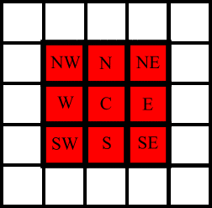
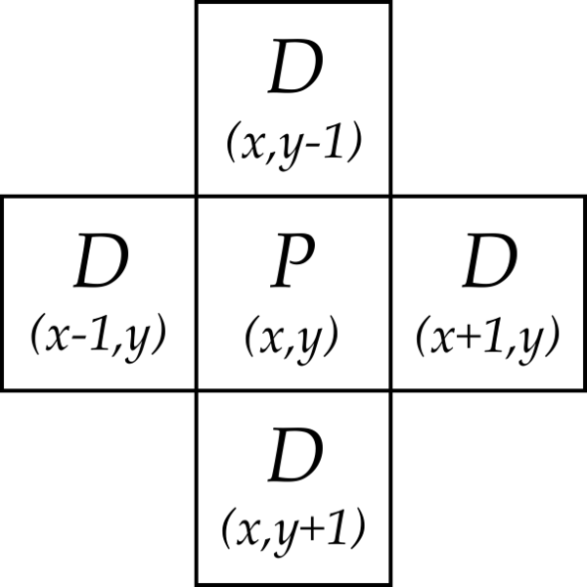
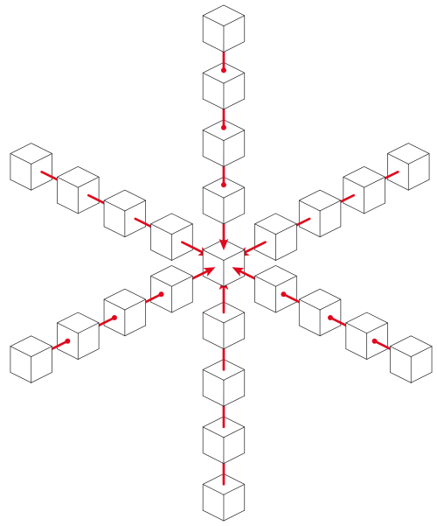
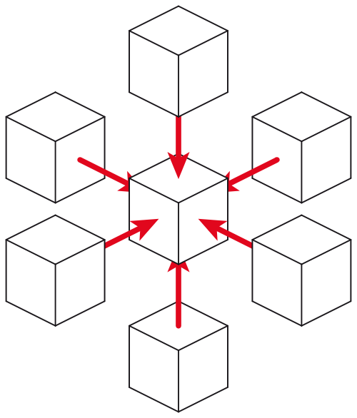
Examples of stencils
9-point stencil in 2D
(game of Life)
5-point stencil in 2D
(temperature problem)
25-point stencil in 3D
(seismic modeling)
7-point stencil in 3D
(3D temperature problem)
… and many more

Slide 14
Parallelizing Stencil Computations
Parallelism is simple
  Span t∞ = constant, so potential parallelism pp = size of problem!
  Even decomposition across processors gives load balance
Communication volume
  v = total # of boundary cells between patches
Spatial locality limits communication cost
  Communicate only boundary values from neighboring patches

Slide 15
Where’s the data (5-point stencil problem)?
Each of n stencil points has some fixed amount of data
  Divide stencil points among processors, n/p points each
How do you divide up a sqrt(n) by sqrt(n) region of points?
Block row (or block col) layout: v = 2 * p * sqrt(n)
2-dimensional block layout: v = 4 * sqrt(p) * sqrt(n)

Slide 16
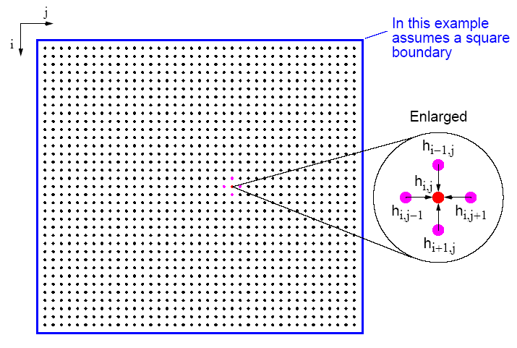
How do you partition the sqrt(n) by sqrt(n) stencil points?
  First version: number the grid by rows
  Leads to a block row decomposition of the region
  v = 2 * p * sqrt(n)
6.43

Slide 17
How do you partition the sqrt(n) by sqrt(n) stencil points?
  Second version: 2D block decomposition
  Numbering is a little more complicated
  v = 4 * sqrt(p) * sqrt(n)
6.43

Slide 18
Where’s the data (temperature problem)?
The matrix A: Nowhere!!
The vectors x, b, r, d:
  Each vector is one value per stencil point
  Divide stencil points among processors, n/p points each
How do you divide up the sqrt(n) by sqrt(n) region of points?
Block row (or block col) layout: v = 2 * p * sqrt(n)
2-dimensional block layout: v = 4 * sqrt(p) * sqrt(n)

Slide 19
Detailed complexity measures for data movement I:
Latency/Bandwidth Model
Moving data between processors by message-passing
Machine parameters:
  α latency (message startup time in seconds)
  β inverse bandwidth (in seconds per word)
  between nodes of Triton, α ∼ 2.2 × 10⁻⁶ and β ∼ 6.4 × 10⁻⁹
Time to send & recv or bcast a message of w words: α + w*β
t_{comm} total commmunication time
t_{comp} total computation time
Total parallel time: t_{p} = t_{comp} + t_{comm}

Slide 20
Ghost Nodes in Stencil Computations
Comm cost = α * (#messages) + β * (total size of messages)
Keep a ghost copy of neighbors’ boundary nodes
Communicate every second iteration, not every iteration
Reduces #messages, not total size of messages
Costs extra memory and computation
Can also use more than one layer of ghost nodes
Green = my interior nodes
Blue = my boundary nodes
Yellow
= neighbors’ boundary nodes
= my “ghost nodes”

Slide 21
Synchronous Circuit Simulation
Circuit is a graph made up of subcircuits connected by wires
  Component simulations need to interact if they share a wire.
  Data structure is irregular (graph) of subcircuits.
  Parallel algorithm is timing-driven or synchronous:
    Evaluate all components at every timestep (determined by known circuit delay)
Graph partitioning assigns subgraphs to processors (NP-complete)
  Determines parallelism and locality.
  Attempts to evenly distribute subgraphs to nodes (load balance).
  Attempts to minimize edge crossing (minimize communication).
edge crossings = 6
edge crossings = 10
Notes:
Nodes and edges in graph may be weighted
Optimal graph partitioning is NP-complete (define for non-CS audience)
Good graph partitioning techniques exist
More on this in a later lecture

Slide 22
Asynchronous Simulation
Synchronous simulations may waste time:
  Simulate even when the inputs do not change.
Asynchronous simulations update only when an event arrives from another component:
  No global time steps, but individual events contain time stamp.
  Example: Game of life in loosely connected ponds (don’t simulate empty ponds).
  Example: Circuit simulation with delays (events are gates flipping).
  Example: Traffic simulation (events are cars changing lanes, etc.).
Asynchronous is more efficient, but harder to parallelize
  In MPI, events can be messages …
  … but how do you know when to “receive”?

Slide 23
Particle Systems

Slide 24
Particle Systems
A particle system has
  a finite number of particles.
  moving in space according to Newton’s Laws (i.e. F = ma).
  time is continuous.
Examples:
  stars in space: laws of gravity.
  atoms in a molecule: electrostatic forces.
  neutrons in a fission reactor.
  electron beam and ion beam semiconductor manufacturing.
  cars on a freeway: Newton’s laws + models of driver & engine.
Many simulations combine particle simulation techniques with some discrete event techniques.

Slide 25
Forces in Particle Systems
Force on each particle decomposed into near and far:
force = external_force + nearby_force + far_field_force
External force
  ocean current to sharks and fish world (S&F 1).
  externally imposed electric field in electron beam.
Nearby force
  sharks attracted to eat nearby fish (S&F 5).
  balls on a billiard table bounce off of each other.
  Van der Waals forces in fluid (1/r⁶).
Far-field force
  fish attract other fish by gravity-like (1/r² ) force (S&F 2).
  gravity, electrostatics
  forces governed by elliptic PDEs.

Slide 26
Parallelism in External Forces
External forces are the simplest to implement.
  Force on one particle is independent of other particles.
  “Embarrassingly parallel”.
Evenly distribute particles on processors
  Any even distribution works.
  Locality is not an issue, since no communication.
For each particle on processor, apply external force.

Slide 27
Parallelism in Nearby Forces
Nearby forces require interaction => communication.
Force depends on other particles nearby (e.g. collisions)
Simple algorithm: check every pair for collision: O(n²)
Parallelism by decomposition of physical domain:
  O(n/p) particles per processor if evenly distributed.
Better algorithm: only check pairs near boundaries
Need to check for collisions between regions

Slide 28
Parallelism in Nearby Forces
Challenge 1: interactions of particles near boundaries:
  Communicate particles near boundary to neighboring processors.
  Surface to volume effect limits communication.
  Which communicates less: squares (as below) or slabs?
Communicate particles in boundary region to neighbors

Slide 29
Parallelism in Nearby Forces
Challenge 2: load imbalance, if particles cluster together:
  Stars in galaxies, for example
To reduce load imbalance, divide space unevenly.
  Each region contains roughly equal number of particles.
  Quad-tree in 2D, oct-tree in 3D.
Example: each square contains at most 3 particles
See: http://njord.umiacs.umd.edu:1601/users/brabec/quadtree/points/prquad.html

Slide 30
Parallelism in Far-Field Forces
Far-field forces involve all-to-all interaction and communication.
Force on one particle depends on all other particles.
  Examples: galaxies (gravity), protein folding (electrostatics)
  Simplest algorithm is O(n²) as in S&F 2, 4, 5.
  Decomposing space does not help total work or communication,
  since every particle needs to “visit” every other particle.
Use more clever algorithms to beat O(n²) ?
Implement by rotating particle sets.
Keeps processors busy
All processors see all particles
Just like MGR matrix multiply!

Slide 31
Far-field forces: Tree Decomposition
“Fast multipole” algorithms
  Approximate the force from far-away particles
  Simplify a group of far-away particles into a single multipole.
  Do this at every scale simultaneously (every quadtree level)
  Each quadtree node contains an approximation of descendants.
O(n log n) or even O(n)
instead of O(n²).
“Top 10 Algorithms of the
20th Century” (resources page)
Tutorial on course web page.

Slide 32
Summary of Particle Methods
Model contains discrete entities, namely, particles
force = external_force + nearby_force + far_field_force
Time is continuous – is discretized to solve
Simulation follows particles through timesteps
  All-pairs algorithm is simple, but inefficient, O(n²)
  Particle-mesh methods approximates by moving particles
  Tree-based algorithms approximate by treating set of particles as a group, when far away
This is a special case of a “lumped” system . . .

Slide 33
Lumped Systems:
ODEs

Slide 34
System of Lumped Variables
Finitely many variables
Depending on a continuous parameter (usually time)
Example 1 – System of chemical reactions:
  Each reaction consumes some “compounds” and produces others
  Stoichometric matrix S: rows for compounds, cols for reactions
  Compound concentrations x(i) in terms of reaction rates v(j):
  dx/dt = S * v
Example 2 – Electronic circuit:
  Circuit is a graph.
    wires are edges.
    each edge has resistor, capacitor, inductor or voltage source.
  Variables are voltage & current at endpoints of edges.
  Related by Ohm’s Law, Kirchoff’s Laws, etc.
Forms a system of ordinary differential equations (ODEs).
  Differentiated with respect to time

Slide 35
Example: Stoichiometry in chemical reactions
reaction 1: CP => PC
reaction 2: C + P => CP
reaction 3: C + AP => CP + A
Matrix S : row = compound, column = reaction
Linear ODE system: d/dt (concentration) = S * (reaction rate)
  compound A: dx₁/dt 0 0 1
  compound C: dx₂/dt 0 -1 -1 v₁
  compound P: dx₃/dt = 0 -1 0 * v₂
  compound CP: dx₄/dt -1 1 1 v₃
  compound AP: dx₅/dt 0 0 -1
  compound PC: dx₆/dt 1 0 0

Slide 36
Example: Electronic circuit
State of the system is represented by
  v_{n}(t) node voltages
  i_{b}(t) branch currents all at time t
  v_{b}(t) branch voltages
Equations include
  Kirchoff’s current
  Kirchoff’s voltage
  Ohm’s law
  Capacitance
  Inductance
Write as single large system of ODEs (possibly with constraints).
0 M 0 v_{n} 0
M^{T} 0 -I * i_{b} = S
0 R -I v_{b} 0
0 -I C*d/dt 0
0 L*d/dt I 0

Slide 37
Solving ODEs
In most examples, the matrices are sparse:
  most array elements are 0.
  neither store nor compute on these 0’s.
Given a set of ODEs, two kinds of questions are:
  Compute the values of the variables at some time t
    Explicit methods
    Implicit methods
  Compute modes of vibration
    Eigenvalue problems
Notes:
Reason is a locality property from physics.

Slide 38
Solving ODEs: Explicit Methods
Rearrange ODE into the form x’(t) = f(x) = A*x,
where A is a sparse matrix
  Compute x(i*dt) = x[i]
  at i=0,1,2,…
  Approximate x’(i*dt)
  x[i+1]=x[i] + dt*slope
Explicit methods, e.g., (Forward) Euler’s method.
  Approximate x’(t)=A*x by (x[i+1] - x[i] )/dt = A*x[i].
  x[i+1] = x[i]+dt*A*x[i], i.e. sparse matrix-vector multiplication.
Tradeoffs:
  Simple algorithm: sparse matrix vector multiply.
  Stability problems: May need to take very small time steps, especially if system is stiff.
Use slope
at x[i]

Slide 39
Solving ODEs: Implicit Methods
Assume ODE is x’(t) = f(x) = A*x, where A is a sparse matrix
  Compute x(i*dt) = x[i]
  at i=0,1,2,…
  Approximate x’(i*dt)
  x[i+1]=x[i] + dt*slope
Implicit method, e.g., Backward Euler solve:
  Approximate x’(t)=A*x by (x[i+1] - x[i] )/dt = A*x[i+1].
  (I - dt*A)*x[i+1] = x[i], i.e. we need to solve a sparse linear system of equations.
Trade-offs:
  Larger timestep possible: especially for stiff problems
  Harder algorithm: need to solve a sparse system at each step
Use slope
at x[i+1]

Slide 40
ODEs and Sparse Matrices
All these reduce to sparse matrix problems
  Explicit: sparse matrix-vector multiplication.
  Implicit: solve a sparse linear system
    direct solvers (Gaussian elimination).
    iterative solvers (use sparse matrix-vector multiplication).
  Eigenvalue/eigenvector algorithms may also be either explicit or implicit.

Slide 41
Partial Differential Equations
(PDEs)

Slide 42
Continuous Variables, Continuous Parameters
Examples:
Parabolic (time-dependent) problems:
  Heat flow: Temperature(position, time)
  Diffusion: Concentration(position, time)
Elliptic (steady state) problems:
  Electrostatic or Gravitational Potential: Potential(position)
Hyperbolic problems (waves):
  Quantum mechanics: Wave-function(position,time)
Many problems combine features of above
Fluid flow: Velocity,Pressure,Density(position,time)
Elasticity: Stress,Strain(position,time)

Slide 43
2D Implicit Method
Multiplying by this matrix is just nearest neighbor computation on 2D grid.
To solve this system, there are several techniques.
Graph and “5 point stencil”
4 -1 -1
-1 4 -1 -1
-1 4 -1
-1 4 -1 -1
-1 -1 4 -1 -1
-1 -1 4 -1
-1 4 -1
-1 -1 4 -1
-1 -1 4
-1
-1
4
-1
A =
-1
3D case is analogous (7 point stencil)

Slide 44
The (2-dimensional) model problem
n^{1/2}
Graph is a regular square grid with n = k^2 vertices.
Corresponds to matrix for regular 2D finite difference mesh.
Gives good intuition for behavior of sparse matrix algorithms on many 2-dimensional physical problems.
There’s also a 3-dimensional model problem.

Slide 45
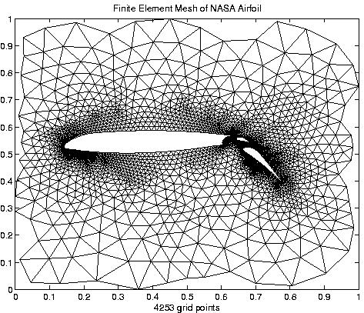
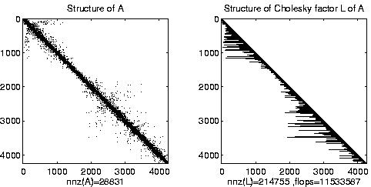
Irregular mesh: NASA Airfoil in 2D

Slide 46
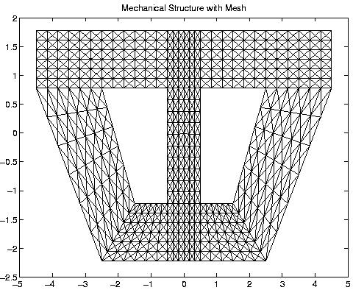
Composite Mesh from a Mechanical Structure

Slide 47
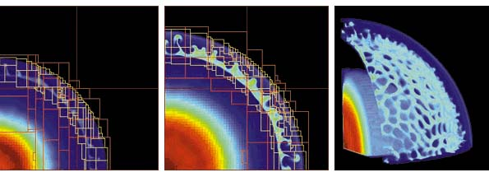
Adaptive Mesh Refinement (AMR)
Adaptive mesh around an explosion
  Refinement done by calculating errors
Parallelism
  Mostly between “patches,” dealt to processors for load balance
  May exploit some within a patch (SMP)

Slide 48
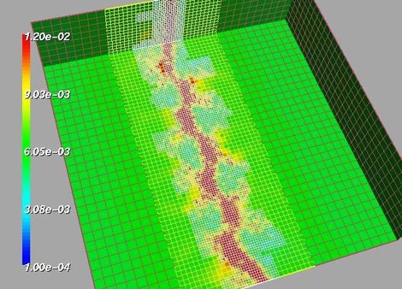
Adaptive Mesh
fluid density
Shock waves in a gas dynamics using AMR (Adaptive Mesh Refinement) See: http://www.llnl.gov/CASC/SAMRAI/

Slide 49
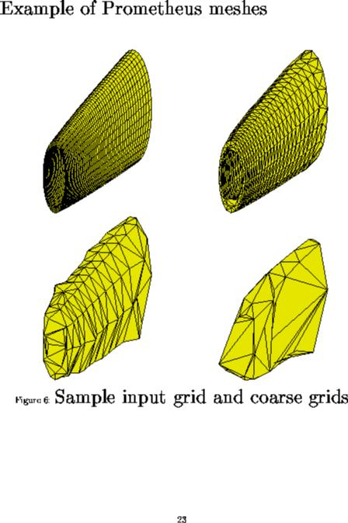
Irregular mesh: Tapered Tube (Multigrid)

Slide 50
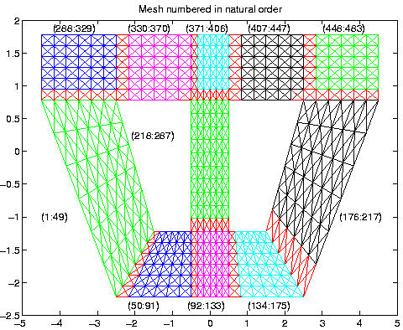
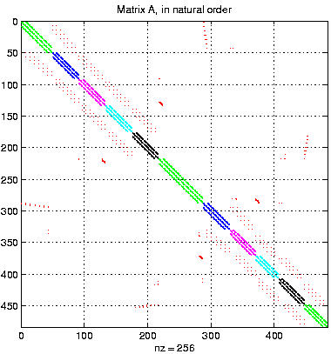
Converting the Mesh to a Matrix

Slide 51
The Landscape of Ax = b Algorithms
Gaussian
elimination
Iterative
More General
Any
matrix
Symmetric
positive
definite
matrix
More Robust
More Robust
Less Storage

Slide 52
Conjugate gradient in general
CG can be used to solve any system Ax = b, if …

Slide 53
Conjugate gradient in general
CG can be used to solve any system Ax = b, if …
The matrix A is symmetric (a_{ij} = a_{ji}) …
… and positive definite (all eigenvalues > 0).

Slide 54
Conjugate gradient in general
CG can be used to solve any system Ax = b, if …
The matrix A is symmetric (a_{ij} = a_{ji}) …
… and positive definite (all eigenvalues > 0).
Symmetric positive definite matrices occur a lot
in scientific computing & data analysis!

Slide 55
Conjugate gradient in general
CG can be used to solve any system Ax = b, if …
The matrix A is symmetric (a_{ij} = a_{ji}) …
… and positive definite (all eigenvalues > 0).
Symmetric positive definite matrices occur a lot
in scientific computing & data analysis!
But usually the matrix isn’t just a stencil.
Now we do need to store the matrix A. Where’s the data?

Slide 56
Conjugate gradient in general
CG can be used to solve any system Ax = b, if …
The matrix A is symmetric (a_{ij} = a_{ji}) …
… and positive definite (all eigenvalues > 0).
Symmetric positive definite matrices occur a lot
in scientific computing & data analysis!
But usually the matrix isn’t just a stencil.
Now we do need to store the matrix A. Where’s the data?
The key is to use graph data structures and algorithms.

Slide 57
Graphs and Sparse Matrices
Sparse matrix is a representation of a (sparse) graph
1 2 3 4 5 6
1 1 1
2 1 1 1
3 1 1 1
4 1 1
5 1 1
6 1 1
3
2
4
1
6
5
Matrix entries are edge weights
Number of nonzeros per row is the vertex degree
Edges represent data dependencies in matrix-vector multiplication

Slide 58
Data structure for sparse matrix A (stored by rows)
31 | 53 | 59 | 41 | 26
31 | 0 | 53
0 | 59 | 0
41 | 26 | 0
1 | 3 | 2 | 1 | 2
  Full matrix:
    2-dimensional array of real or complex numbers
    (nrows*ncols) memory
Sparse matrix:
  compressed row storage
  about (2*nzs + nrows) memory

Slide 59
Distributed-memory sparse matrix data structure
P₀
P₁
Each processor stores:
# of local nonzeros
range of local rows
nonzeros in CSR form
P₂
P_{n}

Slide 60
Vector and matrix primitives for CG
DAXPY: v = α*v + β*w (vectors v, w; scalars α, β)
  Broadcast the scalars α and β, then independent * and +
  comm volume = 2p, span = log n
DDOT: α = v^{T}*w = Σ_{j} v[j]*w[j] (vectors v, w; scalar α)
  Independent *, then + reduction
  comm volume = p, span = log n
Matvec: v = A*w (matrix A, vectors v, w)
  The hard part
  But all you need is a subroutine to compute v from w
  Sometimes you don’t need to store A (e.g. temperature problem)
  Usually you do need to store A, but it’s sparse ...

Slide 61
Parallel Dense Matrix-Vector Product
y = A*x, where A is a dense matrix
Layout:
  1D by rows
Algorithm:
  Foreach processor j
  Broadcast X(j)
  Compute A(p)*x(j)
A(i) is the n by n/p block row that processor Pi owns
Algorithm uses the formula
  Y(i) = A(i)*X = Σ_{j} A(i)*X(j)
P0 P1 P2 P3
x
P0
P1
P2
P3
y

Slide 62
Parallel sparse matrix-vector product
Lay out matrix and vectors by rows
y(i) = sum(A(i,j)*x(j))
Only compute terms with A(i,j) ≠ 0
Algorithm
  Each processor i:
  Broadcast x(i)
  Compute y(i) = A(i,:)*x
Optimizations
  Only send each proc the parts of x it needs, to reduce comm
  Reorder matrix for better locality by graph partitioning
  Worry about balancing number of nonzeros / processor,
  if rows have very different nonzero counts
P0 P1 P2 P3
x
P0
P1
P2
P3
y

Slide 63
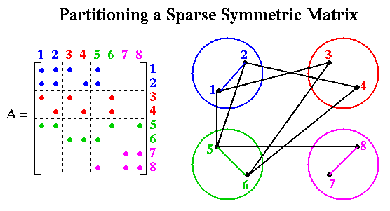
Sparse Matrix-Vector Multiplication

Slide 64
Graph partitioning (topic of later lecture)
Assigns subgraphs to processors
Determines parallelism and locality.
Tries to make subgraphs all same size (load balance)
Tries to minimize edge crossings (communication).
Exact minimization is NP-complete.
See Matlab demo.
edge crossings = 6
edge crossings = 10
Notes:
Nodes and edges in graph may be weighted
Optimal graph partitioning is NP-complete (define for non-CS audience)
Good graph partitioning techniques exist
More on this in a later lecture

Slide 65
Scientific computation and data analysis
Continuous
physical modeling
Linear algebra
Computers

Slide 66
Scientific computation and data analysis
Continuous
physical modeling
Discrete
structure analysis
Linear algebra
Graph theory
Computers
Computers

Slide 67
Scientific computation and data analysis
Continuous
physical modeling
Discrete
structure analysis
Linear algebra & graph theory
Computers

Slide 68
Other memory layouts for matrix-vector product
Column layout of the matrix eliminates the broadcast
  But adds a reduction to update the destination – same total comm
Blocked layout uses a broadcast and reduction, both on only sqrt(p) processors – less total comm
Blocked layout has advantages in multicore / Cilk++ too
P0 P1 P2 P3
P0 P1 P2 P3
P4 P5 P6 P7
P8 P9 P10 P11
P12 P13 P14 P15

Slide 69
Challenges of Irregular Meshes for PDE’s
How to generate them in the first place
  For example, Triangle, a 2D mesh generator (Shewchuk)
  3D mesh generation is harder! For example, QMD (Vavasis)
How to partition them into patches
  For example, ParMetis, a parallel graph partitioner (Karypis)
How to design iterative solvers
  For example, PETSc, Aztec, Hypre (all from national labs)
  … Prometheus, a multigrid solver for finite elements on irregular meshes
How to design direct solvers
  For example, SuperLU, parallel sparse Gaussian elimination
These are challenges to do sequentially, more so in parallel

