Slide 1
CS 240A: Solving Ax = b in parallel
Dense A: Gaussian elimination with partial pivoting (LU)
  Same flavor as matrix * matrix, but more complicated
Sparse A: Gaussian elimination – Cholesky, LU, etc.
  Graph algorithms
Sparse A: Iterative methods – Conjugate gradient, etc.
  Sparse matrix times dense vector
Sparse A: Preconditioned iterative methods and multigrid
  Mixture of lots of things

Slide 2
Matrix and Graph
1
2
4
7
5
3
6
A
G(A)
Edge from row i to column j for nonzero A(i,j)
No edges for diagonal nonzeros
If A is symmetric, G(A) is an undirected graph
Symmetric permutation PAP^{T} renumbers the vertices

Slide 3
Compressed Sparse Matrix Storage
value:
31 | 41 | 59 | 26 | 53
31 | 0 | 53
0 | 59 | 0
41 | 26 | 0
row:
1 | 3 | 2 | 3 | 1
1 | 3 | 5 | 6
colstart:
Full storage:
  2-dimensional array.
  (nrows*ncols) memory.
Sparse storage:
  Compressed storage by columns (CSC).
  Three 1-dimensional arrays.
  (2*nzs + ncols + 1) memory.
  Similarly, CSR.

Slide 4
The Landscape of Ax=b Solvers
Direct
A = LU
Iterative
y’ = Ay
More General
Non-
symmetric
Symmetric
positive
definite
More Robust
More Robust
Less Storage (if sparse)

Slide 5
CS 240A: Solving Ax = b in parallel
Dense A: Gaussian elimination with partial pivoting (LU)
  See April 15 slides
  Same flavor as matrix * matrix, but more complicated
Sparse A: Gaussian elimination – Cholesky, LU, etc.
  Graph algorithms
Sparse A: Iterative methods – Conjugate gradient, etc.
  Sparse matrix times dense vector
Sparse A: Preconditioned iterative methods and multigrid
  Mixture of lots of things

Slide 6
Gaussian elimination to solve Ax = b
For a symmetric, positive definite matrix:
Matrix factorization: A = LL^{T} (Cholesky factorization)
Forward triangular solve: Ly = b
Backward triangular solve: L^{T}x = y
For a nonsymmetric matrix:
Matrix factorization: PA = LU (Partial pivoting)
. . .

Slide 7
Sparse Column Cholesky Factorization
for j = 1 : n
L(j:n, j) = A(j:n, j);
for k < j with L(j, k) nonzero
% sparse cmod(j,k)
L(j:n, j) = L(j:n, j) – L(j, k) * L(j:n, k);
end;
% sparse cdiv(j)
L(j, j) = sqrt(L(j, j));
L(j+1:n, j) = L(j+1:n, j) / L(j, j);
end;
j
L^{T}
L
A
L
Column j of A becomes column j of L

Slide 8
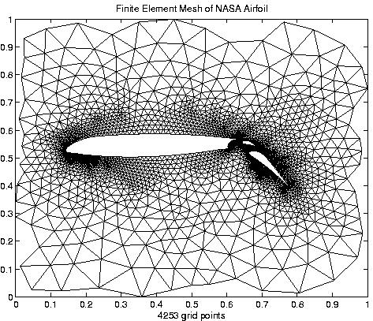
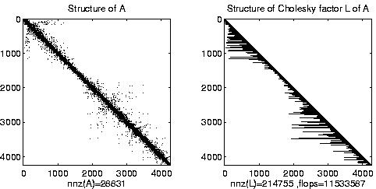
Irregular mesh: NASA Airfoil in 2D

Slide 9
Graphs and Sparse Matrices: Cholesky factorization
Fill: new nonzeros in factor
1
3
7
1
3
7
Symmetric Gaussian elimination:
for j = 1 to n
add edges between j’s
higher-numbered neighbors
8
6
8
6
4
10
4
10
9
5
2
9
5
2
G(A)
G⁺(A)
[chordal]

Slide 10
Permutations of the 2-D model problem
Theorem: With the natural permutation, the n-vertex model problem has Θ(n^{3/2}) fill. (“order exactly”)
Theorem: With any permutation, the n-vertex model problem has Ω(n log n) fill. (“order at least”)
Theorem: With a nested dissection permutation, the
n-vertex model problem has O(n log n) fill. (“order at most”)

Slide 11
Nested dissection ordering
A separator in a graph G is a set S of vertices whose removal leaves at least two connected components.
A nested dissection ordering for an n-vertex graph G numbers its vertices from 1 to n as follows:
  Find a separator S, whose removal leaves connected components T₁, T₂, …, T_{k}
  Number the vertices of S from n-|S|+1 to n.
  Recursively, number the vertices of each component:
  T₁ from 1 to |T₁|, T₂ from |T₁|+1 to |T₁|+|T₂|, etc.
  If a component is small enough, number it arbitrarily.
It all boils down to finding good separators!

Slide 12
Separators in theory
If G is a planar graph with n vertices, there exists a set of at most sqrt(6n) vertices whose removal leaves no connected component with more than 2n/3 vertices.
(“Planar graphs have sqrt(n)-separators.”)
“Well-shaped” finite element meshes in 3 dimensions have n^{2/3} - separators.
Also some other classes of graphs – trees, graphs of bounded genus, chordal graphs, bounded-excluded-minor graphs, …
Mostly these theorems come with efficient algorithms, but they aren’t used much.

Slide 13
Separators in practice
Graph partitioning heuristics have been an active research area for many years, often motivated by partitioning for parallel computation.
Some techniques:
  Spectral partitioning (uses eigenvectors of Laplacian matrix of graph)
  Geometric partitioning (for meshes with specified vertex coordinates)
  Iterative-swapping (Kernighan-Lin, Fiduccia-Matheysses)
  Breadth-first search (fast but dated)
Many popular modern codes (e.g. Metis, Chaco) use multilevel iterative swapping
Matlab graph partitioning toolbox: see course web page

Slide 14
Complexity of direct methods
Time and space to solve any problem on any well-shaped finite element mesh
n^{1/2}
n^{1/3}
 | 2D | 3D
Space (fill): | O(n log n) | O(n ^{4/3} )
Time (flops): | O(n ^{3/2} ) | O(n ² )

Slide 15
CS 240A: Solving Ax = b in parallel
Dense A: Gaussian elimination with partial pivoting (LU)
  See April 15 slides
  Same flavor as matrix * matrix, but more complicated
Sparse A: Gaussian elimination – Cholesky, LU, etc.
  Graph algorithms
Sparse A: Iterative methods – Conjugate gradient, etc.
  Sparse matrix times dense vector
Sparse A: Preconditioned iterative methods and multigrid
  Mixture of lots of things

Slide 16
The Landscape of Ax=b Solvers
Direct
A = LU
Iterative
y’ = Ay
More General
Non-
symmetric
Symmetric
positive
definite
More Robust
More Robust
Less Storage (if sparse)

Slide 17
Conjugate gradient iteration
x₀ = 0, r₀ = b, d₀ = r₀
for k = 1, 2, 3, . . .
α_{k} = (r^{T}_{k-1}r_{k-1}) / (d^{T}_{k-1}Ad_{k-1}) step length
x_{k} = x_{k-1} + α_{k} d_{k-1} approx solution
r_{k} = r_{k-1} – α_{k} Ad_{k-1} residual
β_{k} = (r^{T}_{k} r_{k}) / (r^{T}_{k-1}r_{k-1}) improvement
d_{k} = r_{k} + β_{k} d_{k-1} search direction
One matrix-vector multiplication per iteration
Two vector dot products per iteration
Four n-vectors of working storage

Slide 18
Sparse matrix data structure (stored by rows)
31 | 53 | 59 | 41 | 26
31 | 0 | 53
0 | 59 | 0
41 | 26 | 0
1 | 3 | 2 | 1 | 2
  Full:
    2-dimensional array of real or complex numbers
    (nrows*ncols) memory
Sparse:
  compressed row storage
  about (2*nzs + nrows) memory

Slide 19
Distributed row sparse matrix data structure
P₀
P₁
Each processor stores:
# of local nonzeros
range of local rows
nonzeros in CSR form
P₂
P_{p-1}

Slide 20
Matrix-vector product: Parallel implementation
Lay out matrix and vectors by rows
y(i) = sum(A(i,j)*x(j))
Skip terms with A(i,j) = 0
Algorithm
  Each processor i:
  Broadcast x(i)
  Compute y(i) = A(i,:)*x
Optimizations: reduce communication by
  Only send as much of x as necessary to each proc
  Reorder matrix for better locality by graph partitioning
P0 P1 P2 P3
x
P0
P1
P2
P3
y

Slide 21
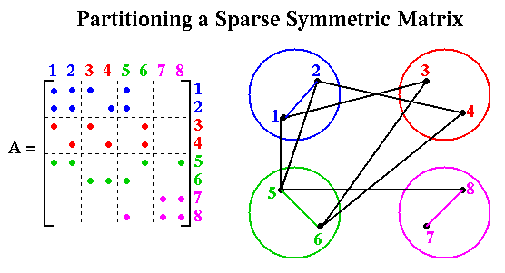
Sparse Matrix-Vector Multiplication

Slide 22
CS 240A: Solving Ax = b in parallel
Dense A: Gaussian elimination with partial pivoting (LU)
  See April 15 slides
  Same flavor as matrix * matrix, but more complicated
Sparse A: Gaussian elimination – Cholesky, LU, etc.
  Graph algorithms
Sparse A: Iterative methods – Conjugate gradient, etc.
  Sparse matrix times dense vector
Sparse A: Preconditioned iterative methods and multigrid
  Mixture of lots of things

Slide 23
Conjugate gradient: Convergence
In exact arithmetic, CG converges in n steps
(completely unrealistic!!)
Accuracy after k steps of CG is related to:
  consider polynomials of degree k that are equal to 1 at 0.
  how small can such a polynomial be at all the eigenvalues of A?
Thus, eigenvalues close together are good.
Condition number: κ(A) = ||A||₂ ||A⁻¹||₂ = λ_{max}(A) / λ_{min}(A)
Residual is reduced by a constant factor by
O( sqrt(κ(A)) ) iterations of CG.

Slide 24
Preconditioners
Suppose you had a matrix B such that:
  condition number κ(B⁻¹A) is small
  By = z is easy to solve
Then you could solve (B⁻¹A)x = B⁻¹b instead of Ax = b
Each iteration of CG multiplies a vector by B⁻¹A:
  First multiply by A
  Then solve a system with B

Slide 25
Preconditioned conjugate gradient iteration
x₀ = 0, r₀ = b, d₀ = B⁻¹ r_{0,} y₀ = B⁻¹ r₀
for k = 1, 2, 3, . . .
α_{k} = (y^{T}_{k-1}r_{k-1}) / (d^{T}_{k-1}Ad_{k-1}) step length
x_{k} = x_{k-1} + α_{k} d_{k-1} approx solution
r_{k} = r_{k-1} – α_{k} Ad_{k-1} residual
y_{k} = B⁻¹ r_{k} preconditioning solve
β_{k} = (y^{T}_{k} r_{k}) / (y^{T}_{k-1}r_{k-1}) improvement
d_{k} = y_{k} + β_{k} d_{k-1} search direction
One matrix-vector multiplication per iteration
One solve with preconditioner per iteration

Slide 26
Choosing a good preconditioner
Suppose you had a matrix B such that:
  condition number κ(B⁻¹A) is small
  By = z is easy to solve
Then you could solve (B⁻¹A)x = B⁻¹b instead of Ax = b
B = A is great for (1), not for (2)
B = I is great for (2), not for (1)
Domain-specific approximations sometimes work
B = diagonal of A sometimes works
Better: blend in some direct-methods ideas. . .

Slide 27
Incomplete Cholesky factorization (IC, ILU)
x
A
R^{T}
R
Compute factors of A by Gaussian elimination,
but ignore fill
Preconditioner B = R^{T}R ≈ A, not formed explicitly
Compute B⁻¹z by triangular solves (in time nnz(A))
Total storage is O(nnz(A)), static data structure
Either symmetric (IC) or nonsymmetric (ILU)

Slide 28
Incomplete Cholesky and ILU: Variants
1
4
1
4
Allow one or more “levels of fill”
  unpredictable storage requirements
Allow fill whose magnitude exceeds a “drop tolerance”
  may get better approximate factors than levels of fill
  unpredictable storage requirements
  choice of tolerance is ad hoc
Partial pivoting (for nonsymmetric A)
“Modified ILU” (MIC): Add dropped fill to diagonal of U or R
  A and R^{T}R have same row sums
  good in some PDE contexts
2
3
2
3

Slide 29
Incomplete Cholesky and ILU: Issues
Choice of parameters
  good: smooth transition from iterative to direct methods
  bad: very ad hoc, problem-dependent
  tradeoff: time per iteration (more fill => more time)
  vs # of iterations (more fill => fewer iters)
Effectiveness
  condition number usually improves (only) by constant factor (except MIC for some problems from PDEs)
  still, often good when tuned for a particular class of problems
Parallelism
  Triangular solves are not very parallel
  Reordering for parallel triangular solve by graph coloring

Slide 30
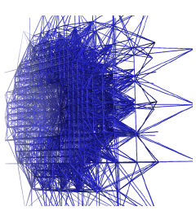
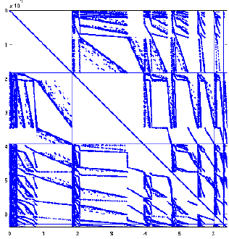
Coloring for parallel nonsymmetric preconditioning
[Aggarwal, Gibou, G]
263 million DOF
Level set method for multiphase
interface problems in 3D
Nonsymmetric-structure,
second-order-accurate octree discretization.
BiCGSTAB preconditioned by parallel triangular solves.

Slide 31
Sparse approximate inverses
A
B⁻¹
Compute B⁻¹ ≈ A explicitly
Minimize || B⁻¹A – I ||_{F} (in parallel, by columns)
Variants: factored form of B⁻¹, more fill, . .
Good: very parallel
Bad: effectiveness varies widely

Slide 32
Other Krylov subspace methods
Nonsymmetric linear systems:
  GMRES:
  for i = 1, 2, 3, . . .
  find x_{i} ∈ K_{i} (A, b) such that r_{i} = (Ax_{i} – b) ⊥ K_{i} (A, b)
  But, no short recurrence => save old vectors => lots more space
  (Usually “restarted” every k iterations to use less space.)
  BiCGStab, QMR, etc.:
  Two spaces K_{i} (A, b) and K_{i} (A^{T}, b) w/ mutually orthogonal bases
  Short recurrences => O(n) space, but less robust
  Convergence and preconditioning more delicate than CG
  Active area of current research
Eigenvalues: Lanczos (symmetric), Arnoldi (nonsymmetric)

Slide 33
Multigrid
For a PDE on a fine mesh, precondition using a solution on a coarser mesh
Use idea recursively on hierarchy of meshes
Solves the model problem (Poisson’s eqn) in linear time!
Often useful when hierarchy of meshes can be built
Hard to parallelize coarse meshes well
This is just the intuition – lots of theory and technology

Slide 34
Complexity of linear solvers
Time to solve model problem (Poisson’s equation) on regular mesh
n^{1/2}
n^{1/3}
 | 2D | 3D
Sparse Cholesky: | O(n^{1.5} ) | O(n² )
CG, exact arithmetic: | O(n² ) | O(n² )
CG, no precond: | O(n^{1.5} ) | O(n^{1.33} )
CG, modified IC: | O(n^{1.25} ) | O(n^{1.17} )
CG, support trees: | O(n^{1.20} ) -> O(n¹⁺ ) | O(n^{1.75} ) -> O(n¹⁺ )
Multigrid: | O(n) | O(n)

Slide 35
Complexity of direct methods
Time and space to solve any problem on any well-shaped finite element mesh
n^{1/2}
n^{1/3}
 | 2D | 3D
Space (fill): | O(n log n) | O(n ^{4/3} )
Time (flops): | O(n ^{3/2} ) | O(n ² )

