Slide 1
Challenges in Service Modeling, Composition, and Analysis
Jianwen Su
University of California, Santa Barbara

Slide 2
Web Services: The Big Questions
An old slide from
SIGMOD tutorial [Hull-S. 04
SIGMOD Rec 05]
Simplify and/or automate web service
Discovery
  What properties should be described?
  How to efficiently query against them?
Composition
  Specifying goals of a composition
  Specifying constraints on a composition
  Building a composition
  Analysis of compositions
Invocation
  Keeping enactments separated
  Providing transactional guarantees
Monitoring
  How to track enactments
  Recovering from failed enactments
Primary focus
of this tutorial
+ Data

Slide 3
Data for Services: A New Frontier
Jianwen Su
University of California, Santa Barbara

Slide 4
Outline
Application Needs
“Legacy” Services
“Programmable” Services
Data Encapsulating Services
Research Challenges
Conclusions

Slide 5
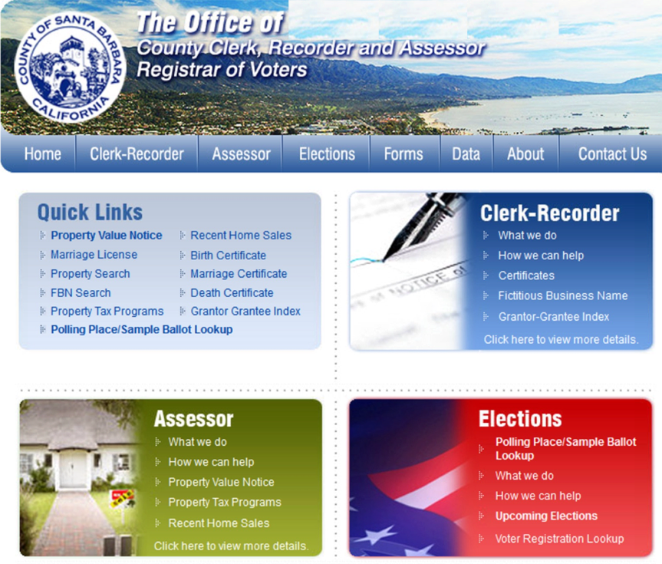
Real Estate Property Management

Slide 6
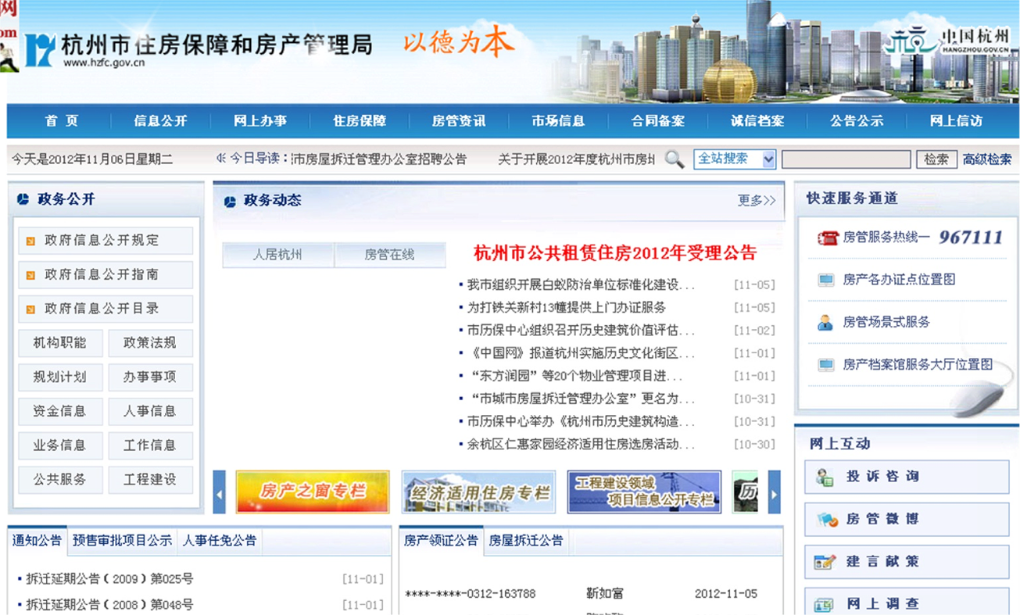
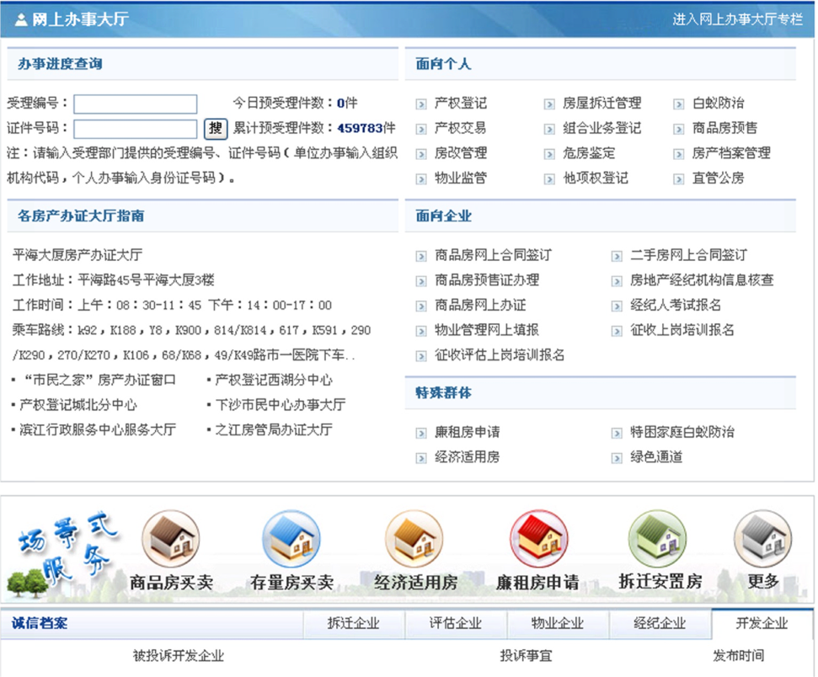
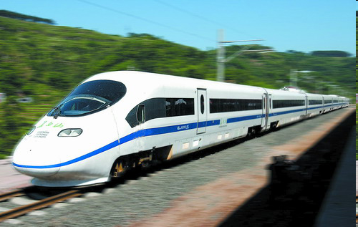

A Housing Management Bureau
200,000+ for
500 workflow models
300,000 cases/year
[Jin et al CoopIS 2011]

Slide 7
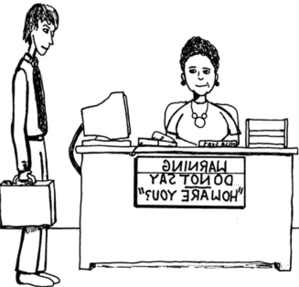






Permit for Selling an Unbuilt Appartment
Obtaining a Permit
preliminary
review
secondary
review
application
approval
delivary
certificate
lic. fee payment

Slide 8
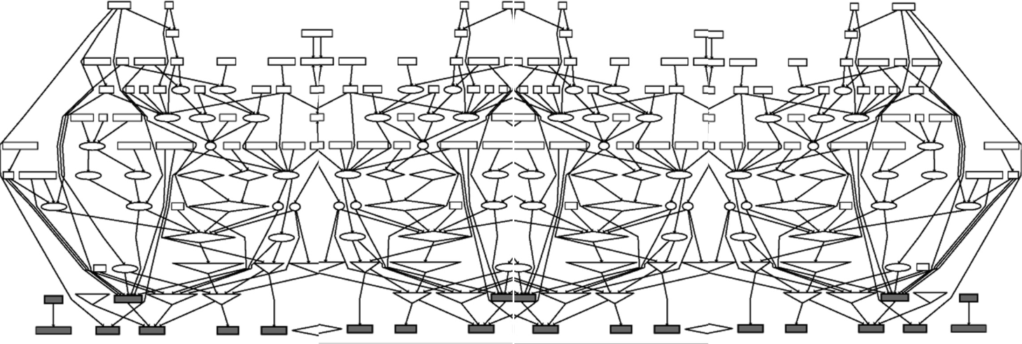
A Housing Management System
Ad hoc design, developed over time, patches, multiple technologies, … a typical legacy system
Problems:
  Embedded business logic, hard to learn
  hard to maintain, costly to add new functionality
  hard to change/evolve

Slide 9
SOA Paints a Bright Picture, Scene 1 …
Services encapsulate system details and reflect business logic, easier to learn
Easier to manage even if not technically
New functions on top of services
Inheritance
Reassessment
Title Change
Appraisal
Sales-transaction
Tax Calculation
Determine tax base
services

Slide 10
Scene 2: A World of “PAL”s, …
Organize into collections of services that may be offered to other cities
AppraisalPAL
Inheritance
Reassessment
Title Change
Sales-transaction
Tax Calculation
Determine tax base
TaxPAL
TitlePAL
services

Slide 11
…Their PALs, or
Towards a goal of
Business Process as a Service (BPaaS)
HR_PAL
AccountingPAL
AssessorPAL
AppraisalPAL
Reassessment
Inheritance
Title Change
Tax Calculation
Determine tax base
TaxPAL
TitlePAL

Slide 12
Scene 3: Virtual Enterprise Systems
Towards a goal of
Business Process as a Service (BPaaS)
Enterprise may run virtual IT systems
HR_PAL
AppraisalPAL
AccountingPAL
AssessorPAL
Enterprise System
Reassessment
Inheritance
Title Change
Tax Calculation
Determine tax base
TaxPAL
TitlePAL
What are
technical
issues?

Slide 13
Technical Issues
How to query?
Warn if #applications
for title change involving
tax reassessment reach 5
How to compose?
Is it “correct”?
new service
Certificate
Inheritance
Reassessment
Title Change
Appraisal
Sales-transaction
Tax Calculation
Determine tax base
Sales-transaction
Add new edu tax
services
How to do
transactions?
How to change
& evole?

Slide 14
Outline
Application Needs
“Legacy” Services
“Programmable” Services
Data Encapsulating Services
Research Challenges
Conclusions

Slide 15
“Legacy” Services
Services have states, but only finitely many
Can be modeled with:
finite state machines, process algebras, workflow nets (Petri nets), activity diagrams, state charts, …
Have been used in studying problems related to service composition
  Automated design, e.g., Roman services
  Verification
  Optimization (e.g., QoS based)
Wealth of knowledge, rich literature
[WWW, ICSOC, ICWS, SCC, SOCA, …]

Slide 16

Roman Services
A service consists of activities with a finite state control
Transitions labeled by activities
For a given state, the out-edges represent the set of options that will be presented to the user
Online Music Store
init
search
search
init
search
listen
listen
cart
cart
cart
buy
buy
search

Slide 17
The Composition Problem
desired
service
Online Music Store
init
search
search
init
listen
search
listen
cart
cart
buy
cart
buy
search
?
available services
Web store
init
search
cart
Juke
Bank
search
buy
listen

Slide 18
Composition As a Delegator
Delegator:
a service annotated
with delegations
Online Music Store
init
Web
search
Web
search
init
Web
search
Juke
listen
listen
cart
cart
Web
cart
Web
buy
Bank
buy
Web
search
Available services
Web store
Bank
init
search
cart
Juke
Bank
listen
buy
search

Slide 19
Roman Service Composition
Problem:
Given a target Roman service and a set of Roman services, find a delegator if exists
[Berardi-Calvanese-DeGiacomo-Lenzerini-Mecella ICSOC 03]
Deterministic [Berardi-Calvanese-DeGiacomo-Lenzerini-Mecella ICSOC 03]
Nontdeterminitic & Lookahead (batched)
[Gerede-Hull-Ibarra-S. ICSOC 04]
May delegate more than once [Berardi et al ICSOC 04]
With messages [Berardi-Calvanese-De Giacomo-Hull-Mecella VLDB 05]
Online delegation [Gerede-Ibarra-Ravikumar-S. TCS 08]
Use only a subset of services [Hassen-Nourine-Toumani ICSOC 08]

Slide 20
Legacy Services in Practice: Limited Applicability
How to query?
Warn if #applications
for title change involving
tax reassessment reach 5
age>55 & …
How to compose?
Is it “correct”?
new service
Certificate
Inheritance
Reassessment
Title Change
Appraisal
Sales-transaction
Tax Calculation
Determine tax base
Sales-transaction
Add new edu tax
services
How to do
transactions?
How to change
& evole?

Slide 21
Outline
Application Needs
“Legacy” Services
“Programmable” Services
Data Encapsulating Services
Research Challenges
Conclusions

Slide 22
Service Programming: Data as Variables
Roughly: finite states plus variables
  Pragmatic approach
Examples: BPEL, jBPM, YAWL, …
Design:
Programming with services
Analysis/checking “correctness”:
well, undecidable
A BPEL Process

Slide 23
BPEL is Turing Complete
Before: b a
Current: b
After: c a …
State: q
Before: a b a
Current: c
After: a …
State: p
a
b
b
c
a
Finite State
Control
a | q | a | r | L
b | q | a | p | R
…
q
BPEL can express all Turing computations
Checking properties for standalone BPEL is not solvable
Take a step back: finite state variables

Slide 24
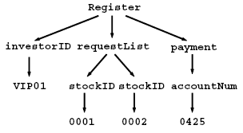
“Finite State” Variables
BPEL control structure → a finite state machine
XML Schema typed variables:
  primitive types limited to a finite set of values
  Structured: finitely many “repeats”
Can be improved with the “hyperplane” technique
[Gerede-S. ICSOC 07]
<invoke operation="approve",
invar="request",
outvar="aprvInfo" >
<catch faultname="loanfault">
< ☹ handler1 ☹ />
</catch>
</invoke>
[approve_In := request]
! approve_In
loanfault
? loanfault
ε
?approve_Out
handler1
[aprvInfo := approve_Out]
[Fu-Bultan-S. WWW 04]
[Fu-Bultan-S. ISSTA 04]

Slide 25
Helps, But Services Are Connected via Data
How to query?
Warn if #applications
for title change involving
tax reassessment reach 5
age>55 & …
How to compose?
Is it “correct”?
new service
Certificate
Inheritance
Reassessment
Title Change
Appraisal
Sales-transaction
Tax Calculation
Determine tax base
Sales-transaction
Add new edu tax
services
How to do
transactions?
How to change
& evole?

Slide 26
Collaborating BPEL Services
Two finite state machines
with input queues can simulate
Turing machines [Brand-Zafiropulo JACM 83]
Model checking BPEL services
with queues and
finite state variables is not solvable
a
b
b
c
a
Finite State
Control
a | q | a | r | L
b | q | a | p | R
…
q
queue
M₁
a b # b # q # c a …
queue
M₂
… a # p # c # a c a

Slide 27
Service Programming is an Art
How to query?
Warn if #applications
for title change involving
tax reassessment reach 5
age>55 & …
How to compose?
Is it “correct”?
new service
Certificate
Inheritance
Reassessment
Title Change
Appraisal
Sales-transaction
Tax Calculation
Determine tax base
Sales-transaction
Add new edu tax
services
How to do
transactions?
How to change
& evole?

Slide 28
Current Practice
Data and services are separately modeled, designed, managed
The separation adds difficulties in design, execution, maintenance, changes
In addition, many issues can’t be addressed
  Workflow transaction remains an art
  Data consistency is a concern of DBMS even though violations are caused by service execution
  Biz analytics is an after thought
  Long tail phenomenon is a “holy grail”

Slide 29
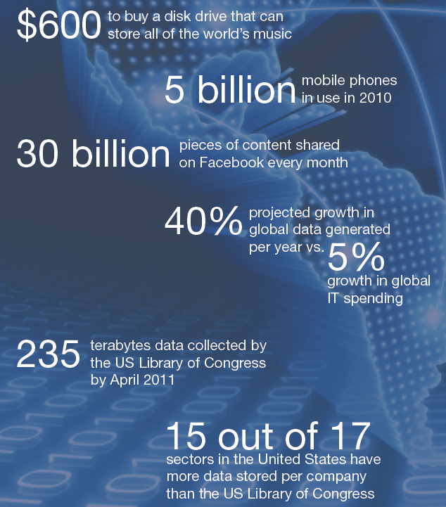
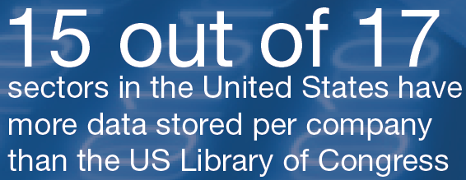
Big Data—A Gowing Torrent
Mckinsey Global Institute, June 2011: Big data: The next frontier for innovation, competition, and productivity
Availability of “big data” brings opportunities for improving productivity

Slide 30

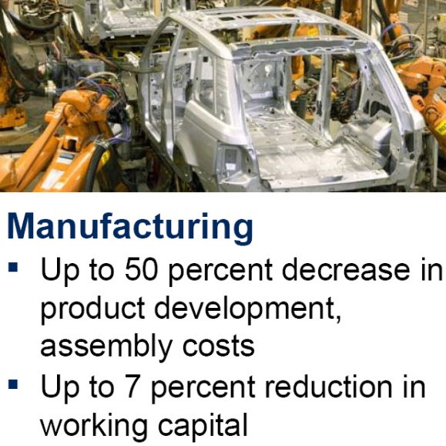
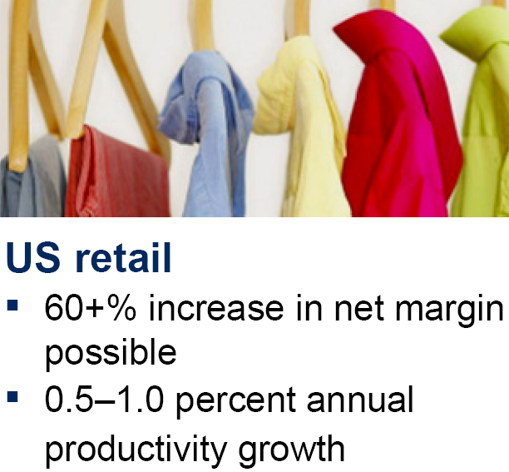
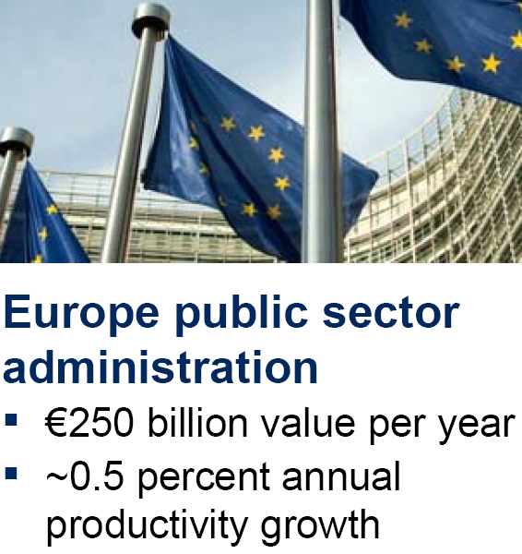
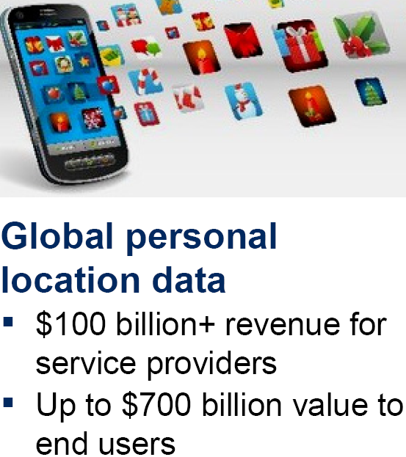
Big Data + Biz Processes Big Potential
Two observations
A significant portion of big data generated by biz processes
Productivity growth only obtainable via more efficient/effective biz processes
Source:
MGI Analysis

Slide 31
Service Programming is an Art
How to query?
Warn if #applications
for title change involving
tax reassessment reach 5
age>55 & …
How to compose?
Is it “correct”?
new service
Certificate
Inheritance
Reassessment
Title Change
Appraisal
Sales-transaction
HELP NEEDED
Tax Calculation
Determine tax base
Sales-transaction
Add new edu tax
services
How to do
transactions?
How to change
& evole?
The real world is not too kind

Slide 32
Needed: Enterprise Data Management
Business Process as a Service (BPaaS)
HRPal
AccountingPal
AssessorPal
AppraisalPal
Reassessment
Inheritance
Title Change
?
Tax Calculation
Determine tax base
TaxPal
TitlePal

Slide 33
Possibility 1: Monopoly Model
Served by an alliance of
PALs lead by a major player
The major player defines
data management,
protocols, etc.
KingPal
Enterprise system

Slide 34
Possibility 2: Open Market Model
No major players
Enterprise makes its own data
management plan
Bring Your Own Data (BYOD)
Could also use a “dataPal”
Data needed for services
+ services states
Enterprise system

Slide 35
An Application Challenge
What are appropriate models for both:
  Enterprise data and management
  Enterprise services inter-related through persistent data
Must support
  Composition design and analysis
  Runtime service execution management
  Transactions
  Process evolution

Slide 36
Outline
Application Needs
“Legacy” Services
“Programmable” Services
Data Encapsulating Services
Research Challenges
Conclusions

Slide 37
Services Aware of Data Management
First attempt: services + persistent data + mappings
Verbatim copy of the reality, not much help
Services and data are not intimately related
age>55 & …
How to compose?
Is it “correct”?
new service
How to query?
Certificate
Inheritance
Reassessment
Title Change
Appraisal
Sales-transaction
Tax Calculation
Determine tax base
Sales-transaction
Add new edu tax
services
How to do
transactions?
How to change
& evole?

Slide 38
Four Kinds of Data
Business data essential for business logic
  Examples: items, shipping addresses
Enactment status: the current execution snapshot
  Examples: order sent, shipping request made
Resource usage and state needed for service execution
  Examples: cargo space reserved, truck schedule to be determined
Correlation between processes instances
  Example: 3 warehouse fulfillment process instances for Jane’s order
Need models that include both control and data

Slide 39
Process Models & Data
Four classes of process models:
Data abstraction models: data mostly absent
  WF (Petri) nets, BPMN, UML Activity Diagrams, …
Data-aware models: data present (as variables), but storage and management hidden
  BPEL, YAWL, …
Storage-aware models: schemas for persistent stores, mappings to/from data in BPs defined and managed manually
  jBPM, …
Data encapsulting models: logical data modeling, automated modeling other 3 types, data-storage mapping
  Business artifact-centric models

Slide 40
Business Artifacts
A business artifact is a key conceptual business entity that is used in guiding the operation of the business
  fedex package delivery, patient visit, application form, insurance claim, order, financial deal, registration, …
  both “information carrier” and “road-maps”
Technically, it includes two parts:
  Information model:
  data needed to move through workflow
  Lifecycle:
  possible ways to evolve
Very natural to business managers and BP modelers

Slide 41
Example: Restaurant Processes
repository
Artifacts
Activity
Create
Guest Check
GC
Add Item
Guest Check
KO
Kitchen Order
Prepare
Receipt
Open
GCs
Pending
KOs
Receipt
RC
Cash Balance
Pending
Receipts
Closed
GCs
Prepare &
Test Quality
Payment
Paid
Receipts
Update
Cash Balance
Ready
KOs
Disagreed
Receipts
Deliver
Recalculate
Receipt
Archived
Receipts
Archived
GCs
CB
Archived
KOs
Cash
Balance
Notes:
Data flows
Data flow view, cite, and differences
Data flow diagramming [DeMarco-78]

Slide 42
Artifact-Centric Biz Process Models
customer
info
cart
. . .
+
Specification of
artifact lifecycles
Artifacts (Info models)
Informal model [Nigam-Caswell IBM Sys J 03]
Systems: BELA (IBM 2005), Siena (IBM 2007),
EZ-Flow (ArtiFlow) (Fudan-UCSB 2010), Barcelona (IBM 2010)
Formal models
  State machines [Gerede-Bhattacharya-S. SOCA 07][Gerede-S. ICSOC 07]
  Rules [Bhattacharya-Gerede-Hull-Liu-S. BPM 07][Hull et al WSFM 2010]

Slide 43
SeGA: A Service Wrapper/Mediator
[Sun-Xu-S.-Yang CoopIS 12]
SeGA separates data from execution engine
Serves as a mediator
Incoming
event
to SeGA
SeGA
...
Event Queue
Fetch correlated
instances of
the event
Dispatcher
Repository
Send the event,
the process instances,
& their schemas
to the engine
. . .
EZ-Flow
Engine n
Dispatcher retrieves
the updated instances &
stores into the repository
Outgoing
event
Barcelona
Engine n
Barcelona
Engine 1
Process the event,
update the instances, & emit outgoing events
1. SeGA receives incoming events
...
2. A dispatcher fetches the correlated BP instances according to the type of the incoming event
SeGA
Event Queue
Artifact
Repository
Dispatcher
Incoming event
BP instance
Schema
Outgoing event
3. The dispatcher sends the incoming event, the BP instances, and their schemas to the corresponding engine
Barcelona
Engine 1
EZ-Flow
Engine 1
. . .
. . .
. . .
5. The dispatcher retrieve the updated BP instances from the engine and store them back to the repository
Barcelona
Engine n
4. The engine then processes the incoming event, updates the BP instances, and sends outgoing events

Slide 44
Data Encapsulating Services
Data package between SeGA & services:
  Business data, enactment data, resource data, correlation data
Data encapsulating services: Stateful services but the engine need not maintain state
Independence of
data and service management
SeGA
Enterprise
system

Slide 45
Independence of D-S Management
Freedom to change service and execution without altering data management
Freedom to change data management without altering services
The independence hides the differences between the worlds of services and PALs
  Great start for some facinating research!
services
PALs

Slide 46
Towards a “Flat World” of Services
SeGA is a first step but an ad hoc prototype more structured methodology needed
Conceptual level:
  More types of data? Resource models? Transaction issues?
  Technical problems—four areas
System level:
  Architecture for data encapsulating services?
  APIs for (non-)functional properties?
Goal: a unified technical framework for services (biz processes and otherwise)

Slide 47
Outline
Application Needs
“Legacy” Services
“Programmable” Services
Data Encapsulating Services
Research Challenges
Conclusions

Slide 48
Research Challenges
age>55 & …
new service
Composition
/ design
Runtime
Certificate
Inheritance
Reassessment
Title Change
Appraisal
Sales-transaction
Tax Calculation
Determine tax base
Sales-transaction
Add new edu tax
services
Transactions
Evolution

Slide 49
Research Challenges
Design: What are appropriate service designs? Choreography vs orchestration (Part II)? Design aid (analysis/model checking tool), interoperation
Runtime: Enforcement of process/data constraints, KPI/monitoring techniques, resource planning and management
Transactions: What is the notion of workflow transaction?
Change/evolution: Process vs instance changes, long lasting vs temporary, longtail
Big data: monitoring to analytics to change

Slide 50
Choreorgraphy For Artifacts
Participants are processes represented by biz artifacts
  Partial information model visible
Correlations between process instances (not just models)
Data from artifacts used in specifying sequencing constraints
A fragment of first-order linear time logic
Detailed in the afternoon session [Sun-Xu-S. ICSOC 12]

Slide 51
Execution Semantics
Formal model (semantics) for task execution
based on Petri nets
Represents data (input/output) requirements and
carries enactments
[Xu-S.-Yan-Yang-Zhang CoopIS 2011]
Enactment + core artifact
start
fetch
invoke
store
end
event_{s}
started
ready
done
stored
event_{e}
Event (with contents)
Other data

Slide 52
Artifact-Centric BPs are Easier to Change
Biz process = biz artifacts =
state machine lifecycle + BP change rules
BP change rules conservatively extend workflow
  Could be temporary, non-schematic
Rules allow biz processes to respond to situations with many more options
Estimated labor savings:
  9% for Hangzhou HMB (preliminary study) or
  38 out of 400 FTEs
[Xu-S.-Yan-Yang-Zhang CoopIS 2011]

Slide 53
Workflow and Data Management
Environment (customer, manager, …)
Pay by
bank
Bank
reply
Register
request
Checkout
Order
pay
Order
paid
Ship
prepare
…
Customer
register
Order
create
Contact
customer
support
Customer
support
reply
…
Order
further action
Order
action taken
Inventory
sell
…
INSERT Customer(email…)
INSERT
Order (…, custid, qty, …)
SELECT … FROM Order
WHERE…
UPDATE Order
SET order_stat = … WHERE …
UPDATE Inventory SET avail_qty=… WHERE …
DBMS
Customer(…,
email UNIQUE,
…)
Order(…,
FOREIGN KEY cid
REFERENCE Customer,
…)
If the ship_stat of the referenced Ship is not FINISH or FAILED, the ord_stat of the Order must not be RETURN nor CANCEL
[Liu-S.-Yang CoopIS 11]
Integrity constraints (ICs): key in data management
Many possible ways, our approach: Guard injection

Slide 54
Incremental (Runtime) Enforcement
Logical properties: first order + linear time logic
Execution snapshot: relational database
+
[De Masellis-S. 2012]

Slide 55
Research Challenges
Design: What are appropriate service designs? Choreography vs orchestration (Part II)? Design aid (analysis/model checking tool), interoperation
Runtime: Enforcement of process/data constraints, KPI/monitoring techniques, resource planning and management
Transactions: What is the notion of workflow transaction?
Change/evolution: Process vs instance changes, long lasting vs temporary, longtail
Big data: monitoring to analytics to change

Slide 56
Outline
Application Needs
“Legacy” Services
“Programmable” Services
Data Encapsulating Services
Research Challenges
Conclusions

Slide 57
Conclusions
Inclusion of data is critical to capture business logics into services
  Data are not just variables; important to remember “persistence”
Separation of data and service management is a promising approach (e.g., BYOD)
  DSM independence
Problems are more difficult, demand creative solutions!
  Do we have alternatives?
Scientific principles can and should guide engineering practice, but they don’t have to speak the same buzz words

Slide 58
Acknowledgements
Helpful comments from:
Richard Hull (IBM)
Yutian Sun (UCSB)
Jian Yang (Macquarie U)

Slide 59
References
[Hull-S. 04] R. Hull and J. Su: Tools for Design of Composite Web Services. ACM SIGMOD, 2004, pages 958-961
[Hull-S. 05] R. Hull and J. Su: Tools for composite web services: A short overview. SIGMOD Record, 34(2):86-95, 2005
[Jin et al CoopIS 2011] T. Jin, J. Wang, and L. Wen: Efficient Retrieval of Similar Business Process Models Based on Structure. CoopIS 2011, pages 56-63
[Berardi-Calvanese-DeGiacomo-Lenzerini-Mecella ICSOC 03] Daniela Berardi, Diego Calvanese, Giuseppe De Giacomo, Maurizio Lenzerini, Massimo Mecella: Automatic Composition of E-services That Export Their Behavior. ICSOC 2003: 43-58
[Gerede-Hull-Ibarra-S. ICSOC 04] C.E. Gerede, R. Hull, O.H. Ibarra, and J. Su: Automated composition of e-services: lookaheads. ICSOC, 2004, pages 252-262
[Berardi et al ICSOC 04] D. Berardi, G. De Giacomo, M. Lenzerini, M. Mecella, and D. Calvanese: Synthesis of underspecified composite e-services based on automated reasoning. ICSOC, 2004, pages 105-114
[Berardi-Calvanese-De Giacomo-Hull-Mecella VLDB 05] D. Berardi, D. Calvanese, G. De Giacomo, R. Hull, M. Mecella: Automatic Composition of Transition-based Semantic Web Services with Messaging. VLDB, 2005, pages 613-624
[Gerede-Ibarra-Ravikumar-S. TCS 08] C. E. Gerede, O. H. Ibarra, B. Ravikumar, and J. Su: Minimum-cost delegation in service composition. Theor. Comput. Sci., 409(3):417-431, 2008
[Hassen-Nourine-Toumani ICSOC 08] R. R. Hassen, L. Nourine, F. Toumani: Protocol-Based Web Service Composition. ICSOC, 2008, pages 38-53
[Fu-Bultan-S. WWW 04] X. Fu, T. Bultan, and J. Su: Analysis of interacting BPEL web services. WWW, 2004, pages 621-630
[Fu-Bultan-S. ISSTA 04] X. Fu, T. Bultan, and J. Su: Model checking XML manipulating software. ISSTA, 2004, pages 252-262
[Gerede-S. ICSOC 07] C. E. Gerede and J. Su: Specification and Verification of Artifact Behaviors in Business Process Models. ICSOC, 2007, pages 181-192
[Brand-Zafiropulo JACM 83] D. Brand and P. Zafiropulo. On communicating finite-state machines. Journal of the ACM, 30(2):323–342, 1983
[Nigam-Caswell IBM Sys J 03] A. Nigam, N.S. Caswell: Business artifacts: An approach to operational specification. IBM Systems Journal, 42(3):428–445, 2003
[Gerede-Bhattacharya-S. SOCA 07] C.E. Gerede, K. Bhattacharya, and J. Su: Static Analysis of Business Artifact-centric Operational Models. SOCA, 2007, pages 133-140
[Gerede-S. ICSOC 07] C.E. Gerede and J. Su: Specification and Verification of Artifact Behaviors in Business Process Models. ICSOC, 2007, pages 181-192
[Bhattacharya-Gerede-Hull-Liu-S. BPM 07] K. Bhattacharya, C. E. Gerede, R. Hull, R. Liu, and J. Su: Towards Formal Analysis of Artifact-Centric Business Process Models. BPM, 2007, pages 288-304
[Hull et al WSFM 2010] R. Hull, E. Damaggio, F. Fournier, M. Gupta, F.T. Heath, S. Hobson, M.H. Linehan, S. Maradugu, A. Nigam, P. Sukaviriya, R. Vaculín: Introducing the Guard-Stage-Milestone Approach for Specifying Business Entity Lifecycles. WS-FM, 2010, pages 1-24
[Sun-Xu-S.-Yang CoopIS 12] Y. Sun, W. Xu, J. Su, and J. Yang:SeGA: A Mediator for Artifact-Centric Business Processes, CoopIS, 2012
[Sun-Xu-S. ICSOC 12] Y. Sun, W. Xu, and J. Su: Declarative Choreographies for Artifacts. ICSOC, 2012, pages 420-434
[Xu-S.-Yan-Yang-Zhang CoopIS 2011] W. Xu, J. Su, Z. Yan, J. Yang, and L. Zhang: An Artifact-Centric Approach to Dynamic Modification of Workflow Execution. CoopIS, 2011, pages 256-273
[Liu-S.-Yang CoopIS 11] X. Liu, J. Su, J. Yang: Preservation of Integrity Constraints by Workflow. CoopIS, 2011, pages 64-81
[De Masellis-S. 2012] R. De Masellis and J. Su: Runtime Enforcement of First-order LTL Properties in Data-centric Workflows, in preparation, 2012

