Slide 1
Distributed Memory Programming with Message-Passing
Pacheco’s book Chapter 3
T. Yang, CS240A
Part of slides from the text book and B. Gropp

Slide 2
Outline
# Chapter Subtitle
An overview of MPI programming
  Six MPI functions and hello sample
  How to compile/run
More on send/receive communication
Parallelizing numerical integration with MPI

Slide 3
Mainly for distributed memory systems
Not targeted for shared memory machines. But can work

Slide 4
Message Passing Libraries
  MPI, Message Passing Interface, now the industry standard, for C/C++ and other languages
  Running as a set of processes. No shared variables
All communication, synchronization require subroutine calls
  Enquiries
    How many processes? Which one am I? Any messages waiting?
  Communication
    point-to-point: Send and Receive
    Collectives such as broadcast
  Synchronization
    Barrier

Slide 5
Advanced Features of MPI
Communicators encapsulate communication spaces for library safety
Datatypes reduce copying costs and permit heterogeneity
Multiple communication modes allow precise buffer management
Extensive collective operations for scalable global communication
Process topologies permit efficient process placement, user views of process layout
Profiling interface encourages portable tools
Slide source: Bill Gropp, ANL
Notes:
Need to be able to connect heterogeneous (old and new) processors, with
Different ISAs, etc.
Communicators let us refer to procs 0-15, no matter which physical processors you get
And develop libraries independently, that do not interfere with one another
Datatypes: not all datatypes look alike, even ints (big-endian vs little-endian:
Taken from Jonathan Swift’s “Gulliver’s Travels”, where the kingdoms of Lilliput and Blefuscu
fought over which end of a soft boiled egg to open: people from Blefuscu opened the
big end first, and were called big-endians; in our case it refers to the byte order of integers)
and MPI hides all this from the user
Modes: put in network, come back after delivered, or
put in network, return right away
put in network, return right away, but promise not to overwrite the buffer before sent
Can give system hints about topologies (there is a 2D mesh!) or ignore it
Karl Fuerlinger will talk about perf monitoring later in semester

Slide 6
MPI Implementations & References
The Standard itself (MPI-2, MPI-3):
  at http://www.mpi-forum.org
Implementation for Linux/Windows
  Vendor specific implementation
  MPICH
  Open MPI
Other information on Web:
  http://en.wikipedia.org/wiki/Message_Passing_Interface
  http://www.mcs.anl.gov/mpi MPI talks and tutorials, a FAQ, other MPI pages
Notes:
All installed already

Slide 7
MPI is Simple
Many parallel programs can be written using just these six functions, only two of which are non-trivial:
  MPI_INIT
  MPI_FINALIZE
  MPI_COMM_SIZE
  MPI_COMM_RANK
  MPI_SEND
  MPI_RECV
To measure time: MPI_Wtime()
Slide source: Bill Gropp, ANL

Slide 8
Finding Out About the Environment
Two important questions raised early:
  How many processes are participating in this computation?
  Which one am I?
MPI functions to answer these questions:
  MPI_Comm_size reports the number of processes.
  MPI_Comm_rank reports the rank, a number between 0 and size-1, identifying the calling process
    p processes are numbered 0, 1, 2, .. p-1
Slide source: Bill Gropp, ANL

Slide 9
Mpi_hello (C)
#include "mpi.h"
#include <stdio.h>
int main( int argc, char *argv[] )
{
int rank, size;
MPI_Init( &argc, &argv );
MPI_Comm_rank( MPI_COMM_WORLD, &rank );
MPI_Comm_size( MPI_COMM_WORLD, &size );
printf( "I am %d of %d!\n", rank, size );
MPI_Finalize();
return 0;
}
Slide source: Bill Gropp, ANL
Notes:
Input arguments might be “initialize with 4 processors”
MPI_COMM_WORLD = communicator, means “get me all the processors available, not a subset”

Slide 10
Mpi_hello (C++)
#include "mpi.h"
#include <iostream>
int main( int argc, char *argv[] )
{
int rank, size;
MPI::Init(argc, argv);
rank = MPI::COMM_WORLD.Get_rank();
size = MPI::COMM_WORLD.Get_size();
std::cout << "I am " << rank << " of " << size <<
“!\n";
MPI::Finalize();
return 0;
}
Slide source: Bill Gropp, ANL

Slide 11
Compilation
wrapper script to compile
source file
mpicc -O -o mpi_hello mpi_hello.c
Mix with openmp
mpicc -O -o mpi_hello mpi_hello.c -fopenmp

Slide 12
Execution with mpirun or mpiexec
mpirun -n <number of processes> <executable>
mpirun -n 1 ./mpi_hello
run with 1 process
mpirun -n 4 ./mpi_hello
run with 4 processes

Slide 13
Execution
mpirun -n 1 ./mpi_hello
I am 0 of 1 !
mpirun -n 4 ./mpi_hello
I am 0 of 4 !
I am 1 of 4 !
I am 2 of 4 !
I am 3 of 4 !

Slide 14
mpirun -n 4 ./mpi_hello
#include "mpi.h"
#include <stdio.h>
int main( int argc, char *argv[] )
{
int rank, size;
MPI_Init( &argc, &argv );
MPI_Comm_rank( MPI_COMM_WORLD, &rank );
MPI_Comm_size( MPI_COMM_WORLD, &size );
printf( "I am %d of %d!\n", rank, size );
MPI_Finalize();
return 0;
}
CPU process 0
CPU process 1
CPU process 2
CPU process 3
Notes:
Input arguments might be “initialize with 4 processors”
MPI_COMM_WORLD = communicator, means “get me all the processors available, not a subset”

Slide 15
Running an MPI job at Comet
#!/bin/bash
#SBATCH --job-name="hellompi"
#SBATCH --output="hellompi.%j.%N.out"
#SBATCH --partition=compute
#SBATCH --nodes=2
#SBATCH --ntasks-per-node=24
#SBATCH --export=ALL
#SBATCH -t 01:30:00
#This job runs with 2 nodes, 24 cores per node for a total of 48 cores.
#ibrun in verbose mode will give binding detail
ibrun -v ../hello_mpi

Slide 16
MPI Programs
Written in C/C++.
  Has main.
  Uses stdio.h, string.h, etc.
Need to add mpi.h header file.
Identifiers defined by MPI start with “MPI_”.
First letter following underscore is uppercase.
  For function names and MPI-defined types.
  Helps to avoid confusion.
MPI functions return error codes or MPI_SUCCESS

Slide 17


MPI Components
MPI_Init
  Tells MPI to do all the necessary setup.
MPI_Finalize
  Tells MPI we’re done, so clean up anything allocated for this program.

Slide 18
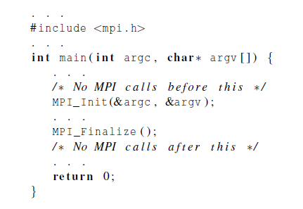
Basic Outline

Slide 19
Basic Concepts: Communicator
Processes can be collected into groups
  Communicator
  Each message is sent & received in the same communicator
A process is identified by its rank in the group associated with a communicator
There is a default communicator whose group contains all initial processes, called MPI_COMM_WORLD
Slide source: Bill Gropp, ANL
Notes:
How to have messages from FFT routines not delivered to matmul subroutine,
Even if both referring to processors 0 through 7:
need “contexts” (eg FFT context, matmul context etc) to guarantee correct delivery

Slide 20



Communicators
number of processes in the communicator
my rank
(the process making this call)

Slide 21
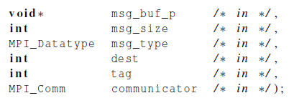

Basic Send
Things specified:
  How will “data” be described?
  How will processes be identified?
  How will the receiver recognize/screen messages?

Slide 22
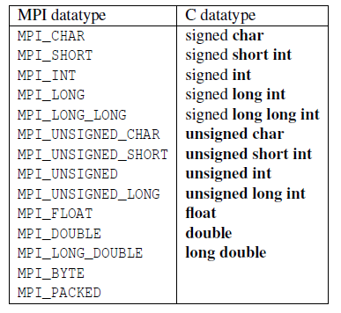
Data types

Slide 23
MPI Datatypes
The data in a message to send or receive is described by a triple (address, count, datatype), where
An MPI datatype is recursively defined as:
  predefined, corresponding to a data type from the language (e.g., MPI_INT, MPI_DOUBLE)
  a contiguous array of MPI datatypes
  a strided block of datatypes
  an indexed array of blocks of datatypes
  an arbitrary structure of datatypes
There are MPI functions to construct custom datatypes, in particular ones for subarrays
May hurt performance if datatypes are complex
Slide source: Bill Gropp, ANL
Notes:
What would it mean to send a linked list? What do pointers mean?
MPI does whatever copying/packing/unpacking is needed.

Slide 24
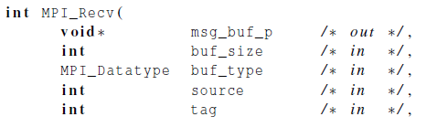

Basic Receive: Block until a matching message is received
Things that need specifying:
  Where to receive data
  How will the receiver recognize/screen messages?
  What is the actual message received

Slide 25

Message matching
MPI_Send
dest
MPI_Recv
src

Slide 26

Receiving messages without knowing
A receiver can get a message without knowing:
  the amount of data in the message,
  the sender of the message,
    Specify the source as MPI_ANY_SOURCE
  or the tag of the message.
    Specify the tag as MPI_ANY_TAG

Slide 27
Status argument: who sent me and what tag is?
MPI_Status*
Who sent me
What tag is
Error code
Actual message length

Slide 28
Retrieving Further Information from status argument in C
Status is a data structure allocated in the user’s program.
In C:
  int recvd_tag, recvd_from, recvd_count;
  MPI_Status status;
  MPI_Recv(..., MPI_ANY_SOURCE, MPI_ANY_TAG, ..., &status )
  recvd_tag = status.MPI_TAG;
  recvd_from = status.MPI_SOURCE;
  MPI_Get_count( &status, datatype, &recvd_count );
Slide source: Bill Gropp, ANL
Notes:
Receive data from anyone, ask later who sent it, how much, which tag

Slide 29
Retrieving Further Information in C++
Status is a data structure allocated in the user’s program.
In C++:
  int recvd_tag, recvd_from, recvd_count;
  MPI::Status status;
  Comm.Recv(..., MPI::ANY_SOURCE, MPI::ANY_TAG, ...,
  status )
  recvd_tag = status.Get_tag();
  recvd_from = status.Get_source();
  recvd_count = status.Get_count( datatype );
Slide source: Bill Gropp, ANL
Notes:
Tags could match accidentally, but context cannot, so can’t get someone else’s mail by mistake

Slide 30
MPI Example: Simple send/recive
#include “mpi.h”
#include <stdio.h>
int main( int argc, char *argv[])
{
int rank, buf;
MPI_Status status;
MPI_Init(&argv, &argc);
MPI_Comm_rank( MPI_COMM_WORLD, &rank );
/* Process 0 sends and Process 1 receives */
if (rank == 0) {
buf = 123456;
MPI_Send( &buf, 1, MPI_INT, 1, 0, MPI_COMM_WORLD);
}
else if (rank == 1) {
MPI_Recv( &buf, 1, MPI_INT, 0, 0, MPI_COMM_WORLD,
&status );
printf( “Received %d\n”, buf );
}
MPI_Finalize();
return 0;
}
Proc 0
123456
Proc 1
Slide source: Bill Gropp, ANL
Notes:
Simple program: send a number 123456 from process 0 to process 1
Need branch, because every processor executing same program

Slide 31
MPI Send/Receive Example with C++
#include “mpi.h”
#include <iostream>
int main( int argc, char *argv[])
{
int rank, buf;
MPI::Init(argv, argc);
rank = MPI::COMM_WORLD.Get_rank();
// Process 0 sends and Process 1 receives
if (rank == 0) {
buf = 123456;
MPI::COMM_WORLD.Send( &buf, 1, MPI::INT, 1, 0 );
}
else if (rank == 1) {
MPI::COMM_WORLD.Recv( &buf, 1, MPI::INT, 0, 0 );
std::cout << “Received “ << buf << “\n”;
}
MPI::Finalize();
return 0;
}
Proc 0
123456
Proc 1
Slide source: Bill Gropp, ANL

Slide 32
MPI_Wtime()
Returns the current time with a double float.
To time a program segment
  Start time= MPI_Wtime()
  End time=MPI_Wtime()
  Time spent is end_time – start_time.

Slide 33
Example of using MPI_Wtime()
#include<stdio.h>
#include<mpi.h>
main(int argc, char **argv){
int size, node; double start, end;
MPI_Init(&argc, &argv);
MPI_Comm_rank(MPI_COMM_WORLD, &node);
MPI_Comm_size(MPI_COMM_WORLD, &size);
start = MPI_Wtime();
if(node==0) {
printf(" Hello From Master. Time = %lf \n", MPI_Wtime() - start);
}
else {
printf("Hello From Slave #%d %lf \n", node, (MPI_Wtime() - start));
}
MPI_Finalize();
}

Slide 34

MPI Example: Numerical Integration With Trapezoidal Rule
Pacheco’s book p. 94-101

Slide 35
Approximation of Numerical Integration
Two ideas
Use a simple function to approximate the integral area.
Divide an integral into small segments
₀
x₁

Slide 36
Trapezoid Rule
Straight-line approximation
f(x)
L(x)
x₀
x₁
x

Slide 37
Composite Trapezoid Rule
f(x)
x₀
h
x₁
h
x₂
h
x₃
h
x₄
x

Slide 38

Implementing Composite Trapezoidal Rule
f(x)
x₀
h
x₁
h
x₂
h
x₃
h
x₄
x

Slide 39
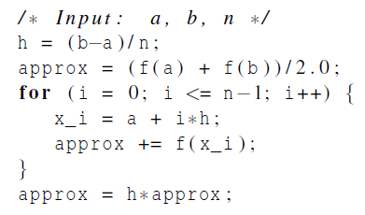
Pseudo-code for a serial program

Slide 40
Parallelizing the Trapezoidal Rule
Partition problem solution into tasks.
Identify communication channels between tasks.
Aggregate tasks into composite tasks.
Map composite tasks to cores.
f(x)
Task 3
Core 3
Task 0
Core 0
Task 1
Core 1
Task 2
Core 2
x₀
h
x₁
h
x₂
h
x₃
h
x₄
x

Slide 41
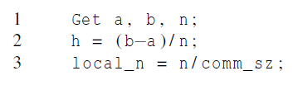
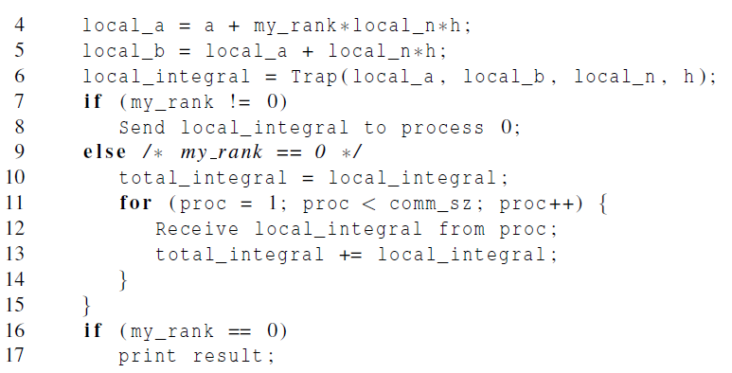
Parallel pseudo-code
Compute the local area
Summation of local values

Slide 42
Tasks and communications for Trapezoidal Rule

Slide 43
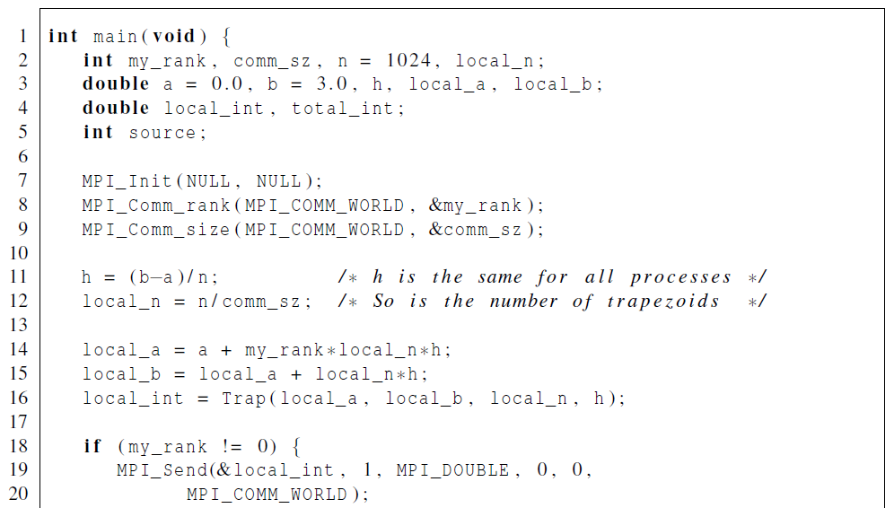
First version (1)
Use send/receive to sum

Slide 44
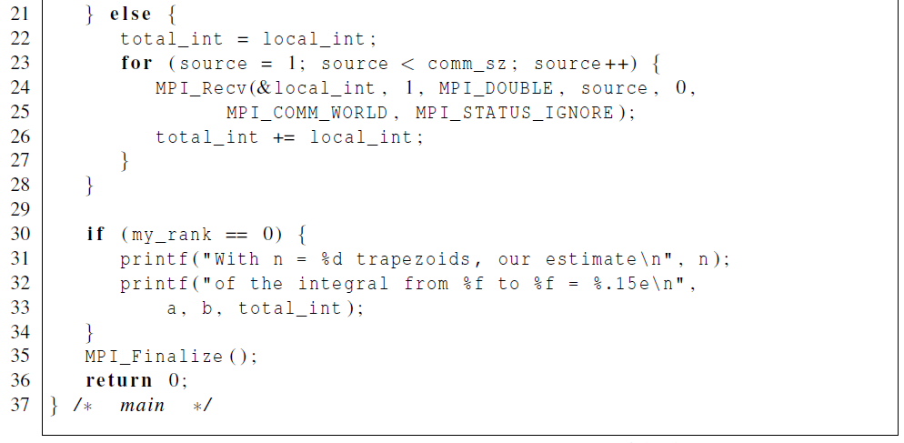
First version (2)
Use send/receive to sum

Slide 45
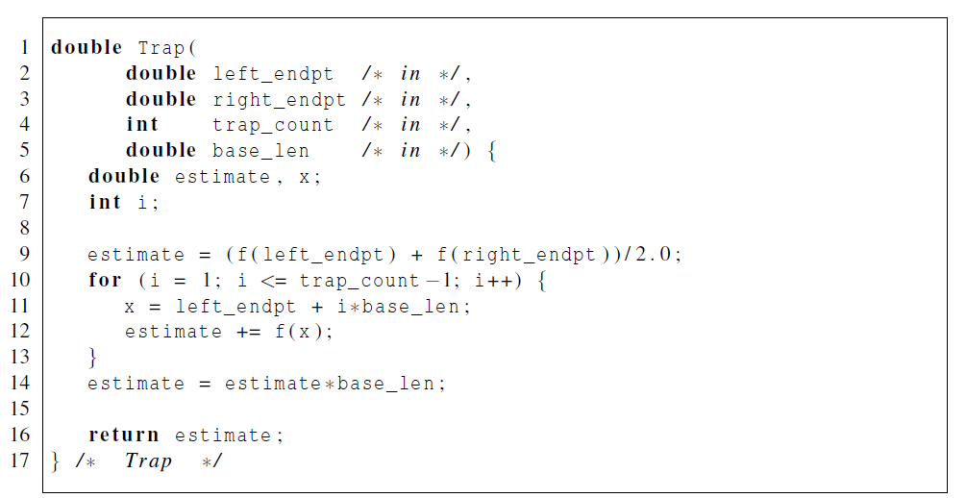
First version: Trapezoidal Rule of local area

Slide 46
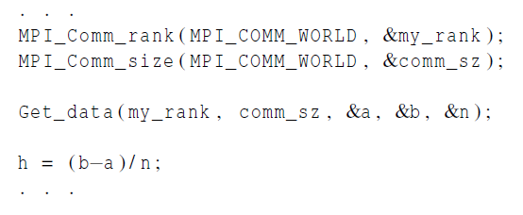
I/O handling in trapezoidal program
Most MPI implementations only allow process 0 in MPI_COMM_WORLD access to stdin.
Process 0 must read the data (scanf) and send to the other processes.

Slide 47
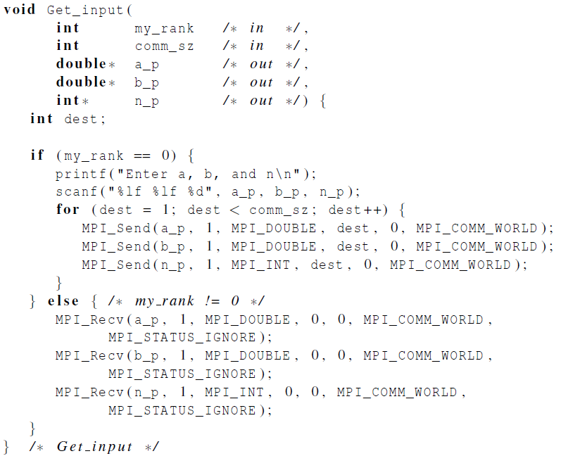
Function for reading user input
Process 0 inputs parameters
Broadcast parameters

