Slide 1
SIMD Programming
CS 240A, 2017

Slide 2
Flynn* Taxonomy, 1966
In 2013, SIMD and MIMD most common parallelism in architectures – usually both in same system!
Most common parallel processing programming style: Single Program Multiple Data (“SPMD”)
Single program that runs on all processors of a MIMD
Cross-processor execution coordination using synchronization primitives
SIMD (aka hw-level data parallelism): specialized function units, for handling lock-step calculations involving arrays
Scientific computing, signal processing, multimedia (audio/video processing)
*Prof. Michael Flynn, Stanford

Slide 3
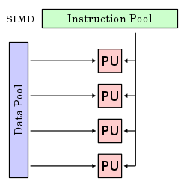
Single-Instruction/Multiple-Data Stream (SIMD or “sim-dee”)
SIMD computer exploits multiple data streams against a single instruction stream to operations that may be naturally parallelized, e.g., Intel SIMD instruction extensions or NVIDIA Graphics Processing Unit (GPU)

Slide 4
SIMD: Single Instruction, Multiple Data
Scalar processing
traditional mode
one operation produces one result
SIMD processing
With Intel SSE / SSE2
SSE = streaming SIMD extensions
one operation produces multiple results
X
X
x3
x2
x1
x0
+
+
Y
Y
y3
y2
y1
y0
X + Y
X + Y
x3+y3
x2+y2
x1+y1
x0+y0
Slide Source: Alex Klimovitski & Dean Macri, Intel Corporation

Slide 5
What does this mean to you?
In addition to SIMD extensions, the processor may have other special instructions
Fused Multiply-Add (FMA) instructions:
x = y + c * z
is so common some processor execute the multiply/add as a single instruction, at the same rate (bandwidth) as + or * alone
In theory, the compiler understands all of this
When compiling, it will rearrange instructions to get a good “schedule” that maximizes pipelining, uses FMAs and SIMD
It works with the mix of instructions inside an inner loop or other block of code
But in practice the compiler may need your help
Choose a different compiler, optimization flags, etc.
Rearrange your code to make things more obvious
Using special functions (“intrinsics”) or write in assembly ☹

Slide 6
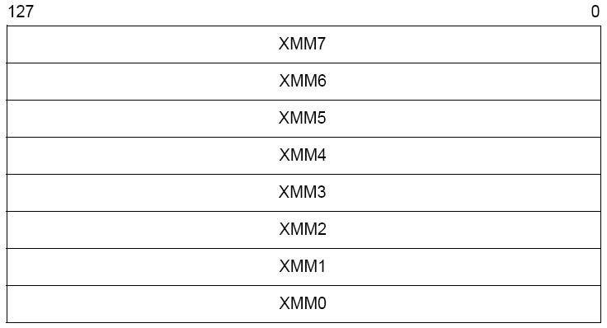
Intel SIMD Extensions
MMX 64-bit registers, reusing floating-point registers [1992]
SSE2/3/4, new 8 128-bit registers [1999]
AVX, new 256-bit registers [2011]
Space for expansion to 1024-bit registers

Slide 7
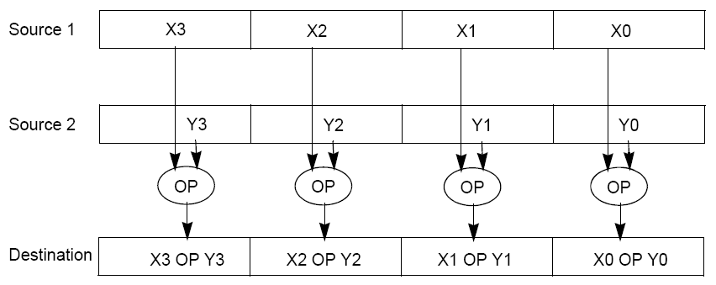
SSE / SSE2 SIMD on Intel
SSE2 data types: anything that fits into 16 bytes, e.g.,
Instructions perform add, multiply etc. on all the data
in parallel
Similar on GPUs, vector processors (but many more simultaneous operations)
4x floats
2x doubles
16x bytes

Slide 8
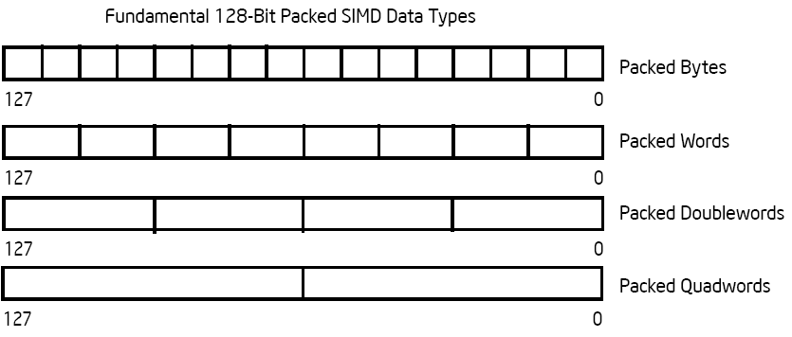
Intel Architecture SSE2+ 128-Bit SIMD Data Types
Note: in Intel Architecture (unlike MIPS) a word is 16 bits
Single-precision FP: Double word (32 bits)
Double-precision FP: Quad word (64 bits)
122 121
96 95
80 79
64 63
48 47
32 31
16 15
16 / 128 bits
122 121
96 95
80 79
64 63
48 47
32 31
16 15
8 / 128 bits
96 95
64 63
32 31
4 / 128 bits
64 63
2 / 128 bits

Slide 9
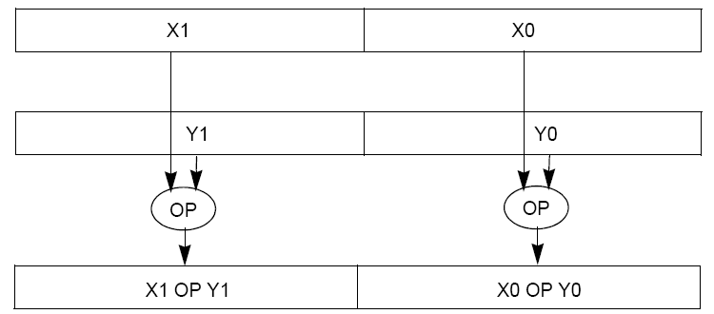
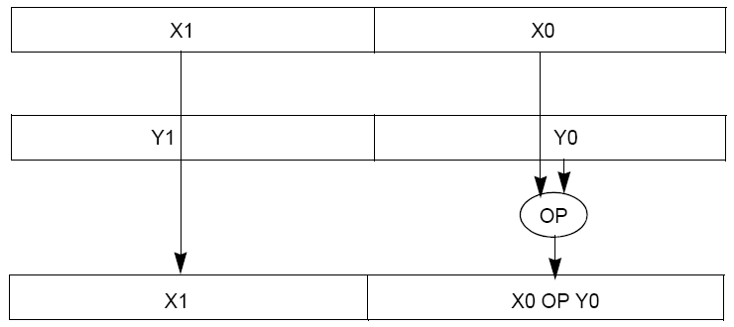
Packed and Scalar Double-Precision Floating-Point Operations
Packed
Scalar

Slide 10
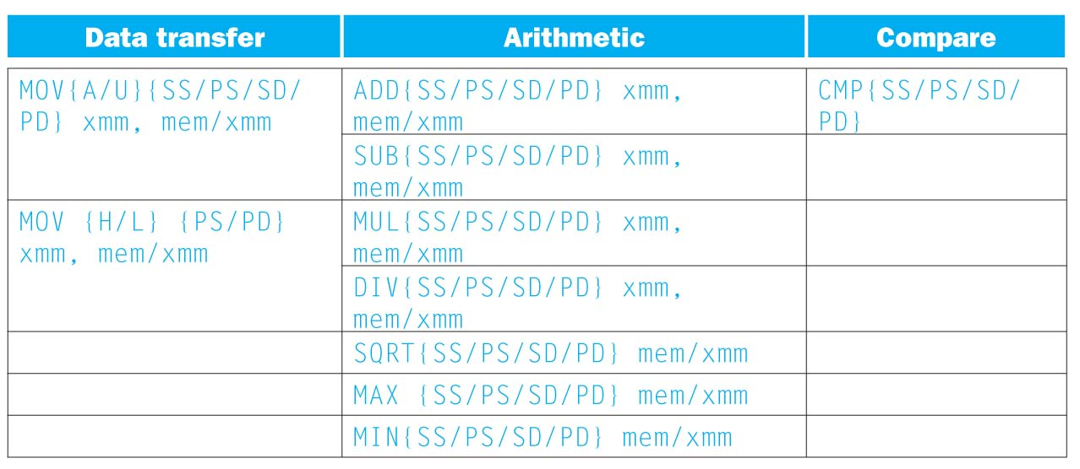
SSE/SSE2 Floating Point Instructions
Move does both load and store
xmm: one operand is a 128-bit SSE2 register
mem/xmm: other operand is in memory or an SSE2 register
{SS} Scalar Single precision FP: one 32-bit operand in a 128-bit register
{PS} Packed Single precision FP: four 32-bit operands in a 128-bit register
{SD} Scalar Double precision FP: one 64-bit operand in a 128-bit register
{PD} Packed Double precision FP, or two 64-bit operands in a 128-bit register
{A} 128-bit operand is aligned in memory
{U} means the 128-bit operand is unaligned in memory
{H} means move the high half of the 128-bit operand
{L} means move the low half of the 128-bit operand

Slide 11
Example: SIMD Array Processing
for each f in array
f = sqrt(f)
for each f in array
{
load f to floating-point register
calculate the square root
write the result from the register to memory
}
for each 4 members in array
{
load 4 members to the SSE register
calculate 4 square roots in one operation
store the 4 results from the register to memory
}
SIMD style

Slide 12
Data-Level Parallelism and SIMD
SIMD wants adjacent values in memory that can be operated in parallel
Usually specified in programs as loops
for(i=1000; i>0; i=i-1)
x[i] = x[i] + s;
How can reveal more data-level parallelism than available in a single iteration of a loop?
Unroll loop and adjust iteration rate

Slide 13
Loop Unrolling in C
Instead of compiler doing loop unrolling, could do it yourself in C
for(i=1000; i>0; i=i-1)
x[i] = x[i] + s;
Could be rewritten
for(i=1000; i>0; i=i-4) {
x[i] = x[i] + s;
x[i-1] = x[i-1] + s;
x[i-2] = x[i-2] + s;
x[i-3] = x[i-3] + s;
}

Slide 14
Generalizing Loop Unrolling
A loop of n iterations
k copies of the body of the loop
Assuming (n mod k) ≠ 0
Then we will run the loop with 1 copy of the body (n mod k) times
and then with k copies of the body floor(n/k) times

Slide 15
General Loop Unrolling with a Head
Handing loop iterations indivisible by step size.
for(i=1003; i>0; i=i-1)
x[i] = x[i] + s;
Could be rewritten
for(i=1003;i>1000;i--) //Handle the head (1003 mod 4)
x[i] = x[i] + s;
for(i=1000; i>0; i=i-4) {// handle other iterations
x[i] = x[i] + s;
x[i-1] = x[i-1] + s;
x[i-2] = x[i-2] + s;
x[i-3] = x[i-3] + s;
}

Slide 16
Tail method for general loop unrolling
Handing loop iterations indivisible by step size.
for(i=1003; i>0; i=i-1)
x[i] = x[i] + s;
Could be rewritten
for(i=1003; i>0 && i> 1003 mod 4; i=i-4) {
x[i] = x[i] + s;
x[i-1] = x[i-1] + s;
x[i-2] = x[i-2] + s;
x[i-3] = x[i-3] + s;
}
for( i= 1003 mod 4; i>0; i--) //special handle in tail
x[i] = x[i] + s;

Slide 17
Another loop unrolling example
Normal loop | After loop unrolling
int x; for (x = 0; x < 103; x++) { delete(x); } | int x; for (x = 0; x < 103/5*5; x += 5) { delete(x); delete(x + 1); delete(x + 2); delete(x + 3); delete(x + 4); } /*Tail*/ for (x = 103/5*5; x < 103; x++) { delete(x); }

Slide 18
Intel SSE Intrinsics
Intrinsics are C functions and procedures for inserting assembly language into C code, including SSE instructions
Instrinsics:
Corresponding SSE instructions:
Vector data type:
_m128d
Load and store operations:
_mm_load_pd MOVAPD/aligned, packed double
_mm_store_pd MOVAPD/aligned, packed double
_mm_loadu_pd MOVUPD/unaligned, packed double
_mm_storeu_pd MOVUPD/unaligned, packed double
Load and broadcast across vector
_mm_load1_pd MOVSD + shuffling/duplicating
Arithmetic:
_mm_add_pd ADDPD/add, packed double
_mm_mul_pd MULPD/multiple, packed double
Notes:
CS267 Lecture 2
18

Slide 19
Example 1: Use of SSE SIMD instructions
For (i=0; i<n; i++) sum = sum+ a[i];
Set 128-bit temp=0;
For (i = 0; n/4*4; i=i+4){
Add 4 integers with 128 bits from &a[i] to temp; }
Tail: Copy out 4 integers of temp and add them together to sum.
For(i=n/4*4; i<n; i++) sum += a[i];

Slide 20
Related SSE SIMD instructions
__m128i _mm_setzero_si128( ) | returns 128-bit zero vector
__m128i _mm_loadu_si128( __m128i *p ) | Load data stored at pointer p of memory to a 128bit vector, returns this vector.
__m128i _mm_add_epi32( __m128i a, __m128i b ) | returns vector (a₀+b₀, a₁+b₁, a₂+b₂, a₃+b₃)
void _mm_storeu_si128( __m128i *p, __m128i a ) | stores content off 128-bit vector ”a” ato memory starting at pointer p

Slide 21
Related SSE SIMD instructions
Add 4 integers with 128 bits from &a[i] to temp vector with loop body temp = temp + a[i]
Add 128 bits, then next 128 bits …
__m128i temp=_mm_setzero_si128();
__m128i temp1=_mm_loadu_si128((__m128i *)(a+i));
temp=_mm_add_epi32(temp, temp1)

Slide 22
Example 2: 2 x 2 Matrix Multiply
Definition of Matrix Multiply:
2
C_{i,j} = (A×B)_{i,j} = ∑ A_{i,k}× B_{k,j}
k = 1
A_{1,1}
A_{1,2}
B_{1,1}
B_{1,2}
C_{1,1}=A_{1,1}B_{1,1} + A_{1,2}B_{2,1}
C_{1,2}=A_{1,1}B_{1,2}+A_{1,2}B_{2,2}
x
=
A_{2,1}
A_{2,2}
B_{2,1}
B_{2,2}
C_{2,1}=A_{2,1}B_{1,1} + A_{2,2}B_{2,1}
C_{2,2}=A_{2,1}B_{1,2}+A_{2,2}B_{2,2}
1
0
1
3
C_{1,1}= 1*1 + 0*2 = 1
C_{1,2}= 1*3 + 0*4 = 3
x
=
0
1
2
4
C_{2,1}= 0*1 + 1*2 = 2
C_{2,2}= 0*3 + 1*4 = 4

Slide 23
Example: 2 x 2 Matrix Multiply
Using the XMM registers
64-bit/double precision/two doubles per XMM reg
C₁
C_{1,1}
C_{2,1}
Stored in memory in Column order
C₂
C_{1,2}
C_{2,2}
A
A_{1,i}
A_{2,i}
B₁
B_{i,1}
B_{i,1}
C₁
C₂
B₂
B_{i,2}
B_{i,2}

Slide 24
Example: 2 x 2 Matrix Multiply
Initialization
I = 1
C₁
0
0
C₂
0
0
A
A_{1,1}
A_{2,1}
_mm_load_pd: Stored in memory in Column order
B₁
B_{1,1}
B_{1,1}
_mm_load1_pd: SSE instruction that loads a double word and stores it in the high and low double words of the XMM register
B₂
B_{1,2}
B_{1,2}

Slide 25
Example: 2 x 2 Matrix Multiply
Initialization
I = 1
C₁
0
0
C₂
0
0
A
A_{1,1}
A_{2,1}
_mm_load_pd: Load 2 doubles into XMM reg, Stored in memory in Column order
B₁
B_{1,1}
B_{1,1}
_mm_load1_pd: SSE instruction that loads a double word and stores it in the high and low double words of the XMM register (duplicates value in both halves of XMM)
B₂
B_{1,2}
B_{1,2}

Slide 26
Example: 2 x 2 Matrix Multiply
First iteration intermediate result
I = 1
C₁
0+A_{1,1}B_{1,1}
0+A_{2,1}B_{1,1}
c1 = _mm_add_pd(c1,_mm_mul_pd(a,b1));
c2 = _mm_add_pd(c2,_mm_mul_pd(a,b2));
SSE instructions first do parallel multiplies and then parallel adds in XMM registers
C₂
0+A_{1,1}B_{1,2}
0+A_{2,1}B_{1,2}
A
A_{1,1}
A_{2,1}
_mm_load_pd: Stored in memory in Column order
B₁
B_{1,1}
B_{1,1}
_mm_load1_pd: SSE instruction that loads a double word and stores it in the high and low double words of the XMM register (duplicates value in both halves of XMM)
B₂
B_{1,2}
B_{1,2}

Slide 27
Example: 2 x 2 Matrix Multiply
First iteration intermediate result
I = 2
C₁
0+A_{1,1}B_{1,1}
0+A_{2,1}B_{1,1}
c1 = _mm_add_pd(c1,_mm_mul_pd(a,b1));
c2 = _mm_add_pd(c2,_mm_mul_pd(a,b2));
SSE instructions first do parallel multiplies and then parallel adds in XMM registers
C₂
0+A_{1,1}B_{1,2}
0+A_{2,1}B_{1,2}
A
A_{1,2}
A_{2,2}
_mm_load_pd: Stored in memory in Column order
B₁
B_{2,1}
B_{2,1}
_mm_load1_pd: SSE instruction that loads a double word and stores it in the high and low double words of the XMM register (duplicates value in both halves of XMM)
B₂
B_{2,2}
B_{2,2}

Slide 28
Example: 2 x 2 Matrix Multiply
Second iteration intermediate result
I = 2
C_{1,1}
C_{2,1}
C₁
A_{1,1}B_{1,1}+A_{1,2}B_{2,1}
A_{2,1}B_{1,1}+A_{2,2}B_{2,1}
c1 = _mm_add_pd(c1,_mm_mul_pd(a,b1));
c2 = _mm_add_pd(c2,_mm_mul_pd(a,b2));
SSE instructions first do parallel multiplies and then parallel adds in XMM registers
C₂
A_{1,1}B_{1,2}+A_{1,2}B_{2,2}
A_{2,1}B_{1,2}+A_{2,2}B_{2,2}
C_{1,2}
C_{2,2}
A
A_{1,2}
A_{2,2}
_mm_load_pd: Stored in memory in Column order
B₁
B_{2,1}
B_{2,1}
_mm_load1_pd: SSE instruction that loads a double word and stores it in the high and low double words of the XMM register (duplicates value in both halves of XMM)
B₂
B_{2,2}
B_{2,2}

Slide 29
Example: 2 x 2 Matrix Multiply (Part 1 of 2)
#include <stdio.h>
// header file for SSE compiler intrinsics
#include <emmintrin.h>
// NOTE: vector registers will be represented in comments as v1 = [ a | b]
// where v1 is a variable of type __m128d and a, b are doubles
int main(void) {
// allocate A,B,C aligned on 16-byte boundaries
double A[4] __attribute__ ((aligned (16)));
double B[4] __attribute__ ((aligned (16)));
double C[4] __attribute__ ((aligned (16)));
int lda = 2;
int i = 0;
// declare several 128-bit vector variables
__m128d c1,c2,a,b1,b2;
// Initialize A, B, C for example
/* A = (note column order!)
1 0
0 1
*/
A[0] = 1.0; A[1] = 0.0; A[2] = 0.0; A[3] = 1.0;
/* B = (note column order!)
1 3
2 4
*/
B[0] = 1.0; B[1] = 2.0; B[2] = 3.0; B[3] = 4.0;
/* C = (note column order!)
0 0
0 0
*/
C[0] = 0.0; C[1] = 0.0; C[2] = 0.0; C[3] = 0.0;

Slide 30
Example: 2 x 2 Matrix Multiply (Part 2 of 2)
// used aligned loads to set
// c1 = [c_11 | c_21]
c1 = _mm_load_pd(C+0*lda);
// c2 = [c_12 | c_22]
c2 = _mm_load_pd(C+1*lda);
for (i = 0; i < 2; i++) {
/* a =
i = 0: [a_11 | a_21]
i = 1: [a_12 | a_22]
*/
a = _mm_load_pd(A+i*lda);
/* b1 =
i = 0: [b_11 | b_11]
i = 1: [b_21 | b_21]
*/
b1 = _mm_load1_pd(B+i+0*lda);
/* b2 =
i = 0: [b_12 | b_12]
i = 1: [b_22 | b_22]
*/
b2 = _mm_load1_pd(B+i+1*lda);
/* c1 =
i = 0: [c_11 + a_11*b_11 | c_21 + a_21*b_11]
i = 1: [c_11 + a_21*b_21 | c_21 + a_22*b_21]
*/
c1 = _mm_add_pd(c1,_mm_mul_pd(a,b1));
/* c2 =
i = 0: [c_12 + a_11*b_12 | c_22 + a_21*b_12]
i = 1: [c_12 + a_21*b_22 | c_22 + a_22*b_22]
*/
c2 = _mm_add_pd(c2,_mm_mul_pd(a,b2));
}
// store c1,c2 back into C for completion
_mm_store_pd(C+0*lda,c1);
_mm_store_pd(C+1*lda,c2);
// print C
printf("%g,%g\n%g,%g\n",C[0],C[2],C[1],C[3]);
return 0;
}

Slide 31
Conclusion
Flynn Taxonomy
Intel SSE SIMD Instructions
Exploit data-level parallelism in loops
One instruction fetch that operates on multiple operands simultaneously
128-bit XMM registers
SSE Instructions in C
Embed the SSE machine instructions directly into C programs through use of intrinsics
Achieve efficiency beyond that of optimizing compiler

